Slide 1
TLS v1.3 0-RTT Support
(and some other SSL stuff)
Update
Fei Deng

Slide 2
Total Round Trip Times (Pre TLS v1.3)
4 phases when a browser access a site for the first time
  DNS lookup
  TCP handshake
    1 round trip
  TLS handshake
    2 round trips ← this is where the magic happens in TLS v1.3 0-RTT
  HTTP
    1 round trip
New Connection: 4 RTT + DNS
Resumed Connection: 3 RTT + DNS

Slide 3
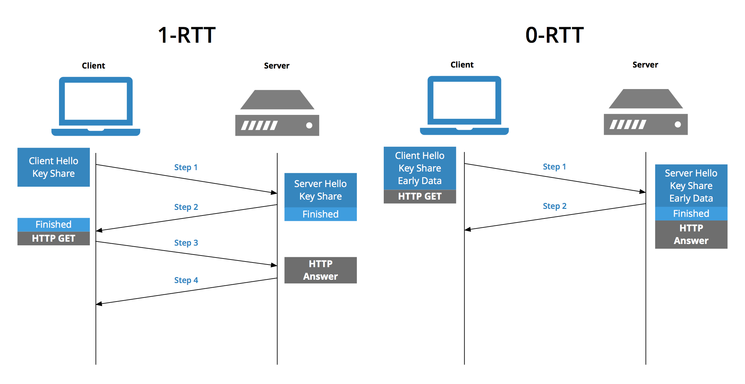
TLS v1.3 1-RTT and 0-RTT
3 RTT + DNS
2 RTT + DNS

Slide 4
Configs and Setup
SSL_CTX_set_max_early_data
  Specifies the maximum amount of early data in bytes that is permitted to be sent on a single connection.
  Setting to 0 effectively disables 0-RTT.
  Value is provided by config options “proxy.config.ssl.server.max_early_data” (records.config).
  Default value of this setting is 0 (0-RTT is disabled by default).
SSL_CTX_set_recv_max_early_data
  Specifies the maximum amount of received early data in bytes that is skipped. If a client sends more than this then the connection will abort.
  Removed the config option “proxy.config.ssl.server.recv_max_early_data” due to the confusions caused by it (setup automatically now).
  The value used here is set to be the same as “proxy.config.ssl.server.max_early_data”, if this value is greater than the default 16384. Otherwise the default value is used instead.
  Default value is 16384.

Slide 5
Configs and Setup (cont.)
SSL_CTX_set_options
  The built-in anti-replay must be disabled in order to use external session cache (per documentation by OpenSSL).
  Non-blocking ssl_accept() calls confuses built-in anti-replay mechanism, so now we disable the built-in anti-replay for both OpenSSL’s internal session cache and ATS’ implementation of session cache.
proxy.config.ssl.server.allow_early_data_params
  Part of the anti-replay protection mechanism.
  Set to 1 to allow HTTP parameters on early data requests, 0 to not allow.
  Default value of this setting is 0.

Slide 6
Implementation (SSL Accept)
// replace call to SSL_accept
while (1) {
ret = SSL_read_early_data(ssl, buf, size, &nread);
if (ret == SSL_READ_EARLY_DATA_ERROR) {
break;
} else {
if (nread > 0) {
early_data_buf.append(buf);
}
if (ret == SSL_READ_EARLY_DATA_FINISH) {
// ret will most likely be WANT_READ here, which is used
// to go to the next stage of processing early data.
ret = SSL_accept(ssl);
early_data_finish = true;
break;
}
}
}

Slide 7
Implementation (SSL Read)
// add to ssl read
if (early_data_buf.len() > 0) {
buf = early_data_buf.copy();
return 0;
}
if (!early_data_finish) {
// read early data
// same logic as when we were doing ssl accept
// directly read in to read buffer, and don’t need to copy to “early_data_buf”
}

Slide 8
Implementation (SSL Write)
// add to ssl write
if (!SSL_is_init_finished(ssl)) {
ret = SSL_write_early_data(ssl, buf, nbytes, &nwrite);
} else {
ret = SSL_write(ssl, buf, nbytes);
}

Slide 9
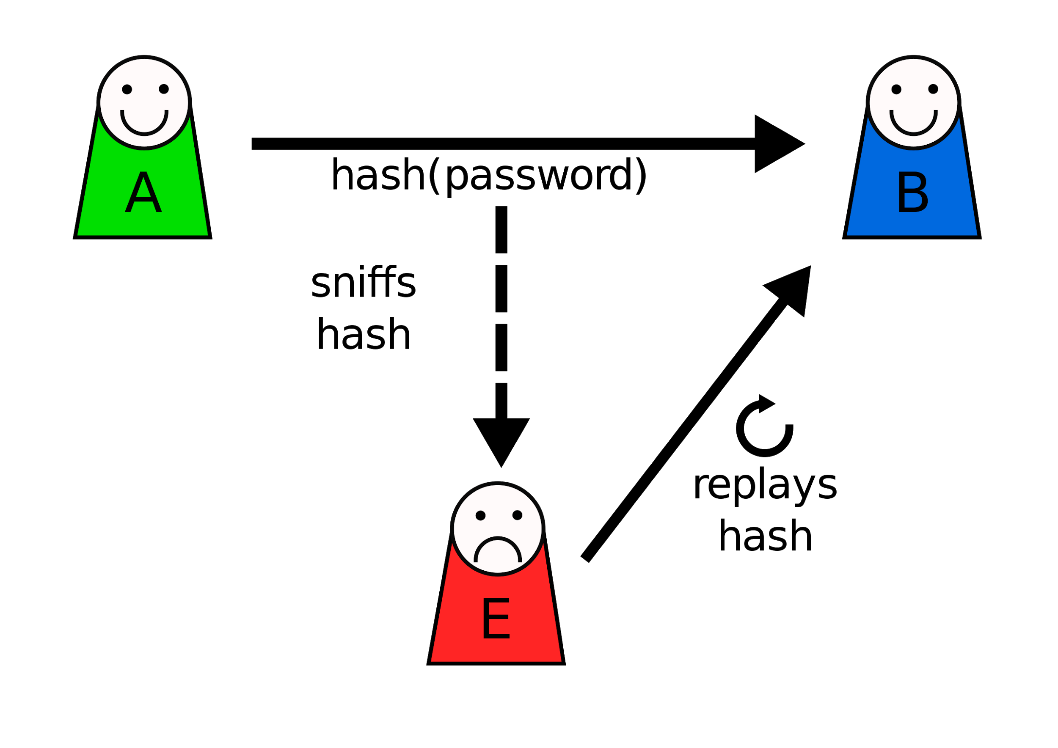
Replay Attack

Slide 10
Anti Replay
Allow tickets once.
  The call back function set by “SSL_CTX_set_tlsext_ticket_key_cb” returns 2.
  Only protects per server (i.e. replays to a different server still works).
Ticket freshness check
  Built into openssl.
  Only protects per server (i.e. replays to a different server still works).
Safe methods only.
  Only allows GET and HEAD method (requested by Leif).
  Does NOT allow any parameters in the request.

Slide 11
SSL Session Reuse Plugin
Used to be Yahoo proprietary, now open sourced.
Shares session information using redis.
Tested in production (deployed in a few locations).

Slide 12
Discussion
When do we want this?
What other changes is needed?
  Requested: Use “sni.yaml” for configs.
SSL session reuse plugin.
  Feedback?

