Slide 1
The State of D&I at the ASF
by Bitergia Analytics & The Apache Software Foundation
ApacheCon, 2020
Notes:
Gris starts here

Slide 2
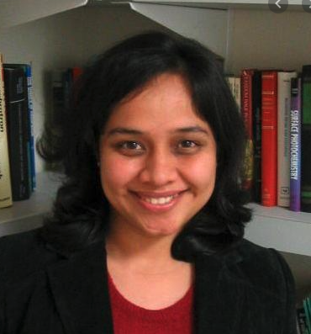
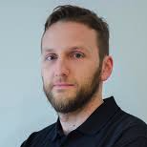


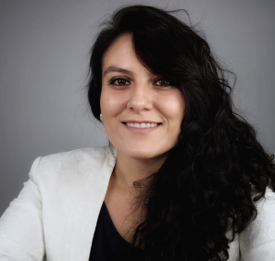
The Research Team
Anita Sarma
Oregon State University
Daniel Izquierdo
Bitergia
Mariam Guizani
Oregon State University
Georg Link
Bitergia
Griselda Cuevas
The Apache Software Foundation

Slide 3
Motivation
Study design, data collection, and analysis aligned with the ASF D&I strategy.
Short term goals
Gather scientific data to study current status of Diversity and Inclusion at the ASF
Raise awareness in our community about the importance of Diversity & Inclusion in the business, and in the open source industry
Find key indicators to track over time
Medium term goals
Instrument ASF’s contributor funnel to recommend a participation baseline for underrepresented groups
Create a toolkit to address the top 3 entry barriers for new contributors from under represented groups
Become a trusted thought partner for PMCs when it comes to D&I
As stated in the ASF EDI goals https://issues.apache.org/jira/browse/DI-25
Notes:
To identify the top 3 barriers we designed the survey

Slide 4
Motivation
3 Efforts to gather data about the ASF community
The Community Survey
Interviews
Quantitative
Analysis

Slide 5
Highlights
Top Insights from Survey and Interviews
The typical ASF contributor is a male, english proficient, highly educated and with time to volunteer
Top challenge types: contrib. background, technical hurdles, communication
Challenges experienced by minorities persist even after they become experienced contributors
Notes:
Leaf: English lang, delayed decision, lack of documentation, lack of tech background
delayed decision, lack of documentation, lack of tech background

Slide 6
Highlights
Recommendations to remove contribution barriers
Documented ASF/project policies and expectations
Streamlined contribution & decision making processes
Accessible resources for technical contributions (e.g. docs)

Slide 7

Phase I: Survey
Notes:
Gris introduces Daniel...

Slide 8
Data Collection Timeline
Up to Oct. 2019
Up to Dec. 2019
Up to Jan. 2020
Up to mid-Feb. 2020
Survey Design
Community Feedback
Data Collection
Deadline Extension
First Survey Design available
Open discussion and addition of ideas, comments, and concerns
Data collection starts
7010 emails sent
Booth FOSDEM opportunity

Slide 9
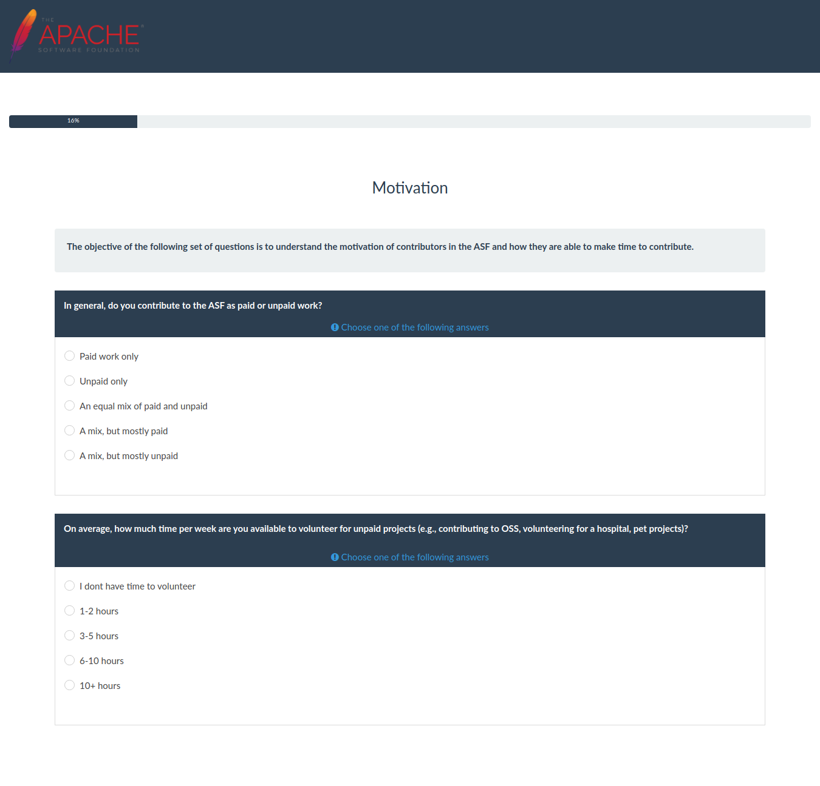
Survey
Survey* is split into:
Contributor Role and Tenure (4 questions)
Motivation (2)
Availability of Protocols / Guidelines (2)
Support for Newcomers (4)
Diversity and Inclusion (11)
Wrap up (3)
Each section contains a motivation introductory
paragraph.
*Questions are available at https://cwiki.apache.org/confluence/pages/viewpage.action?pageId=158869274

Slide 10
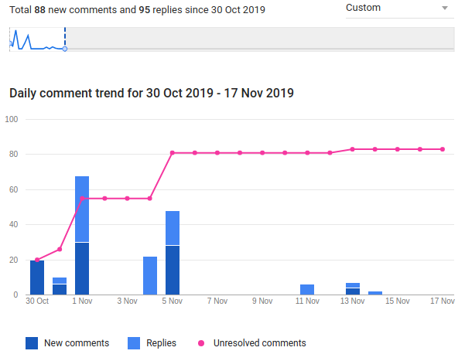
Process
Process
2 Internal iteration followed by feedback process. Meeting notes available*.
Public feedback and discussions followed using Google Docs.
  Comments were left “unresolved” to leave communication trace
Voting and veto process followed as usual at the ASF under the Equity, Diversity, and Inclusion PMC.
Reproducibility: Survey methodology and questions published in the D&I wiki**
Referenced Google Docs Activity
* E.g., https://cwiki.apache.org/confluence/display/EDI/2019-11-13+Meeting+notes+survey
** E.g., https://cwiki.apache.org/confluence/display/EDI

Slide 11
Overview of Data Collected
624
Total Responses
8.9%
Response Rate*
* Based on a considered total community size of 7,010

Slide 12
Survey Analysis Dimensions
Demographics:
Age, Gender, English fluency, Background culture
Socio-economic aspects:
Education, Compensation, Time to volunteer
Experiences in the ASF:
Tenure, mentorship, challenges
Notes:
Given the goal to find participation baseline for underrepresented groups, we used different dimensions to understand the population and their experiences
Academic research has found these dimensions to be factors that lead to barriers in participation in OSS

Slide 13
Survey Results
Notes:
Anita From here:

Slide 14

Average ASF contributor
Demographics
Socio-economic Aspects
Experience in the ASF
40 Years old
Man
Confident in English
Born/lives in the USA
Bachelor’s Degree
No compensation
1 or 2 hours for volunteering
5 Years in the community
Didn’t have a mentor
Faced no challenges
Notes:
Speaker: Anita

Slide 15
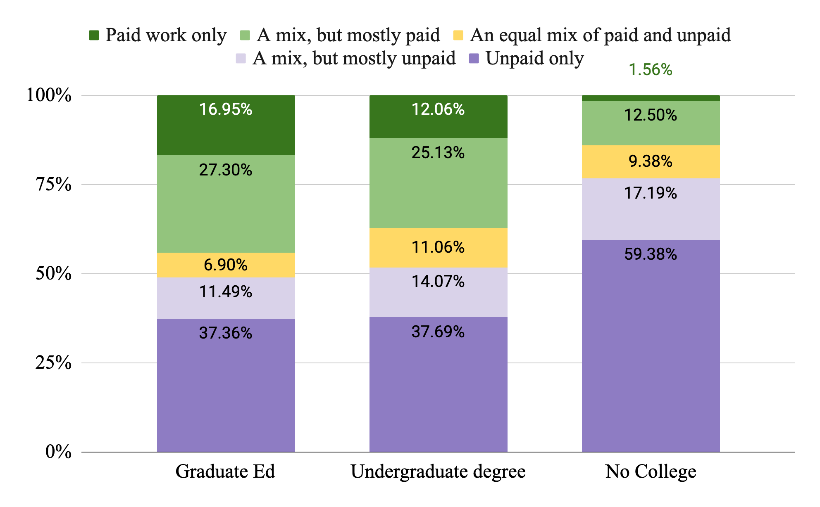
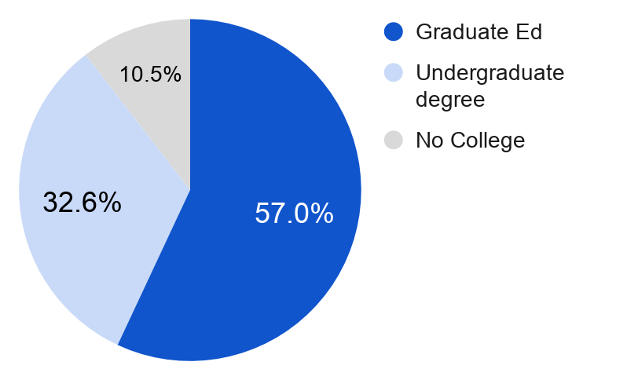
Effect of Formal Education
Those with “No College” education are more likely to be volunteers, perhaps ASF provides paths to gaining technical skills
Does education impact compensation? Yes 𝝌2 (2, N=611)=23.46, p<.05
Question to community:
How to attract volunteers who have no college education?

Slide 16
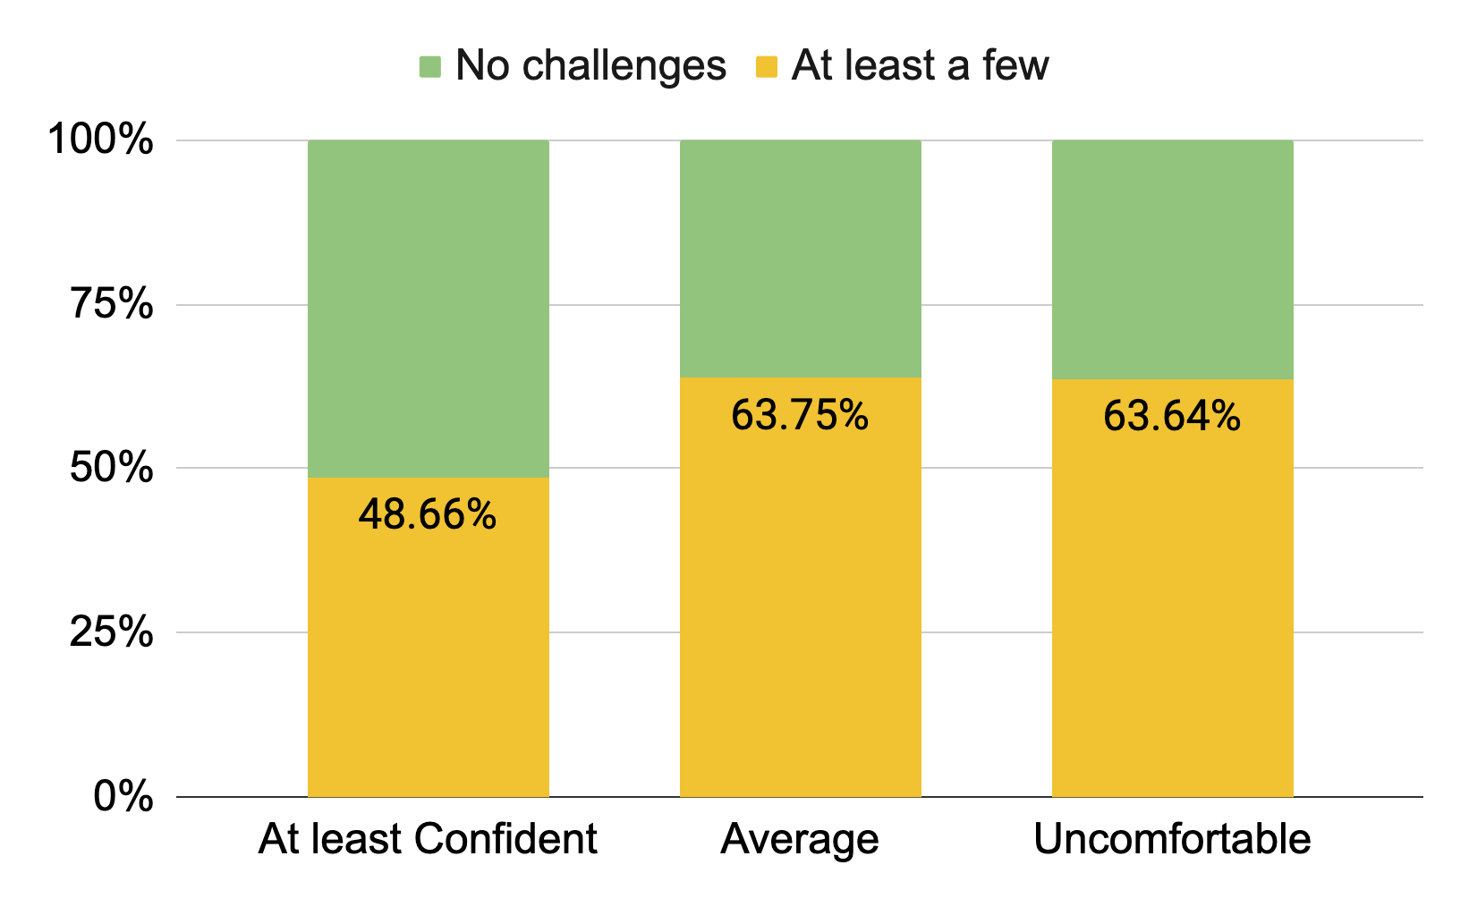
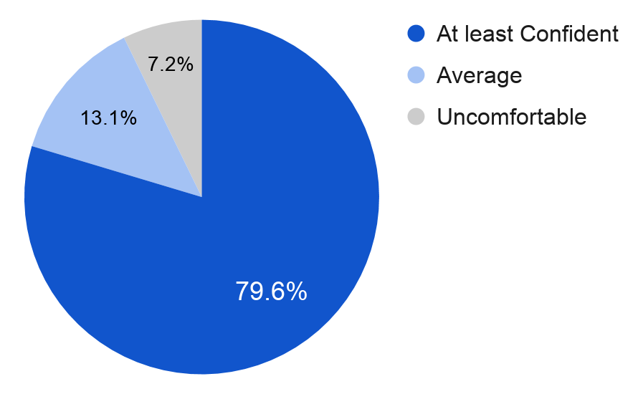
Effect of English Fluency
Those with an average English fluency or less faced more challenges
Does fluency in English impact challenges faced? Yes 𝝌2 (2, N=609)=8.96, p<.05
Question to community:
How can we lower the language barrier?

Slide 17
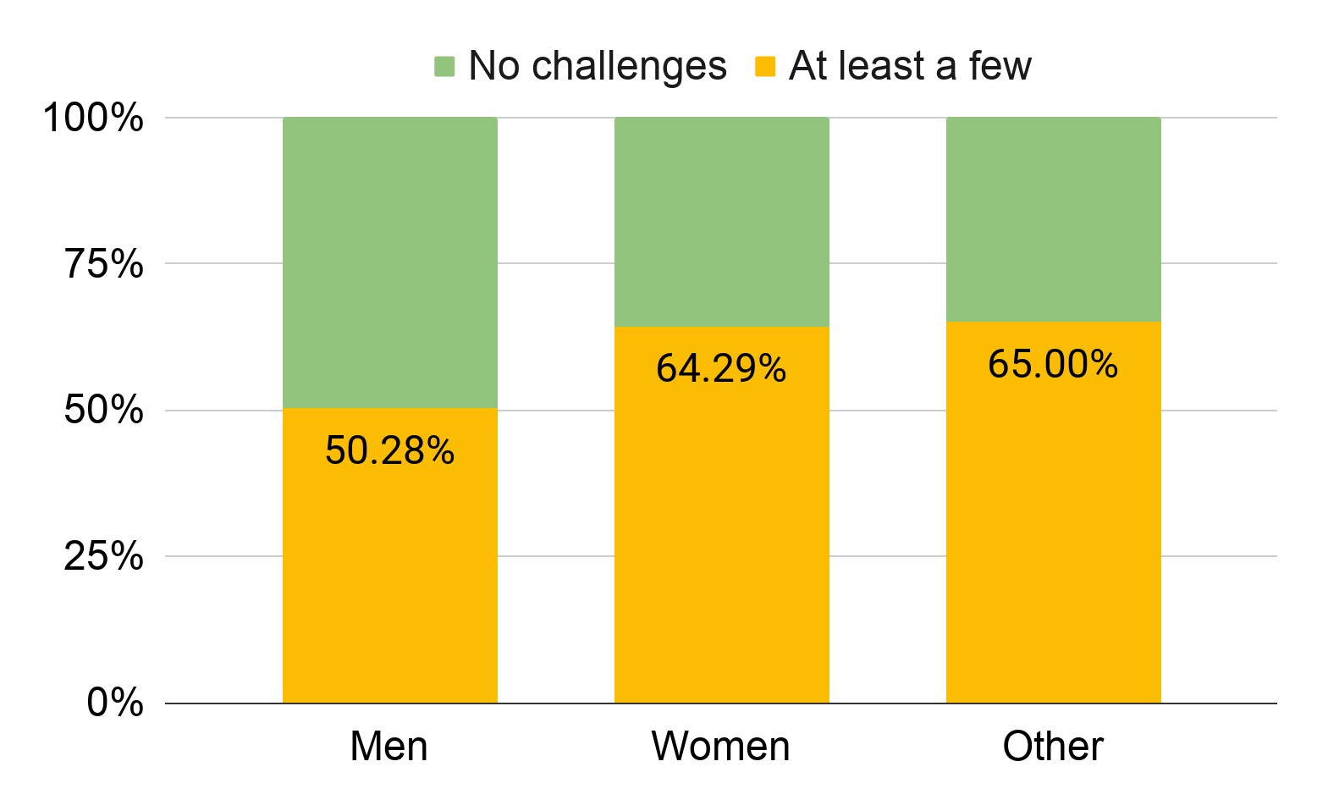
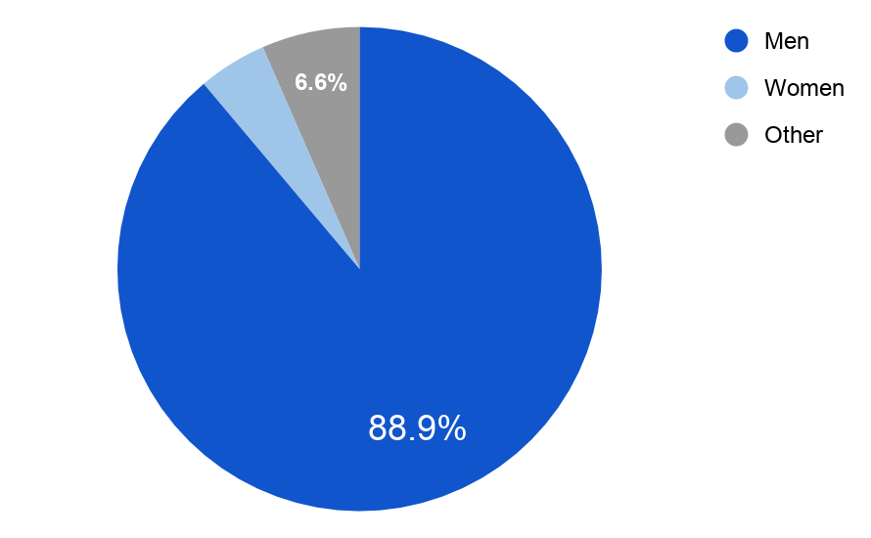
Effect of Gender
Those who self-identified as women or other (not men) faced more challenges
Does gender impact challenges faced? Yes. 𝝌2 (1, N=611)=5.04, p<.05
Question to community:
How can we reduce gender barriers?
4.6%
*
* We aggregated who identified as non-binary, prefer to self describe, not state into others

Slide 18
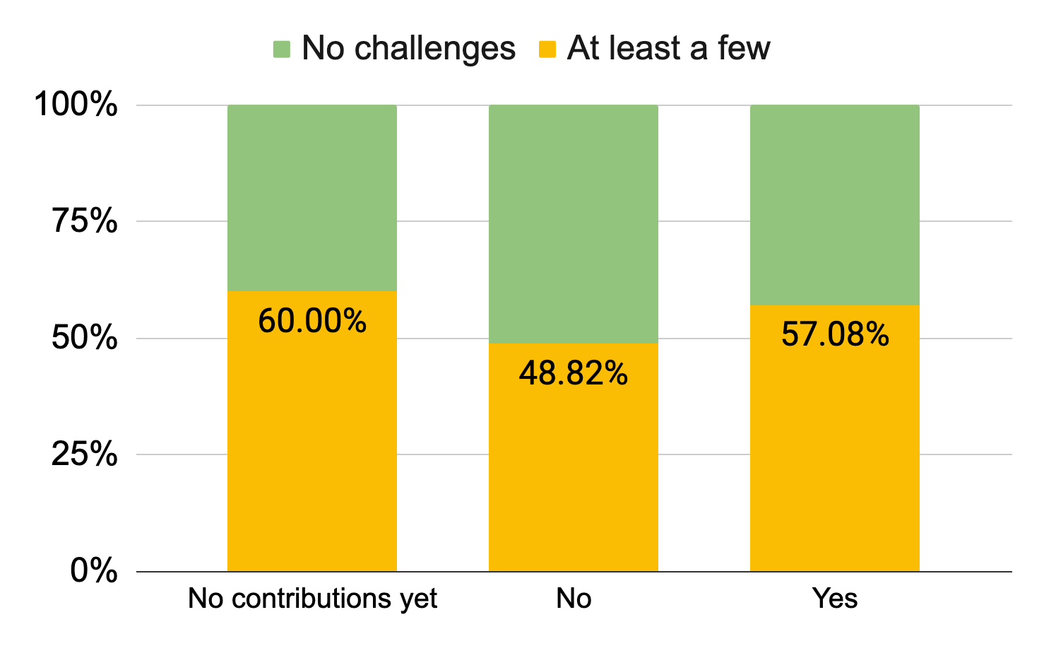
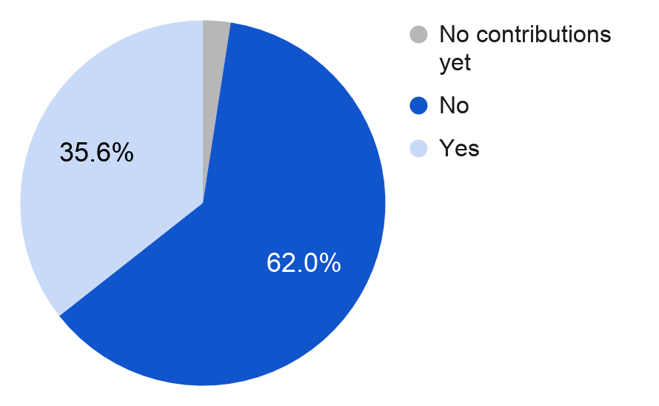
Effect of having a Mentor
Those who had mentor(s) faced slightly more challenges
Do mentors impact challenges faced? No; 𝝌2 (1, N=600)=3.80, p>.05
Question to community:
Why is mentoring not helping with challenges? What is the role of mentors?

Slide 19
Survey Summary
Education impacts compensation: yes (p<0.05)
Those in minority face challenges
  English fluency: Yes (p<0.05)
  Gender: Yes (p < 0.05)
  Having a mentor: No (p >0.05)
Men who face challenges have different demographics: No
Those who move country where they grew up...
  ... different demographics: No
  … challenges to contributing: No
Notes:
Speaker: Anita
Anita: Caveat: all hypothesis answers from survey are correlation. Interviews will help answer causation.
Statistics are done on Chi2 tests, where feasible.
2b: gender differences between Men and Women+other
2c: differences between those who had mentor/not have mentor. No contributions yet not counted

Slide 20
Phase II: Interviews
Notes:
Mariam here

Slide 21
Objectives
Interviews Numbers
Groups | Interviewees
Gender minority | 5
Language minority | 1
Men with challenges | 4
Contributors who left | 5
Newcomers | 4
Total | 19
221 open ended survey responses on challenges
Deeper dive to analyze these challenges
19 interviews
Jun-Sept 2020
Notes:
Our main objective was to understand the challenges the community is facing
221 survey respondent that reported facing at least a few challenges and described these challenges in an open ended question
Additionally follow up interviews with some survey respondents and Additional interviews with people who left and newcomers
These interviews spanned a variety of contributors

Slide 22
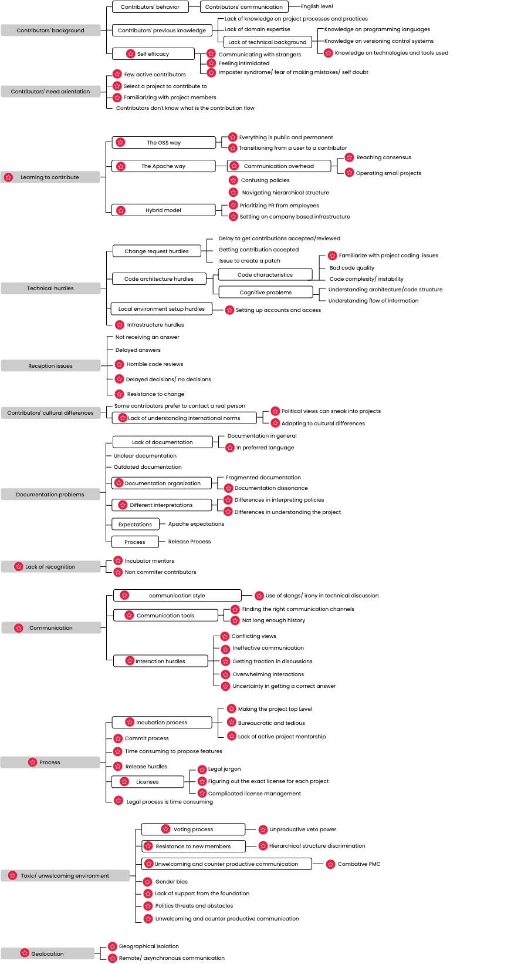
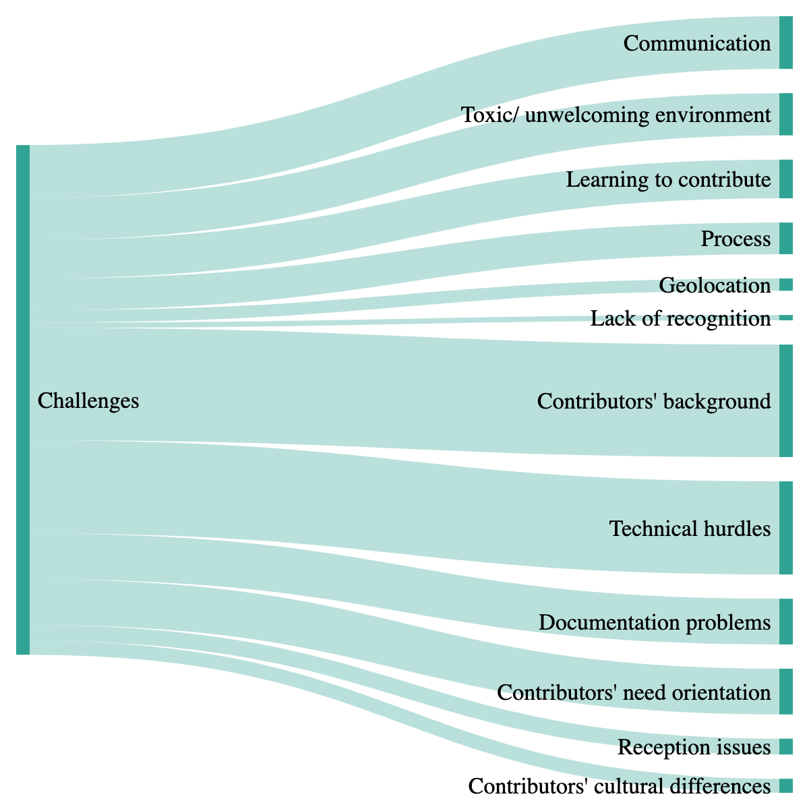
Identified Challenges
Challenges specific to the ASF
12 categories of challenges
Each category comprises subsequent challenges
6 of these found in academia for other OSS projects, and 6 that are specific to the ASF
Challenges that under-represented groups face even after becoming experienced
Notes:
multiple round of qualitative analysis for both the survey open ended question and te interviews.
we found 12 categories of challenges
the tree diagram figure shows an overview of the challenges, the red dot mark indicates that these challenges are specific to ASF.
moving on to the green figure:
the top part with the red out line shows the challenges categories that are specific to ASF (communication, learning to contribute, geolocation etc.. )
The bottom part (grey outline) shows challenges that were reported in literature as challenges faced by newcomers -> these challenges are ones that experienced under represented contributors still face.

Slide 23
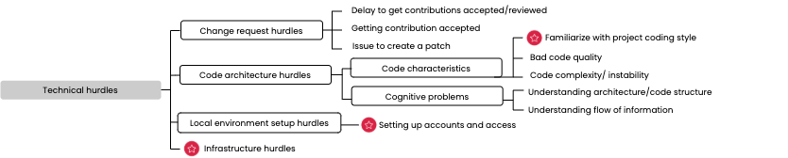
Identified Challenge: Technical Hurdles
“I had a difficulty to understand project guidelines for accepting code changes. Some remarks indicated that style guidelines were important, yet large refactorings were shunned”
“It was hard to convince the project committers in my decisions and why they should have accepted my code .”
Identified challenges specific to the ASF

Slide 24
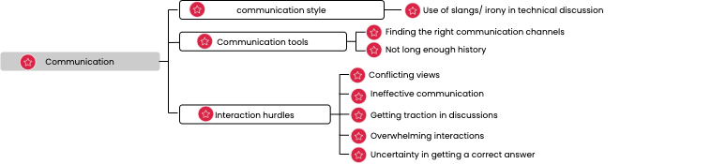
Identified Challenge: Communication
“Some people use more idiomatic expressions when [expressing] their feelings for example, which is hardly understandable or misleading to non-native speakers”
“Technical dispute over architectural direction of a project.”
“Also very hard for a [underrepresented] newcomer/coder to catch up with the heated discussions on the members list. I was happy being a committer but once I saw all the members discussion in the list I was overwhelmed. I have never commented on the members list for this reason.”
Identified challenges specific to the ASF
Notes:
“it is still hard to understand phrases, slangs or irony from native speakers on operational lists.”

Slide 25
Identified Challenge: Communication
Strategy subcategory 1 | Strategy 1
 | Strategy 2
Identified challenges specific to the ASF
Notes:
“it is still hard to understand phrases, slangs or irony from native speakers on operational lists.”

Slide 26
Phase III: Quantitative Analysis
Notes:
Daniel takes over

Slide 27
Quantitative Analysis: Happening Next
Focus on projects listed by survey answers (Airflow, Beam, Cassandra, CouchDB, Flink, Hadoop, HTTPD, Lucene, NetBeans, OpenOffice, Spark, and Tomcat)

Slide 28
Quantitative Analysis: Happening Next
Focus on projects listed by survey answers (Airflow, Beam, Cassandra, CouchDB, Flink, Hadoop, HTTPD, Lucene, NetBeans, OpenOffice, Spark, and Tomcat)
Gender is the only attribute automatically analyzed by the tooling and based on the first name of each developers. No manual data cleaning is planned

Slide 29
Quantitative Analysis: Happening Next
Focus on projects listed by survey answers (Airflow, Beam, Cassandra, CouchDB, Flink, Hadoop, HTTPD, Lucene, NetBeans, OpenOffice, Spark, and Tomcat)
Gender is the only attribute automatically analyzed by the tooling and based on the first name of each developers. No manual data cleaning is planned
Limitations are related to the binary result of gender, and the heuristics to retrieve and split info by first name of the contributors. The focus is only on certain type of contributions (as commits, issues, and review processes).

Slide 30
Quantitative Analysis: Happening Next
Focus on projects listed by survey answers (Airflow, Beam, Cassandra, CouchDB, Flink, Hadoop, HTTPD, Lucene, NetBeans, OpenOffice, Spark, and Tomcat)
Gender is the only attribute automatically analyzed by the tooling and based on the first name of each developers. No manual data cleaning is planned
Limitations are related to the binary result of gender, and the heuristics to retrieve and split info by first name of the contributors. The focus is only on certain type of contributions (as commits, issues, and review processes).
Introductory results will give a quick overview of the current status of the diversity in these projects.

Slide 31
Quantitative Analysis: Happening Next
Focus on projects listed by survey answers (Airflow, Beam, Cassandra, CouchDB, Flink, Hadoop, HTTPD, Lucene, NetBeans, OpenOffice, Spark, and Tomcat)
Gender is the only attribute automatically analyzed by the tooling and based on the first name of each developers. No manual data cleaning is planned
Limitations are related to the binary result of gender, and the heuristics to retrieve and split info by first name of the contributors. The focus is only on certain type of contributions (as commits, issues, and review processes).
Introductory results will give a quick overview of the current status of the diversity in these projects.
This analysis is a Starting Point of a discussion about the current state of one aspect of diversity in a sample of ASF projects. This analysis is not intended to be exhaustive or prescriptive of the entire ASF environment.

Slide 32
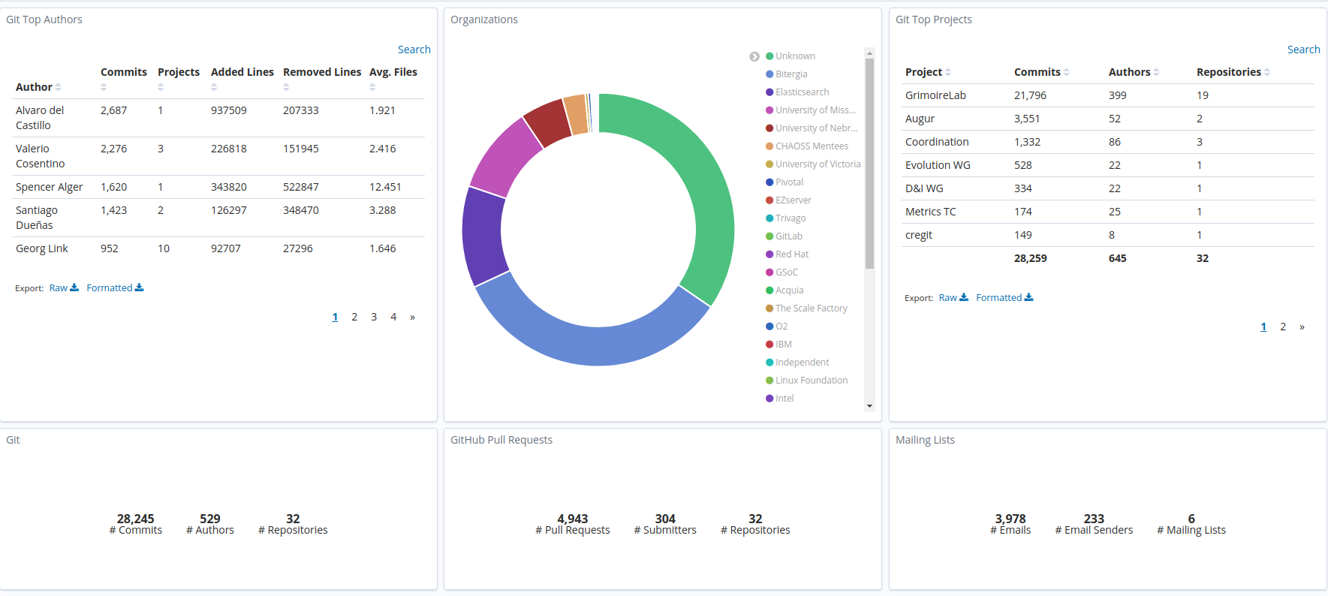
Quantitative Analysis: Happening Next
Focus on projects listed by survey answers (Airflow, Beam, Cassandra, CouchDB, Flink, Hadoop, HTTPD, Lucene, NetBeans, OpenOffice, Spark, and Tomcat)
Gender is the only attribute automatically analyzed by the tooling and based on the first name of each developers. No manual data cleaning is planned
Limitations are related to the binary result of gender, and the heuristics to retrieve and split info by first name of the contributors. The focus is only on certain type of contributions (as commits, issues, and review processes).
Introductory results will give a quick overview of the current status of the diversity in these projects.
This analysis is a Starting Point of a discussion about the current state of one aspect of diversity in a sample of ASF projects. This analysis is not intended to be exhaustive or prescriptive of the entire ASF environment.
A private-access Dashboard is the output we’ll have to aggregate this results and work at the level of projects.

Slide 33
Quantitative Analysis: Happening Next
Focus on projects listed by survey answers (Airflow, Beam, Cassandra, CouchDB, Flink, Hadoop, HTTPD, Lucene, NetBeans, OpenOffice, Spark, and Tomcat)
Gender is the only attribute automatically analyzed by the tooling and based on the first name of each developers. No manual data cleaning is planned
Limitations are related to the binary result of gender, and the heuristics to retrieve and split info by first name of the contributors. The focus is only on certain type of contributions (as commits, issues, and review processes).
Introductory results will give a quick overview of the current status of the diversity in these projects.
This analysis is a Starting Point of a discussion about the current state of one aspect of diversity in a sample of ASF projects. This analysis is not intended to be exhaustive or prescriptive of the entire ASF environment.
A private-access Dashboard is the output we’ll have to aggregate this results and work at the level of projects.

Slide 34
Summary

Slide 35
Summary
The typical ASF contributor is a male, english proficient, highly educated and with time to volunteer
Top challenge types: contrib. background, technical hurdles, communication
Challenges experienced by minorities persist even after they become experienced contributors
INSIGHTS

Slide 36
Summary
The typical ASF contributor is a male, english proficient, highly educated and with time to volunteer
Top challenge types: contrib. background, technical hurdles, communication
Challenges experienced by minorities persist even after they become experienced contributors
INSIGHTS
Documented ASF/project policies and expectations
Streamlined contribution & decision making processes
Accessible resources for technical contributions (e.g. docs)
RECOMMENDATIONS
Notes:
Streamlined: code first & then discuss, lengthy decision making/consensus building, each project is self-governing and has different process/culture
Leaf: English lang, delayed decision, lack of documentation, lack of tech background

Slide 37
Questions?
Thank you to all our participants!

Slide 38
The State of D&I at the ASF
by Bitergia Analytics & The Apache Software Foundation
ApacheCon, 2020
Notes:
Gris starts here

