Slide 1
The Django Portal as a UI Platform for Apache Airavata
Marcus Christie / machrist@iu.edu
Cyberinfrastructure Integration Research Center
Pervasive Technology Institute
Indiana University

Slide 2
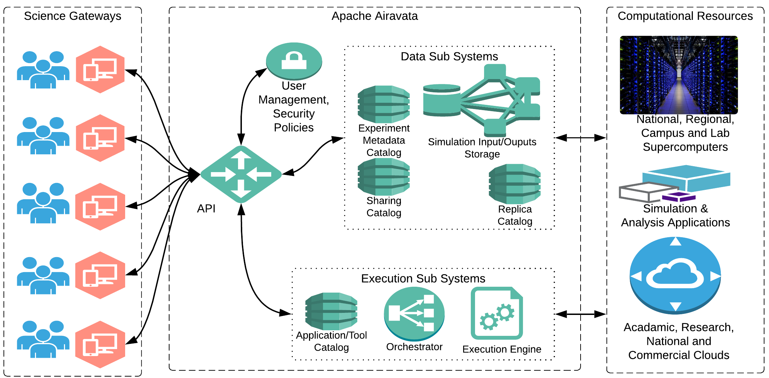
Apache Airavata architecture

Slide 3
Airavata API Clients
Thrift IDL
PHP
User Interface
Airavata
API Service
Java
C++
Python
and more

Slide 4
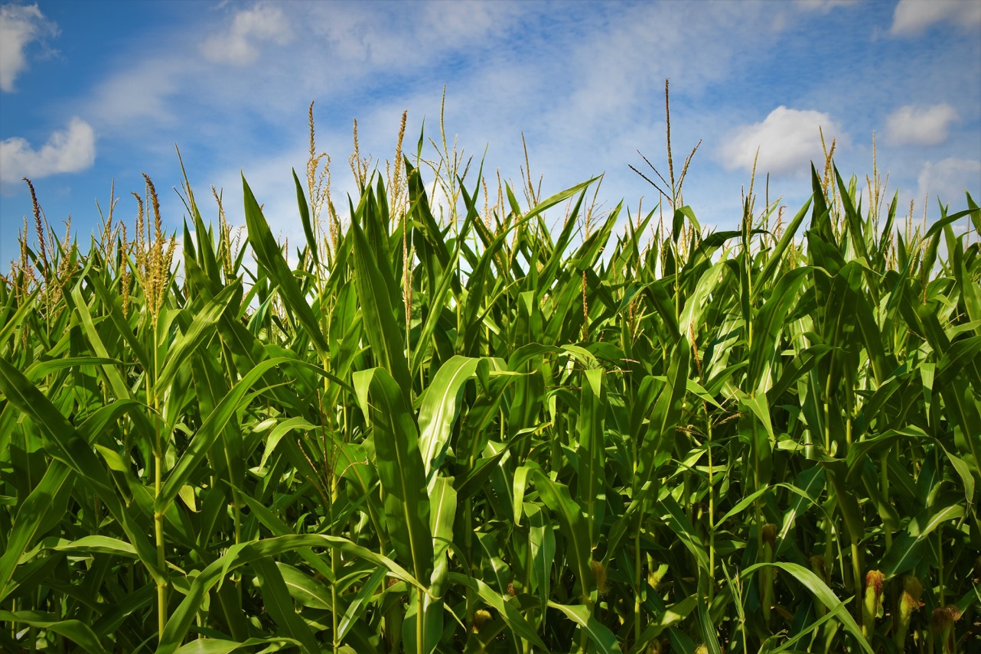
Phase 1: the “Field of Dreams” approach
Photo by Waldemar Brandt on Unsplash

Slide 5


Phase 2: Reference Implementation
Photo by Martin Widenka on Unsplash

Slide 6

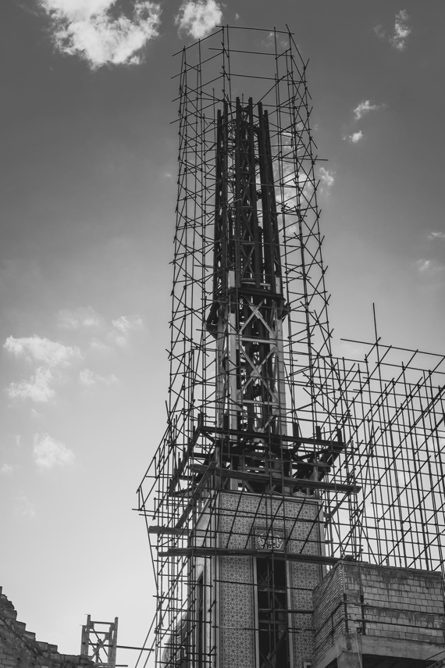
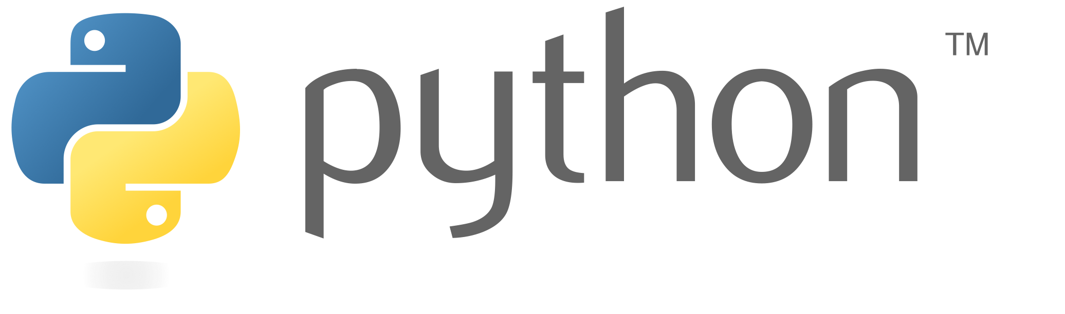
Phase 3: Base + plugin framework
Photo by Ashkan Forouzani on Unsplash

Slide 7

Airavata Django Portal architecture
Portal Page
Airavata API Client
Dynamic UI
Web Browser
REST API
Web Server
Compute, Storage Resources
Airavata API

Slide 8
Airavata Django Portal architecture
Portal Page
Airavata API Client
Dynamic UI
REST API
Airavata Middleware
Custom Comp
Web Browser
Web Server

Slide 9
Input editor customization
Customized: radio, checkbox, etc.
Standard input types: String, File upload
Validations

Slide 10
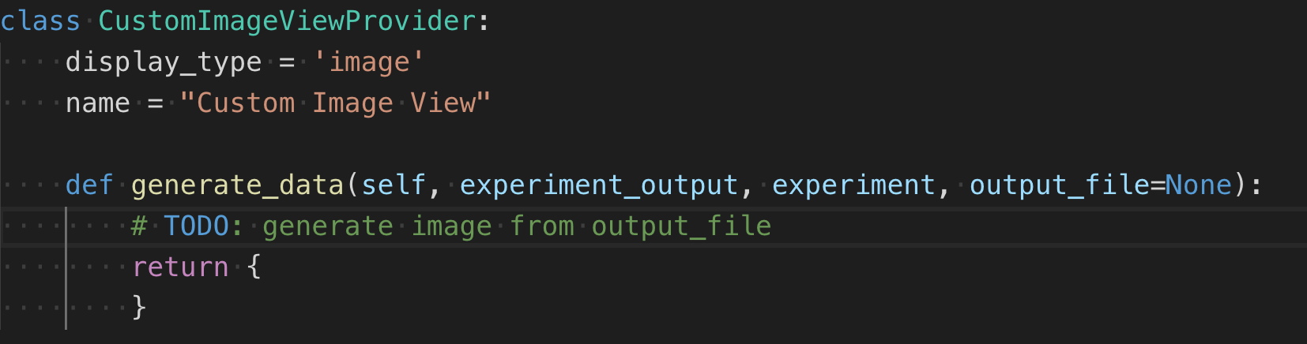
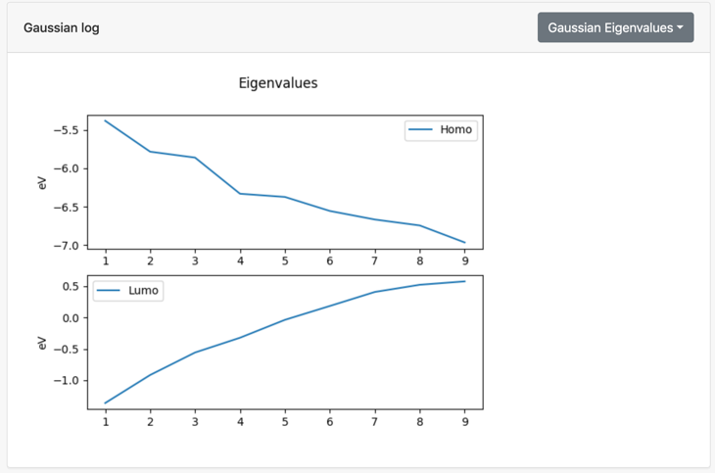
Custom experiment output views
By default, the Django portal allows users to download files
Custom output views can be created by implementing a Python function
Output view types
  link
  image
  chart
  table of data
  notebook
  ... and more are possible
Link
Image

Slide 11
Custom Django apps
For when you have extensive custom UI needs
  Intuitive tools that construct input file(s) on user’s behalf
  Query and visualize output results
Examples: SimCCS, Interactwel
Plugins are called “apps” in the Django web framework
Requires substantial web development skills
What does the process look like?
  HTML/CSS/JS mockups -> integrate with Django Airavata JS API
  Take tools you already have -> wrap as Django web services

Slide 12
You are here
Register for gateway tenant
Add applications and compute resources
Customize user interface

Slide 13
Preview of tutorial
Hands on: Submit a computational experiment (Gaussian)
Tutorial: create an application and customize its user interface
Tutorial: create a custom output viewer
Tutorial: create a custom Django app that makes use of the AiravataAPI JavaScript SDK

Slide 14
Building Blocks
Backend (Python)
  Airavata Python SDK
  Airavata Django Portal SDK
Frontend (JavaScript)
  JavaScript API – models, services, utilities (AiravataAPI.js)

Slide 15
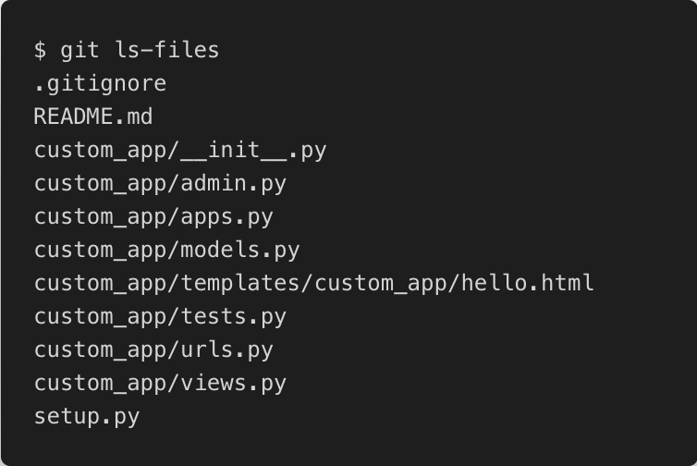
Custom Django app
Python package
setup.py metadata

Slide 16
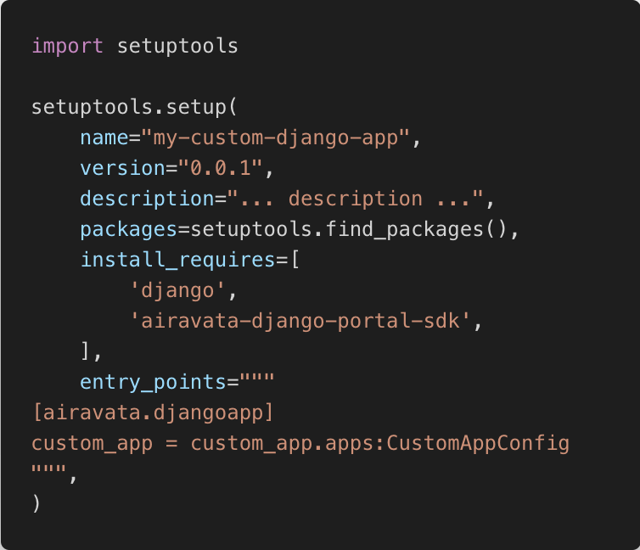
entry_points (setup.py)

Slide 17
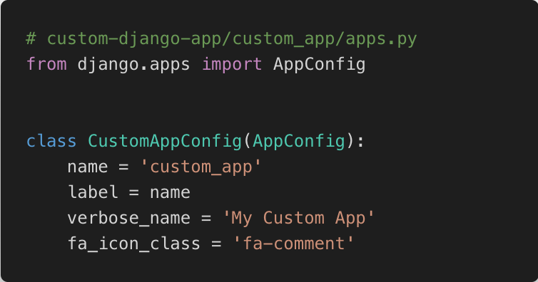
AppConfig

Slide 18
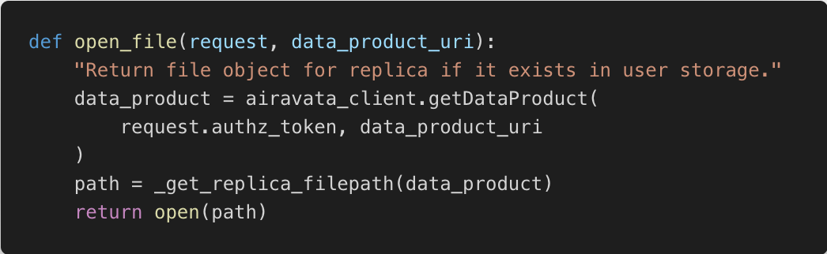
Using Airavata Python SDK

Slide 19
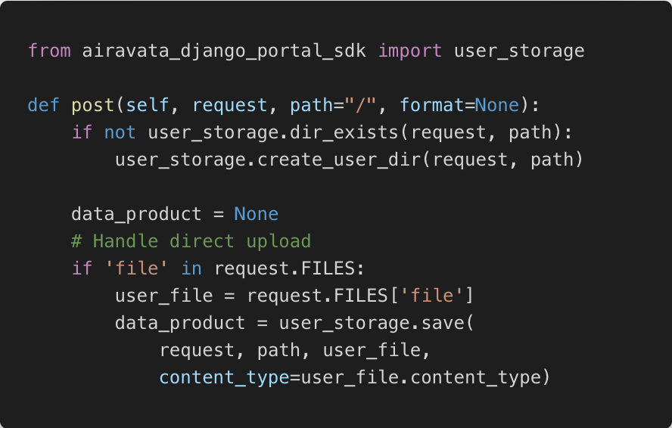
Using Airavata Django Portal SDK

Slide 20
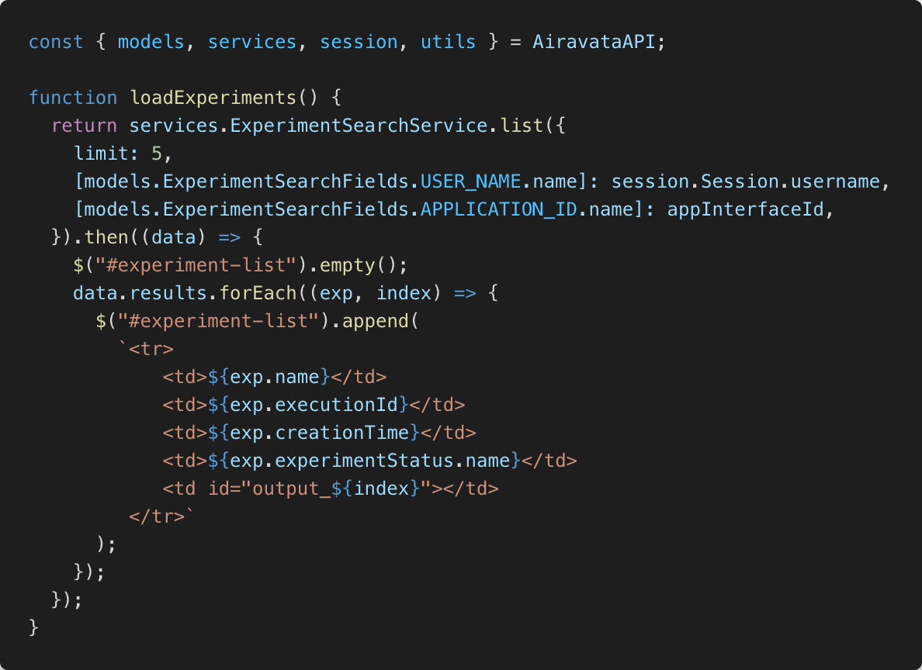
Using AiravataAPI.js

Slide 21
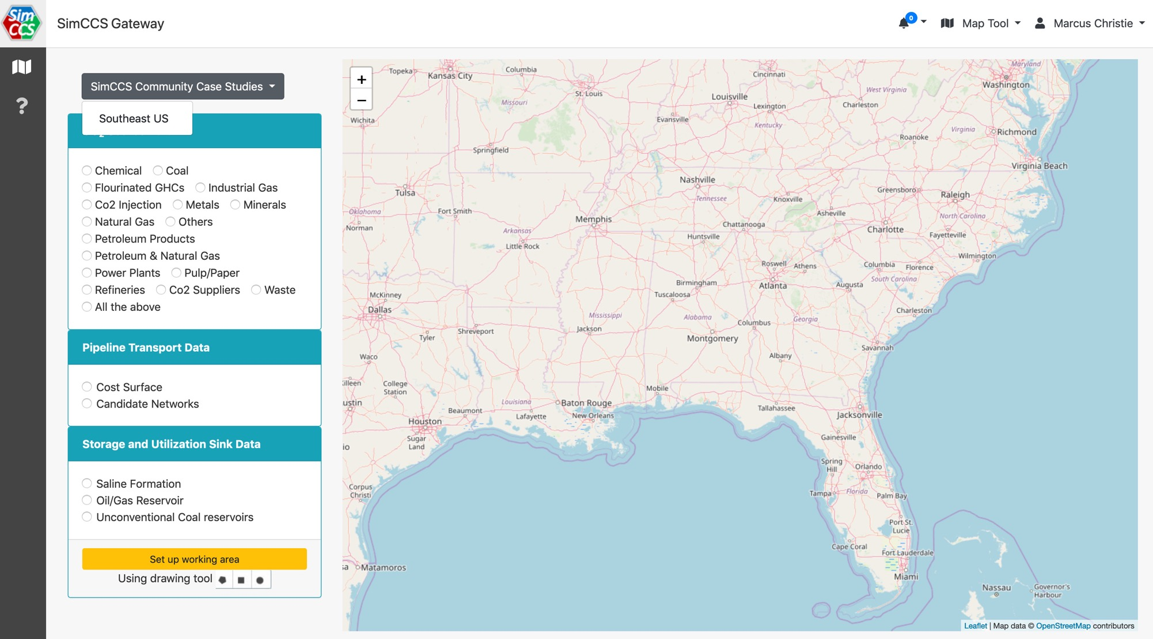
SimCCS demo
Selected Sources/Sinks
Airavata API Client
1
2
SimCCS
library
3
SimCCS views.py
4
5
REST API
SimCCS custom template

Slide 23
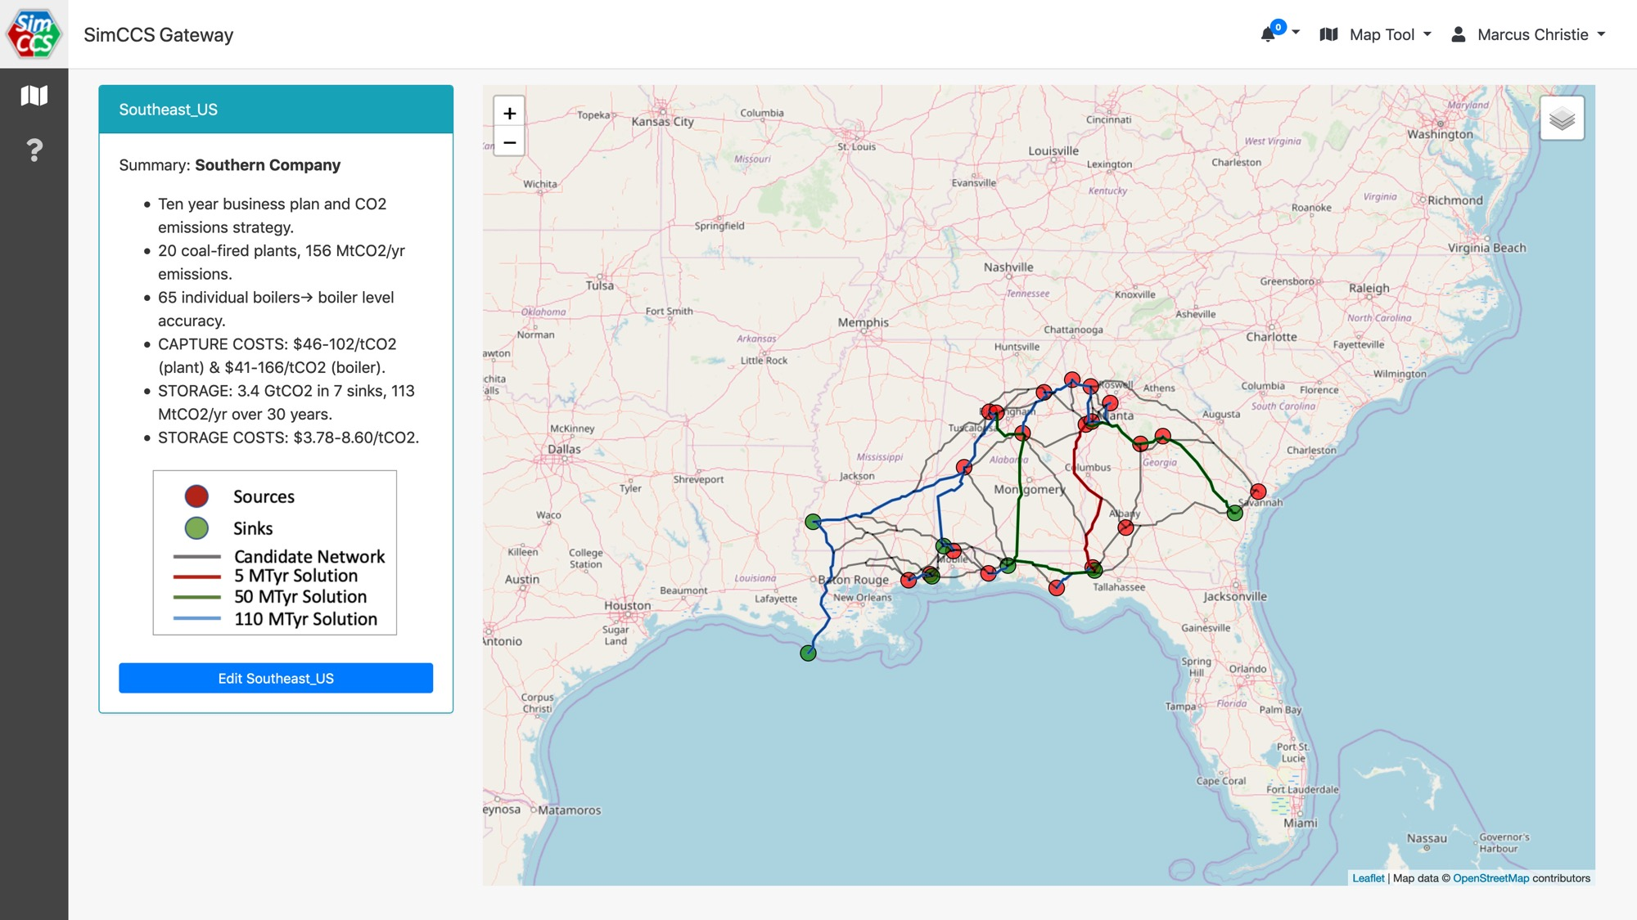

Slide 24
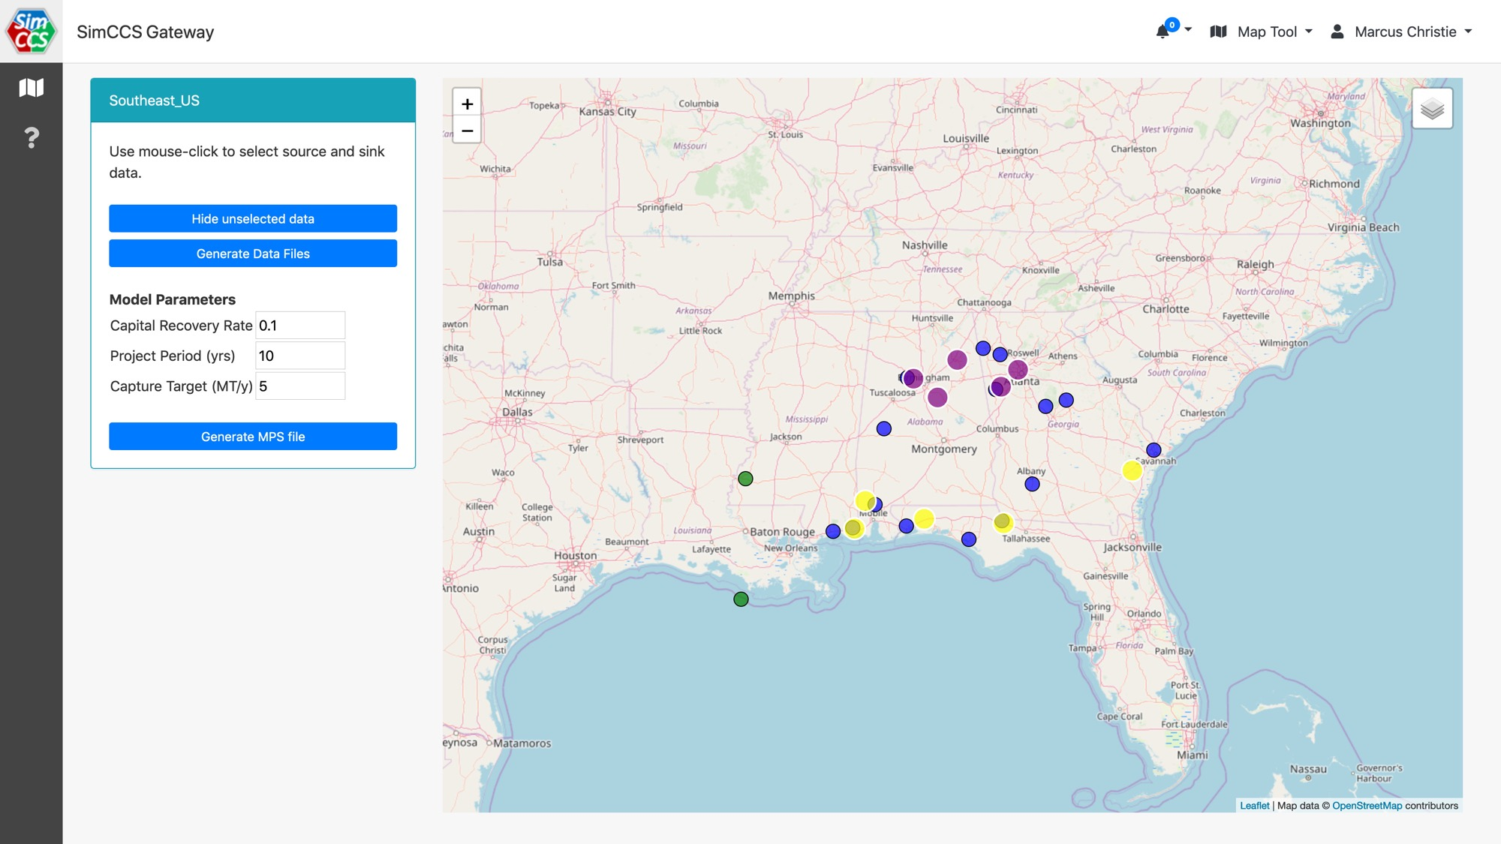

Slide 25
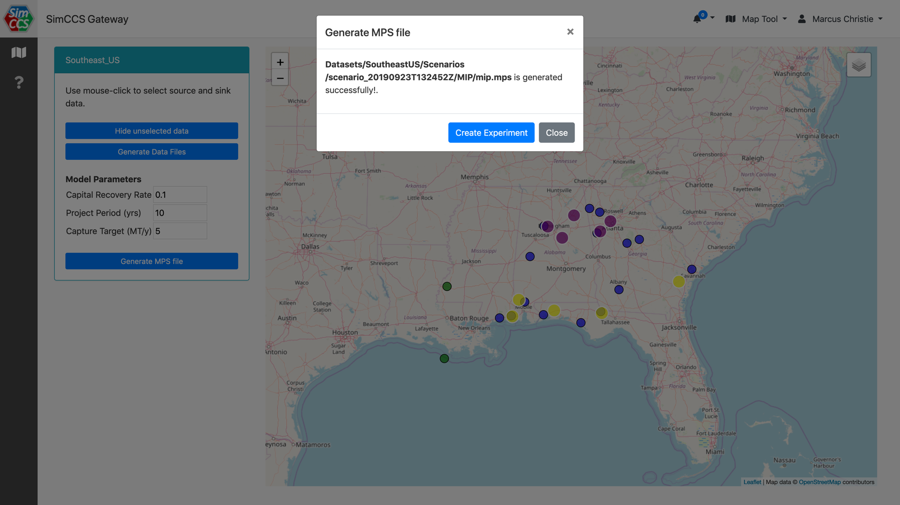

Slide 26
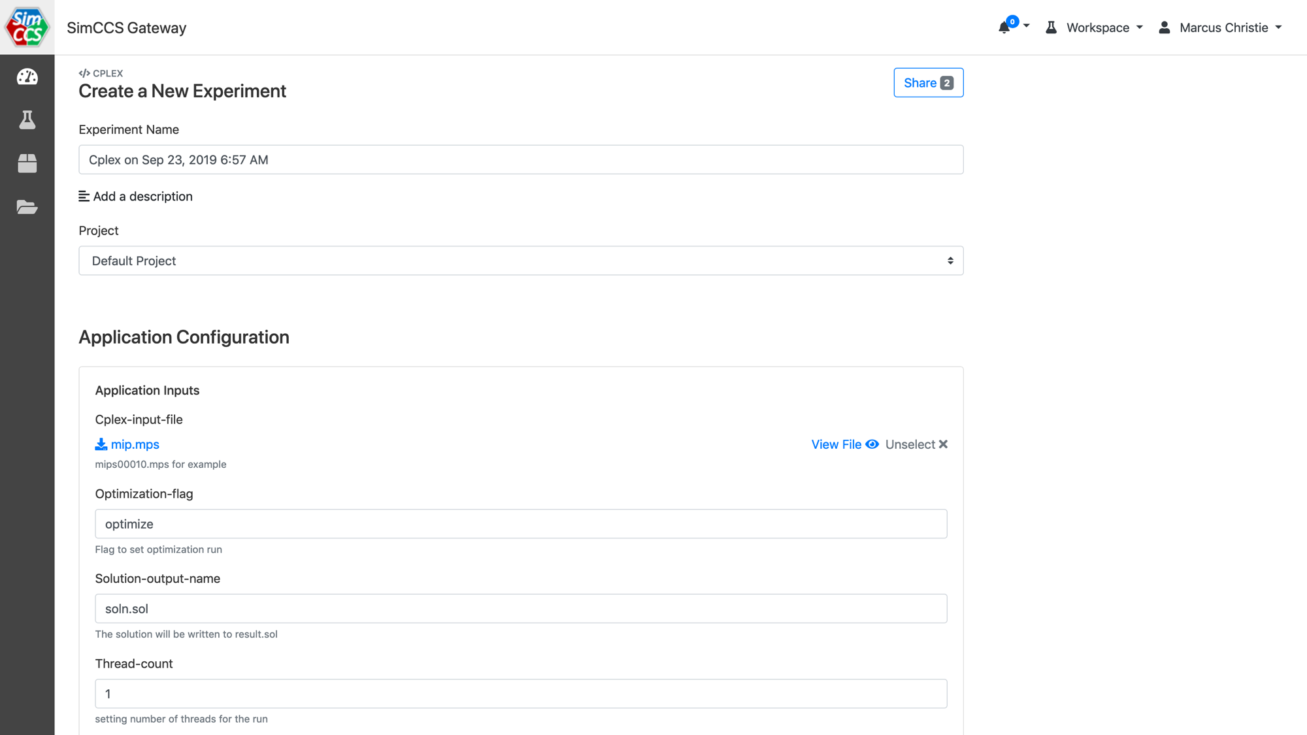
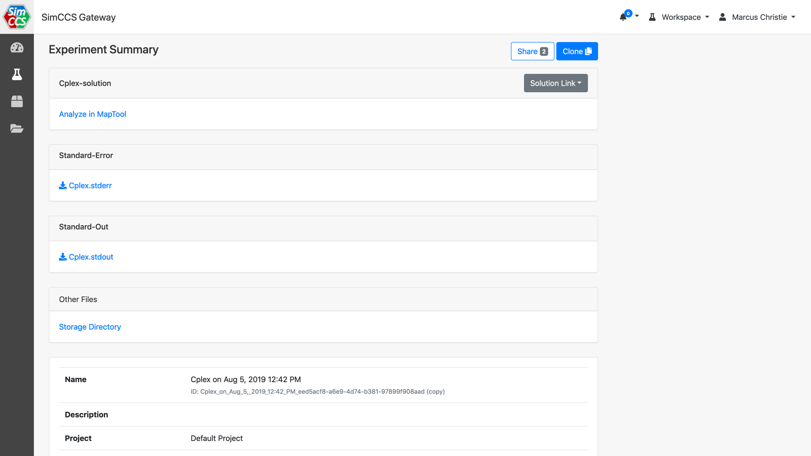

Slide 27
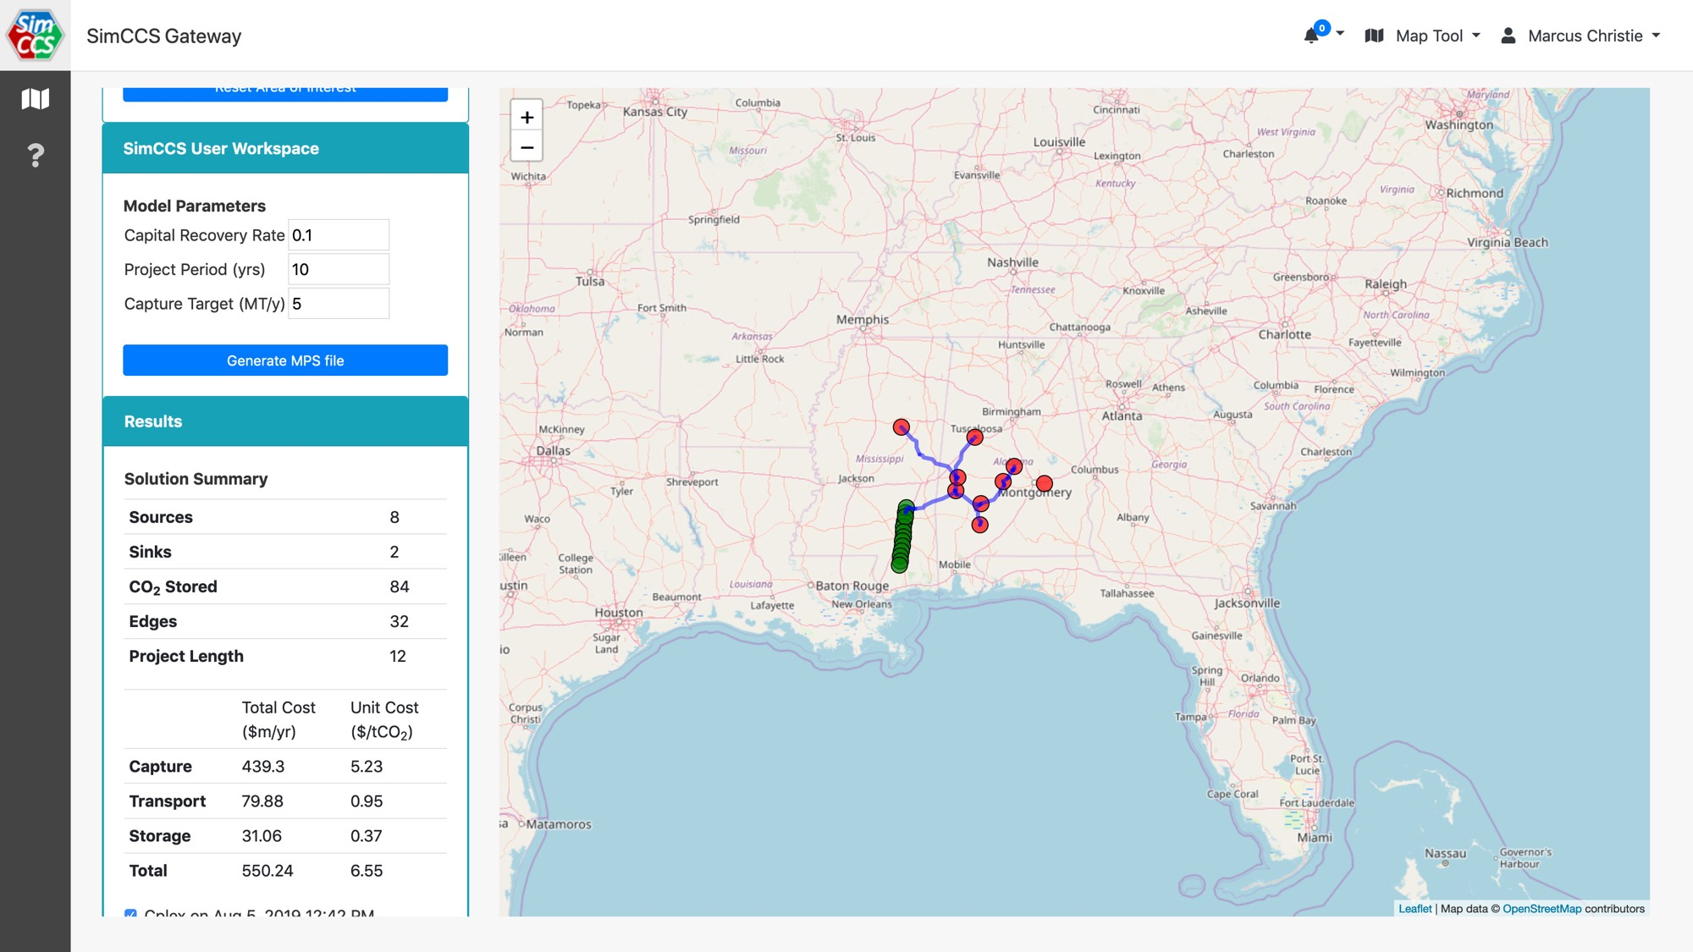

Slide 28
Wrap up

Slide 29
Next steps
Help creating a gateway?
Request a gateway: scigap.org
Get help building a gateway: email us at circ@iu.edu
Questions?
My email: machrist@iu.edu
Survey:
https://sciencegateways.org/g20tutorialeval
Find us at Gateways 2020
Custos security tutorial - Wed 1pm EST
Containerizing Scientific Applications tutorial – Thu & Fri 1pm EST
Managed File Transfer – Oct 20 2:45pm EST
FAIR Data and SEAGrid – Oct 20 3pm EST
SGCI Tech Summit: Gateway Interoperability – Oct 21 1pm EST
Alzheimer’s Disease Drug Discovery – Oct 21 3:50pm EST

