Slide 1
Brain Trust Wrap Up
Science Gateways Research Center
Pervasive Technology Institute
Indiana University

Slide 2
Using the Science Gateway Platform as a Service
SciGaP.org
We run Apache Airavata so you don’t have to:
30+ gateways, 60+ applications, 40+ resources

Slide 3
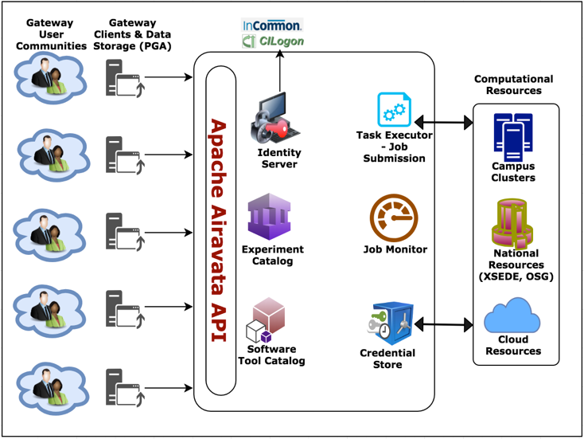

Slide 4
How to Get a SciGaP Gateway
Fill out a request at https://scigap.org
Customize It
Integrate with your campus resources
Try It Out
Localize it
Request SGCI Extended Developer Support
Add your applications and onboard early users
We’ll contact you in one business day, create a basic gateway for you within five business days
Add your user interfaces, visualization support, post processors, etc.
Our support team will work with you every step of the way

Slide 5
More Airavata Talks and Posters
Paper | Implementing a Flexible, Fault Tolerant Job Management System for Science Gateways
Paper | A Science Gateway for Atomic and Molecular Physics
Poster | Experiences from scaling Science Gateway operations
Poster | How the Science Gateways Community Institute Supports Those Who Are Creating Websites to Access Shared Resources Sectors of Local Communities
Poster | InterACTWEL Science Gateway for Adaptation Planning in Food-Energy-Water
Posters | The Distant Reader - Tool for Reading
Poster | The USD Science Gateway: A Bridge Between Research and Advanced Computing
Poster | LSU Computational System Biology Gateway for Education
Poster | Towards Run Time Estimation of the Gaussian Chemistry Code for SEAGrid Science Gateway

Slide 6
Beyond Tech Support
Get help from the Science Gateways Community Institute
  Short term consulting: UX, security, graphic design, etc
  Attend Focus Week
  https://sciencegateways.org

Slide 7
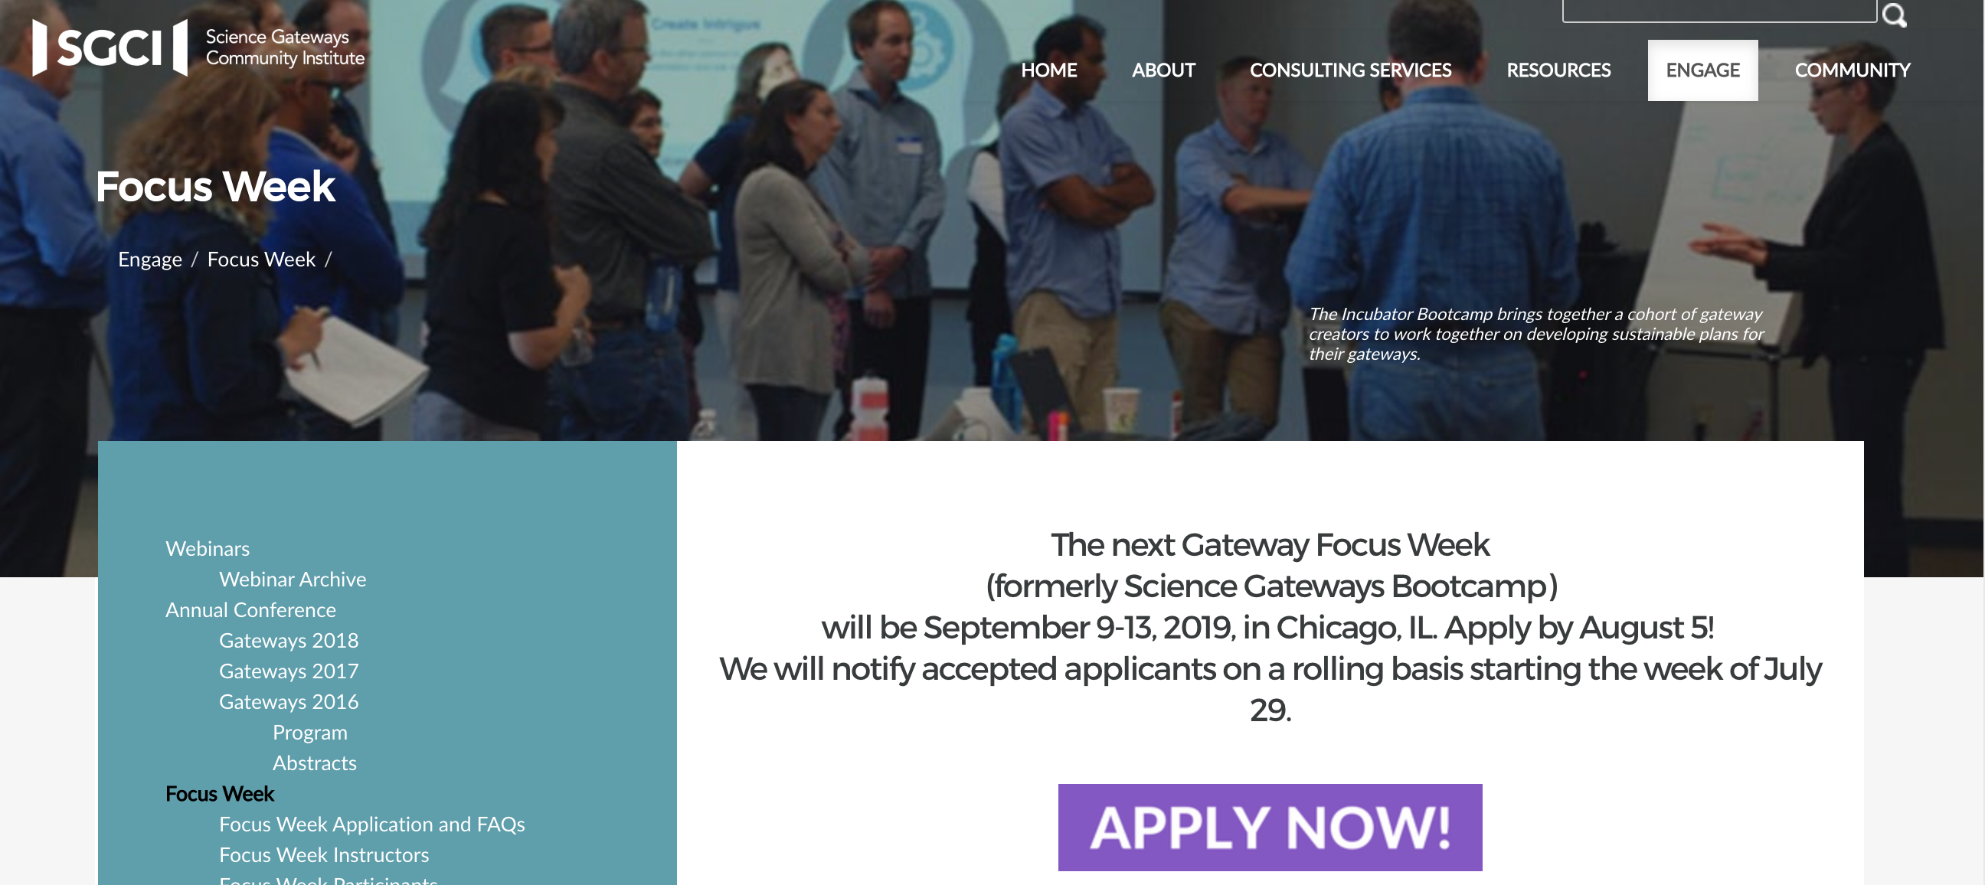

Slide 8
Contact Us
sgrc-iu-group@iu.edu

