Slide 1
Developing Science Gateways using Apache Airavata
Science Gateways Research Center
Pervasive Technology Institute
Indiana University

Slide 2
Acknowledgments
Primary development of Apache Airavata is funded through the NSF OAC SI2-SSI Award 1339774 to the Science Gateways Platform as a Service (SciGaP).
We acknowledge the contributions of the Apache Airavata Community comprising of 24 Project Management Committee, 38 committers, 35 Google Summer of Code Students and the user community at large. .

Slide 3
Science gateways are commonly described as user-centric environments that enable broader and deeper use of advanced computing resources, storage, data collections, and scientific applications.
What is a Science Gateway?

Slide 4
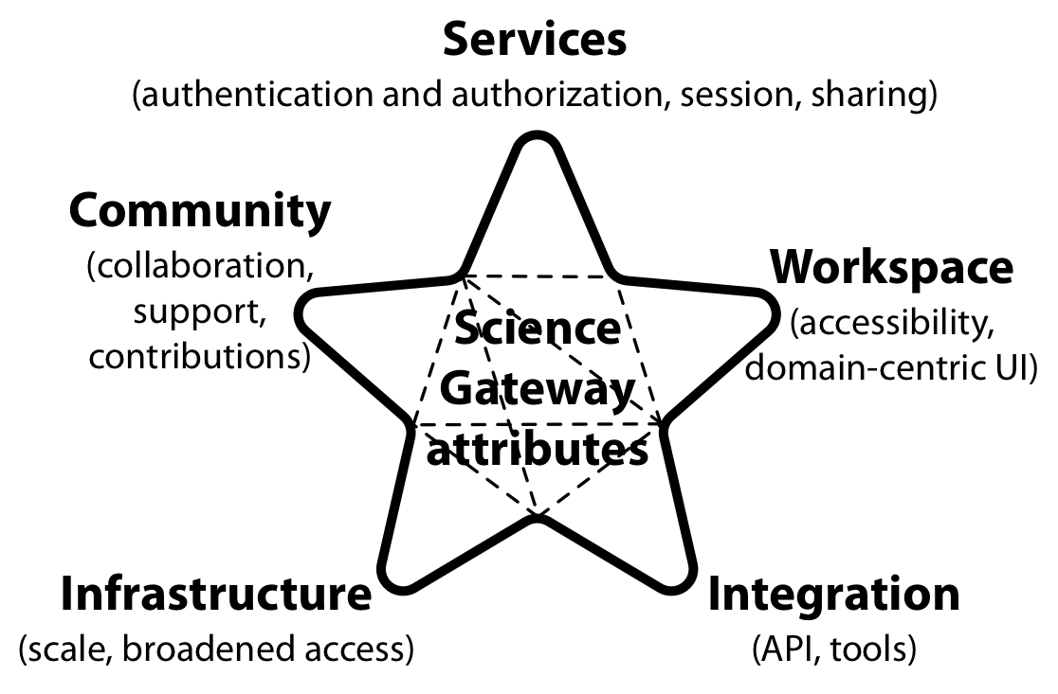
* Reference Paper: Towards a Science Gateway Reference Architecture, Pierce et al. IWSG 2018
Interconnected attributes of a science gateway*

Slide 5
Apache Airavata is a general purpose distributed systems framework used to build science gateways

Slide 6

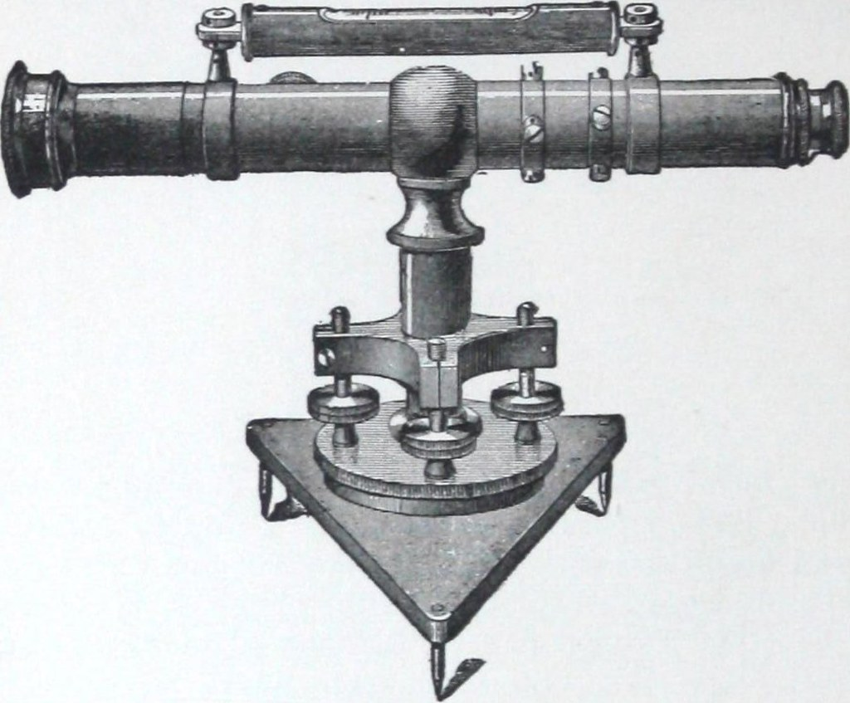
Airavata User Communities
Interdisciplinary Science Gateways
Campus Cyber Gateways
Instrument based Gateways
Airavata Users
Data Centric Gateways
Educational Gateways

Slide 7
Science Gateway Layers
IV
A
B
III
C
II
Abstractions to HPC/Cloud Infrastructure
D
I
This includes abstractions to scientific applications/tools.

Slide 8

Science Gateway Layers
IV
A
B
III
C
Data Abstractions
II
Abstractions to HPC/Cloud Infrastructure
This includes access, discovery and analysis of observational/experimental as well as computed data.
D
I
This includes abstractions to scientific applications/tools.

Slide 9
Science Gateway Layers
Science Goals
IV
A
Gateways often are platforms for scientific exploration.
B
III
C
Data Abstractions
II
Abstractions to HPC/Cloud Infrastructure
This includes access, discovery and analysis of observational/experimental as well as computed data.
D
I
This includes abstractions to scientific applications/tools.

Slide 10
Science Gateway Layers
User-centric environments
Gateways democratize layers I, II and III.
Science Goals
IV
A
Gateways often are platforms for scientific exploration.
B
III
C
Data Abstractions
II
Abstractions to HPC/Cloud Infrastructure
This includes access, discovery and analysis of observational/experimental as well as computed data.
D
I
This includes abstractions to scientific applications/tools.

Slide 11
Science Gateway Layers
User-centric environments
Gateways democratize layers I, II and III.
Science Goals
IV
A
Gateways often are platforms for scientific exploration.
B
III
C
Data Abstractions
II
Abstractions to HPC/Cloud Infrastructure
This includes access, discovery and analysis of observational/experimental as well as computed data. Also integrates with external data reposities
D
I
This includes abstractions to scientific applications/tools.

Slide 12
Let’s Look at Some Example
Science Gateways

Slide 13
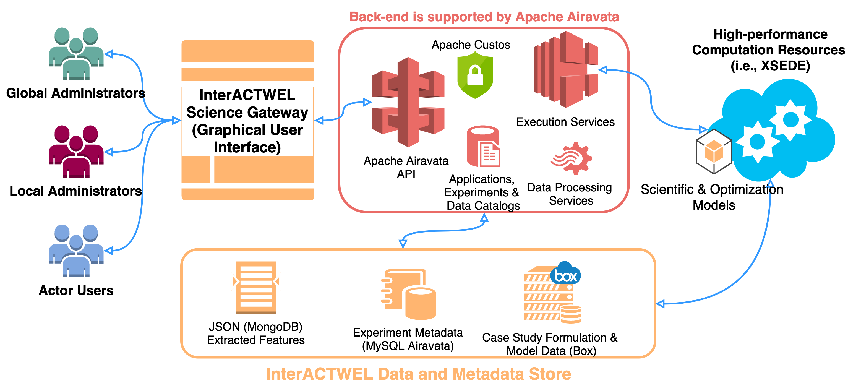
InterACTWEL Science Gateway

Slide 14
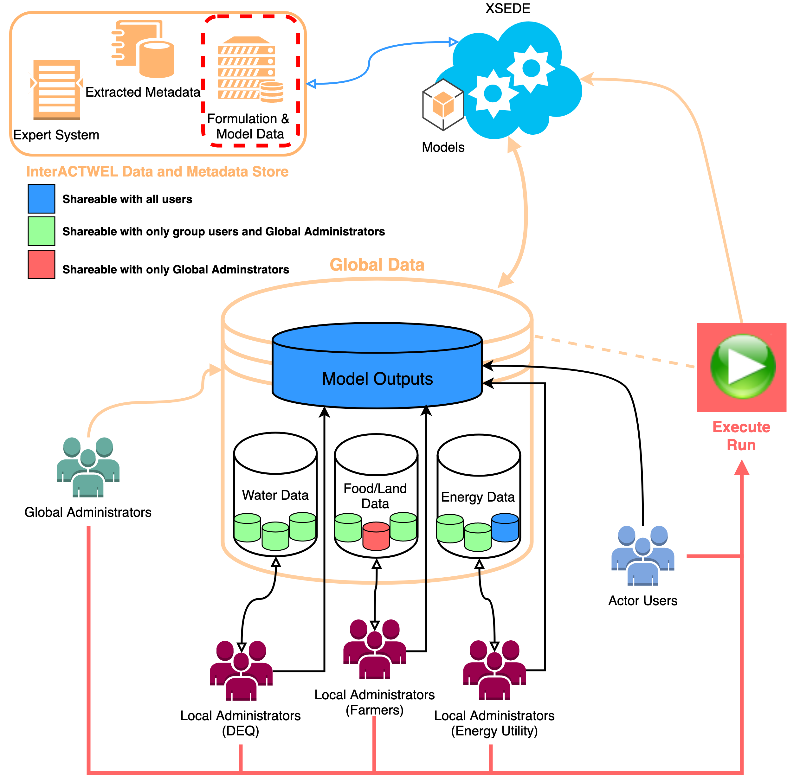
InterACTWEL:
Adaptation Planning in Food-Energy-Water Sectors of Local Communities

Slide 15
Tutorial Overview
A heuristic approach, improvised over a decade.
Introduction
Next Steps:
Consultations
Execute Experiments
Discuss
Call to
Action
12
Hands-On
11
1
10
2
9
3
Think
Discuss
8
4
Brain Trust
7
5
Custos Security
Discuss
Hands-On
6
This will be an engaging afternoon, be prepared to be involved.
Extending Airavata
Data Analysis

Slide 16
What would you like to take away?
Introduction
Next Steps:
Consultations
Execute Experiments
Discuss
Call to
Action
12
Hands-On
11
1
10
2
9
3
Introduction
Think
Discuss
8
4
Name, Institution, role.
State your interest in Science Gateways and/or Apache Airavata.
Describe your goal(s) for this afternoon.
Brain Trust
7
5
Custos Security
Discuss
Hands-On
6
Extending Airavata
Data Analysis

Slide 17
Hands-on Exercise of a baseline Airavata Capability
Introduction
Next Steps:
Consultations
Execute Experiments
Discuss
Call to
Action
12
Hands-On
11
1
10
2
9
3
Execute Experiments
Think
Discuss
8
4
Brain Trust
7
5
Custos Security
You will use a science gateway to execute computational simulations on XSEDE’s Comet Cluster at SDSC and Jetstream Cloud at IU & TACC.
Discuss
Hands-On
6
Extending Airavata
Data Analysis

Slide 18
All things Security
Introduction
Next Steps:
Consultations
Execute Experiments
Discuss
Call to
Action
12
Hands-On
11
1
10
2
9
3
Custos Security
Think
Discuss
8
4
Brain Trust
7
5
Custos Security
We will discuss Authentication, and Credential Management.
Will demonstrate how to use groups to manage fine-grained authorizations of resources, applications & data.
Discuss
Hands-On
6
Extending Airavata
Data Analysis

Slide 19
Post processing of Simulation Results
Introduction
Next Steps:
Consultations
Execute Experiments
Discuss
Call to
Action
12
Hands-On
11
1
10
2
9
3
Data Analysis
Think
Discuss
8
4
Brain Trust
7
5
Custos Security
You will browse/search and analyse output data.
You will learn to make content of computational inputs and outputs discoverable.
Discuss
Hands-On
6
Extending Airavata
Data Analysis

Slide 20
Customize it for your use. We can still host it.
Introduction
Next Steps:
Consultations
Execute Experiments
Discuss
Call to
Action
12
Hands-On
11
1
10
2
9
3
Extending Airavata
Think
Discuss
8
4
Brain Trust
7
5
Custos Security
We will present various extension points to Airavata and offer tips on customizing and extending Airavata for your specific research use cases.
Discuss
Hands-On
6
Extending Airavata
Data Analysis

Slide 21
Pose a problem and seek a mindshare from your peers
Introduction
Next Steps:
Consultations
Execute Experiments
Discuss
Call to
Action
12
Hands-On
11
1
10
2
9
3
Brain Trust
Think
Discuss
8
4
You can propose a Cyberinfrastructure problem or challenge you would like to address.
A cohort of participants will brain storm and offer suggestions.
Brain Trust
7
5
Custos Security
Discuss
Hands-On
6
Extending Airavata
Data Analysis

Slide 22
Specific Follow on Steps
Introduction
Next Steps:
Consultations
Execute Experiments
Discuss
Call to
Action
Hands-On
11
12
1
10
2
9
3
Next Steps
Think
Discuss
8
4
Brain Trust
7
5
Custos Security
We will discuss how to get in touch with us.
We will also present options to seek free expert consulting help through XSEDE, SGCI & SciGaP projects.
Discuss
Hands-On
6
Extending Airavata
Data Analysis

Slide 23
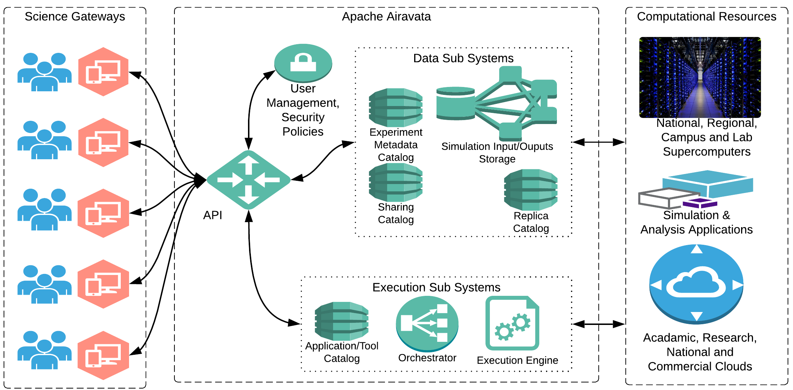

Slide 24
Brain Trust
Problem owner describe the challenge(s). (2 mins)
Organize into cohorts (5 mins)
Questions/Clarifications from audience. (5 mins)
Audience writes 10 ideas onto post-its. (5 mins)
Group brainstorms ideas, a couple seconds each (20 mins).
Identify relevant follow-ups for tutorial organizers (5 mins)

Slide 25
Portal “Framework”
Built in support for Custos Authentication
Uses Custos Fine-Grained Group based authorization
Pluggable Apps
Reusable UI Components
Focus on science centric user interfaces, framework provides lot of core capabilities

Slide 26
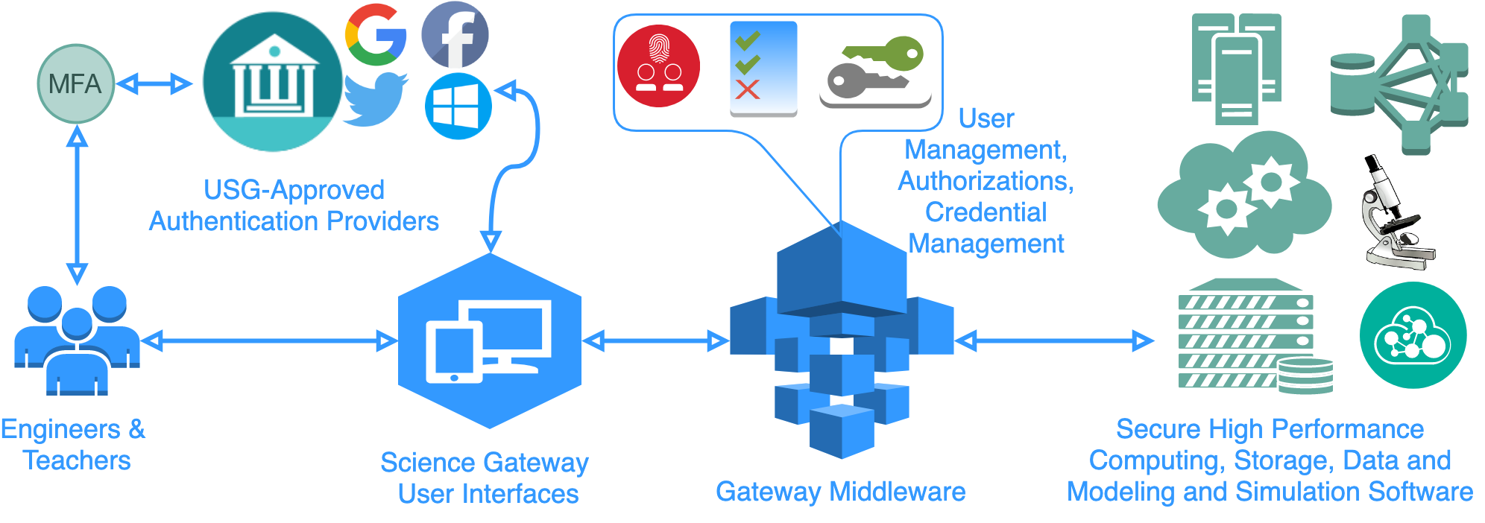
Airavata Ecosystem Overview

Slide 27
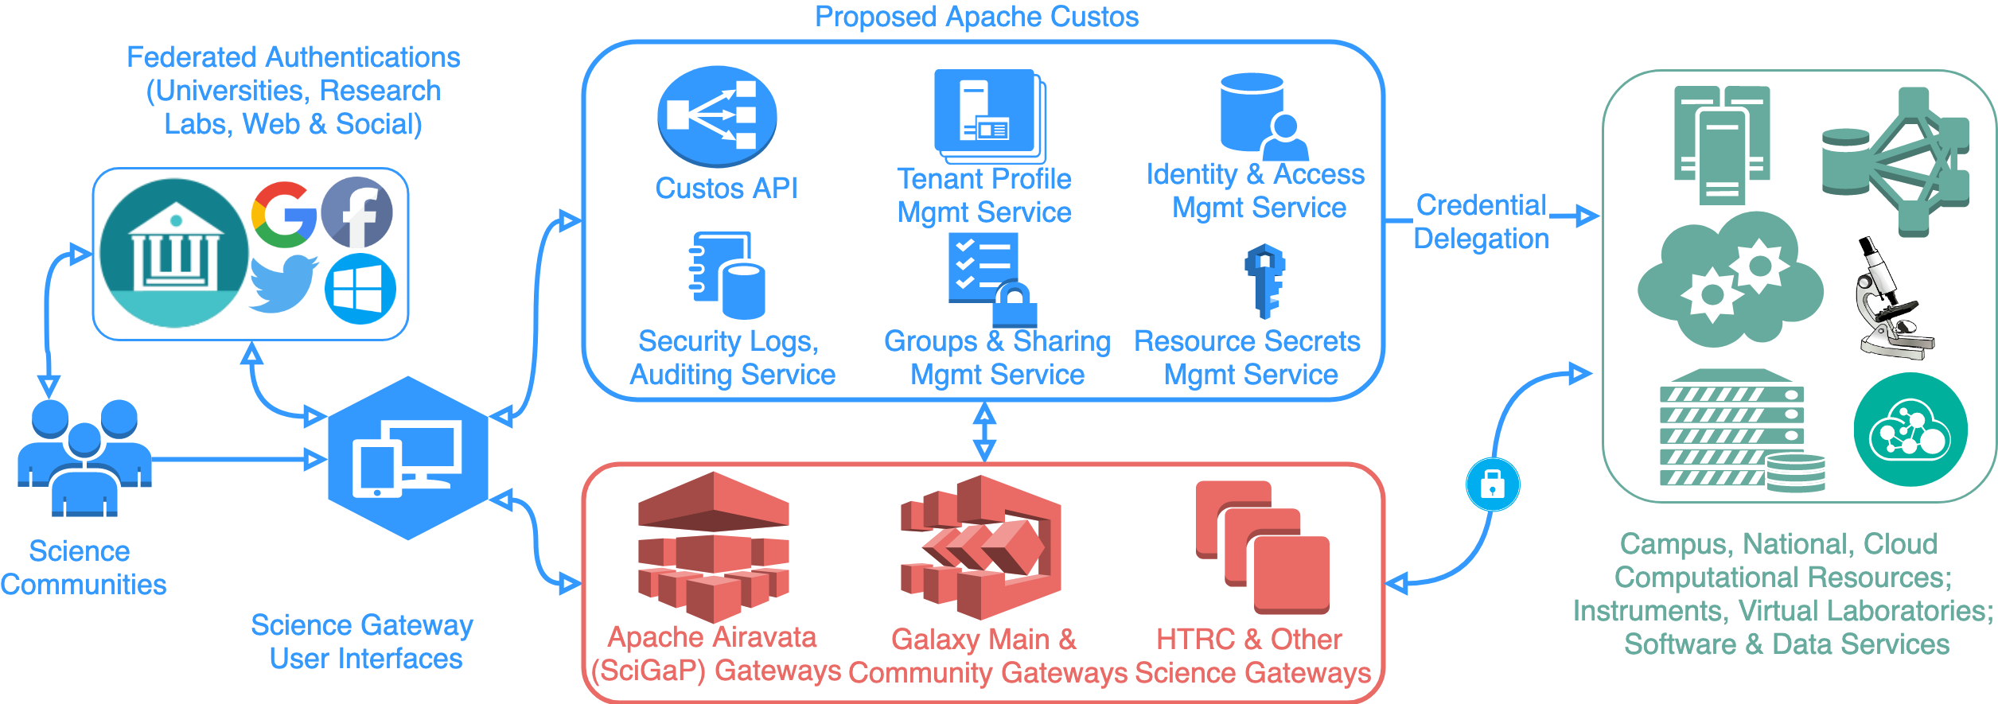
Custos Overview

Slide 28
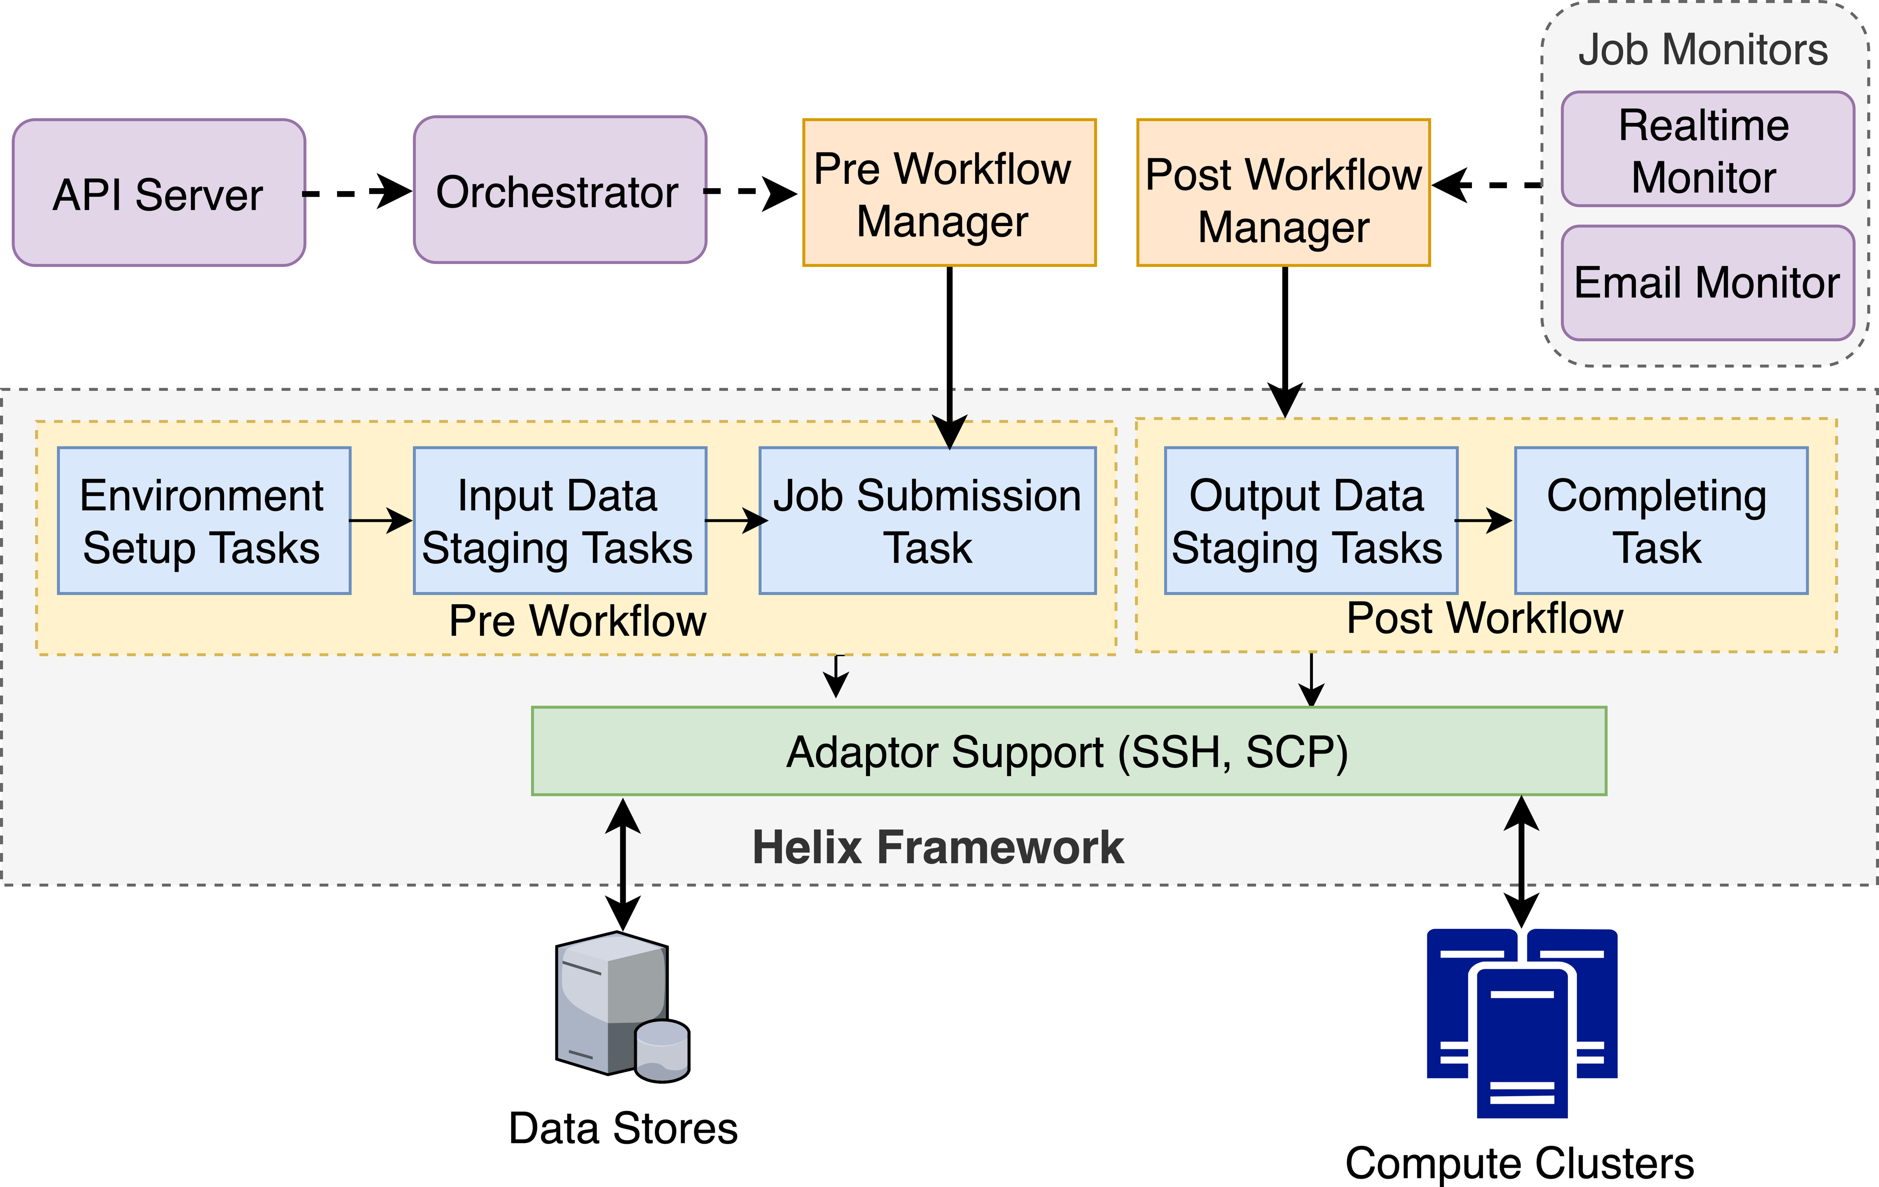
Airavata Core Capability: Programmable Execution Engine

Slide 29
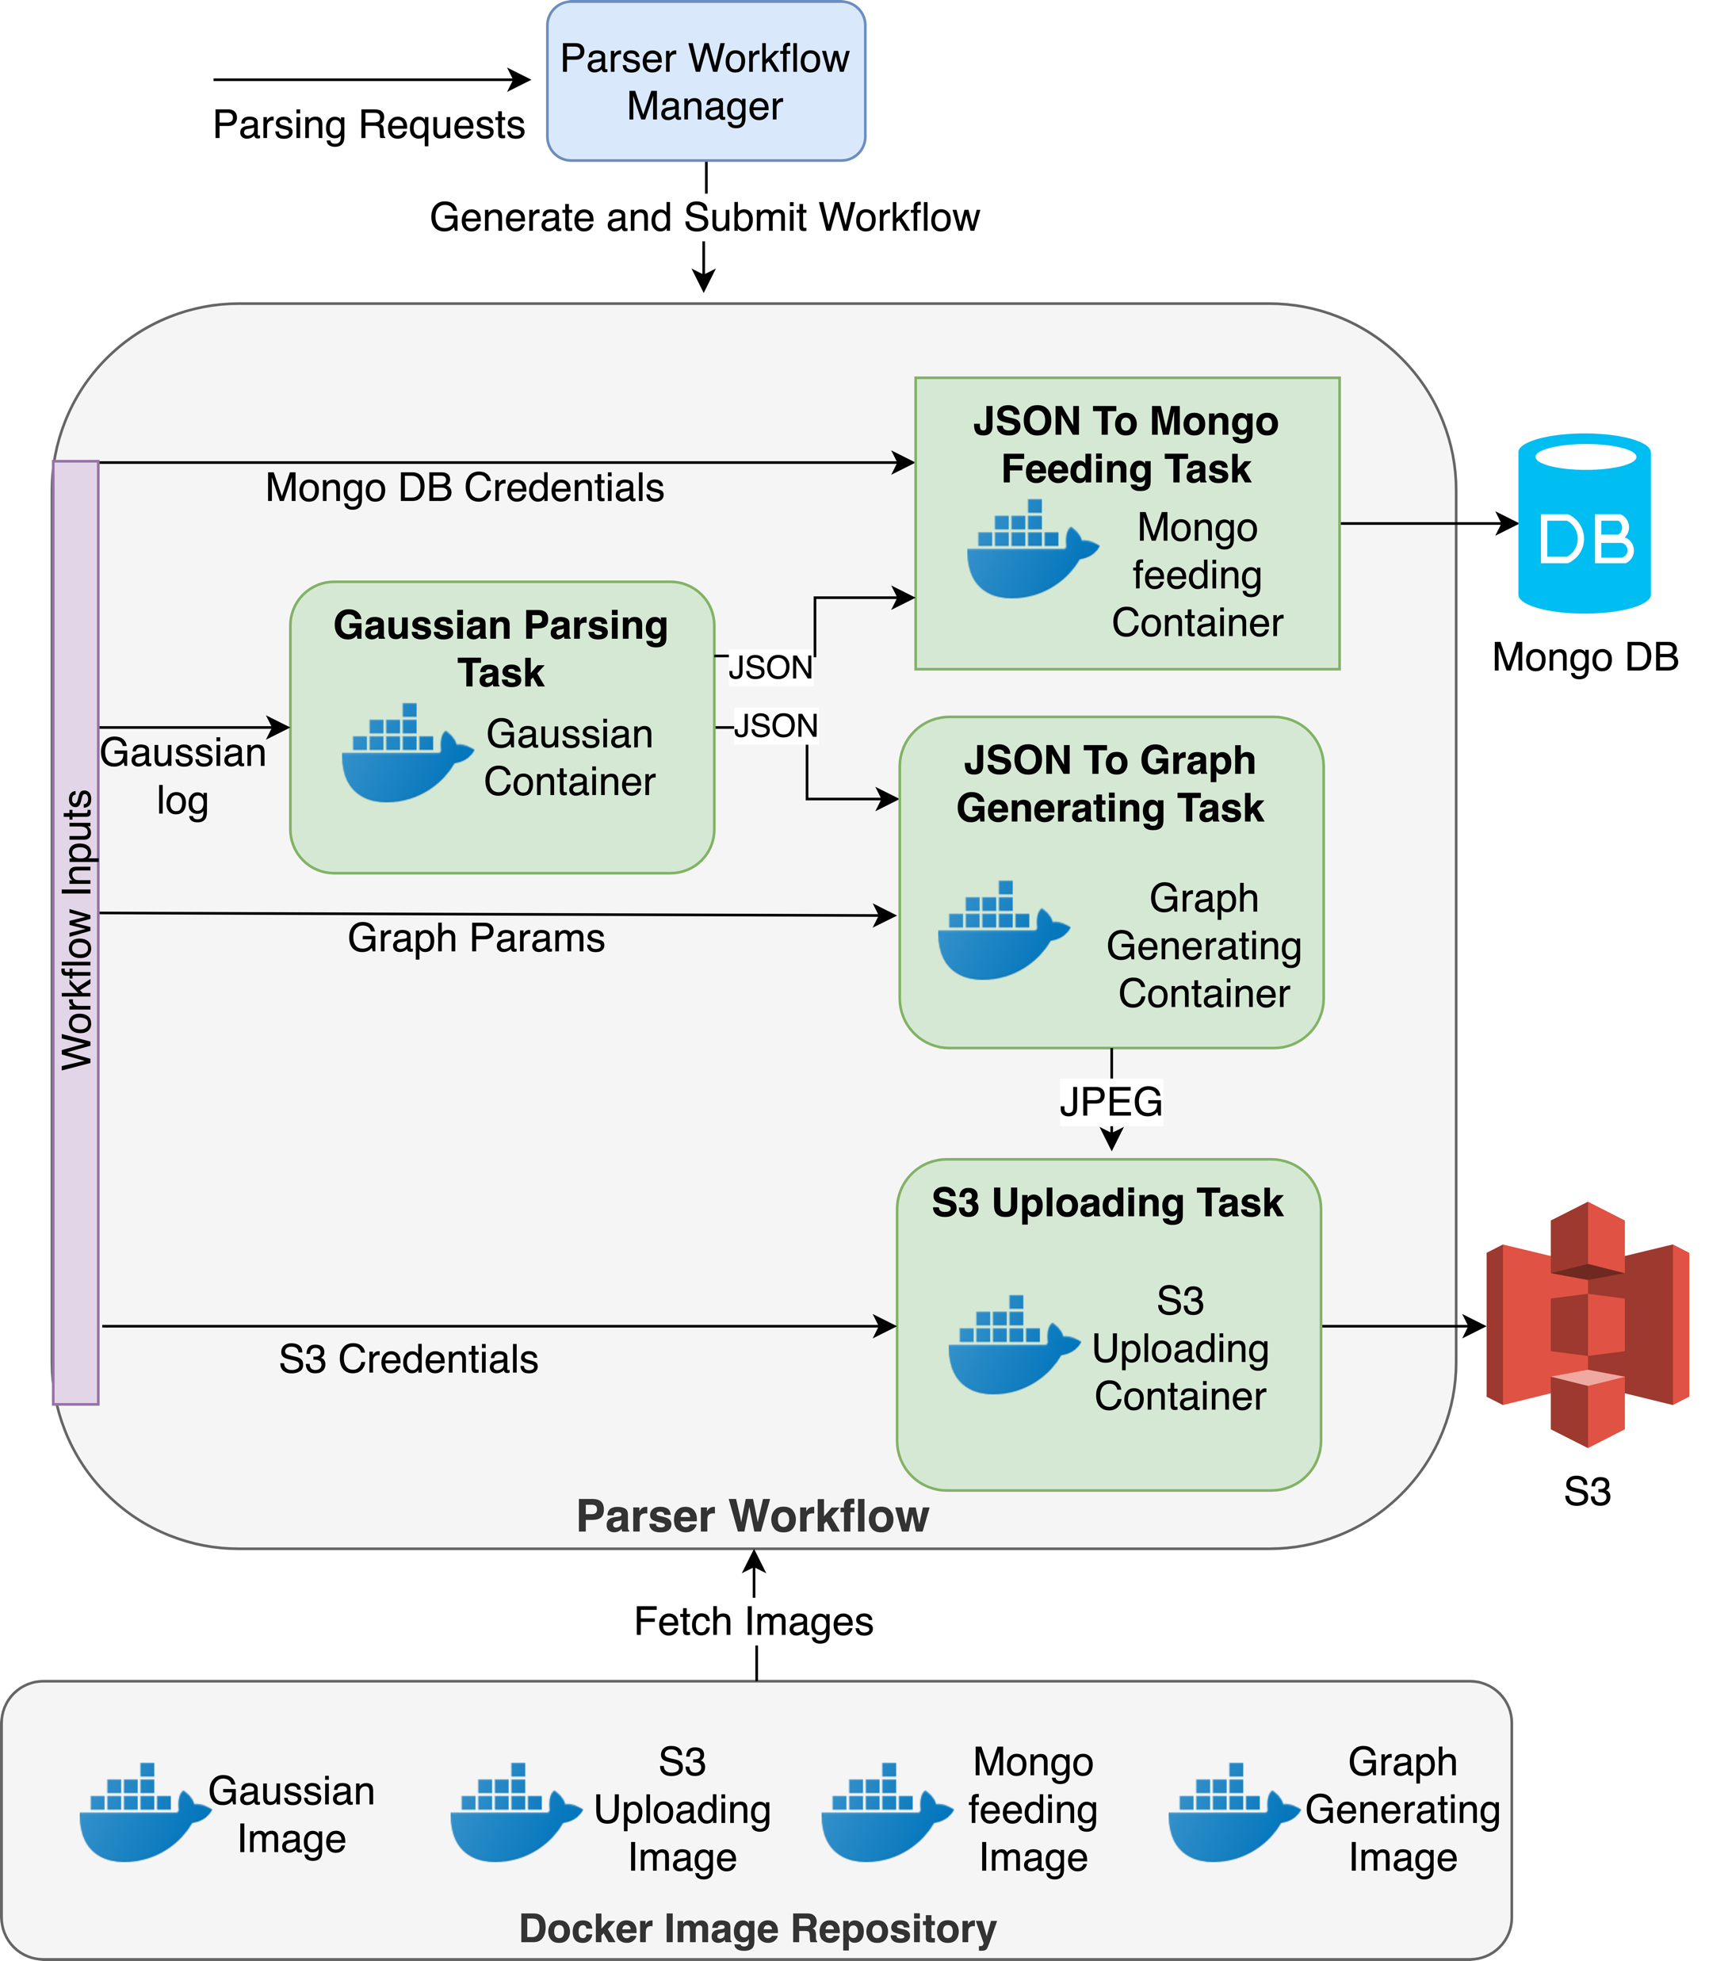
Airavata Core Capability: Searchable scientific data

Slide 30
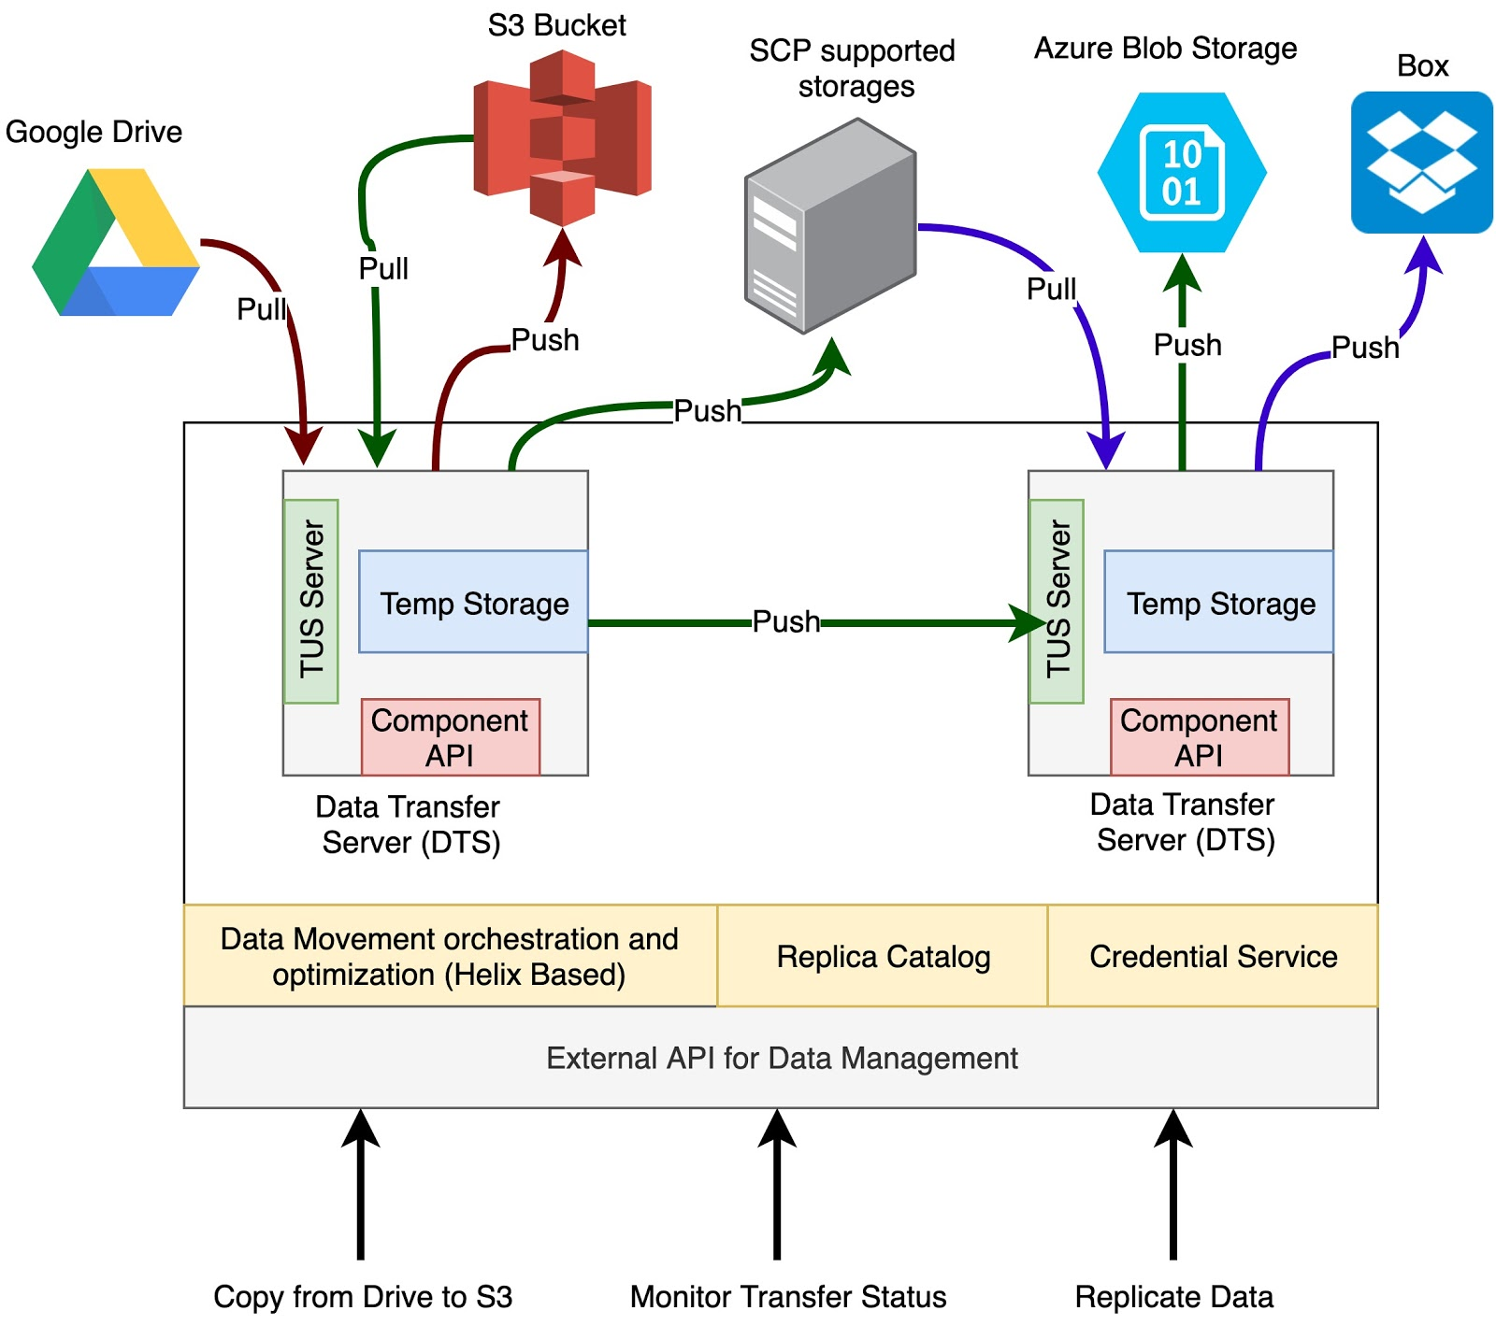
Fall 2019 Capability: Managed File Transfer

Slide 31
Full Stack Science Gateway Cyberinfrastructure
“Science-Centric” User Interfaces
Custos Security Services
Apache Airavata Middleware Services
OnDemand Clusters, Container Infrastructure
HPC & Cloud Infrastructure

Slide 32
Airavata Legacy
OGCE 2
SciGaP
Generalized Software Components and Services
Centralized Operations
2001
2003
2011
Custos
“Alliance” Grid Portal Efforts
2010
2013
2018
LEAD
Apache Donation
Early Science Gateway efforts, OGCE 1
Open Source to
“Open Communities”

Slide 33
Proposals and Grants Accelerating Airavata Roadmap
Collaboration Building & Grant Writing
Grant Execution & Operations
Ideate
Sprint planning
ABSTRACT
Learn
Product
Backlog
Sprint
execution
Define
Try experiments
Pivot / Persevere?
Build
Sprint
Review
Shipable
increment
CONCRETE
Empathize
Measure
ITERATE
Custom Point Solutions
Generalized Solutions
DESIGN THINKING
LEAN STARTUP
AGILE

