Slide 1
Building LinkedIn’s Real-time Data Pipeline
Jay Kreps

Slide 2
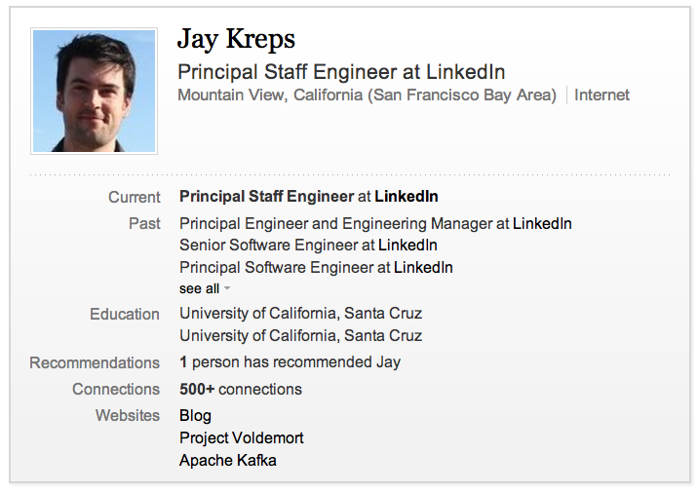

Slide 3
What is a data pipeline?

Slide 4
What data is there?
Database data
Activity data
  Page Views, Ad Impressions, etc
Messaging
  JMS, AMQP, etc
Application and System Metrics
  Rrdtool, graphite, etc
Logs
  Syslog, log4j, etc
Notes:
Thousands of data types being rapidly evolved by hundreds of engineers

Slide 5
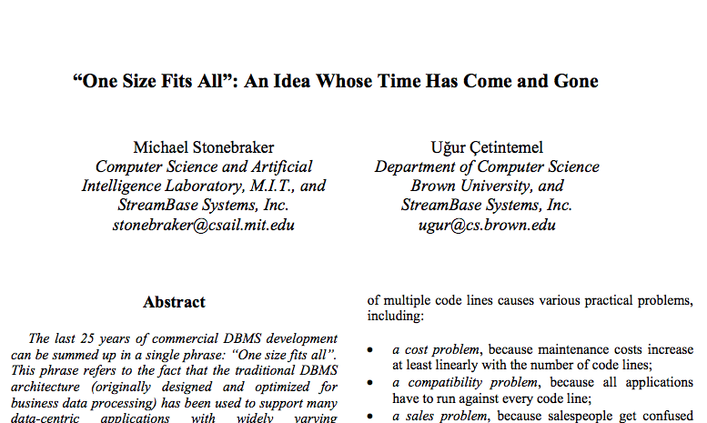
Notes:
Revolution in data systems: more scalable, but more specialized
Systems: Data Warehouse, Stream Processing, Sensor networks, Text search, Scientific databases, Document stores
2005 - ICDE

Slide 6
Data Systems at LinkedIn
Search
Social Graph
Recommendations
Live Storage
Hadoop
Data Warehouse
Monitoring Systems
…

Slide 7
Problem: Data Integration

Slide 8
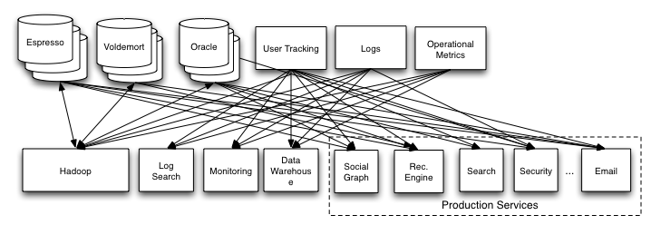
Point-to-Point Pipelines

Slide 9
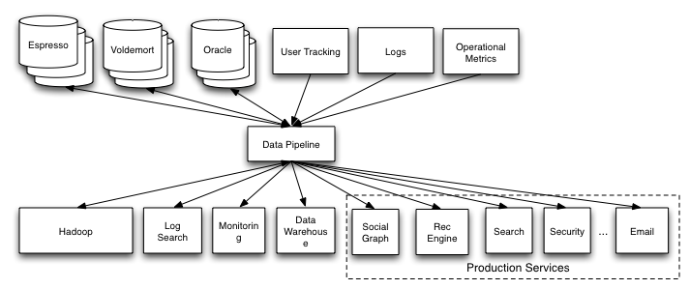
Centralized Pipeline

Slide 10
How have companies solved this problem?

Slide 11
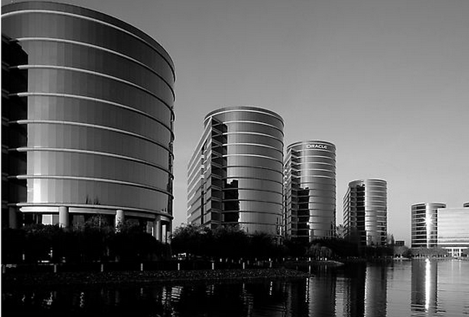
The Enterprise Data Warehouse
Notes:
“Data entry”
IT-centric
“Cleansed and Conformed”
Central ETL

Slide 12
Problems
Data warehouse is a batch system
Central team that cleans all data?
One person’s cleaning…
Relational mapping is non-trivial…

Slide 13

My Experience
Notes:
2008
ETL is a huge problem
Everything most things that are batch will eventually become real-time
Data integration is the value
Good way to grow a team

Slide 14
LinkedIn’s Pipeline

Slide 15
LinkedIn Circa 2010
Messaging: ActiveMQ
User Activity: In house log aggregation
Logging: Splunk
Metrics: JMX => Zenoss
Database data: Databus, custom ETL

Slide 16
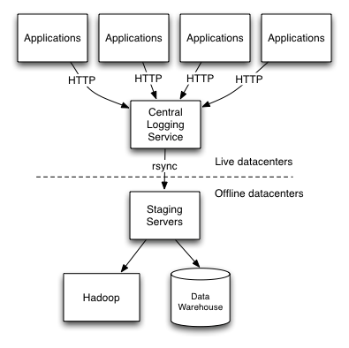
2010 User Activity Data Flow
Notes:
Problems: fragile, labor intensive, unscalable at the human layer

Slide 17
Problems
Fragility
Multi-hour delay
Coverage
Labor intensive
Slow
Does it work?
Notes:
Fundamentally unscalable in a human way
“What is going on with X”

Slide 18
Four Ideas
Central commit log for all data
Push data cleanliness upstream
O(1) ETL
Evidence-based correctness

Slide 19
Four Ideas
Central commit log for all data
Push data cleanliness upstream
O(1) ETL
Evidence-based correctness

Slide 20
What kind of infrastructure is needed?

Slide 21
Very confused
Messaging (JMS, AMQP, …)
Log aggregation
CEP, Streaming
Notes:
What did google do?

Slide 22
First Attempt:
Don’t reinvent the wheel!

Slide 23
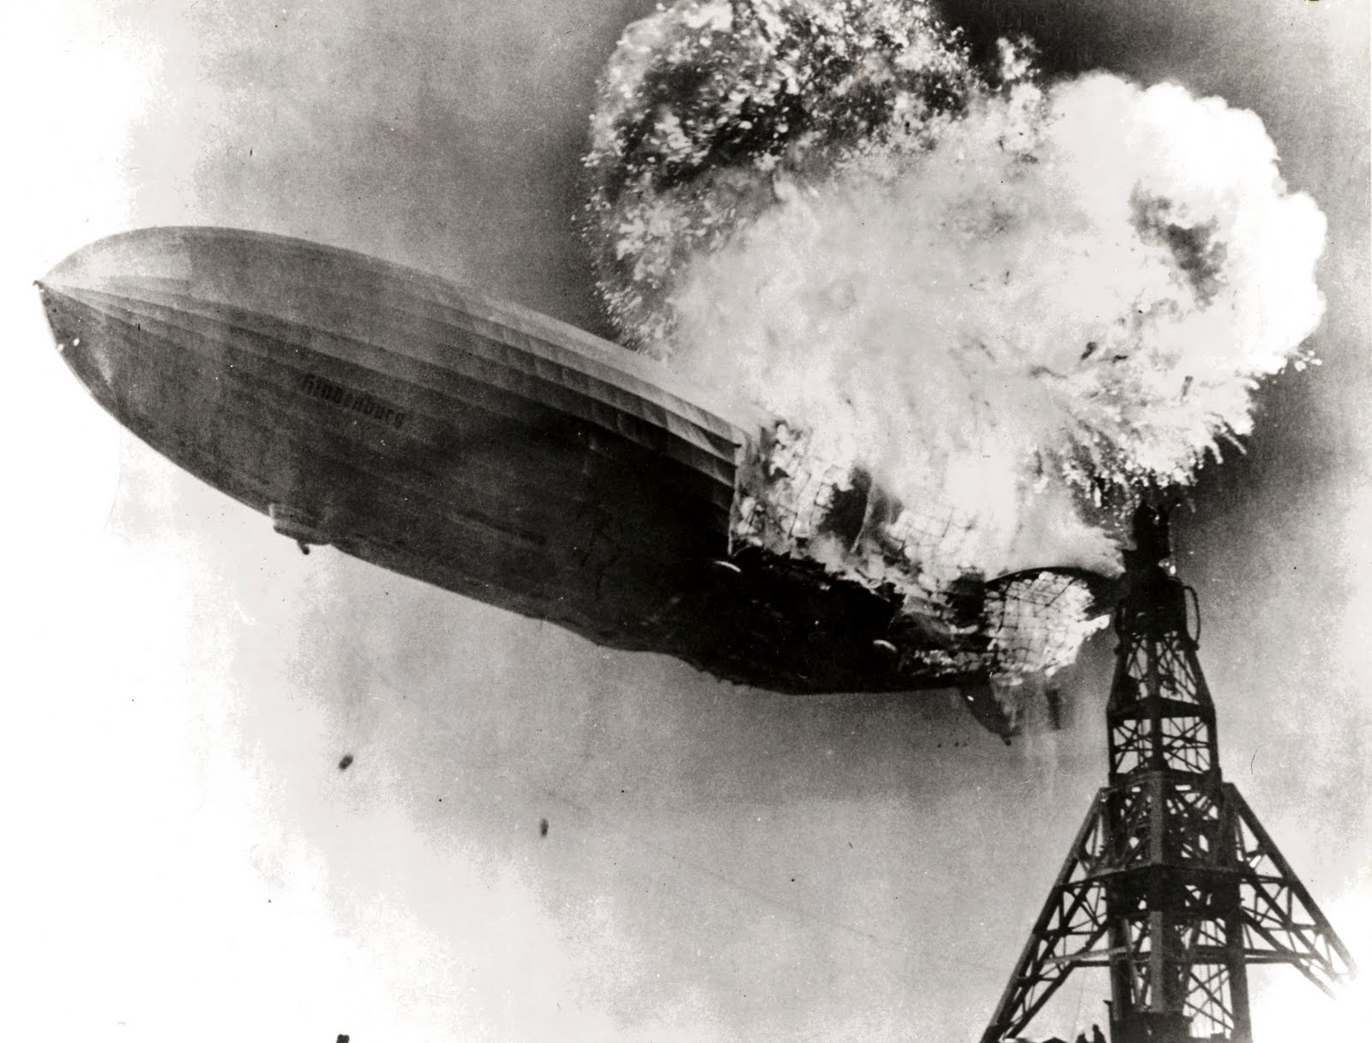

Slide 24
Problems With Messaging Systems
Persistence is an afterthought
Ad hoc distribution
Odd semantics
Featuritis

Slide 25
Second Attempt:
Reinvent the wheel!

Slide 26
Idea: Central, Distributed
Commit Log
Notes:
Different from messaging:
log can be replayed
logs are fast

Slide 27
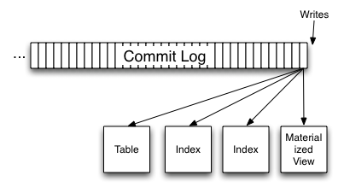
What is a commit log?

Slide 28

Data Flow
Notes:
Two kinds of things:
Just apply data to the system for a particular type of query (no transformation)
Data processing

Slide 29
Apache Kafka

Slide 30
Some Terminology
Producers send messages to Brokers
Consumers read messages from Brokers
Messages are sent to a Topic
Each topic is broken into one or more ordered partitions of messages

Slide 31
APIs
send(String topic, String key, Message message)
Iterator<Message>

Slide 32
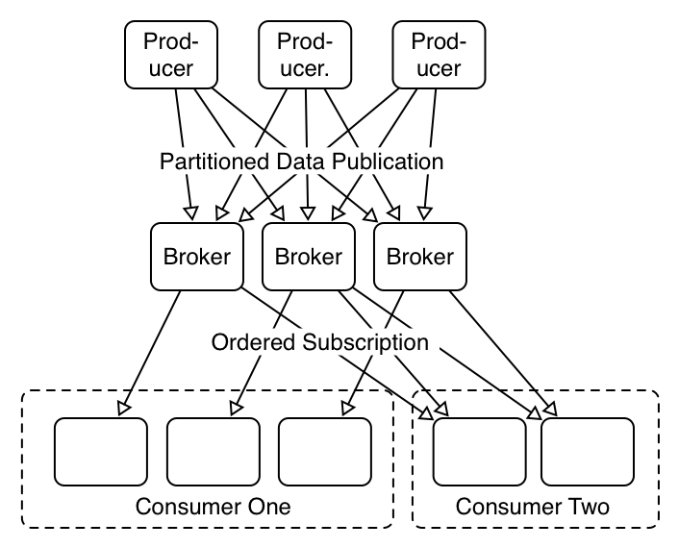
Distribution

Slide 33
Performance
50MB/sec writes
110MB/sec reads

Slide 34
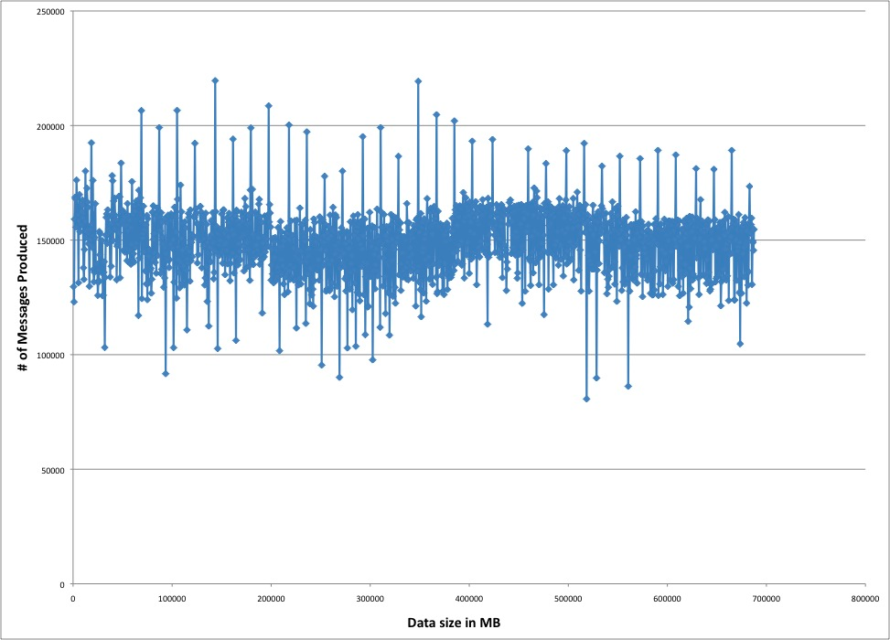
Performance

Slide 35
Performance Tricks
Batching
  Producer
  Broker
  Consumer
Avoid large in-memory structures
  Pagecache friendly
Avoid data copying
  sendfile
Batch Compression

Slide 36
Kafka Replication
In 0.8 release
Messages are highly available
No centralized master
Notes:
Current status: works in the lab
Replication factor for each topic
Server can block until

Slide 37
Kafka Info
http://incubator.apache.org/kafka

Slide 38
Usage at LinkedIn
10 billion messages/day
Sustained peak:
  172,000 messages/second written
  950,000 messages/second read
367 topics
40 real-time consumers
Many ad hoc consumers
10k connections/colo
9.5TB log retained
End-to-end delivery time: 10 seconds (avg)

Slide 39
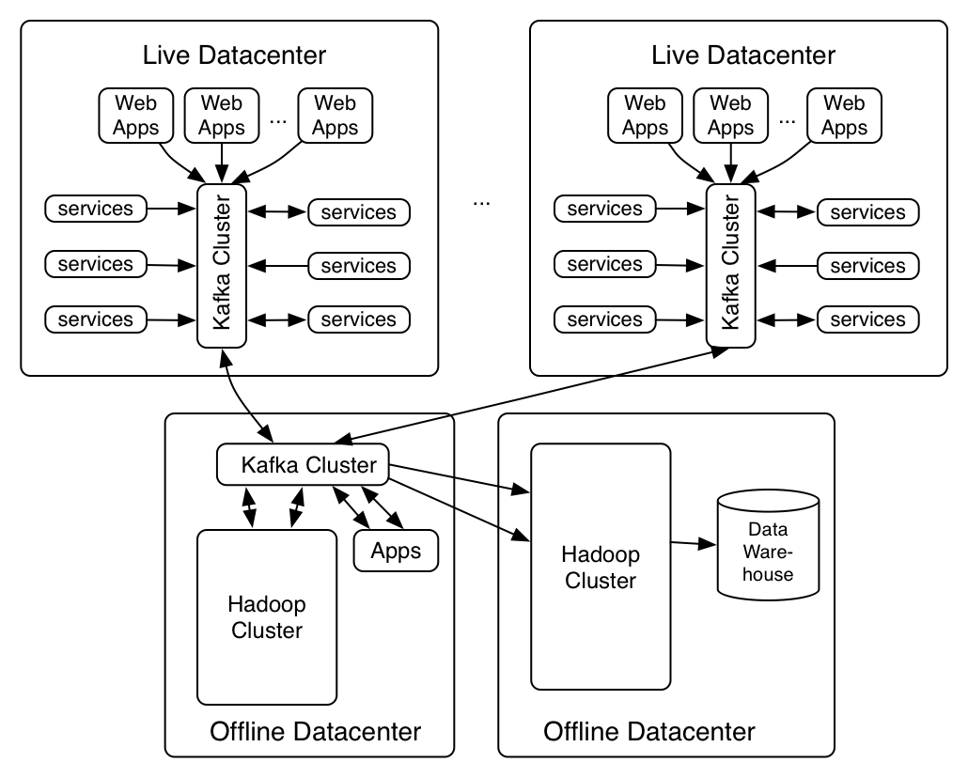
Datacenters

Slide 40
Four Ideas
Central commit log for all data
Push data cleanliness upstream
O(1) ETL
Evidence-based correctness

Slide 41
Problem
Hundreds of message types
Thousands of fields
What do they all mean?
What happens when they change?

Slide 42
Make activity data part of the domain model

Slide 43

Schema free?

Slide 44
LOAD ‘student’ USING PigStorage()
AS (name:chararray, age:int, gpa:float)

Slide 45
Schemas
Structure can be exploited
  Performance
  Size
Compatibility
Need a formal contract

Slide 46

Avro Schema
Avro – data definition and schema
Central repository of all schemas
Reader always uses same schema as writer
Programatic compatibility model
Notes:
Not part of kafka

Slide 47
Workflow
Check in schema
Code review
Ship

Slide 48
Four Ideas
Central commit log for all data
Push data cleanliness upstream
O(1) ETL
Evidence-based correctness

Slide 49
Hadoop Data Load
Map/Reduce job does data load
One job loads all events
Hive registration done automatically
Schema changes handled transparently
~5 minute lag on average to HDFS

Slide 50
Four Ideas
Central commit log for all data
Push data cleanliness upstream
O(1) ETL
Evidence-based correctness

Slide 51
Does it work?
Notes:
Computer science versus engineering

Slide 52
All messages sent must be delivered to all consumers (quickly)

Slide 53
Audit Trail
Each producer, broker, and consumer periodically reports how many messages it saw
Reconcile these counts every few minutes
Graph and alert

Slide 54
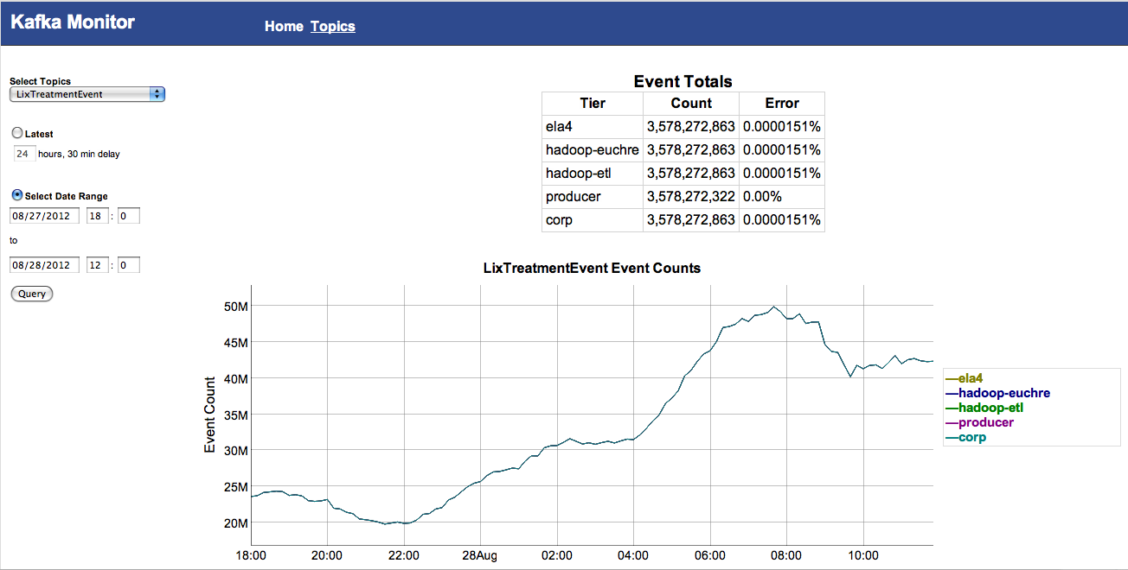
Audit Trail

Slide 55
Questions?

