Slide 1


Apache CloudStack
Evolution
Alex Huang
Software Architect, Citrix Systems

Slide 2
Design Goals
Make it easier for developers to get started
Allow developers with different skill sets to work on different parts of CloudStack
Give operator the choice to deploy only parts of CloudStack that they want to use
Allow CloudStack components to be written in languages other than Java
Increase deployment’s availability and maintainability

Slide 3
Action Plan
Disaggregate CloudStack services
Clearly differentiate between automation, orchestration, and provisioning
Switch to using well-known frameworks
Allow better composition at the resource layer
Change the deployment model for better resiliency

Slide 4
Disaggregating CloudStack

Slide 5
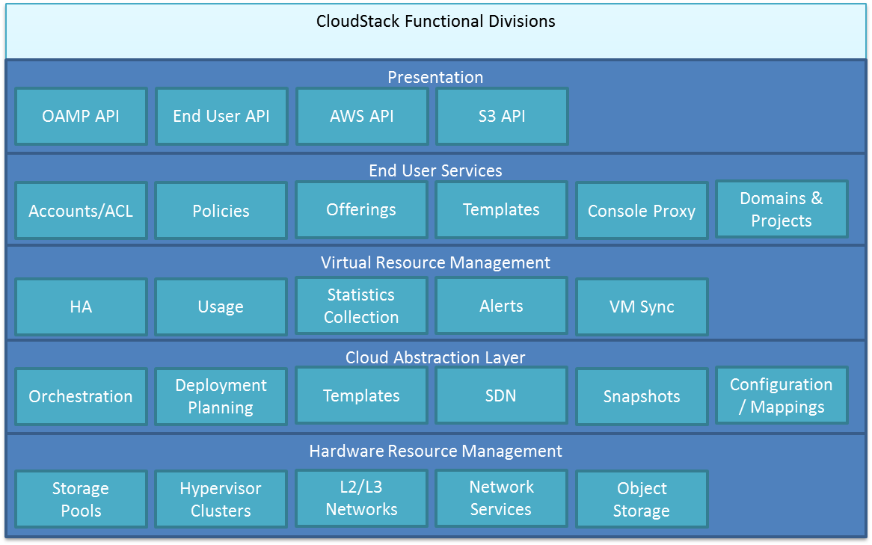
CloudStack Functional Layers

Slide 6
Cons
Interdependency in these layers causes reliability problems.
  Contracts between layers cannot be enforced since each layer cannot be individually tested.
Developer skill set must range from API design all the way to system level programming to effectively code in CloudStack
CloudStack availability and maintainability suffers because layers with different availability and maintainability requirements are deployed in one process.

Slide 7
Action Plan
Service | Purpose
Cloud-Engine | Presents a data center abstraction layer Orchestration within the data center abstraction layer Provisioning of the physical resources Directory for services and service end points
Cloud-Access | Account and directory connectors Authentication ACL & Governess
Cloud-API | End User API & UI
Cloud-Management | Management of physical resources Data Center automation Admin UI

Slide 8
CloudStack Service Properties
Independent life cycle
Independent scaling
Independent testing
RPC through reliable message queue
Notification through event systems
Individual database (even further in the future)

Slide 9
Cloud-Engine vs Cloud-API
Data Center Abstraction API
Cloud API
Speaks in virtualization terms (CPU, RAM, etc)
Callers can specify deployment destination down to the host
Can be used to deploy service VMs (such as SSVM and VR)
Contains orchestration logic
Speaks in service contracts (service offerings, network offerings, disk offerings)
Callers can only specify deployment destination through resource dedication
Can only deploy user VMs
Contains business logic

Slide 10
Skill Sets
Service | Skill Set
Cloud-Engine | System level understanding of hypervisors, network, storage May require C, phython, Java lanauages Details further
Cloud-API | REST Web 2.0 Appreciation of end user’s technical level
Cloud-Management | Understanding of how an operator likes to run their data center Probably a mix of Java and python
Cloud-Access | Experiences with LDAP and Active Directory Experiences with roles and security access

Slide 11
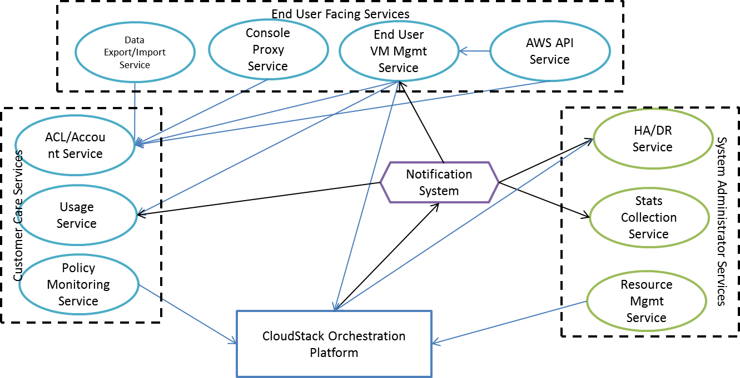
A Possible Future

Slide 12
Automation, Orchestration, & Provisioning

Slide 13
What is the difference?
The key is the data center abstraction layer
  Virtual Machine, Template, Nic, IP Address, Volume, Network, Rules, Snapshot
Orchestration orchestrates within this abstraction layer
Provisioning manifests concepts in abstraction layer on physical resources
Automation orchestrates above the data center abstraction layer to bring greater functionality

Slide 14
Examples
Orchestration
  VM deploy, Volume creation, Network Creation, Network rules propagation
Provisioning
  Starting a VM on a hypervisor
  The actual movement of a volume from one storage pool to another
Automation
  HA Process
  Putting a resource into maintenance mode
  Uploading and downloading templates
  DR process

Slide 15
Why is this important?
Cloud-Engine is still too big.
Partners need to clearly see the division in functionality between Cloud-Engine and their work.
Disaggregating CloudStack Services allow developer to quickly add services utilizing Cloud-Engine
Disaggregating Cloud-Engine allows partners to add more infrastructure to be utilized in the cloud.

Slide 16
Cloud-Engine Components
Component | Purpose
Orchestration | Orchestration of the Data Center Abstraction Layer
DeploymentPlanner | Plans the deployment destination for virtual machine and volumes
Compute | Provisioning of the hypervisor
NetworkGuru | Provides mapping of Network to physical network
NetworkElement | Provides various network services
PrimaryDataStore | Provisioning of storage
ImageStore | Provisioning of templates
BackingStore | Provisioning of backup storage
SnapshotService | Provides volume snapshots
MotionService | Provides data movements between various storage technologies

Slide 17
Cloud-Engine Component Properties
Recommended to have independent life cycles, databases, scaling, and testing.
Utilize CloudStack’s plugins to bridge provisioning needed by Cloud-Engine and functionality provided by the component.
All APIs must be asynchronous.
Operations are idempotent.

Slide 18
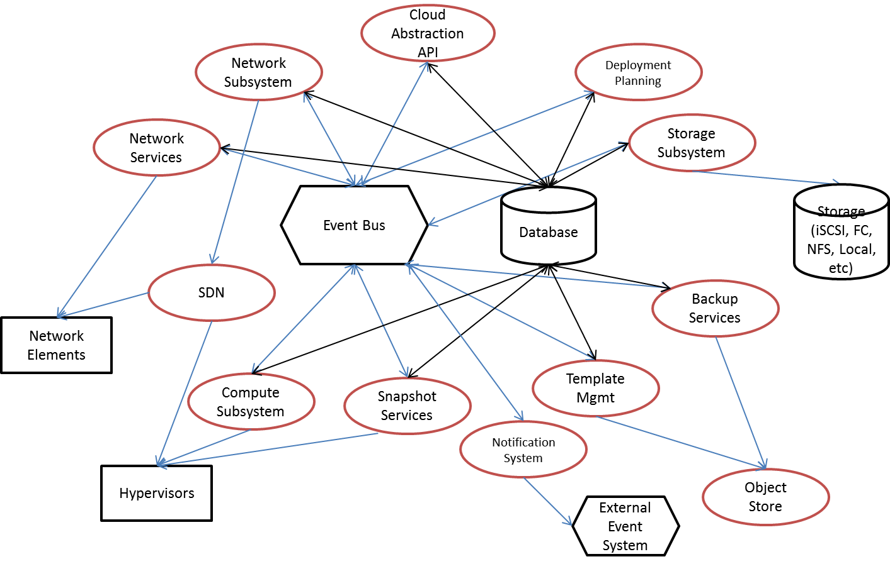
Cloud-Engine Components

Slide 19
Changing CloudStack’s Deployment Model

Slide 20
CloudStack 4.0
Availability Zone 7
Region 2 Mgmt Server Cluster
Region 1 MgmtServer Cluster
Availability Zone 1
Data Center 2
Data Center 1
Availability Zone 2
Availability Zone 6
Availability Zone 4
Availability Zone 5
Data Center 3
Availability Zone 3
Data Center 5
Data Center 4

Slide 21
Cons
Management plane goes down, the entire cloud is not operable.
No fault containment to the availability zone
Unable to do a zone by zone upgrade of CloudStack
Cannot guarantee zero downtime upgrades

Slide 22
New Deployment Model
VM Users
GSLB
Data Center 1
Data Center n
Cloud-API
Cloud-API
Cloud-API
Cloud-Access
Cloud-Acces
Account
Database
CloudStack Cloud-Engine
CloudStack Cloud-Engine
Account
Database
Admin Console
Admin Console
Database
Database

Slide 23
Scalability
Cloud-API nodes can be brought up and added to cluster to handle more requests
Cloud-Engine cluster and Cloud-API cluster are scaled independently
  Cloud-Engine cluster to hardware resources
  Cloud-API cluster to incoming requests

Slide 24
Availability
Cloud-API Servers can be deployed in geographically remote locations because they don’t share databases
One Cloud-API Server going down only impacts the tasks it is executing
Any number of Cloud-API Servers can be brought up
Cloud-Engine cluster going down means only one zone is down. Not the whole cloud.
Even if the entire Cloud-API cluster is down, admins can still manage VMs by directly connecting to the Cloud-Engine cluster.

Slide 25
Maintainability
Zones can be individually upgraded
Only the zone being upgraded cannot be provisioned
Cloud-API Servers can be brought up with new versions and then the old ones shutdown

