Slide 1
Palo Alto Networks firewall orchestration using CloudStack
June 25th, 2013

Slide 2
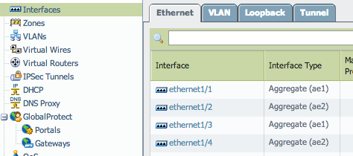
Pre-configure the Palo Alto device
Setup the Public and Private interfaces on the PA.
Pre-configure the Public interface according to the Public IP range in CS.

Slide 3
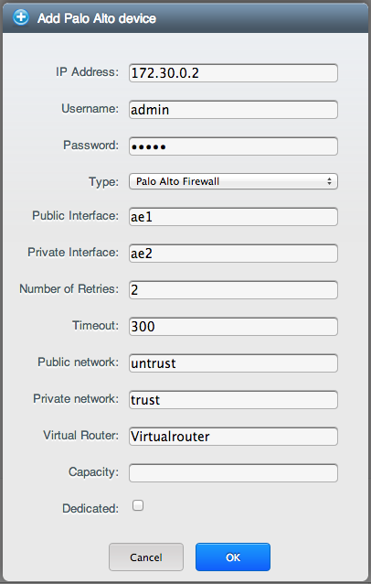

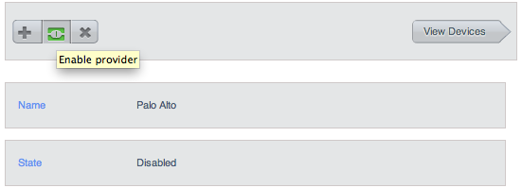
Add the PA as a service provider
Add the PA device as
a guest network
service provider.
Enable the provider.

Slide 4
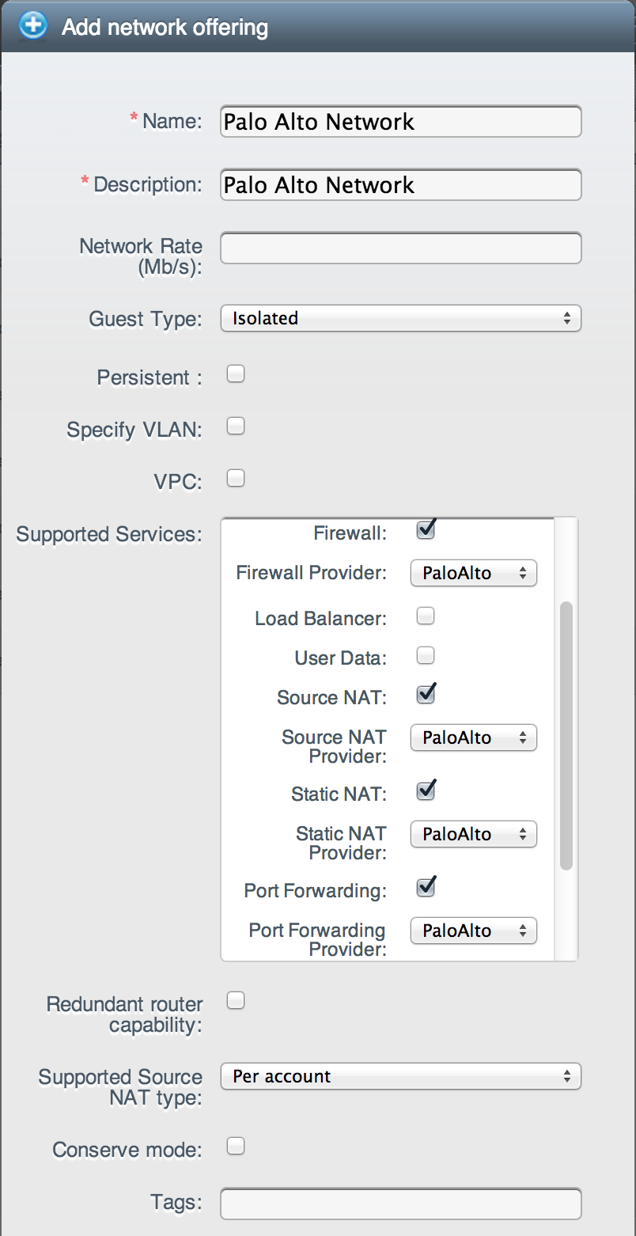
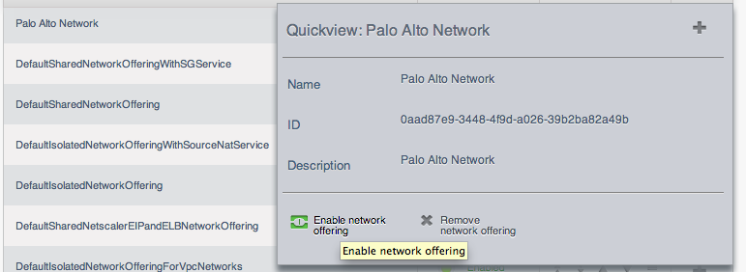
Create a Network Offering
Expose the PA through
a network offering.
PA provides: Source NAT,
Static NAT, Port Forwarding
and Firewall services.
Enable the new offering.
Notes:
The CloudStack VR provides DHCP and DNS in this service offering.

Slide 5
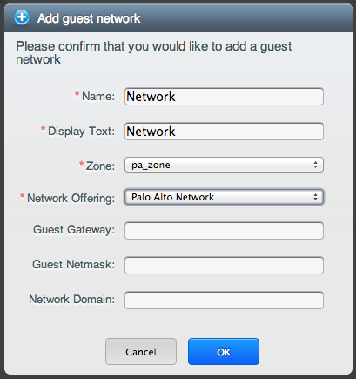
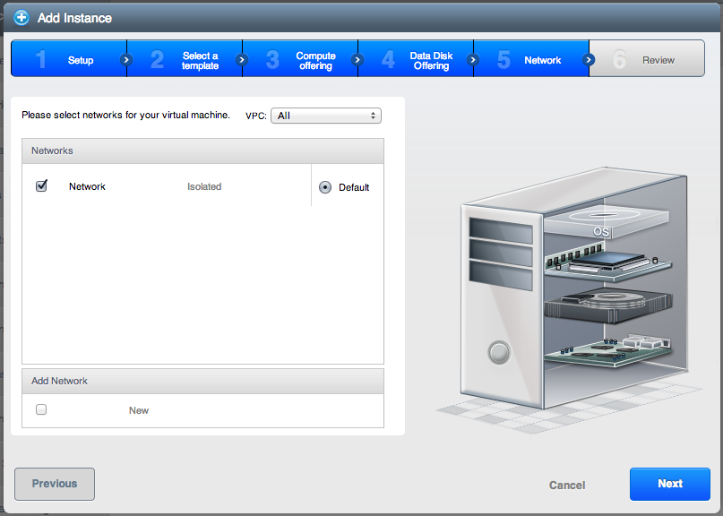
Use the Palo Alto
Add a network using the service offering.
Launch a VM on the new network.

Slide 6
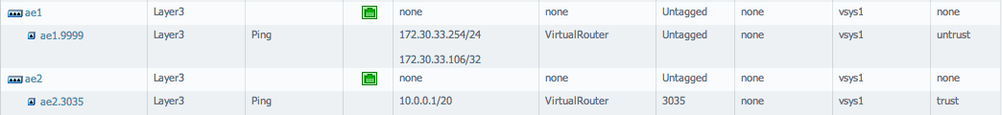
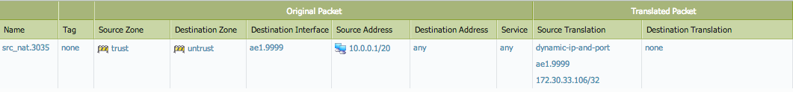
Check what happened on the PA
A Source NAT IP is allocated on ‘ae1’.
A guest network has been setup on ‘ae2’.
A Source NAT rule now connects the guest network to the public IP.
A policy isolates the guest network.

Slide 7
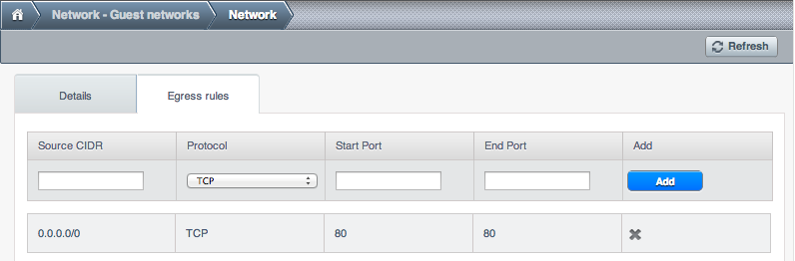
Egress firewall rules

Slide 8
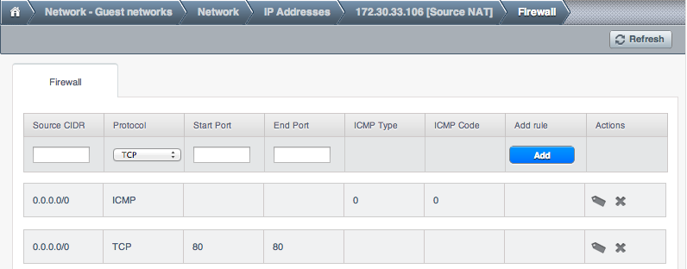
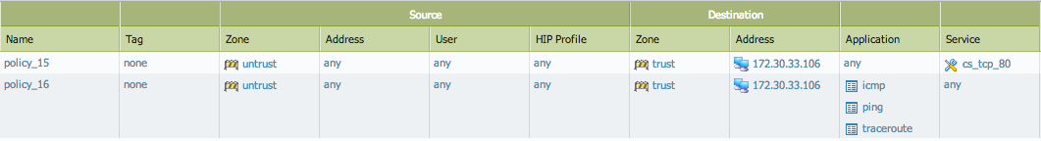
Ingress firewall rules

Slide 9
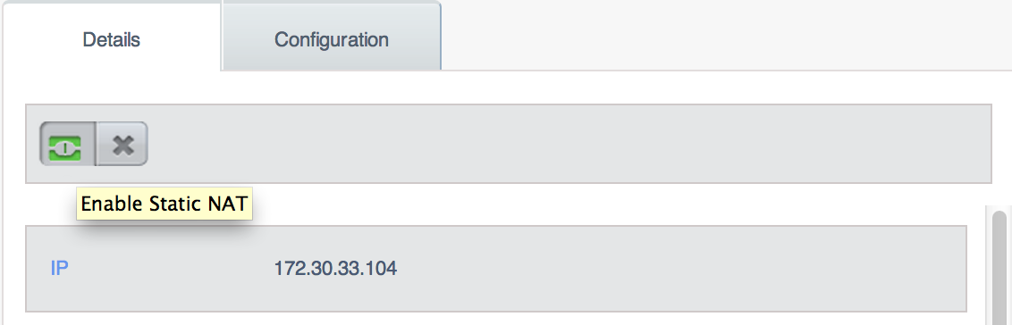
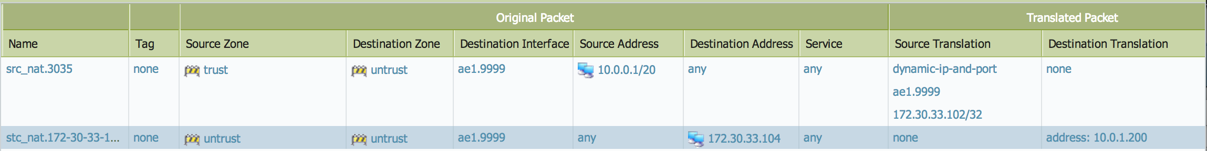
Static NAT rules

Slide 10
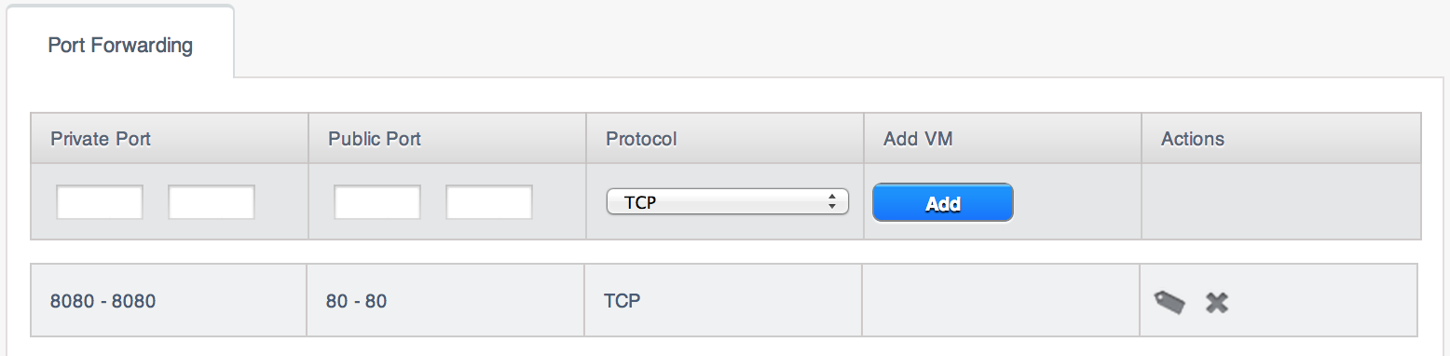
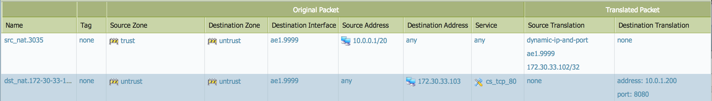
Port Forwarding rules

