Slide 1
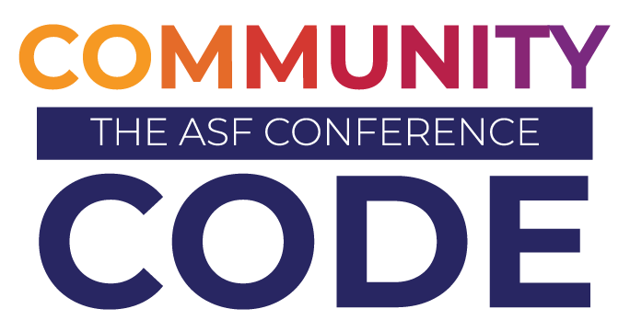

Title
Brian Proffitt, ASF Vice President, Marketing & Publicity; Conferences

Slide 2

Header
Notes:
From January 2023:
372M repos including 28M public
100M developers
And at ASF there are 300+ projects - why would someone choose yours
There are millions of OSS projects with more coming out all the time
How will you attract users and contributors to yours?
Ushering in next generation of maintainers / succession planning
Bringing new contributions and innovations to the project
Notes:
There are millions of open source projects that exist today. And there are many more that come out all the time. And regardless of the size of your community or code base, we know from experience as an industry that even the smallest communities can have an outsized impact on the global digital infrastructure that everyone uses. We saw it with Heartbleed for example, very small maintainer team on OpenSSL. Really important code base.
When we consider marketing in open source, the goal really is about how do you attract new contributors to your project, new users to your project, to make sure that your project is sustainable and healthy, long term.
Even well, established, well known projects can benefit from new contributors. It helps you usher in the next generation of maintainers for your project. It's like succession planning for your project, which is really important. I think as this industry matures, that has become a question that we've grappled with in open source in the past decade.
How do we think about succession planning, and bringing new contributions and innovations into the project as well?
When we think about marketing and open source it really is about how do you create a healthy long term sustainable community that will support your project, long term, whether you're new and emerging, and trying to just attract a lot of contributors for innovation, creating new things.
Or it's a very well known established project that may already have high adoption, but needs a community to support and make sure that it is maintained to the highest level of quality. So that's what we're going to talk about today.
This is the problem space we’ll discuss today: how you can you leverage marketing to help your project grow
we'll walk through different types of marketing you can do for projects, depending on what your needs are. And, and then, at the end, we'll talk about ASF marketing and publicity resources that are available to you as a top level project.

Slide 3
Header
Cell 1 | Cell 2
Cell 3 | Cell 4
Cell 5 | Cell 6
Cell 7 | Cell 8
Cell 9 | Cell 10
Notes:
From January 2023:
372M repos including 28M public
100M developers
And at ASF there are 300+ projects - why would someone choose yours
There are millions of OSS projects with more coming out all the time
How will you attract users and contributors to yours?
Ushering in next generation of maintainers / succession planning
Bringing new contributions and innovations to the project
Notes:
There are millions of open source projects that exist today. And there are many more that come out all the time. And regardless of the size of your community or code base, we know from experience as an industry that even the smallest communities can have an outsized impact on the global digital infrastructure that everyone uses. We saw it with Heartbleed for example, very small maintainer team on OpenSSL. Really important code base.
When we consider marketing in open source, the goal really is about how do you attract new contributors to your project, new users to your project, to make sure that your project is sustainable and healthy, long term.
Even well, established, well known projects can benefit from new contributors. It helps you usher in the next generation of maintainers for your project. It's like succession planning for your project, which is really important. I think as this industry matures, that has become a question that we've grappled with in open source in the past decade.
How do we think about succession planning, and bringing new contributions and innovations into the project as well?
When we think about marketing and open source it really is about how do you create a healthy long term sustainable community that will support your project, long term, whether you're new and emerging, and trying to just attract a lot of contributors for innovation, creating new things.
Or it's a very well known established project that may already have high adoption, but needs a community to support and make sure that it is maintained to the highest level of quality. So that's what we're going to talk about today.
This is the problem space we’ll discuss today: how you can you leverage marketing to help your project grow
we'll walk through different types of marketing you can do for projects, depending on what your needs are. And, and then, at the end, we'll talk about ASF marketing and publicity resources that are available to you as a top level project.

