Slide 1
Min Chen Prachi Damle
Citrix
CloudStack Identity and Access Management (IAM)

Slide 2
Agenda
Background
Our Design Goal
Architecture
Implementation
Use Cases
Next Steps

Slide 3
Background
Limited IAM Services
  Out-of-box fixed roles (Root Admin, Domain Admin, User) with prebaked access control.
  No support for customized roles creation.
  Special hard-coded access control logic baked in service layer for some resources like networks, affinity group, etc.
  Granting permissions by dedicated APIs is very restrictive.

Slide 4
Our Goal
Provide True Pluggable IAM Service

Slide 5
Our Goal
Provide True Pluggable IAM Service

Slide 6
What is IAM
Policy
Principal
Role
Permission
Resource
👩
Impersonate
Principal
Action
Resource
👫
Allow/Deny
Allow/Deny
Resource
Principal
Permission
👨
Principal
Action
Resource
member
Group
Allow/Deny
Resource
Allow/Deny
Principal
member
Permission
👦
Principal
Action
Resource
Resource

Slide 7
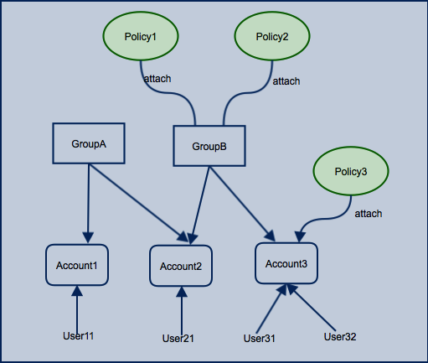
Our IAM Model

Slide 8
Pluggable IAM Service
  Host IAM server as an Independent Service listening at an endpoint which CloudStack or other portal services call to do access checks

Slide 9
Pluggable IAM Components
Server
  An implementation of pure IAM taxonomy independent of CloudStack.
  Out-of-box IAM server implementation based on our IAM schema
  Provide IAM server interface for third-party (LDAP/AD based) to implement a different IAM server.
Plugin
  A plugin integrated with CloudStack through adapter interfaces:
    APIChecker
    SecurityChecker
    QuerySelector
  Serve new IAM API requests

Slide 10
IAM Component Diagram
CloudStack
IAM Service
cloud-plugin-iam
cloud-api
APIChecker
RoleBasedAPIChecker
IAM Server APIs
cloud-iam-server
SecurityChecker
RoleBasedEntityChecker
QuerySelector
RoleBasedQuerySelector
cloud-server
IAM Plugin APIs

Slide 11
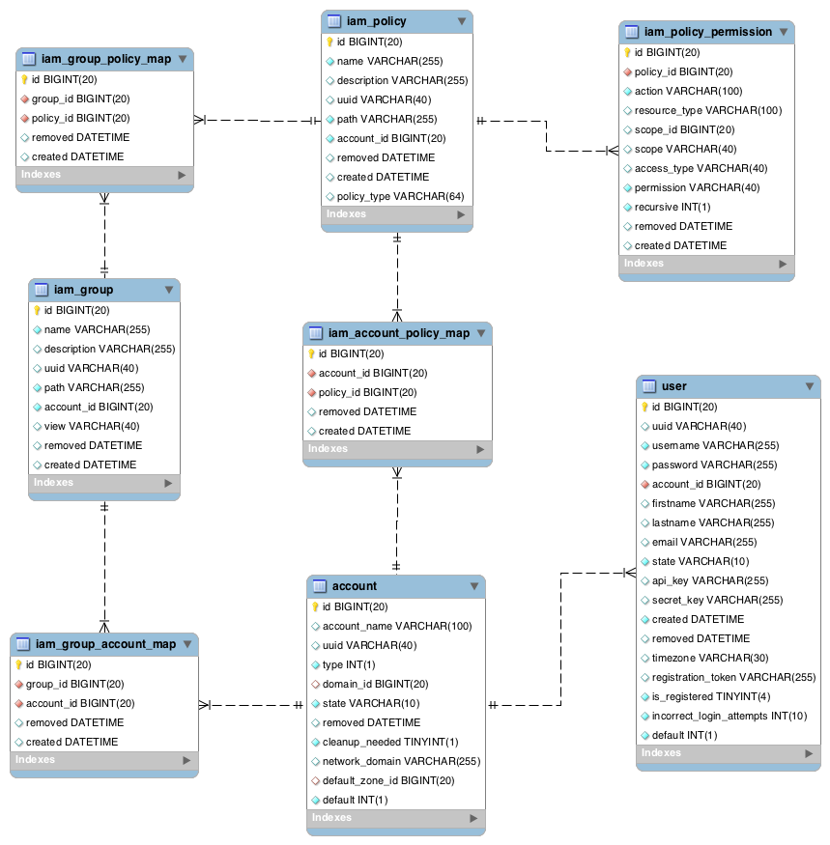
IAM Server
IAM Schema
Implement IAM Server
interface to provide your
own 3rd-party IAM server.

Slide 12
IAM Plugin
IAM APIs
Adapters
  APIChecker
  SecurityChecker
    AccessType
  QuerySelector
Plugin understands CloudStack’s terminology

Slide 13
IAM APIs
addAccountToIAMGroup
removeAccountFromIAMGroup
createIAMGroup
deleteIAMGroup
listIAMGroups
👩
attachIAMPolicyToIAMGroup
removeIAMPolicyFromIAMGroup
Account
attachIAMPolicyToAccount
removeIAMPolicyFromAccount
createIAMPolicy
deleteIAMPolicy
listIAMPolicies
addIAMPermissionToIAMPolicy
removeIAMPermissionFromIAMPolicy

Slide 14
APIChecker
CS APIChecker interface
commands.properties
RoleBasedAPIAccessChecker
  On startup loads permissions from commands.properties
  checkAccess by listing policy permissions
public interface APIChecker extends Adapter {
boolean checkAccess(User user, String apiCommandName) throws PermissionDeniedException; }
1 = ADMIN, 2 = RESOURCE_DOMAIN_ADMIN, 4 = DOMAIN_ADMIN, 8 = USER
startVirtualMachine=15

Slide 15

Default CloudStack Policies
startVirtualMachine = 15
IAM APIChecker
Root Admin Group
Domain Admin Group
Root Admin Policy
Permission
User Group
Domain Admin Policy
startVirtualMachine
VirtualMachine
Scope: ALL
User Policy
Permission
Permission
startVirtualMachine
VirtualMachine
DOMAIN
$domainId
startVirtualMachine
VirtualMachine
ACCOUNT
$accountId
Permission
migrateVirtualMachine

Slide 16
SecurityChecker
CS SecurityChecker interface
RoleBasedEntityAccessChecker
  Check Policy permissions for the entity and action/accessType
  Only work with ‘Allow’. No ‘Deny’ in this phase.
  AccessType
    ListEntry (read-only access)
    UseEntry (read and use access)
    OperateEntry (operate access)
public interface SecurityChecker extends Adapter {
  boolean checkAccess(Account caller, ControlledEntity entity, AccessType accessType, String action) throws PermissionDeniedException;
}

Slide 17


Access Check Flow
👩
User1
startVirtualMachine ‘Foo’
IAM API Checker
startVirtualMachine ‘Foo’
👩
Root Admin
startVirtualMachine ‘Foo’
IAM SecurityChecker
👩
User2
Foo
💻
Domain Admin Group
Root Admin Group
User Group
Domain Admin Policy
Root Admin Policy
User Policy
Permission
Permission
Permission
startVirtualMachine
VirtualMachine
DOMAIN
$domainId
startVirtualMachine
VirtualMachine
Scope: ALL
startVirtualMachine
VirtualMachine
ACCOUNT
$accountId

Slide 18
IAM QuerySelector
QuerySelector => RoleBasedQuerySelector
public interface QuerySelector extends Adapter {
List<Long> getAuthorizedDomains(Account caller, String entityType, AccessType accessType);
List<Long> getAuthorizedAccounts(Account caller, String entityType, AccessType accessType);
List<Long> getAuthorizedResources(Account caller, String entityType, AccessType accessType);
boolean isGrantedAll(Account caller, String action, AccessType accessType);
List<String> listIAMGroupsByAccount(long accountId);
}

Slide 19
Custom Policy
Use Case: Domain admin wants to grant “read only access” to all VMs of his domain to some service desk accounts.
👩
ReadOnlyPolicy
Permission
addAccountToIAMGroup
Service Desk
Group
attachIAMPolicyToIAMGroup
listVirtualMachines
VirtualMachine
DOMAIN
$domainId
👨

Slide 20
Cross-Account Grant
Use Case: Account A has a VM foo, and she wants to grant Account B to Start/Stop her VM foo.
Foo
A
💻
👩
VMOpPolicy
Permission
CreateIAMPolicy
startVirtualMachine
VirtualMachine
RESOURCE
foo
attachIAMPolicyToAccount
Permission
stopVirtualMachine
VirtualMachine
RESOURCE
foo
👨
B

Slide 21
Next Step
Integrate IAM model with all CloudStack access control logic
  Shared and isolated networks
  Handle non ControlledEntity like Zone and Service Offering(Disk offering, Network Offering)
  Dedicated resource feature
Provide UI support for IAM APIs.
Handle JSON based policy definition.

Slide 22
References
Functional Spec:
https://cwiki.apache.org/confluence/display/CLOUDSTACK/CloudStack+IAM+guidelines+for+API+and+Service+Layer
Guidelines for Developers:
https://cwiki.apache.org/confluence/display/CLOUDSTACK/CloudStack+IAM+guidelines+for+API+and+Service+Layer

