Slide 1

Swift UI in CloudStack with Single Sign-On
CloudStack Collaboration Conference 2012

Slide 2


Who is CloudOps
Managed Services
Professional Services
Will Stevens
Private cloud management
Cloud building
CloudOps Lead Developer
Management of private clouds based on 5 years experience
Affordable solutions based on open-core technologies
24/7 management (servers, resources)
Design and build-out of clouds tailored to enterprises and cloud service providers
Public cloud management
Cloud Architecture
24/7 management of customer’s solutions on Amazon Web Services
Application architecture optimized for the cloud

Slide 3
A shout out…
ca.movember.com/team/788849
{

Slide 4
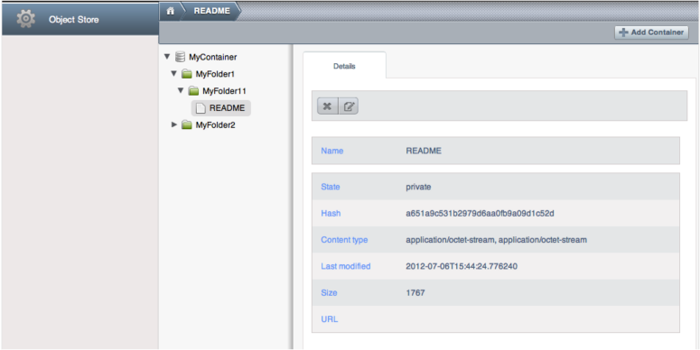
Let’s jump right in
Swift UI integrated into CloudStack

Slide 5


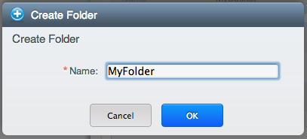
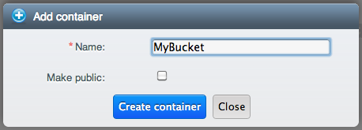
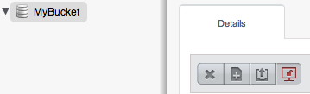
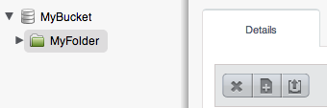
Some Examples

Slide 6


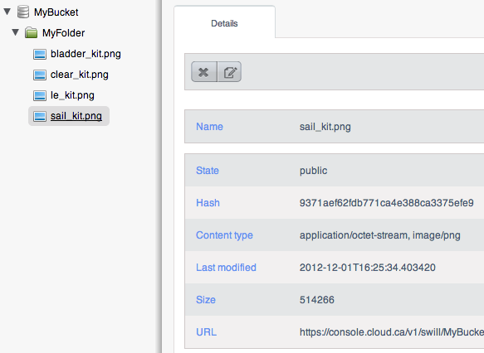
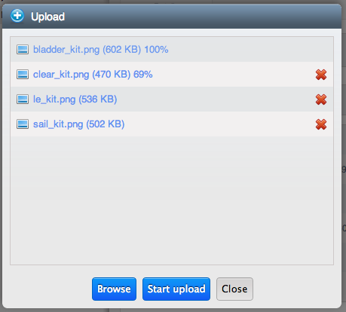
Some Examples

Slide 7
The Basics
Two main components of the implementation
  The actual UI for Swift integrated into CloudStack
  The Swift auth middleware which allows Swift to authenticate against CloudStack users

Slide 8
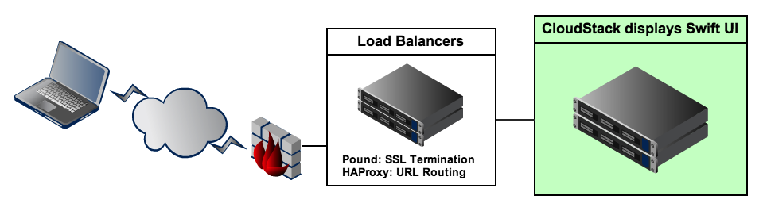
The Swift UI
The Swift UI is integrated directly into the CloudStack UI
Development sponsored by CloudOps
We are in the process of Open Sourcing

Slide 9
The Swift UI
Implemented entirely in the UI, no Java
Thin JS wrapper around the Swift API
Supports public and private containers
Supports virtual directories
Supports cascade deletes
Multilingual support
Cross browser support using Plupload
(Requires some configuration in HAProxy)

Slide 10
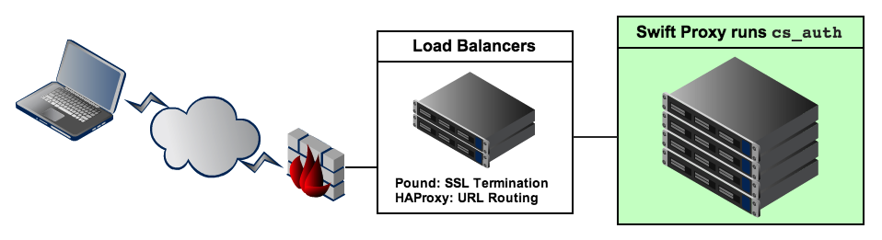
Swift Authentication
Swift auth via cs_auth or mauth
I developed these at CloudOps
Get the code at: github.com/cloudops

Slide 11
Swift Authentication
Both cs_auth and mauth enable Swift to authenticate CloudStack users
mauth is extensible, CS is the default
Caches CS users to limit network usage
No syncing of users between systems
Role based ACL, including public access
Supports the S3 API through swift3

Slide 12
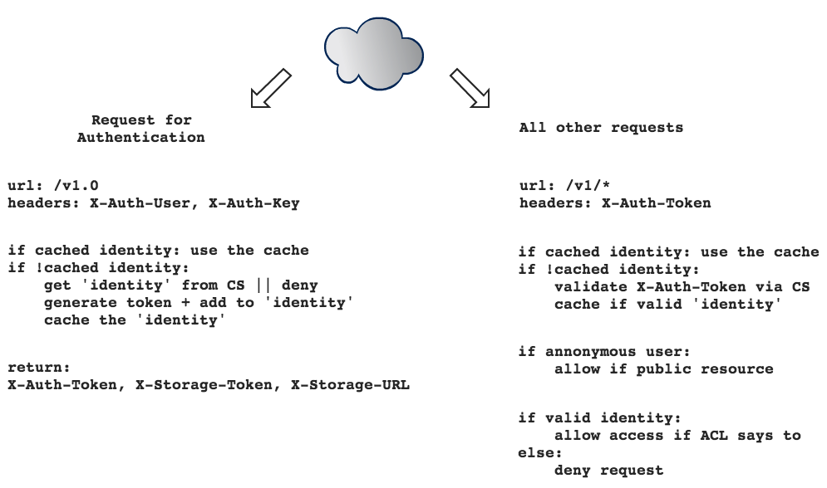
Swift Auth Flow

Slide 13
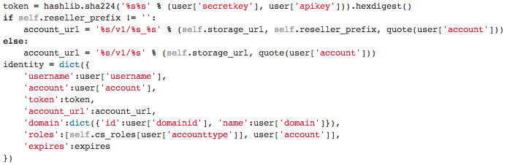
The ‘identity’

Slide 14
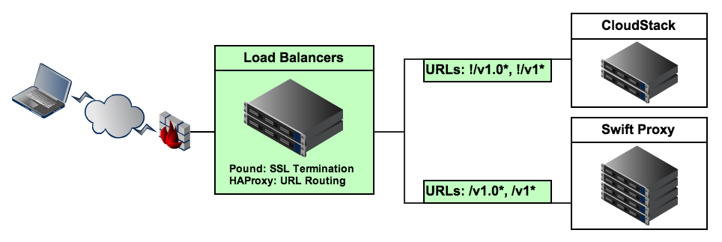
Load Balancer Tweaks
URL routing with HAProxy
  Handles both CloudStack API and Swift API
  URLs starting with /v1.0 and /v1 go to Swift
  All other URLs go to CloudStack

Slide 15
Load Balancer Tweaks (haproxy.cfg)
Browser support for PUT requests
frontend Public-HTTP
mode http
bind *:80
acl swift_path path_beg /v1 /v1.0
use_backend swift if swift_path
default_backend cloudstack
backend swift
mode http
server swift_proxy_1 10.100.1.100
server swift_proxy_2 10.100.1.101
option httpchk
reqirep ^POST\s+(.*)$ PUT\ \1
backend cloudstack
mode http
server cloudstack 10.100.1.50:8080

Slide 16
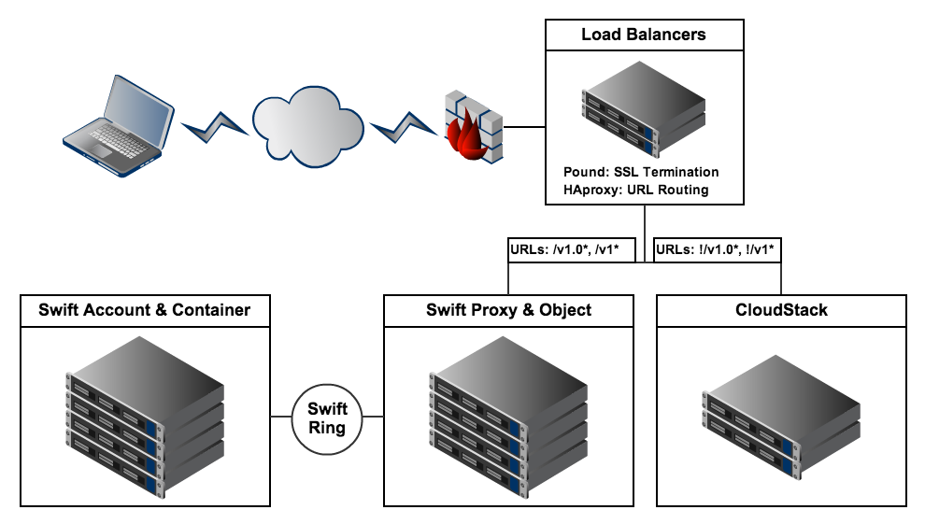
The Final Configuration
Putting it all together

Slide 17
Questions
?
Will Stevens
Email: wstevens@cloudops.com
Company: www.cloudops.com
Blog: www.swillops.com
Twitter: swillops

