Slide 1
ATS Lua Plugin
Kit Chan (kichan@yahoo-inc.com)
Notes:
Hi, My name is kit.

Slide 2
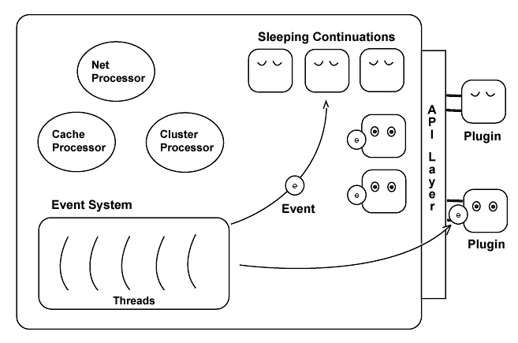
Apache Traffic Server [1]
ATS - fast, scalable and extensible HTTP/1.1 compliant caching proxy server
C APIs
  Http Header Manipulation
  Http Transaction
  Statistics
  Management
  More!!!

Slide 3
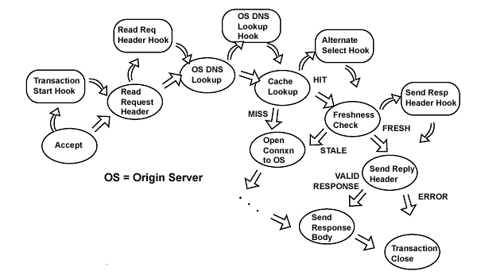
Hooks & Plugins [1]
Plugins – implemented as Continuations
Triggered into Activity through Hooks attached to various state of HTTP transaction

Slide 4
Writing Plugins
Continuation is hard to follow
  “Gotos with arguments” [2]
C/C++ code
  Memory management
  Complex data structure
header_rewrite plugin [3]
  Attempt to save you from writing plugins for simple tasks
  Use config files to do simple tasks, such as adding/removing headers
  No unit test framework
  Hard to use – not a real language
# sample header_rewrite conf
# add Cache-Control header
cond %{READ_RESPONSE_HEADER_HOOK} [AND]
rm-header Cache-Control
add-header Cache-Control “max-age=0, public” [L]

Slide 5
Varnish & VCL
Varnish [4] – another popular HTTP caching proxy server
  Major competitor to ATS
VCL [5] – Varnish Configuration Language
  DSL to configure Varnish
  Things you can do
    “direct certain requests to certains backends”
    “alter the requests and the responses”
  Major advantage over others !!! [6] [7]
//sample VCL to
//remove cookie from image reqs
sub vcl_recv {
if (req.url ~ "^/images") {
unset req.http.cookie;
}
}

Slide 6

Leveling the Playing Field – Lua [8]
Scripting Language
  Simple to learn and use
  Abstract user from variable types and memory management
Light weight library ~ 200KB
Extensible through C APIs
Easy to be embedded into applications, such as ATS
Uses – Redis, MySQL Proxy, many game engines

Slide 7
Plugin Implementation Details
ATS C APIs are exposed as Lua Functions under the ‘ts’ module
  Loaded as library to the core
When ATS starts,
  ATS Creates and inits Lua VM
  Load the specified Lua script and registered its global functions and variables in Lua VM
  Register hooks with specific or designated functions in the Lua script
During a HTTP transaction handled by ATS,
  Registered Lua functions for HTTP transaction hooks will be triggered

Slide 8
More Details
Open Source
  Contributed by Yahoo and Taobao [9][10]
  Adoptions by community is increasing
Documentation [11]
ATS 4
  Required lua 5.1.4 shared library
ATS 5
  Luajit 2.0.3 [12] is compiled into ATS core
  Compatible with lua 5.1.x
  Luajit has better performance but a 2GB limit on memory
Notes:
PANIC: unprotected error in call to Lua API (not enough memory)

Slide 9
Sample Lua Scripts for ATS
-- Lua script to add CORS header to response
-- for a request with matching Referer header
function send_response()
if ts.ctx['origin'] == nil then
ts.debug("invalid referer");
else
ts.client_response.header['Access-Control-Allow-Origin'] = ts.ctx['origin']
end
return 0
end
function do_global_read_request()
local referer = ts.client_request.header.Referer
if referer == nil then
ts.ctx['origin'] = nil
else
ts.ctx['origin'] = string.match(referer, "http://%a+.yahoo.com")
end
ts.hook(TS_LUA_HOOK_SEND_RESPONSE_HDR, send_response)
return 0
end

Slide 10
Coding Guidelines
Due to the 2GB limit with luajit, we should not keep large amount of data in arrays
Functionality should be grouped in module
-- cors_lib.lua contains module for adding CORS resp header for a request with matching Referer header
local cors_lib = {}
function cors_lib.send_response()
ts.client_response.header['Access-Control-Allow-Origin'] = ts.ctx['origin‘]
return 0
end
function cors_lib.execute()
local referer = ts.client_request.header.Referer
if referer ~= nil then
ts.ctx['origin'] = string.match(referer, "http://%a+.yahoo.com")
if ts.ctx['origin'] ~= nil then
ts.hook(TS_LUA_HOOK_SEND_RESPONSE_HDR, send_response)
end
end
end
return cors_lib

Slide 11
Coding Guidelines
A main lua script can then be used to add these modules and use their function
-- main lua script to be refererd by ATS
-- read in the module defined in separate files
ts.add_package_path('/home/y/var/media/cors_lib.lua')
local cors_lib = require “cors_lib"
function do_global_read_request()
cors_lib.execute()
return 0
end

Slide 12
Unit Test Framework
Using lunit [13]
Need to provide stubs/mocks for functions in ‘ts’ module (ts.lua)
require "lunit"
ts = require 'ts'
local cors_lib = require ‘cors_lib'
module( “cors_testcase", lunit.testcase )
function test_failure()
ts.client_request.header[‘Referer’] = ‘http://news.yahoo.com’
cors_lib.execute()
assert_equal(‘http://news.yahoo.com’,
ts.client_response.header[‘Access-Control-Allow-Origin
‘Matched’)
end

Slide 13
Performance Implication
Test setup
  proxying 6K object for Origin server with sufficient capacity
  header_rewrite / lua scripts provided to add response header
Performance Implication is negligible
 | Requests/s | Latency (ms) | CPU Util
ATS4 (No Plugin) | 5494 | 25 | 85%
ATS4 with header_rewrite | 5791 | 25 | 90%
ATS4 with Lua | 5776 | 27 | 90%
ATS5 (No plugin) | 5676 | 33 | 93%
ATS5 with header_rewrite | 5213 | 30 | 95%
ATS5 with Lua | 5210 | 35 | 95%

Slide 14

Futures
Short term
  More Lua functions covering more ATS C APIs
  Security/Sandbox/safety?
  More performance analysis – when will GC run? / Best Practices
Longer term
  Deeper integration with the ATS core for Lua
  Replace configuration files for ATS

Slide 15
Refereces
ATS - https://docs.trafficserver.apache.org/en/latest/sdk/how-to-create-trafficserver-plugins.en.html
Computational Continuations - http://www.jquigley.com/files/talks/continuations.pdf
header_rewrite - https://docs.trafficserver.apache.org/en/latest/reference/plugins/header_rewrite.en.html
Varnish - https://www.varnish-cache.org/
VCL - https://www.varnish-cache.org/docs/4.0/users-guide/vcl.html
http://www.slideshare.net/bryan_call/choosing-a-proxy-server-apachecon-2014 (Slides 47)
http://www.bizety.com/2014/06/11/interview-founder-of-varnish-software/
Lua - http://www.lua.org/
TS-2335 - https://issues.apache.org/jira/browse/TS-2335
TS-2555 - https://issues.apache.org/jira/browse/TS-2555
ATS Lua Pugin Documentation - https://docs.trafficserver.apache.org/en/latest/reference/plugins/ts_lua.en.html
Luajit - http://luajit.org/luajit.html
Lunit - http://www.mroth.net/lunit/

