Slide 1

Apache Traffic Server
Cache Toolkit API

Slide 2
Speaker
Alan M. Carroll, Apache Member, PMC
  Started working on Traffic Server in summer 2010.
  Implemented
    Transparency, IPv6, other stuff (like cache!)
  Works for Network Geographics
    Provides ATS and other development services

Slide 3
Outline
Basics of the current cache and API
The Cache Toolkit API
In practice – using the toolkit to build solutions to current user issues.

Slide 4
CURRENT CACHE AND API
What do we have now?

Slide 5
Cache Structure
Cache span – storage on a specific physical device or file.
Cache volume – administrative unit of cache storage
Cache stripe – intersection of cache span and cache volume
Notes:
Expect cache volumes to become increasingly obsolete, but have the problem of how to split spans in to stripes without them.

Slide 6
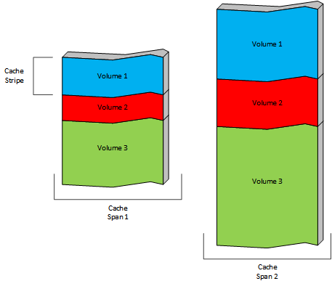
Spans, Volumes, Stripes
The default is to split each physical span in to a stripe for each volume. The volumes can be differently sized leading to differently sized stripes. The stripes are not currently visible from outside the ATS core, administrative control is of volumes.

Slide 7
Stripes
Cache stripes are the internal base storage.
Each stripe has its own directory of objects.
Object storage is a circular buffer.
Each object is stored entirely in a single stripe.

Slide 8
Stripe Assignment
Storing an object requires selecting the stripe. This is called stripe assignment.
Reading an object requires remembering where it was assigned for writing.

Slide 9
Keys and IDs
Each object has a cache key which is a string.
  Default is the URL for the object.
Cache keys are hashed to create a cache id.
The cache id is used as a locator in a stripe directory.
Stripe assignment is independent of cache keys and cache ids.

Slide 10
Notes
Cache misses are usually fast, no I/O required.
Objects can be evicted from cache due to overwrite via the circular buffer.
  But, no fragmentation or GC issues.
  No concept of “full” or “empty”.
Data is never updated, only written anew.

Slide 11
Fragments
Serialized object data is stored in a fragment.
Fragments are grouped for write if small but read individually.
Each fragment has a Doc which is the header.
All metadata for an object is stored in the first fragment.
Every stored fragment has an entry in the stripe directory.

Slide 12
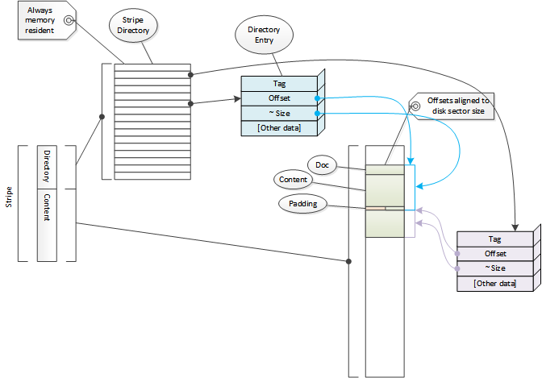
Stripe Directory

Slide 13
Large Objects
Large objects are stored in multiple chained fragments in a single stripe.
  There is a target maximum fragment size
Because an object is always in a single stripe, object size is limited by stripe size, not volume size.
  Therefore also by cache span size.
  Therefore adding disks doesn’t let you store larger objects, only more objects.

Slide 14
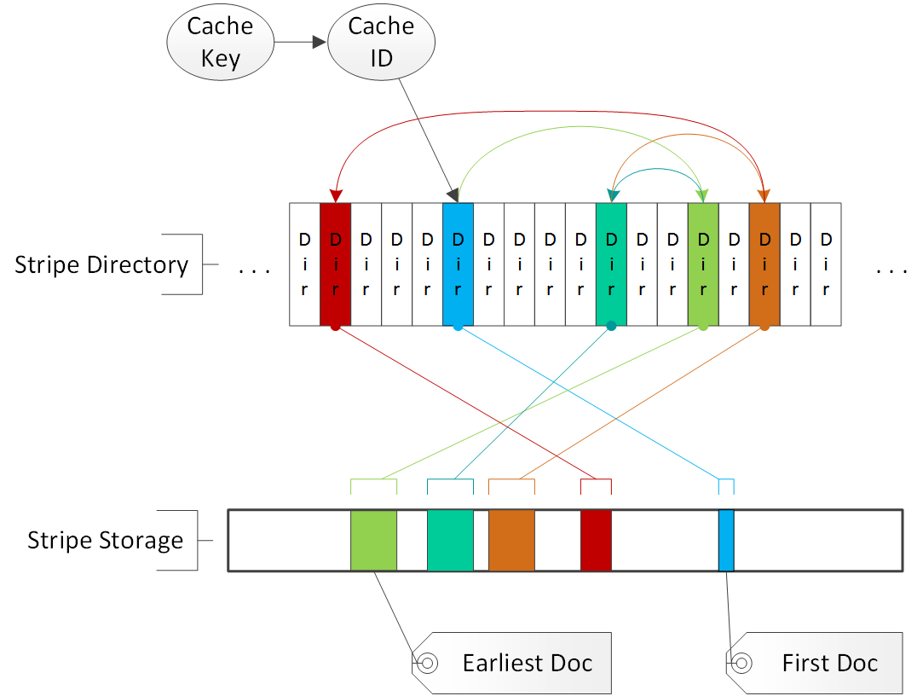
Multi-Fragment Object
The cache key is converted to a cache ID which is then used to locate a directory entry (“Dir”). This in turn is used to locate the first fragment with the metadata (“First Doc”) for the object. “Earliest Doc” is the first fragment with content. Each alternate has a different Earliest Doc.
Notes:
First Doc and Earliest Doc can be the same fragment only if the object has only one alternate and only one fragment.
The directory ordering is arbitrary (hash) but the storage layout is representative.

Slide 15
Alternates
An object can have multiple stored versions.
Each version is an alternate.
Alternates default based on the Vary field.
  Can be changed via configuration or plugin.
Alternates have the same first fragment but different earliest fragments.

Slide 16
Current API
Cacheability.
Cache key.
Alternate selection.
Limited ability to scan objects.
  Metadata (HttpInfo) API appears unimplemented.
No access to cache data structures.
Notes:
Scan is only across the entire cache. Access to header information

Slide 17
API Problems
Can’t interact with stripes.
Very limited inspection of cache state.
Unstable, partially implemented, and undocumented.

Slide 18
Cache Toolkit API
What to build

Slide 19
Motivations
Inadequacies of current API
Traffic Server increasingly used in more specialized / vertical ways
  Leads to desire for very custom extensions
Always good to get increased code cleanliness and modularity
  Mechanisms used for the API can also be used by the core for better modularity.
Notes:
A problem with maintenance is it doesn’t end, even if the original developer switches to new / different technology.
For testing it is about testing in situations where the developer doesn’t need it to work at all, and if no one else is going to use it, that’s entirely wasted effort.

Slide 20
Demotivations
Users don’t want
  Extra testing and design for the general case.
  Constantly porting changes to new versions.
  Publishing code
  Legacy maintenance
  Hiring expensive expertise like me
We don’t want
  Code complexity used in just one deployment
  Similarly for configuration complexity
Notes:
Really, expensive expertise like me should be just “me”. There’s no other expert on the ATS cache. So I suppose the reluctance might not be only the money.

Slide 21
Back Story
History
  Started as tiered storage design effort.
    Initial concept at previous ATS Denver Summit.
  Presented at Yahoo! ATS Summit.
    Everyone wanted different tiered features.
    Then they wanted different cache features.
Since I made the mistake of learning a little bit of how the cache worked, I was assigned to do this.
Notes:
I found out what an “active” community was at that summit.
I like minimalistic, orthogonal base APIs with more complex things layered on top.

Slide 22
A Brilliant Idea
Avoid these issues and get the good stuff with a general (“toolkit”) API for the cache that can be used with plugins.
    “Brilliant!” – Leif
    “Supremely clever!” – Brian
    “Inspired!” – James
    “Is it done yet?” - users

Slide 23
Goals
Make cache state, data, operations visible.
Override cache actions dynamically.
Initiate cache actions.
Provides the tools for users to build the cache feature they want.
Notes:
Emphasize loop between abstract design and user / community requirements and feedback.

Slide 24
Visibility making what was unseen visible
Expose internal structures
  Directories, directory entries.
  Cache volumes, disks, stripes.
Opaque pointer with accessor functions.
  Plugin gets pointer then calls functions for data.
Iteration functions for search.
Useful itself but also required by rest of API.

Slide 25
Hooks
Getting in to the action
Cache events
  Wrap, disk fail, life cycle, etc.
Object events
  Directory miss, disk miss, evacuation, delete (?)
Special case support for pure statistic hook?
Stripe assignment.
Notes:
This is a blend of both visibility and overriding cache operations. Being able to do interesting instrumentation in hooks is a key part of cache visibility.

Slide 26
Stripe Assignment
Stripe assignment controls accessibility and storage for objects.
Parallel write.
Parallel search on multiple stripes for read.
  Callback per read complete, can accept or wait.
Retry option for read
  Sequential stripe searching.
  Alternate key searches.
Notes:
Seems somewhat trivial but enables very powerful capabilities.
Really the heart of the entire project.

Slide 27
Cache Operations
Copy objects from stripe A to stripe B
  More efficient to parallel store if possible
Probe, delete directory entries.
Evacuation marking.
Read, write cache objects.
Alternate control.

Slide 28
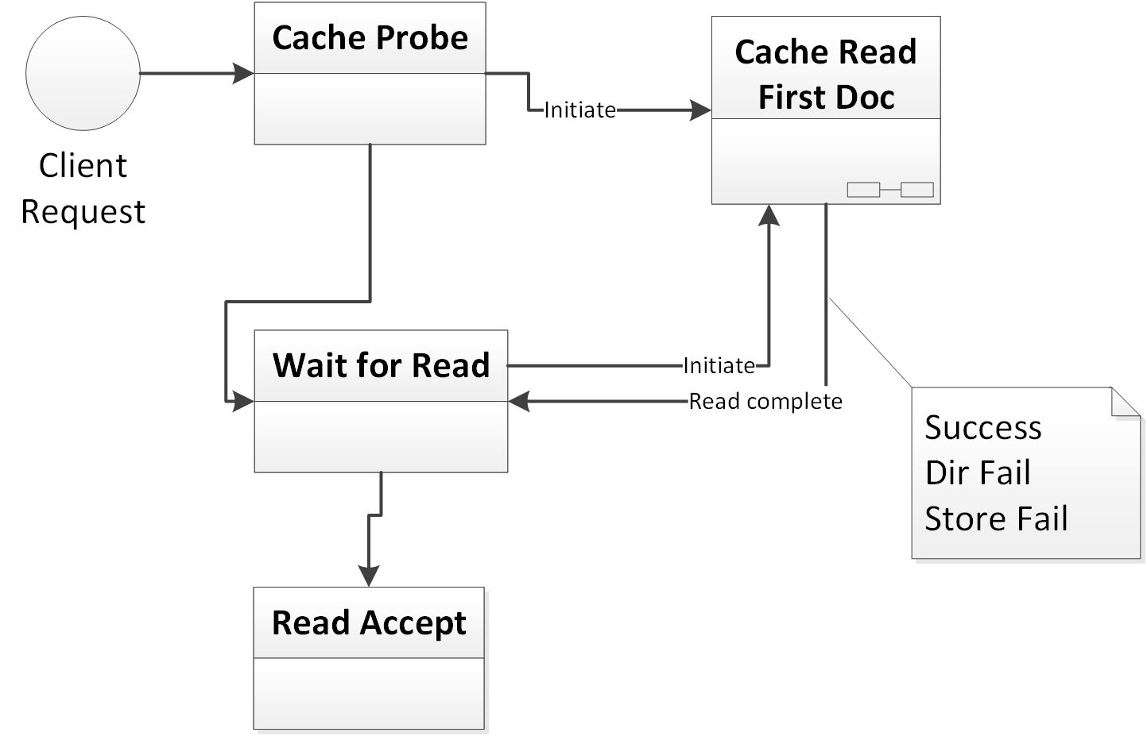
Reading from Cache
The plugin is called once the client request has been parsed. It should then initiate cache reads (or fail and mark the request as a cache miss).
When a read completes the plugin can accept that as that source for a cache hit, discard the read, and/or initiate additional read operations. The plugin can reject any completed read as a miss.

Slide 29
Miscellaneous
Allow storage and volume definitions to have key/value pairs that are visible to the API.
Cache key / ID control
  General string input.
  Alternative hashing.
Enable stripes made out of ram.
  Potentially run no-disk cache.
Notes:
Integrating the ram cache makes tiered storage even better.

Slide 30
Use Cases
Out in the fields

Slide 31
Awesome Yet Practical
Not just a cool API, but useful for actual deployment problems!
Design was use case driven.
So let’s look at some of them.
Notes:
Iptables –list -v -x # –vv for lots of data
Ebtables –t broute –L –Lc
Tcpdump –w <file>

Slide 32
Monitoring
Problem: Can’t optimize cache use if we have no knowledge of what’s happening
How much of my content is still valid?
How many directory misses with disk I/O are occurring?
What is the average chain length in the directory?
How are objects distributed across stripes?
Notes:
This is a big deal for users who want to get the most out of their cache.

Slide 33
Monitoring
Solution: Use API to explore / monitor cache state.
  Hooks to
    Watch for interesting events.
    Generate statistics.
    Generate logging data for post processing.
  API to examine raw cache state
    One off plugins for debugging.
    Build external tools for examination.
    (product idea, don’t steal!)

Slide 34
Annotation
Problem: want better information about cache contents.
Monitoring can be used to accumulate more extensive data about cache contents.
  Live information.
    TS data.
    Custom tags/tables.
  Offline log processing.
Notes:
Custom tags & tables can be used to provide alternative lookup mechanisms, or even things like tagged purge.

Slide 35
Tiered Storage
Problem:
  Two or more types of storage of significantly different access speeds.
  Want to control content location
Solution:
  Create cache volumes based on storage type
  Assign objects to stripes based on type of object and stripe storage.

Slide 36
Tiered Storage 2
Can use multiple write to store on multiple tiers.
  Demoting means just delete in directory (no I/O)
Can still copy if needed.
Can search tiers in parallel or serial

Slide 37
Persistence Control
Problem: some content should be kept for long periods, longer than a stripe wrap.
Solution: segregate content by persistent vs. transitory across stripes.
  Large stable objects only evicted by other large stable objects, not small temporary objects.
  Can read failover from long term to short term
  Potentially do generational GC

Slide 38
Cache Key Flexibility
Problem: Cache lookup commits to a single stripe.
  Variant keys can causes misses
  Any change in stripe assignment hides objects
Solution: Use parallel read or retry
  Read from a different stripe
  Use a different key
Notes:
Need to be able to retry as late as right after alternate selection – select “retry” instead of any alternate

Slide 39
Large Hot Objects
Problem: A small number of large objects that are frequently accessed, causing excessive disk load on a stripe.
Solution: Write the objects to multiple stripes and use stripe assignment to rotate access across the stripes.

Slide 40
Export
If you can examine the cache via an API, you can export it.
Cache state is becoming valuable to many users, export can preserve or copy it.
Import can be done without changes, if with difficulty
  But should try to make it easier
Notes:
Import can be done via PUSH, or synthetic fetches. Annoying but doable. Export in contrast is effectively impossible with the current release.

Slide 41
Cache Cleaning
Problem: clean non-stale objects
Solutions:
  List of URLs (or URL regex) to purge.
  Force cache miss on read if URL match.
  Background scan to pre-emptively delete.
Note: This can be done in the current API. It will just become much easier.

Slide 42
Appendix
Scripts and Resources

Slide 43
State of Development
Some work has been done on prototyping some of the features.
  Learned much about the cache implementation
Design is mostly finalized.
Positive response so far from the community.
Project is funded by Comcast.
Development should start late spring this year.

Slide 44
Versioning / Custom Metadata
Speculative feature!
Fragment type is not really used currently
  Overload it to allow custom parsing of metadata
  Use it to version objects/stripes.
    Need _flen too, but that’s OK.
This would be quite complex
  Need API to unpack alternates.

Slide 45
Resources
ATS has online documentation, a wiki, mailing lists, bug tracker, and IRC channel. Access these via
  http://trafficserver.apache.org
Active community – become involved!
NG Consulting services
  http://network-geographics.com

