Slide 1

Apache Traffic Server
Extensible Host Resolution

Slide 2
Speaker
Alan M. Carroll, Apache Member, PMC
  Started working on Traffic Server in summer 2010.
  Implemented
    Transparency, IPv6, range acceleration, yada yada yada
  Works for Network Geographics
    Provides ATS and other development services

Slide 3
Outline
Current state of things.
Design and Implementation.
  Not just an API upgrade.
Example extensions / use cases.
Notes:
Design driven by trying to make sure use cases could be implemented.

Slide 4
HostDB / DNS
Current status

Slide 5
Resolution Services
Resolve host names (“FQDN”) to IP addresses.
  “Fully Qualified Domain Name”
HostDB caches resolutions for performance.
  Persistent across process restarts.
DNS performs DNS queries (packet level)
Partially handles some additional features
  Round robin
  Split DNS
Handles IPv4, IPv6, SRV to some extent.

Slide 6
Host Resolution
HTTP state machine creates query for FDQN.
HostDB does look up and returns data if found.
Otherwise the query is passed to the DNS and a network query is done.
HTTP state machine gets raw data, handles server retries and round robin.

Slide 7
What’s the point?
High performance is not possible if doing a DNS query for every transaction.
Need more control than available from standard OS host resolution calls.
  Control latency / retries.
  Non-blocking.
  May require specialized DNS for Traffic Server.
Notes:
By “specialized” I mean Traffic Server may need to interact with DNS in a way different from the host OS.

Slide 8
What’s the problem?
Short answer – it’s a mess.
Resolution logic is spread between transaction state machine and HostDB.
  Example: had to change SM for TS-1422
Little modularity inside HostDB.
Mishmash of data structures for IPv4, IPv6, SRV records segregated by hash fiddling.
Notes:
Record types separated by playing games with the hash. No one really understands how the code works.
TS-1422: Apparent DOS with transparency and dead server.

Slide 9
More problems
Very difficult to upgrade or change
  Logic is hardwired, not accessible via any API
    This means changes require expertise in ATS core.
  Few configuration options.
Fixed sized heap allocation
  Configured at process start.
  Must configure size and count (inode problem).
  Bad things happen if size exceeded.
Notes:
It’s personal as well, I get tagged with most of the problems in this area.

Slide 10
Doing Better
Remove address resolution state from HTTP state machine.
Plugin address provisioning.
  Customized DNS querying.
  Other address sources (file/database/YP/etc.).
Filter and re-order addresses.
Extensible data associated with addresses or FQDN.
Remove requirement for core expertise.
Notes:
Filtering and re-ordering is the most desired feature by users.
Added /etc/hosts support, made me want to rewrite this all.
Extensible data is also a big issue, makes moving core to plugin easier.

Slide 11
Host Resolution Architecture
Take a bow for the new Resolution

Slide 12
Style
API
  Minimal.
  Orthogonal.
  Consistent.
No limits on extensions.
Maintainable.
Clean separation of framework from function.

Slide 13
Features
Plugins for host resolution.
  Access to external address data.
  Filtering and control of resolved addresses.
Simple interface for HTTP state machine
  Generator / forward iterator style.
Maintain current functionality, modularized.
Minimize performance loss.
Asynchronous.
Notes:
One feature that may be dropped is persistence.

Slide 14
Design Elements
Framework – Traffic Server core.
Host Query Database – Traffic Server core.
Host Resolution Provider – plugin.
Host Resolver – rooted tree of providers.

Slide 15
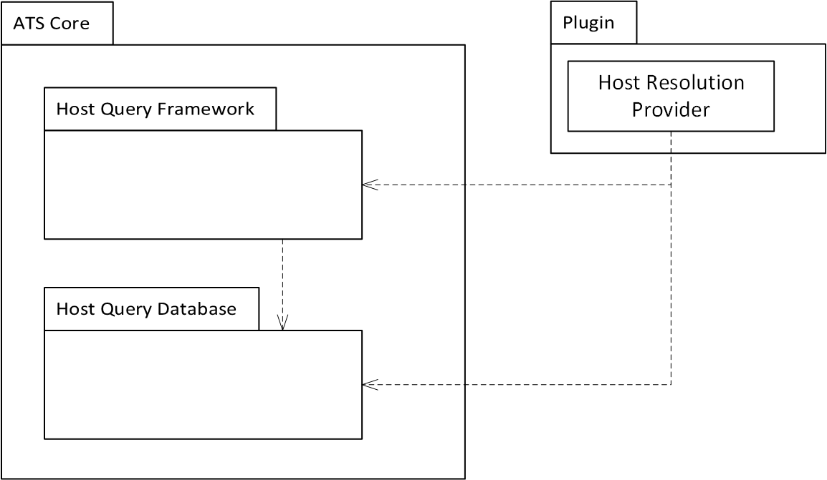
Package Layout
The ATS core has the framework and the HQD. Providers are contained in user created plugins.

Slide 16
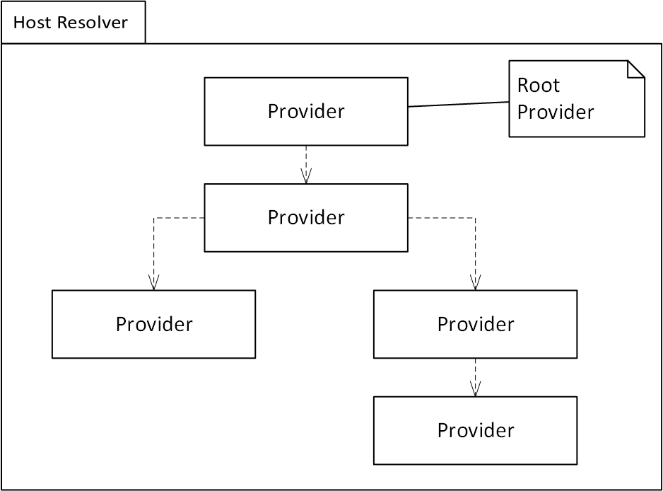
Host Resolver
A host resolver is a tree of providers with a root. The root serves as the external interface of the resolver.

Slide 17
Host Query Database
Indexed by FQDN.
Record is set of key/value pairs plus fixed metadata.
Plugins must register keys.
Values are plugin formatted, opaque to framework.
Expiration / reaping by framework.
Notes:
Limiting HQD size is critical for forward proxies.

Slide 18
Host Query Database 2
A process persistent store
  Each provider can store data in a record.
  This is similar to what is done now but more elegantly, explicitly, and extensibly.
A communication channel.
  Values are cooperative data – no access controls.
  Providers are expected to share data via the HQD.
    Core plugins will document value format
Notes:
Example from later slides – a DNS provider will store its results in the HQD and higher level providers will retrieve those results from the HQD.
Historical Note: The original design was to have uniform API so that each provider would pull addresses the same way the state machine does but it just doesn’t work well in practice – it would be very common to grab all addresses immediately and store them independently, which is ugly.
Overall the HQD solves multiple problems and simplifies the overall API.

Slide 19
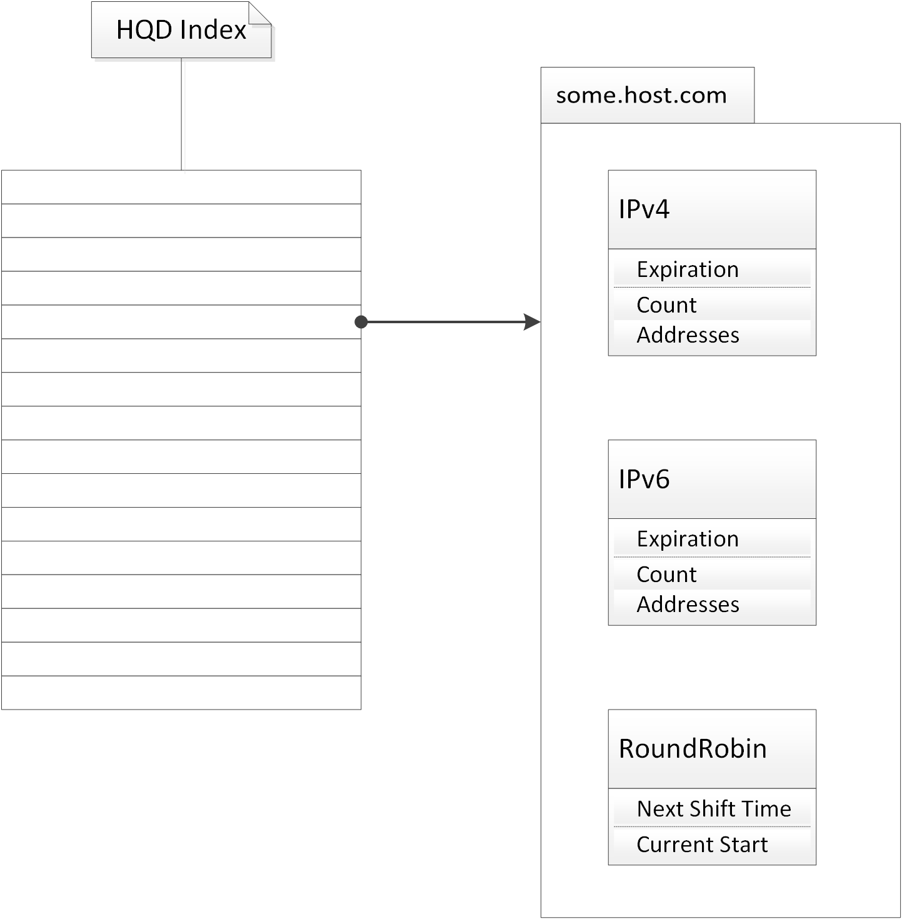
HQD Record
Simple hash table mapping from FQDN to a set of key / value pairs.

Slide 20
Provider
Interface between framework and plugin.
  Framework calls the plugin via provider instance.
All providers must have the address iterator interface.
Provider state.
  Plugin globals.
  Provider instance.
  HQD record.
  Query in HTTP state machine.

Slide 21
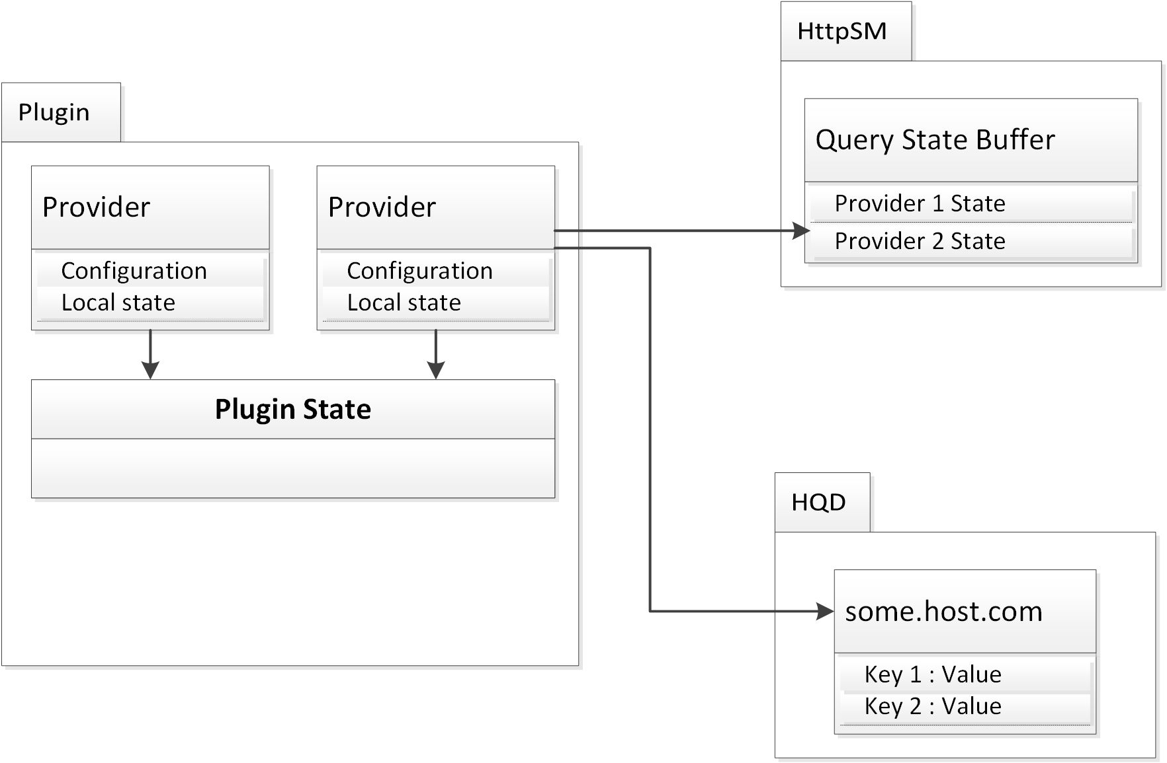
State data diagram
Providers can access data in the plugin (dynamic library) and any internally defined local state. Data for the FQDN of the query is available and a fixed amount of space in the HTTP state machine (transaction) instance.

Slide 22
Provider Instance State
Support multiple instances of the same underlying provider with distinct configuration.
Expected to be relatively inexpensive to have multiple instances of a provider.
Notes:
Example: The nameserver for a DNS instance.

Slide 23
Provider Query state
Need state for each query.
Want to avoid allocation, even class allocator.
Most providers should need a fixed amount of query state.
Provider must export amount of query state required.
Notes:
Very similar to class memory layout logic.

Slide 24
Framework Query State
Therefore – we can provide a static buffer in the state machine instance for the query.
  Buffer size build time configurable.
  Obvious error message if exceeded.
  Dynamic storage must be allocated.
Framework handles doling out memory to each provider.
Framework will call provider for cleanup.
Notes:
Note: As noted, the query state data is expected to be fixed size.

Slide 25
Resolver
Resolver is a rooted tree of providers.
HTTP State machine talks to root provider.
Root provider can pass query to descendents.
Each provider has complete control of whether any descendent provider is used.
Providers share data via the HQD.

Slide 26
Query Actions
State machine initiates query by invoking framework.
Framework locates the HQD record and passes it and the query to root provider.
Root provider can provide addresses out of current data or make requests to descendents.
Framework also sends
  IP family preference.
  ATS HTTP Transaction handle.

Slide 27
Query Results
Root provider streams addresses to HTTP state machine.
HTTP state machine gets addresses as needed.
  Provider can defer decisions until asked.
TBD: does state machine provide feedback to provider on failed addresses?

Slide 28
Asynchronicity
Provider can return “blocked”.
Therefore queries forwarded to descendent providers can block.
Provider can forward multiple blocked queries to different descendent providers.
  This is how parallelism is done.
Provider “resume” called for each completion on ancestor providers of blocking provider.
Notes:
Can forward multiple times to the same provider but this is not useful and difficult to handle.

Slide 29
Asynchronicity 2
Provider that blocks handles continuation and resumption.
Must notify framework of resume.
Framework calls standard “resume” method on ancestor providers.
The “resume” method can return “blocked” to indicate the framework should wait for further continuation completions.

Slide 30
Locking
Global lock for HQD for table lookup/modify.
Per record lock for local access.
Lock is held for query by framework.
Lock is released if root provider is blocked.

Slide 31
Expiration
Expiration time for record in fixed metadata.
Providers can record additional timeouts.
Providers control whether stale data is used.
Framework cleans up expired records not in use.
  Serious issue for forward proxies.

Slide 32
Open HQD
HQD API is available to any plugin.
Intended for external address control not directly involved with host resolution.
  E.g. external updates to propagate to HQD.

Slide 33
Persistence
Not in standard / default configuration.
Can be useful for quicker restarts.
  More useful for reverse proxies.
Requires either
  Persistence of HQD key registration values.
  Key / ID table and conversion on load.

Slide 34
Core Providers
DNS
Host file
Round robin
Failover
Split DNS

Slide 35
Resolver Examples

Slide 36
DNS
Performs DNS queries to an external resolver.
Stores results in HQD under ‘ipv4’ or ‘ipv6’
Provides addresses in order of returned record.
Each provider locked to a specific name server.
Notes:
Iptables –list -v -x # –vv for lots of data
Ebtables –t broute –L –Lc
Tcpdump –w <file>

Slide 37
Host File
Loads standard Unix host file to HQD.
Handles external file update / synchronization.
  This is its main function.
Can act as pass through or an unaccessed leaf.

Slide 38
Round Robin
Cycles HQD address data.
Will forward to another provider for data.
Shift by time or query count.

Slide 39
Failover
Requires descendent DNS providers.
Monitors external query success.
Only uses one descendent at a time.
Shifts among descendents based on availability.

Slide 40
Split DNS
Requires descendent providers.
Returns data if found.
Otherwise selects descendent provider based on split rules.

Slide 41
Gatherer
Requires DNS provider.
Requests IPv4 and IPv6 addresses in parallel.
May also be used to parallel request across multiple DNS servers for performance.

Slide 42
Simple Load Balancer
Requires descendent providers for addresses.
Permutes address data based on balancing rules.
  Client IP address
  Query counts
  URL

Slide 43
Active Load Balancer
Requires descendent providers.
  Or not? Derive from load data?
Uses external data about current server loads.
  Store in global state or HQD.
Iterates addresses in inverse proportion to server loads.

Slide 44
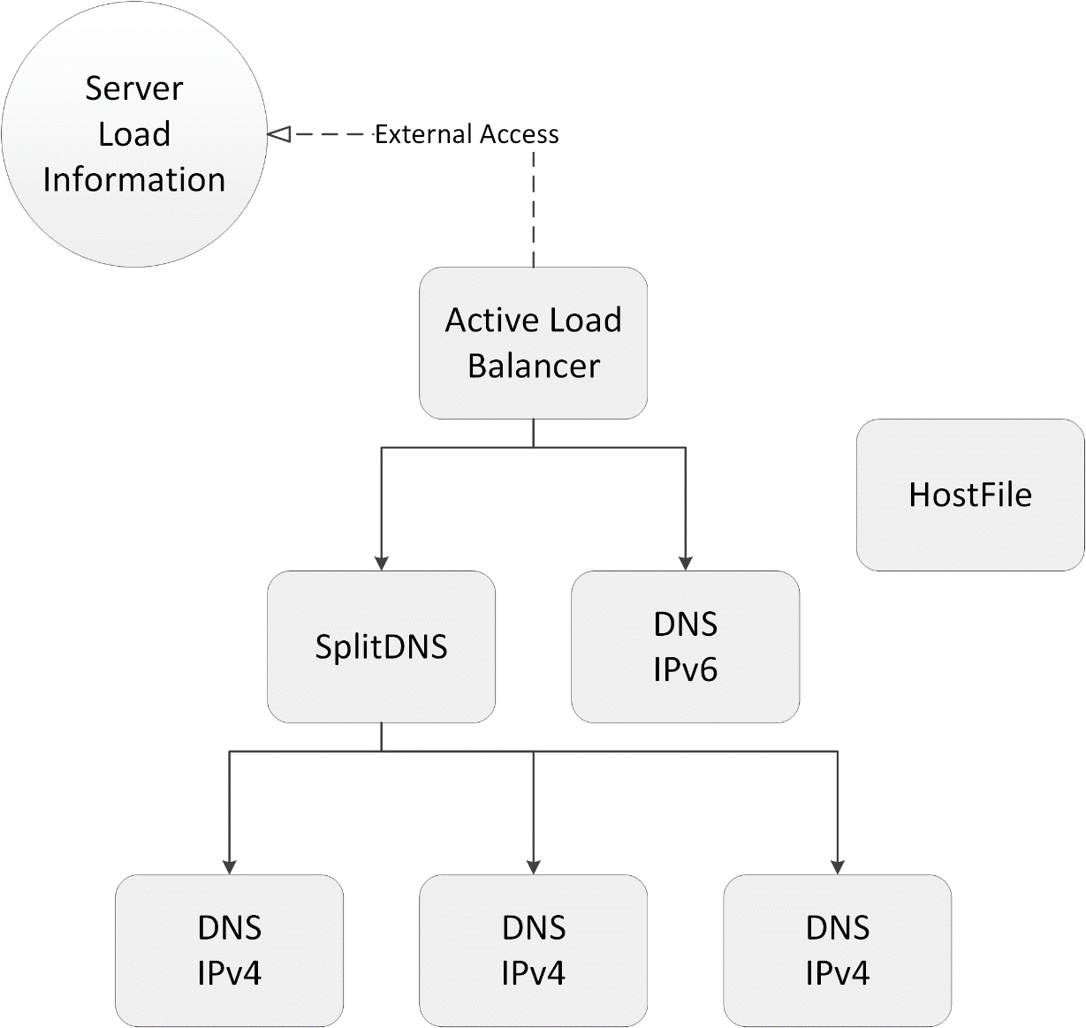
Resolver Structure
HostFile is used to inject the /etc/hosts files but otherwise not directly used.
IPv4 is done in parallel for performance and redundancy.

Slide 45
Walkthrough
Root provider receives query. It uses the HQD handle to check for address information but does not find any. It forwards the query to an IPv6 provider which returns “blocked”. The ALB then forwards the query to the SplitDNS. It decides to forward the query to one of its IPv4 providers. This also returns “blocked” which SplitDNS returns and then the ALB returns.
When the DNS plugin receives a DNS reply it calls the framework to resume query processing. The framework in turns calls “resume” on the appropriate DNS provider and up the ancestors of that provider.

Slide 46
Other
Fundamental point – all of these can be replaced by user without changes to core.
Users can build tweaked versions based on core provider plugin code.
  Much lower barrier to entry to work on plugin code vs. core code.

Slide 47
Appendix
descendent information address providers

Slide 48
Current Status
Basically this slideware.
  Overall design done
  Waiting for time / funding to begin implementation.
Thanks to Openwave for initial design funding.

Slide 49
Open Design Issues
Feedback from server connect fails
  Should the provider be told?
  Does iteration suffice?
Handling overlapping requests for same FQDN from different transactions.
Fixed metadata for records
  Expiration
  Last modified?
  Last accessed?

Slide 50
Open Design Issues
How is this configured?

Slide 51
Resources
ATS has online documentation, a wiki, mailing lists, bug tracker, and IRC channel. Access these via
  http://trafficserver.apache.org
Active community – become involved!
NG Consulting services
  http://network-geographics.com

