Slide 1
Yahoo’s Adventure with ATS

Slide 2
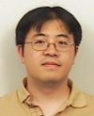
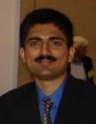
Who are we?
Kit Chan
Principal Engineer @ Yahoo
Working in Media group
Apache Traffic Server Committer
Vijay Prashanth Hosahithlu
Product Manager @Yahoo
Working in Edge Services group

Slide 3

http://www.strongchurch.org/wp-content/uploads/2013/06/corkscrew.jpg
Notes:
http://www.strongchurch.org/wp-content/uploads/2013/06/corkscrew.jpg
Introduction - What we want to talk about today
Disclaimer - While describing the history/timeline, we hope to leave emotions out and simply present the facts.

Slide 4

History - Inktomi
1998 - 2002
TS 2.0 - 1998, 3.0 - 1999, 4.0 - 2000
Customers - AOL, @Home
Interesting Use Case - Transcoding images to smaller sizes for AOL dialup users
Notes:
http://upload.wikimedia.org/wikipedia/en/b/b1/Inktomi.png
http://www.internetnews.com/gsearch/results?cx=partner-pub-8768004398756183%3A5295903031&cof=FORID%3A10&ie=UTF-8&q=inktomi+traffic+server&sa=Search&siteurl=www.internetnews.com%2FxSP%2Farticle.php%2F44591&ref=www.google.com%2Furl%3Fsa%3Dt%26rct%3Dj%26q%3D%26esrc%3Ds%26source%3Dweb%26cd%3D4%26ved%3D0CEQQFjAD%26url%3Dhttp%253A%252F%252Fwww.internetnews.com%252FxSP%252Farticle.php%252F44591%26ei%3Dq-ovU63gLtKFogSL_YH4BA%26usg%3DAFQjCNH65U_UgpLQ4EfhFdKOK9apUWhjCA%26sig2%3DTP6AjCi_b52ArfSpudwOiQ%26bvm%3Dbv.62922401%2Cd.cGU&ss=4572j1268488j24
http://en.wikipedia.org/wiki/Inktomi_(company)

Slide 5

History - YTS
2002 - 2010
Inktomi Acquired by Yahoo - late 2002 / early 2003
Renamed to YTS - Efforts resumed around late 2005
By Feb 2010, served 30 billion objects, 400 terabytes a day for Yahoo
Notes:
http://developer.yahoo.com/blogs/ydn/open-sourcing-traffic-server-700k-lines-code-9-7861.html
http://upload.wikimedia.org/wikipedia/commons/thumb/2/24/Yahoo%21_logo.svg/220px-Yahoo%21_logo.svg.png

Slide 6

History - ASF
2009 - 2010
Preparation - 700K lines of code change, 9 Months
Apache Incubator in July 2009
TLP in April 21, 2010
Notes:
http://developer.yahoo.com/blogs/ydn/open-sourcing-traffic-server-700k-lines-code-9-7861.html
https://www.apache.org/images/feather-small.gif
Pay tribute - Chuck, Leif, Bryan, Andrew, Vijay, Anirban and Miles, Yahoo Edge Team!

Slide 7
Improvement Opportunities
Performance - concurrent connections
Long tail latency - lock design
Extendability on state machine
Programmability - continuation, asynchronous model, plugin architecture

Slide 8
Experiment with Coroutine
Generalized subroutine allowing multiple entry points
Context Switch done explicitly by function call and much faster
Synchronous Programming for Plugins
Allow lock-free environment
pre
A
pre
state
post
pre
post
pre
D
state
post
pre
post
B
pre
state
post
post
pre
E
pre
state
pre
post
pre
post
C
state
post
post

Slide 9
YTS/ATS keeps growing in Yahoo!
2010 - 2013
6000+ nodes running YTS, 300+ nodes running ATS
Varied use cases including reverse proxy, forward proxy; caching; SSL termination; ESI; DoS protection
Squid, Nginx also with significant use

Slide 10
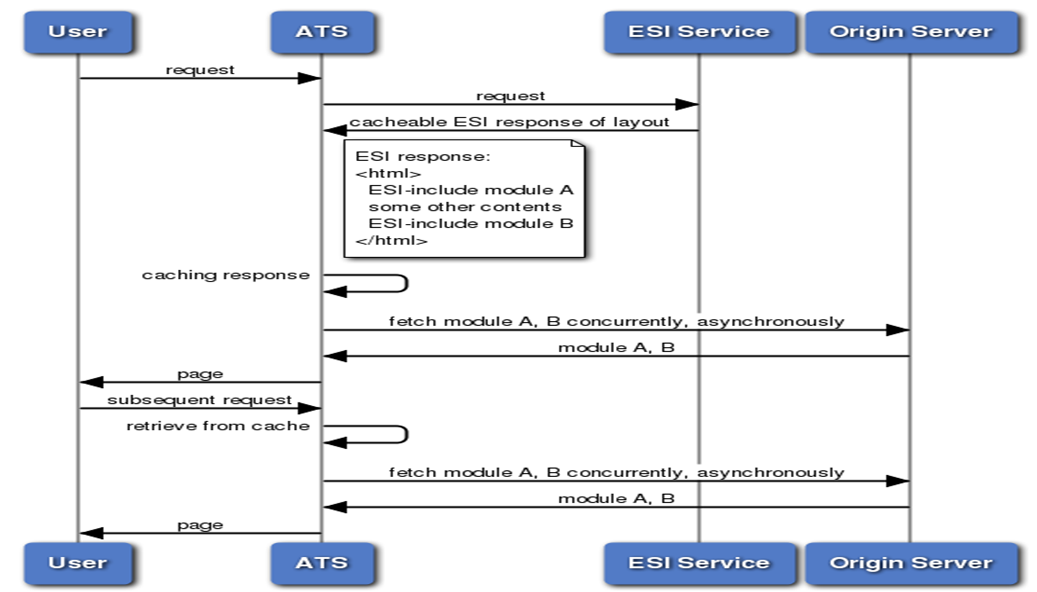
Use Case - ESI

Slide 11
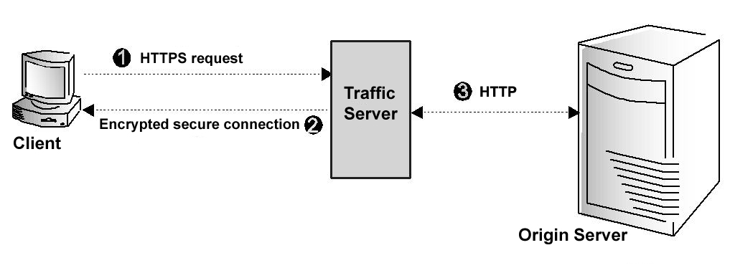
Use Case - SSL Termination
http://docs.trafficserver.apache.org/en/latest/_images/ssl_c.jpg

Slide 12
ATS keeps growing better
2010 - 2014
Performance improvements: 64-bit, gzip, SSL session tickets
Stability improvements: Memory management, Custom logging
Cache enhancements: Clustering, SSD
Protocol support: Web sockets, NPN, SPDY
Security enhancements: PFS, HSTS
Notes:
add timeline

Slide 13
YTS/ATS becomes one in Y!
2013 - 2014
ATS standardized as the recommended caching proxy
Additional plugins: Stale While Revalidate, Stale If Error, CARP, SSL Session Reuse
4500+ nodes running YTS, 9500+ nodes running ATS and growing...

Slide 14
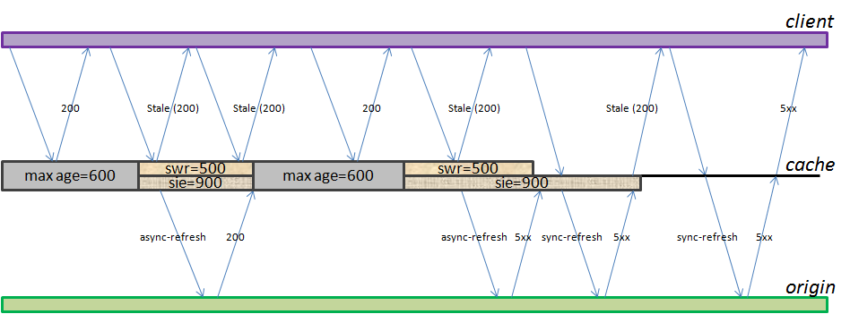
Use Case - SWR, SIE

Slide 15
ATS in Yahoo Today
2014
Hosted on thousands of nodes
Handles hundreds of thousands of requests per second
Serves hundreds of gigabits per second
Committers: 2
Contributors: 6 and growing

Slide 16
How should Business work with Open Source Software?

Slide 17
1) Open Source and Business Challenges & Opportunities

Slide 18


Time to Market/Cost of Development
http://www.sellbetter.ca/wp-content/uploads/2012/09/time-management.jpg
http://www.todayifoundout.com/wp-content/uploads/2010/02/gold-dollar-sign.jpg
Notes:
http://www.sellbetter.ca/wp-content/uploads/2012/09/time-management.jpg
http://www.todayifoundout.com/wp-content/uploads/2010/02/gold-dollar-sign.jpg
Is Open Source Development slow? Does it save my cost of development?

Slide 19

https://na.theiia.org/services/quality/PublishingImages/quality-blocks1.png
Notes:
https://na.theiia.org/services/quality/PublishingImages/quality-blocks1.png
Does open source result in software with poor quality?

Slide 20

Innovation
http://innovationpov.com/wp-content/uploads/2011/05/innovationbulb.jpg
Notes:
http://innovationpov.com/wp-content/uploads/2011/05/innovationbulb.jpg
Will open source drive innovation?

Slide 21

People/Talent
http://avancos-global.com/wp-content/uploads/talent.jpg
Notes:
http://avancos-global.com/wp-content/uploads/talent.jpg
Adopting Open Source Software will definitely help finding talents for your company

Slide 22
2) Understand the Open Source Culture

Slide 23

http://fmgators.ymcacassclay.org/files/2013/07/Volunteers-Needed-2.jpg
Notes:
http://fmgators.ymcacassclay.org/files/2013/07/Volunteers-Needed-2.jpg

Slide 24

Continuous/Incremental Improvement
http://thenewtechnologist.files.wordpress.com/2012/10/incremental-innovation.jpg
Notes:
http://thenewtechnologist.files.wordpress.com/2012/10/incremental-innovation.jpg

Slide 25

Communications
http://pepperltd.com/wp-content/uploads/2014/01/Internal-Communications.jpg
Notes:
http://pepperltd.com/wp-content/uploads/2014/01/Internal-Communications.jpg

Slide 26
3) Come up with an approach/strategy on using Open Source in my business
Notes:
No idea

Slide 27
Open Model in adopting with ATS in a big company
Centralized Model
  Could become bottleneck for organizations with multiple teams using ATS
Open Model
  All are encouraged to contribute directly
  Central team to nurture the collaborative culture
  Central team controls version of ATS to be used
  Central team communicates internally on latest features, patterns, and configuration tips

Slide 28
Other tips in adopting OSS/ATS
No forking allowed
No Hacks/No Quick-fixes*
Communication is very important!
Notes:
* There are exceptions

Slide 29
Benefits of adopting OS
Properties are empowered to make changes
Any engineer/team can contribute
Quality improves because of more reviews from experienced people in the industry
Voluntary help and collaboration increases
Hiring & retaining top talent improves

Slide 30
Q & A

Slide 31
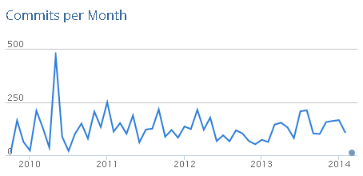
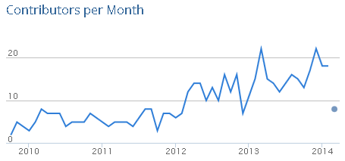
OS Metrics: ATS
Notes:
Source: http://www.ohloh.net/p/trafficserver

Slide 32
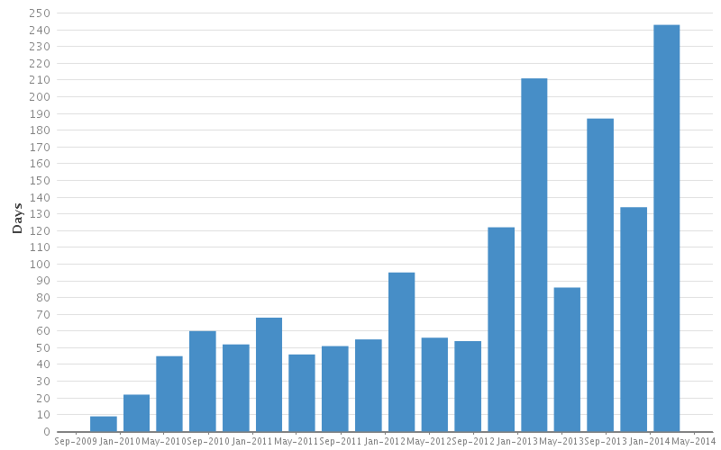
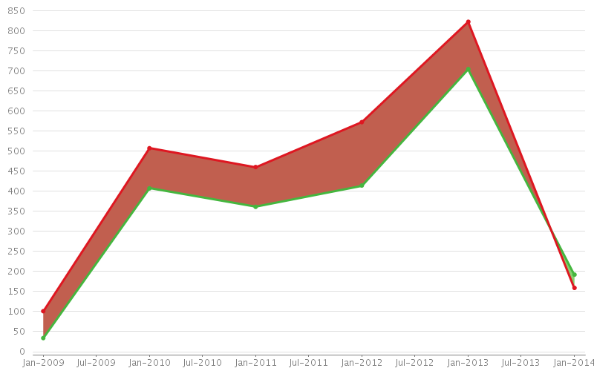
OS Metrics: ATS
Issue resolution time: increasing since Q4 2012
Issues created vs resolved: reversed trend in Dec 2013
Notes:
Source:
(1) https://issues.apache.org/jira/secure/ConfigureReport.jspa?projectOrFilterId=project-12310963&periodName=quarterly&daysprevious=1600&selectedProjectId=12310963&reportKey=com.atlassian.jira.plugin.system.reports%3Aresolutiontime-report&Next=Next
(2) https://issues.apache.org/jira/secure/ConfigureReport.jspa?projectOrFilterId=project-12310963&periodName=yearly&daysprevious=1700&cumulative=false&versionLabels=none&selectedProjectId=12310963&reportKey=com.atlassian.jira.plugin.system.reports%3Acreatedvsresolved-report&Next=Next

Slide 33
OS Metrics: ATS
Project | Apache Traffic Server | nginx | Squid Cache | Varnish
Initial Commit | over 4 years ago | over 11 years ago | about 18 years ago | about 8 years ago
Contributors (Past 12 Months) | 68 developers | 23 developers | 46 developers | 18 developers
Commits (Past 12 Months) | 1,746 commits | 604 commits | 1,586 commits | 1,168 commits
Notes:
Source: www.ohloh.net/p/compare?project_0=Apache+Traffic+Server&project_1=NGINX&project_2=Squid+Cache

