Slide 1


Samza: Stateful Scalable Stream Processing at LinkedIn
Shadi A. Noghabi*, Kartik Paramasivam^, Yi Pan^, Navina Ramesh^, Jon Bringhurst^, Indranil Gupta*, Roy Campbell*
* University of Illinois at Urbana-Champaign
^ LinkedIn Corp.
+

Slide 2
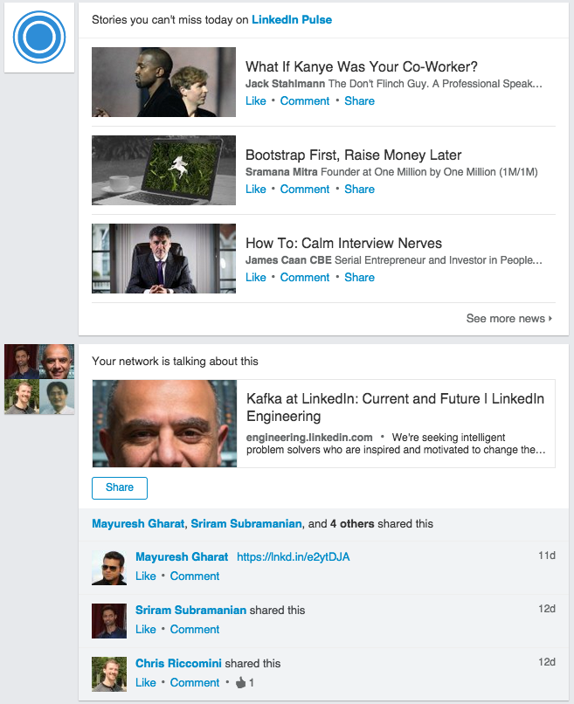


Stream (data in motion) Processing
Security
Click Stream Processing, Interactive User Feeds
Security, Fraud Detection
Application Monitoring
Internet of Things
Ads, Gaming, Trading etc.

Slide 3
Data Processing at LinkedIn
Clients(browser,devices ….)
Services Tier
Ingestion
Espresso
Azure EventHub
AWS
Kinesis
Brooklin
Apache Kafka
Oracle
Processing
Real Time Processing
(Apache Samza)
Notes:
the 3 areas
ingestion,
Processing
serving

Slide 4
Scale of Processing at LinkedIn
In Apache Kafka alone
2.1 Trillion msg/Day
0.5 PB in, 2 PB out per day (compressed)
16 Million msg/sec peaks
Many applications need state along with processing
Several TB for a single application

Slide 5

Apache Samza
A Battle-Tested and Scalable stream/data processing framework
Top-level Apache project since 2014
In use at LinkedIn, Uber, Metamarkets, Netflix, Intuit, TripAdvisor, VmWare, Optimizely, Redfin, etc.
Powers hundreds of apps in LinkedIn’s production

Slide 6
Samza’s Goals
Scalability
Input partitioning
Parallel and independent tasks
Fast Recovery & Restart
Parallel recovery
Host Affinity
Efficient Stateful Processing
Local state
Incremental checkpointing
Unified Data Processing API
For
Stream and Batch
Stream Processing as a library and Stream Processing as a Service (SPaaS)

Slide 7
Samza’s Goals
Scalability
Input partitioning
Parallel and independent tasks
Fast Recovery & Restart
Parallel recovery
Host Affinity
Compaction
Efficient Stateful Processing
Local state
Incremental checkpointing
3-Tier caching
Unified Data Processing API
For
Stream and Batch
Stream Processing as a library and Stream Processing as a Service (SPaaS)

Slide 8
Processing from a Partitioned Source
Input Stream
Processing
Partitions
Tasks
1
1
Client
2
2
3
3
Send with
PartitionKey
Kafka Topic/EventHub
Samza Application
is a made up of Tasks
every Task processes a unique
collection of input partitions
Notes:
Mention that: repartitioning might be required to process from an unpartitioned source

Slide 9
Joining across co-partitioned streams
Ad View Stream
1
Processing
2
Ad Click Through
Rate Stream
Tasks
3
1
1
2
Ad Click Stream
2
3
1
3
2
Samza Application
3

Slide 10
Multi-Stage Dataflow Example
Application logic: Count number of ‘Page Views’ for each member in a 5 minute
window
Page View
in stream
Page View per Member
out stream
Repartition
by member id
Window
Map
SendTo
Intermediate Stream

Slide 11
Multi-Stage Dataflow Example
Page View
in stream
Page View per Member
out stream
Repartition
by member id
Window
Map
SendTo
public class PageViewCountApplication implements StreamApplication {
@Override public void init(StreamGraph graph, Config config) {
MessageStream<PageViewEvent> pageViewEvents = graph.getInputStream("pageViewStream" );
MessageStream pageViewPerMember = graph.getOutputStream("pageViewPerMemberStream" );
pageView
.partitionBy(m -> m.memberId)
.window(Windows.keyedTumblingWindow(m -> m.memberId, Duration.ofMinutes(5),
initialValue, (m, c) -> c + 1))
.map(MyStreamOutput::new)
.sendTo(pageViewPerMember);
}
}
built-in transform functions

Slide 12
Samza’s Goals
Scalability
Input partitioning
Parallel and independent tasks
Fast Recovery & Restart
Parallel recovery
Host Affinity
Compaction
Efficient Stateful Processing
Local state
Incremental checkpointing
Unified Data Processing API
For
Stream and Batch
Stream Processing as a library and Stream Processing as a Service (SPaaS)

Slide 13
Stateful Processing: Aggregations, Windowed Joins ...
Page View
Kafka stream
Samza Application
Page View Per Member
Kafka stream
Task 1
Task 2
Task 3
Store count of page views per member
Count number of ‘Page Views’ for each member in a 5 minute window
State:
Page View Count
Notes:
D4

Slide 14
Local State
Page View
Kafka stream
Samza Application
Page View Per Member
Kafka stream
Task 1
Task 2
Task 3
Count number of ‘Page Views’ for each member in a 5 minute window
Notes:
D4

Slide 15
Local State
Page View
Kafka stream
Samza Application
Page View Per Member
Kafka stream
Task 1
Task 2
Task 3
What about failures?
How to not loose state?
Count number of ‘Page Views’ for each member in a 5 minute window
Notes:
D4

Slide 16

Failure Recovery - Changelog
Page View
Kafka stream
Samza Application
Page View Per Member
Kafka stream
Task 1
DB partition 1
Task 2
DB partition 2
...
Task k
DB partition k
State changes saved to a durable change log
Periodically, at a checkpoint, offsets are flushed along with the state.
Recovery from previous checkpoint upon failures
Changelog
e.g., Kafka log compacted topic
...
partition k
partition 2
partition 1
Notes:
D4

Slide 17
Failure Recovery - Changelog
Page View
Kafka stream
Samza Application
Page View Per Member
Kafka stream
X=10
DB partition 1
Task 1
X=10
Task 2
DB partition 2
...
Offset
1005
Task k
DB partition k
State changes saved to a durable change log
Periodically, at a checkpoint, offsets are flushed along with the state.
Recovery from previous checkpoint upon failures
Changelog
e.g., Kafka log compacted topic
X=10
...
partition k
partition 2
partition 1
Notes:
D4

Slide 18
Failure Recovery - Incremental Checkpoint
Page View
Kafka stream
Samza Application
Page View Per Member
Kafka stream
X=10
DB partition 1
Task 1
X=10
Task 2
DB partition 2
...
Offset
1005
Task k
DB partition k
Offsets
e.g., Kafka log compacted topic
Offset
1005
Changelog
e.g., Kafka log compacted topic
X=10
...
partition k
partition 2
partition 1
Notes:
D4

Slide 19
Comparing Checkpointing Options
Full state checkpointing
  Simply does not scale for non-trivial application state
  … but makes it easier to achieve “repeatable results” when recovering from failure
Incremental state checkpointing
  Scales to any type of application state (e.g. some apps have ~2TB of app state in prod @LinkedIn)
  Achieving repeatable results requires additional techniques (e.g. mechanisms for de-duplicating data)

Slide 20
Fast Restarts with Local State
Input Stream
Durable :
Task-Container-Host Mapping
Task 1, Task 4 -> Host-A
Task 2 -> Host-B
Task 3 -> Host-C
Task-1
Task-4
Task-2
Task-3
Samza Job
Host-A
Host-B
Host-C
Host Affinity in YARN :
Try to place task on same host after upgrade
Minimize state rebuilding Overhead
Change-log

Slide 21
Local State Summary
Pros
Cons
100X better performance
No issues with accidental DoS on remote DB
No need to over provision the remote DB
Does NOT work when adjunct data is large and not co-partitionable in input stream
  Auto-scaling becomes harder
  Repartitioning the Input stream can mess up local state

Slide 22
Samza’s Goals
Scalability
Input partitioning
Parallel and independent tasks
Fast Recovery & Restart
Parallel recovery
Host Affinity
Compaction
Efficient Stateful Processing
Local state
Incremental checkpointing
3-Tier caching
Unified Data Processing API
For
Stream and Batch
Stream Processing as a library and Stream Processing as a Service (SPaaS)

Slide 23
Stream Application in Batch
Application logic: Count number of ‘Page Views’ for each member in a 5 minute
window and send the counts to ‘Page View Per Member’
Page View
in stream
Page View per Member
out stream
Repartition
by member id
Window
Map
SendTo
HDFS
PageView: hdfs://mydbsnapshot/PageViewFiles/
PageViewPerMember: hdfs://myoutputdb/PageViewPerMemberFiles
Zero code changes

Slide 24
Stream Processing as a Library
Page View
Page View per Member
Repartition
by member id
Window
Map
SendTo
Launch Stream Processor
public static void main(String[] args) {
CommandLine cmdLine = new CommandLine();
OptionSet options = cmdLine.parser().parse(args);
Config config = cmdLine.loadConfig(options);
LocalApplicationRunner runner = new
LocalApplicationRunner(config);
PageViewCountApplication app = new
PageViewCountApplication();
runner.run(app);
runner.waitForFinish();
}
job.coordinator.factory=org.apache.samza.zk.
ZkJobCoordinatorFactory
job.coordinator.zk.connect=my-zk.server:2191
Zero code changes

Slide 25
Stream Processing as a Library : Architecture
Pluggable Job Coordinator
Multiple Coordinator implementations
  YARN based Coordination (non-library option)
  Zookeeper based Coordination
  Azure Storage based Coordination
StreamProcessor
StreamProcessor
StreamProcessor
Samza Container
Job Coordinator
Samza Container
Job Coordinator
Samza Container
Job Coordinator
...
ZooKeeper
Notes:
Why do we need it ?
Some applications want to directly embed stream processing as part of broader app (eg. a web frontend)
LinkedIn Tools are not natively built for YARN, so there is some developer friction
Some applications need full control (e.g. unique security, deployment considerations)
Solve API proliferation (Kafka APIs, Databus APIs etc. )

Slide 26
Evaluation

Slide 27
Evaluation Setup
Production Cluster
  500 node YARN cluster
  real world applications
Small Cluster (used for evaluation)
  6 node cluster
    64GB RAM, 24 core CPUs, a 1.6 TB SSD
  micro-benchmarks
    Read-only workload ~ adjunct data in a join
    Read-write workload ~ aggregation over time
Notes:
message size : 100 bytes (read only) or 80 bytes (read/write case)

Slide 28
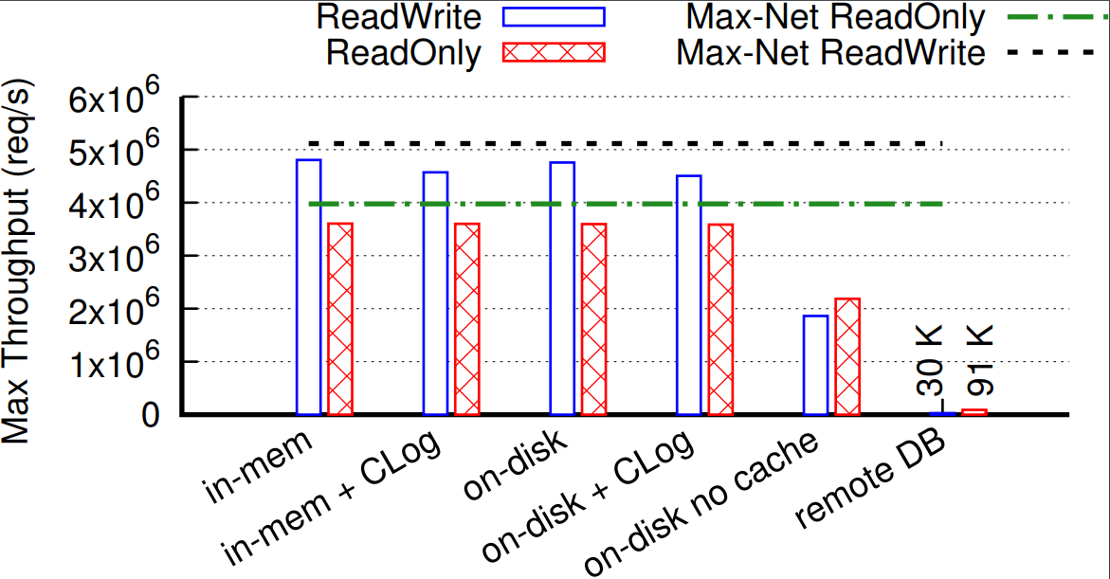
Local State -- Throughput
remote state 30-150x worse than local state
on disk w/ caching comparable with in memory
changelog adds minimal overhead
Notes:
no batching or caching for remote db

Slide 29
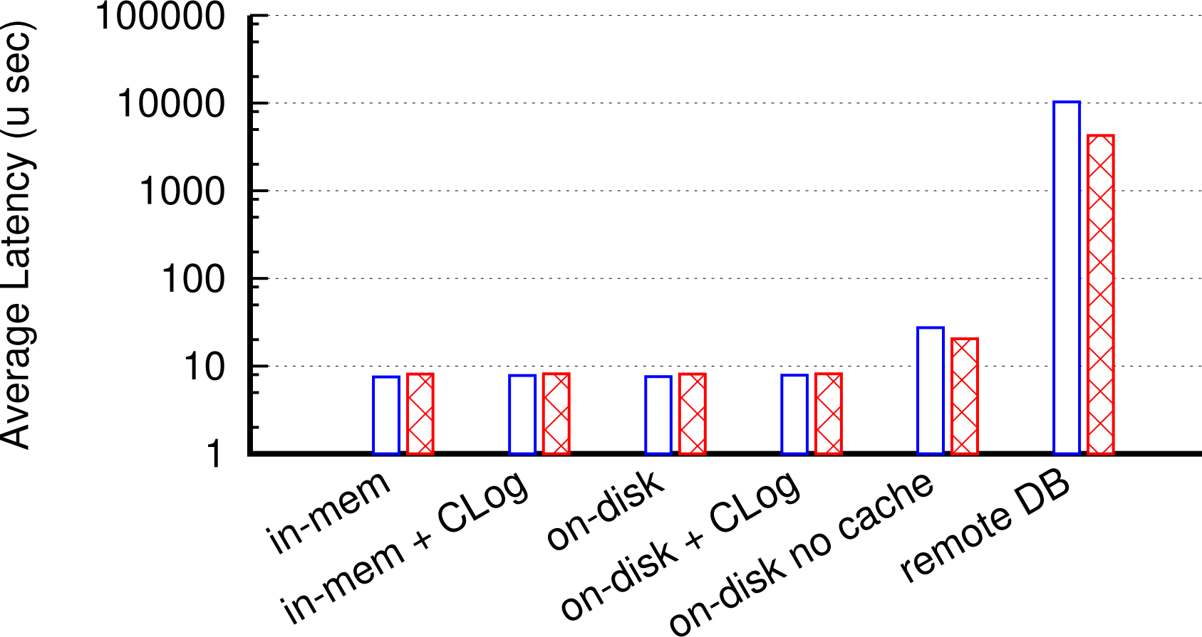
Local State -- Latency
> 2 orders of magnitude slower compared to local state
on disk w/ caching comparable with in memory
changelog adds minimal overhead

Slide 30
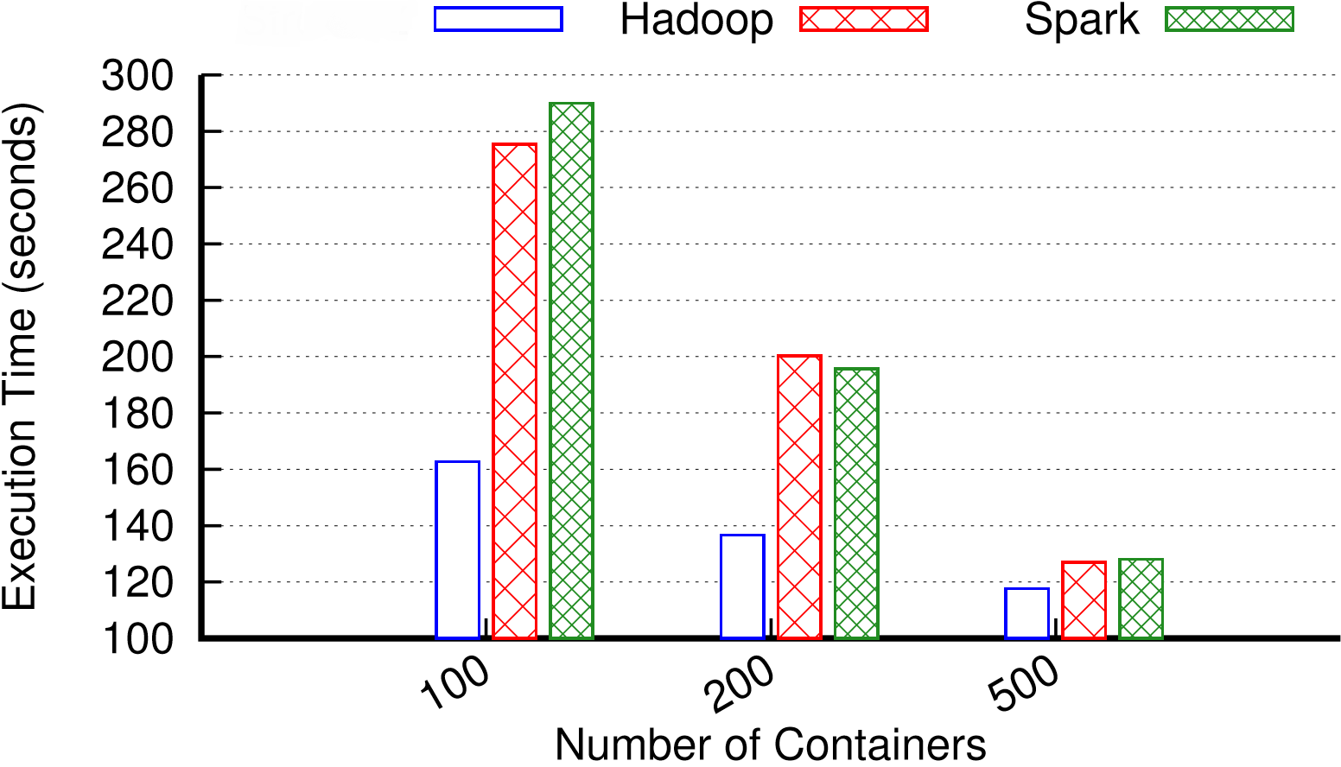
Samza HDFS Benchmark
Samza
Profile count, group-by country
500 files
250GB input

Slide 31
Apache Samza: A Real Time Data Processing Framework - Battle Tested at Scale !!
Scalability
Input partitioning
Parallel and independent tasks
Fast Recovery & Restart
Parallel recovery
Host Affinity
Efficient Stateful Processing
Local state
Incremental checkpointing
Unified Data Processing API
For
Stream and Batch
Stream Processing as a library and Stream Processing as a Service (SPaaS)

