Slide 1
Traffic Server APIs
Brian Geffon
LinkedIn
Nov 16, 2015

Slide 2
C++ API: Introduction
Why was a C++ API necessary?

Slide 3
C++ API Design Considerations
It should never require ts.h
  Encapsulation is used heavily to prevent exposing ts.h types and functions
  For the most part it’s pretty independent of TS versions, we even considered making it standalone from the core but then we’d have #ifdef’s everywhere.
    Given the stability of atscppapi it’s probably completely unnecessary at this point.
  Unfortunately because of transaction level configs (TSHttpTxnConfig*) we now have #include <ts/inkdefs.h>
    Can be removed with a build time step to generate the equivalent C++ enums (anyone interested in taking this on?)

Slide 4
C++ API
Just a wrapper on top of the C API
  Most hooks and transaction level methods available to C API (pull requests appreciated for additional functionality)
  Because it just wraps the C API you can actually use them together if you wanted to.
C++ classes abstract away the weird details of the C API, why should it require 10+ lines of code to get a header value?

Slide 5
C++ API
C plugins can sometimes be tricky to get right.
  QUIZ: Can anyone tell when you REALLY need to use TSHandleMLocHandle release?
  Sometimes you’re responsible for freeing the returned strings (TSUrlStringGet, TSHttpTxnGetClientPequestBody, etc..)
  Sometimes you’re responsible for heap allocating some strings TSHttpTxnErrorBodySet

Slide 6
C++ API
C plugins can sometimes by tricky to get right.
  Transformations
    What a pain these can be
    Transformation plugins have a tremendous amount of boiler plate code.
  Intercepts
    Intercepts also have a huge amount of complexity due to setup and Vconn reading / writing , etc.
  Cleanup in general

Slide 7
Mapping C to C++ API
In the C API you have Global Hooks: hooks that are applied to every transaction.
You also have Transaction Hooks: hooks that are applied only to a specific transaction.
  Transformations are technically “Transaction Hooks” in that they only apply to a single transaction.
  Intercepts can also be thought of as “Transaction Hooks”

Slide 8
Global / Transaction “Hooks”
In the C++ API world we refer to these concepts as “Plugins”: A plugin has many hooks.
Plugin
GlobalPlugin
TransactionPlugin
TransformationPlugin
InterceptPlugin

Slide 9
Plugins: Where do you fit in?
Plugin
GlobalPlugin
TransactionPlugin
MyGlobalPlugin
TransformationPlugin
InterceptPlugin
MyTransactionPlugin
Gzip(Inflate/Deflate)Plugin
MyTransformationPlugin

Slide 10
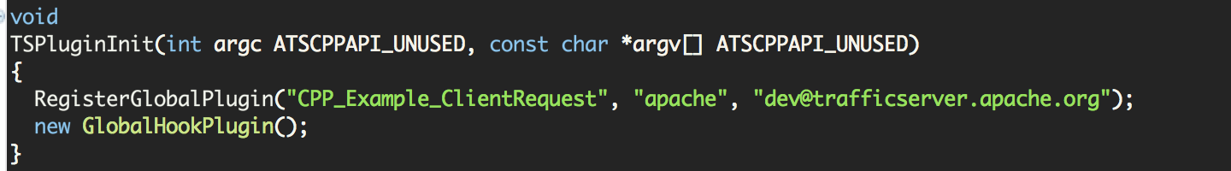
Global Plugin Example
Registration
You have the same DSO entry point as C plugins
That looks suspiciously like a memory leak
  Global plugins exist for the life of the process.

Slide 11
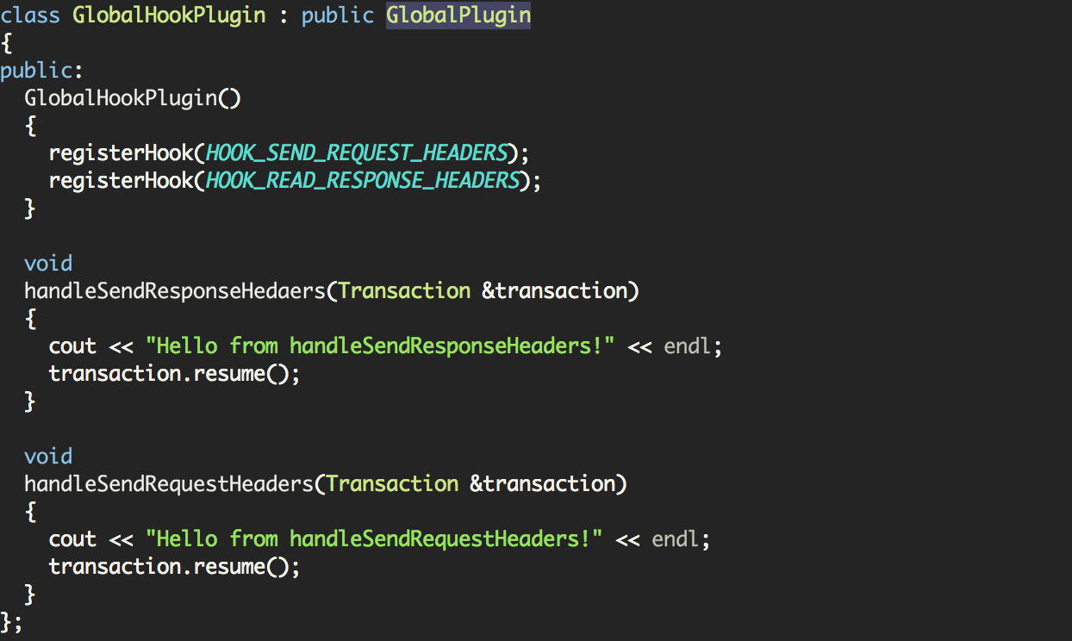
Global Plugin Example
Creating a Hook
As we’ve shown all you do is extend the GlobalPlugin class. Your constructor is where you register the hooks you’re interested in.
Remember: you always extend the class for the plugin type you’re trying to implement
In your constructor you’ll add your Hooks
Finally add the callbacks for each of your hooks.

Slide 12
Global Plugin Example
Creating a Hook
As we’ve shown all you do is extend the GlobalPlugin class. Your constructor is where you register the hooks you’re interested in.
NOTE: A very common gotcha is misspelling or using the wrong callback.
The default implementation for all hooks is to simply resume the transaction!
Always remember to reenable (resume) the transaction or you can reenable to an error state.

Slide 13
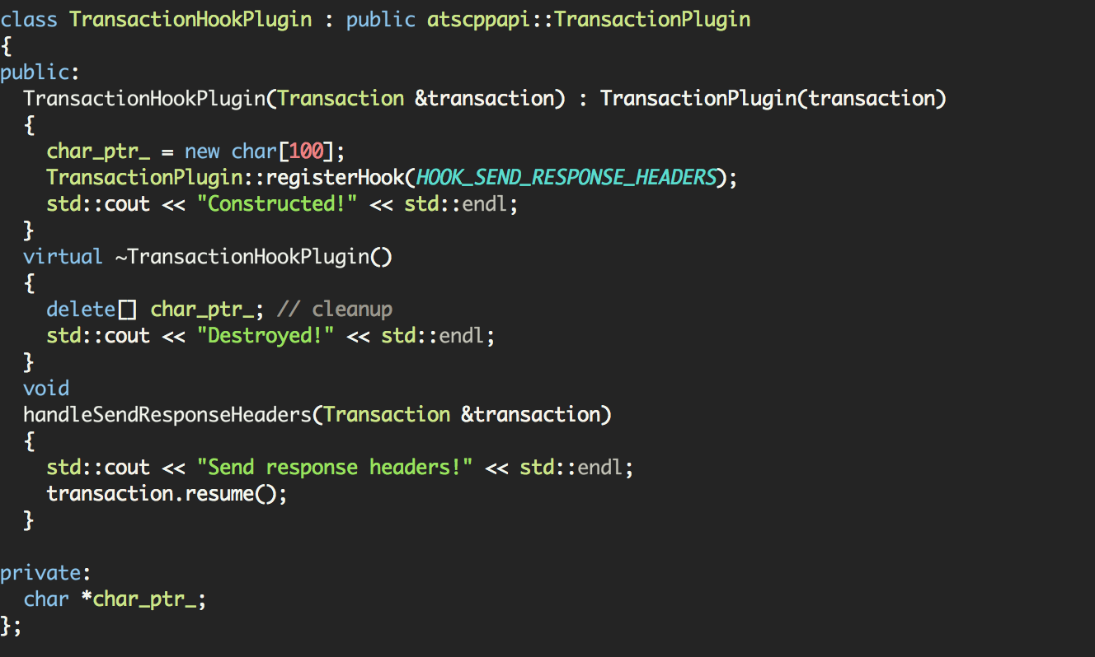
Transaction Plugins
Transaction plugins and Global Plugins are basically the same in terms of implementation.
  Transaction scoped storage is free!
The parent constructor handles the transaction setup
This class is automatically destroyed when a Transaction goes out of scope, so you can cleanup in your destructor. Free transaction scoped storage.

Slide 14
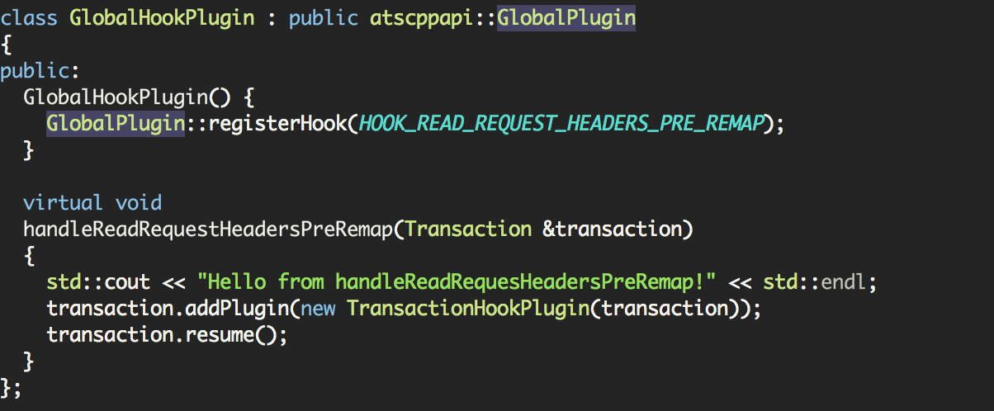
Transactions: attaching transaction plugins
Global hooks can be registered at anytime but they are typically registered in TSPluginInit
TransactionPlugins are attached to a Transaction object.
Just attach a new instance of a TransactionPlugin the transaction takes ownership of the TransactionPlugin and will ensure it’s deleted.

Slide 15
Transactions: request / response objects
You have six request / response objects that you can access via Transactions
ClientRequest &getClientRequest()
Request &getServerRequest()
Response &getServerResponse()
Response &getClientResponse()
Request &getCachedRequest()
Response &getCachedResponse()
Why do client requests return a ClientRequest object instead of just a Request?
ClientRequest Extends Request Because of Pristine urls. As we will see soon Request objects have URL objects, in the case of client requests we actually have the pristine url too.

Slide 16
Request Objects
Request objects allow you to access (see Request.h)
  Request URL (Returns a URL object)
    Pristine URL is also available if it’s a ClientRequest
  Headers (Returns a Headers object)
  Method
  HTTP Version

Slide 17
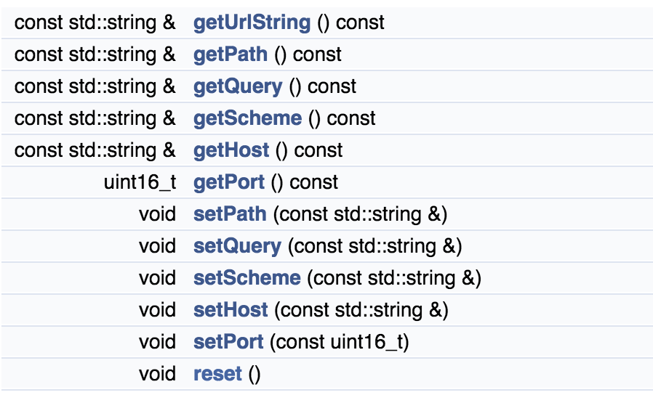
URL Objects
You can obtain a URL object from a Transaction (transaction.getUrl())

Slide 18
Headers Objects
Behave like standard library containers (more or less)
Content-Type: foo
Content-Encoding: gzip, sdch
Content-Length: 20
X-Some-Header: 123,blah
X-Another-Header: foo, bar, baz
A instance of the Headers class contains all the HeaderFields: a header field is a “line.” Iterators are exposed to allow you to iterate over the Headers object, it’s a header_field_iterator.

Slide 19
HeaderField Objects
Content-Type: foo
Content-Encoding: gzip, sdch
Content-Length: 20
X-Some-Header: 123,blah
X-Another-Header: foo, bar, baz
A HeaderField contains a HeaderFieldName and many std::string values.

Slide 20
HeaderFieldName Objects
Every HeaderField has a HeaderFieldName
Content-Type: foo
Content-Encoding: gzip, sdch
Content-Length: 20
X-Some-Header: 123,blah
X-Another-Header: foo, bar, baz
HeaderFieldName is a class created to handle the fact that header names are case-insensitive. It has overloaded comparison operators for case insensitive comparisons.

Slide 21
Header values
Every HeaderField has many values (std::string)
Content-Type: foo
Content-Encoding: gzip, sdch
Content-Length: 20
X-Some-Header: 123,blah
X-Another-Header: foo, bar, baz
A HeaderField contains many header values which are std::strings. To behave like standard containers there are iterators exposed, it’s a header_field_value_iterator.

Slide 22
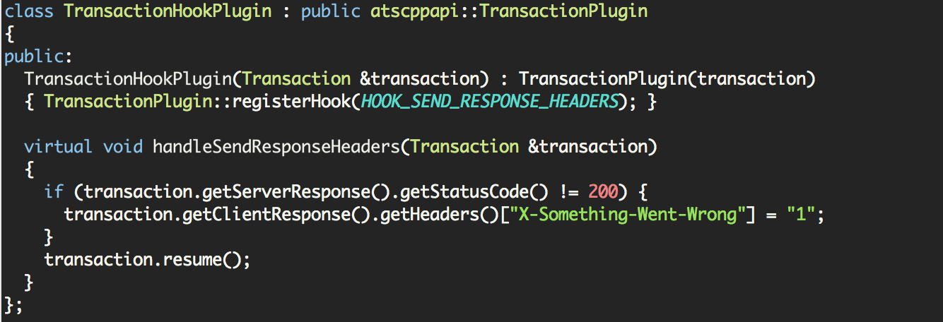
Transaction Examples
NOTE: As is the behavior with most standard containers operator[] causes the element to be created if it doesn’t exist. In the next example we’ll use find on a Header object.
This very simple example looks at the response code from the server and if it’s not 200 it will set a header.

Slide 23
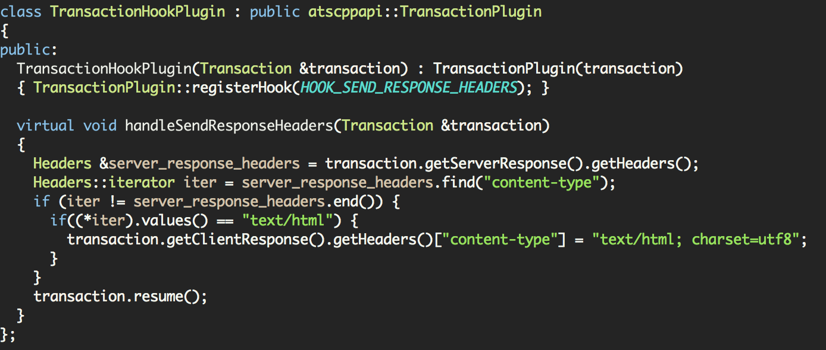
Transaction Examples
Expected behavior for containers.
begin() and end()
Find returns an iterator.
Another simple example, but in this case we’ll use find on the Header object to obtain an iterator.

Slide 24
Transformations
Transformations are stupidly hard in C
Fundamentally all they do is consume data and produce data, the C++ API attempts to make it that simple.
Remember: a TransformationPlugin is just a subclass of a TransactionPlugin so you can do anything you could do in a TransactionPlugin.

Slide 25
Transformations
Transformations are chainable so a common pattern is
InflateGzipTransformation
ArbitraryContentTransform
DeflateGzipTransformation

Slide 26
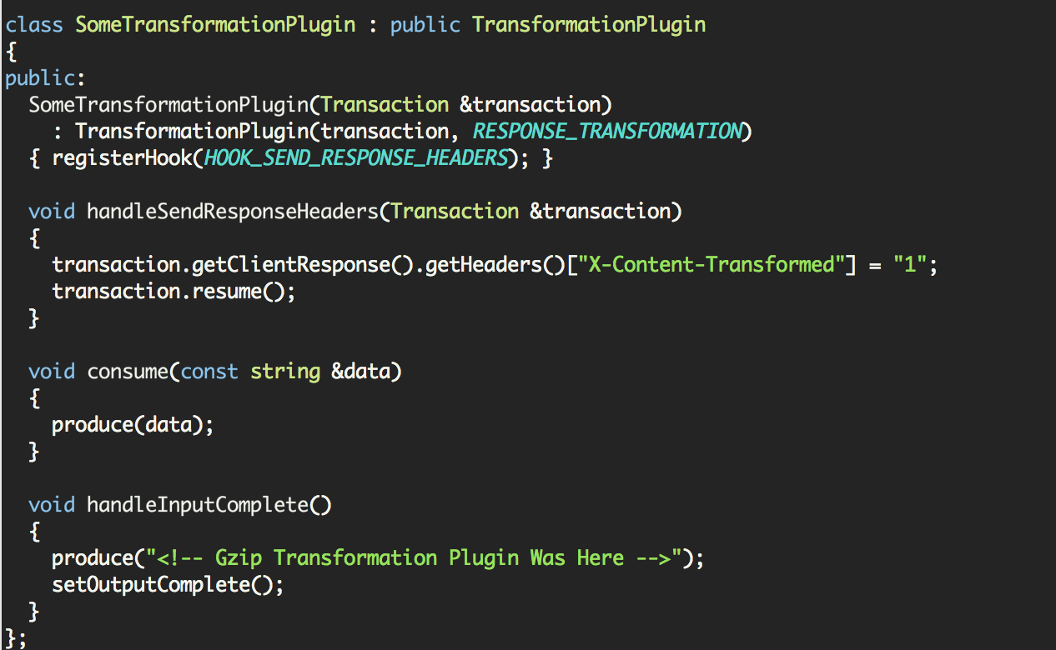
Transformation Example

Slide 27
Transformation Example
Extends TransformationPlugin
Because it’s a TransactionPlugin too it can add it’s own Hooks
Transformations implement two methods consume and handleInputComplete
Transformations have two methods available produce(std::string) and setOutputComplete()
This simple example passes through all data and adds an HTML comment at the end

Slide 28
Transformations
One common question regarding the interface is the manipulation of binary data when consume(const std::string &data) and produce(std::string) both operate with std::string.
This is not a problem at all, just use std::string::c_str() or std::string::data() and std::string::length()
To write binary data you would just do produce(std::string(binary_buffer, len));
OR
std::string::assign(const char *, size_t)
See GzipInfalteTransformation.cpp in lib/atscppapi/src

Slide 29
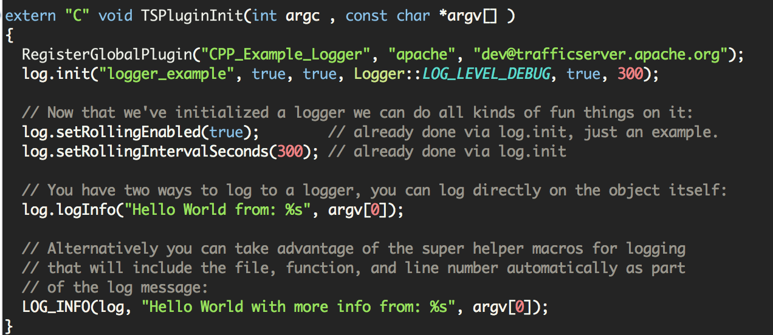
Async Loggers
The C API made available TSTextLogObjects these are exposed via the Logger class. They also have additional functionality around log levels.
Initialize the logger before you use it
Two different built-in ways to log. Directly via the object or using the macros which will include FILE, FUNCTION, and LINE NUMBERS.

Slide 30
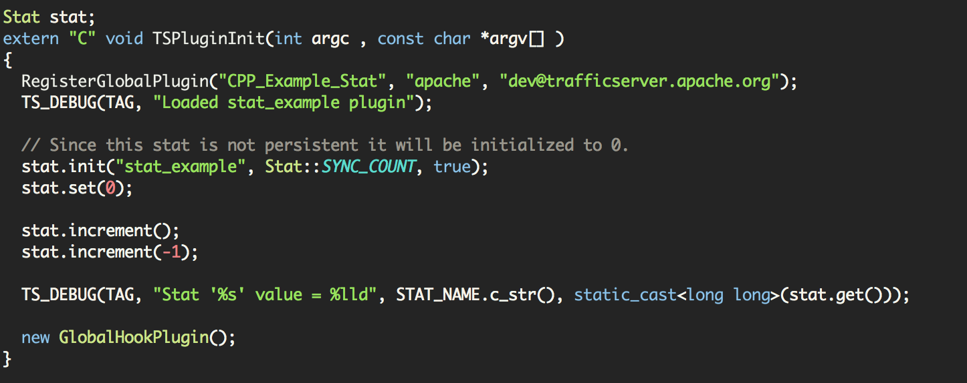
Stats
ATS C APIs support stats which are available via traffic_line or http stats interface
Like loggers you you must init() the stat.
Set / get available on the stats
Finally, you have increment / decrement available on the stat by one or arbitrary amounts.

Slide 31
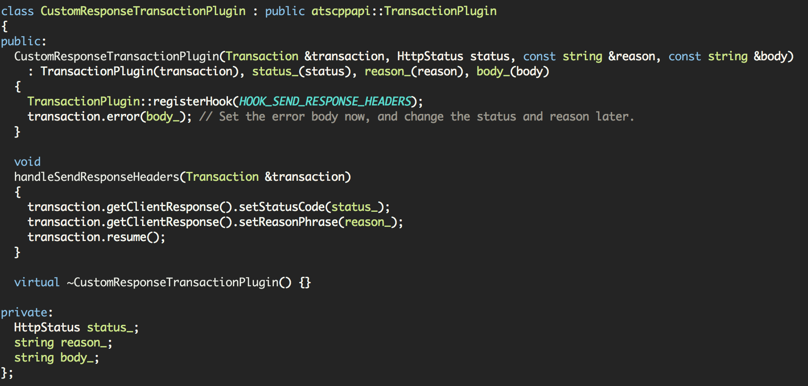
Neat things you can do
Custom response transaction plugin, you don’t need to use an intercept if you want to send a custom response
- See lib/atscppapi/examples/customresponse/customresponse.cpp
Note: the constructor reenables w/ .error() so you should not .resume() after attaching this Plugin

Slide 32
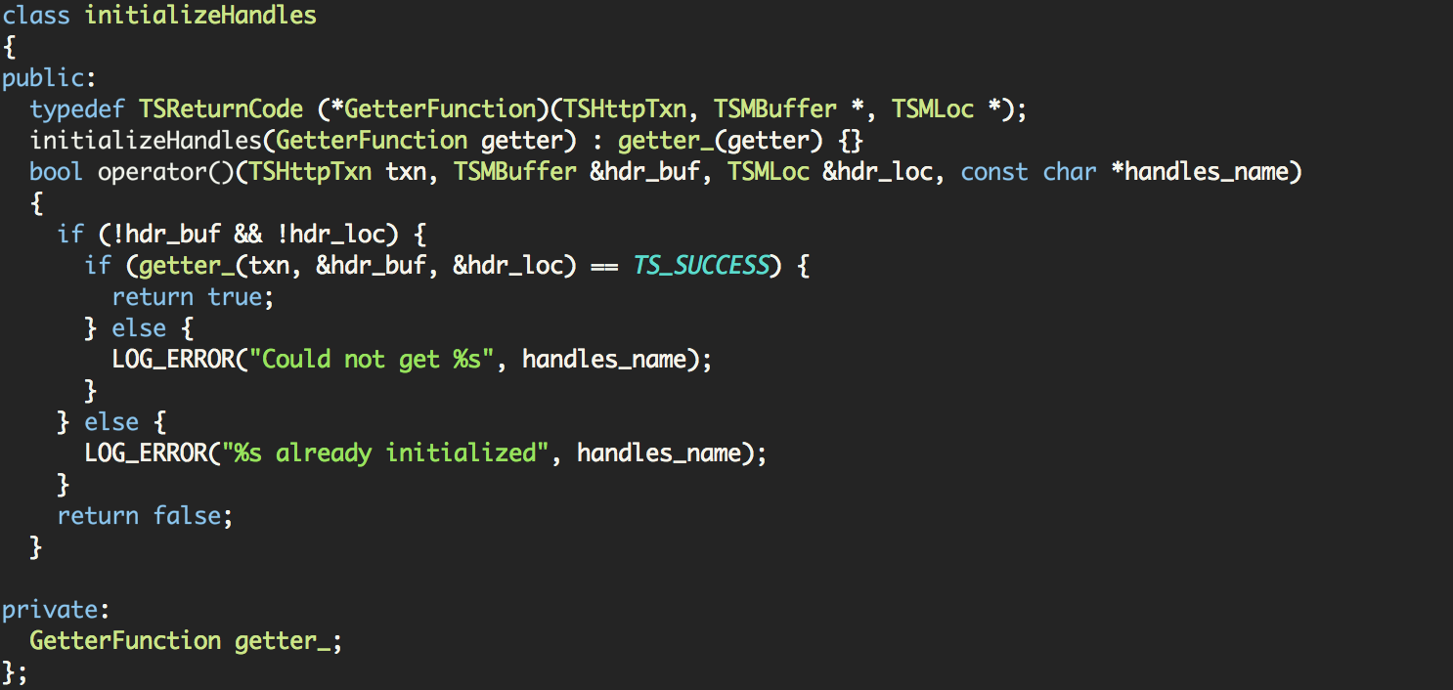
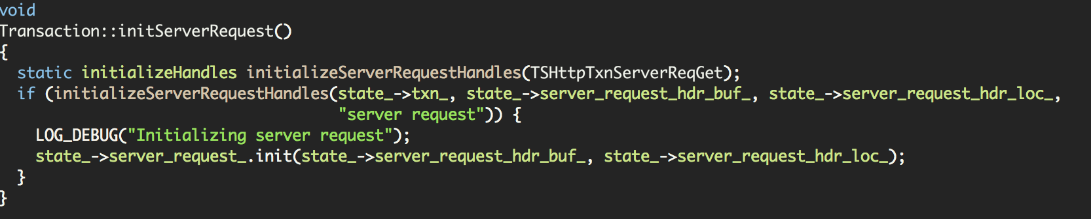
Things that need to improve
Async Mechanism
  It’s currently overly complicated and difficult to use
It’d be nice to remove the caching that exists around many of the internal structures (see the isInitialized() code scattered throughout).
Any takers?
I’m not sure why I thought this was a good idea…but I wrote it so blame me.

Slide 33
Things that would be great to add
Generalizations around VIOs
It would be ideal if we create a C++ API version of the VIOs and VConnections.
  I think Daniel Morilha has done this in his latest plugin contribution.

