Slide 1
Apache Airavata
A high level overview

Slide 2
Overview
Airavata is a general purpose distributed system software framework build on micro-service and component based architecture principles.
Airavata provides capabilities to compose, manage, execute and monitor large scale applications and workflows on distributed computing resources.
Airavata supports executions on local clusters, national grids, academic and commercial clouds.
Airavata is inherently multi-tenanted.

Slide 3
Airavata as a Science Gateway Middleware
Airavata is dominantly used to build science gateways.
Airavata supports secured communications to HPC resources and empowers gateway operators to administer and monitor long running executions.
A reference PHP based gateway is provided to illustrate the Airavata capabilities and can be used to customize science-centric gateways

Slide 4
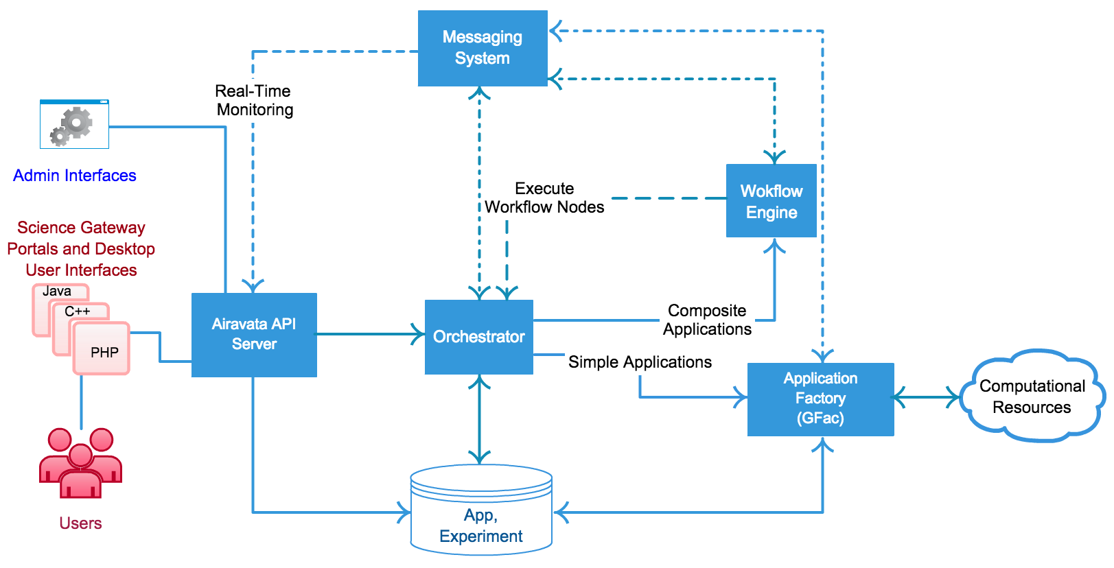
Airavata: Keep it simple, yet flexible
External clients interact with Airavata API (based on Apache Thrift).
Internally, components interact with each other through Component Programming Interfaces (thrift based CPIs).

Slide 5
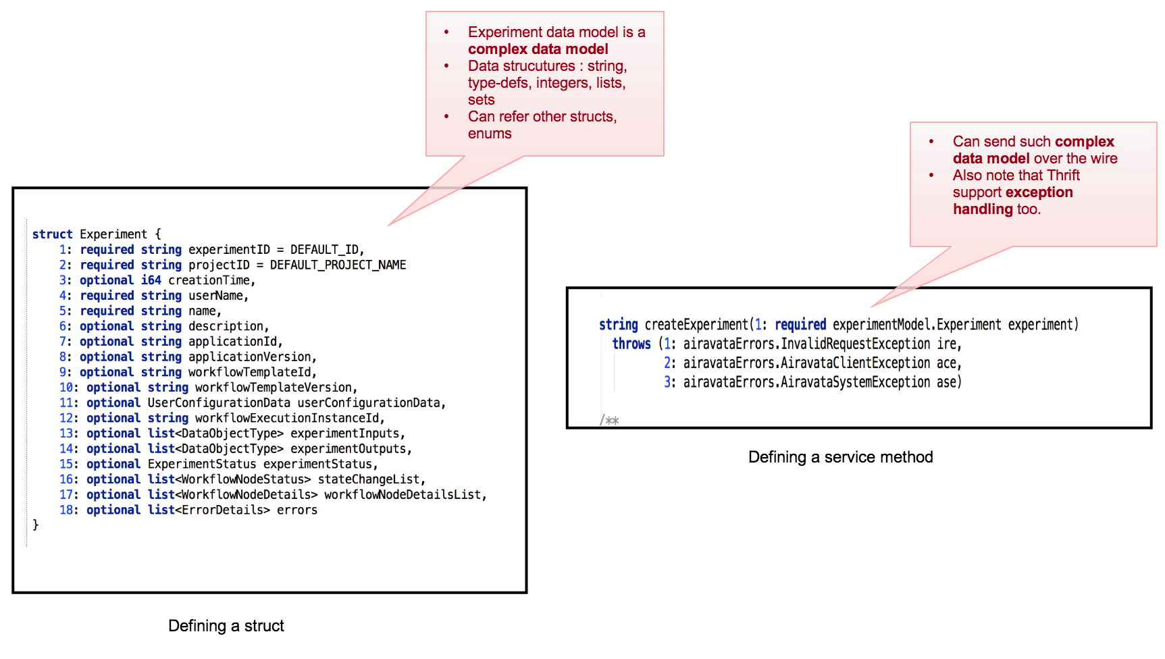
Apache Airavata API’s built over Apache Thrift
Clean way to define IDLs with richer data structures

Slide 6
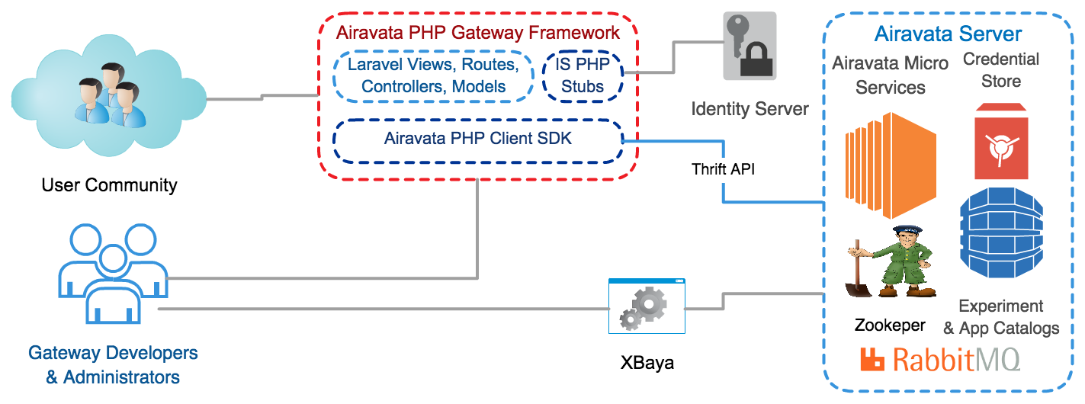
Reference Gateway <-> Airavata Services

Slide 7
SciGaP – Powered by Airavata
Science Gateway Platform as a Service (SciGaP) provides application programmer interfaces (APIs) to hosted generic infrastructure services that can be used by domain science communities to create Science Gateways.
SciGaP hosted service platform is powered by Apache Airavata.
SciGaP helps gateway developers to concentrate their efforts on building their scientific communities and not worry about operations.

Slide 8



SciGaP: Diverse and Complementing TEAM
PI: Marlon Pierce Co-I: Suresh Marru | PI: Mark Miller Co-I: Amit Majumdar | PI: Borries Demeler
GridChem Science Gateway | CIPRES Science Gateway | Ultrascan Science Gateway
IU Cyberinfrastructure Gateway | Neuroscience Gateway

Slide 9
Improve sustainability by converging on a single set of hosted infrastructure services
CIPRES
Neuro Science
Ultrascan
Param
Chem
DES SimWG
GAAMP
BioVLAB
Science Gateways
Science Gateway Platform as a Service (SciGaP)
Graphical Interfaces
Application Programmer Interface
Admin Dashboards
User Identity Management
Job & Workflow Management
Data & Provenance Management
Information, Monitoring & Auditing
Scalable
Load Balanced
Configurable
Fault Tolerant
Maintainable
Secure
Performance
XSEDE
OSG
Future Grid
Data Nets
Campus Clusters
Academic & Commercial Clouds
International Grids

Slide 10
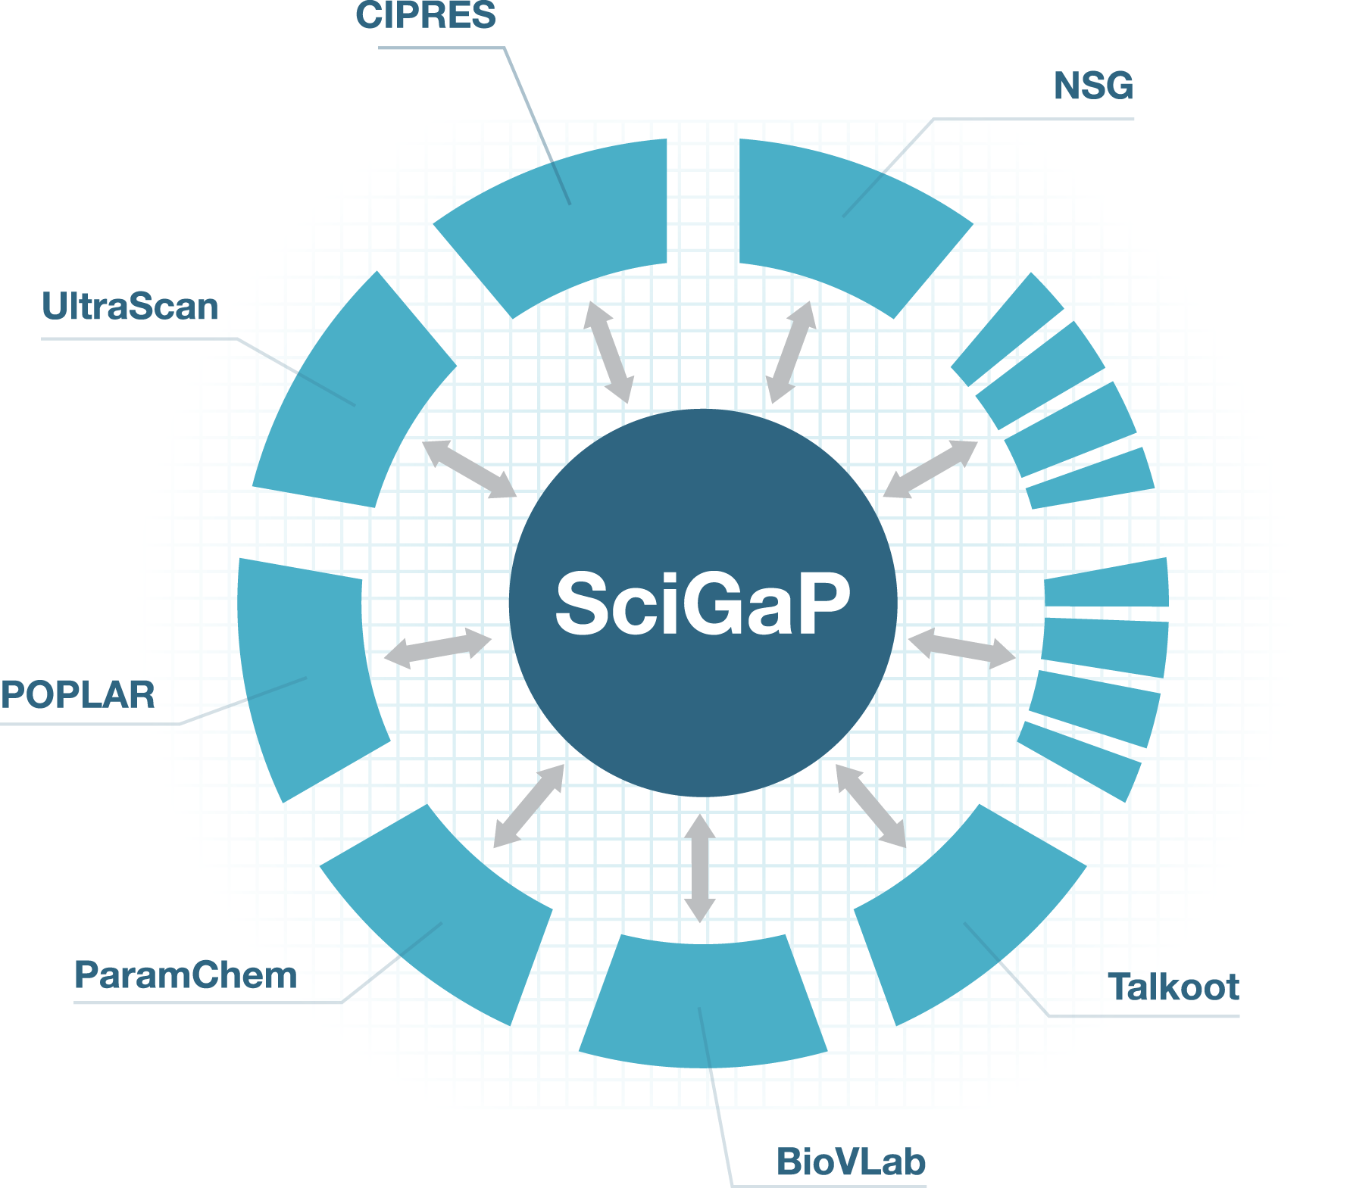

SciGaP Key Mission
Scale number of gateways without having to scale FTE’s needed to support them

Slide 11


Community Hangout
Mailing lists:
architecture@airavata.apache.org
dev@airavata.apache.org
users@airavata.apache.org
Extend Airavata from your project or extend your project from Airavata

