Slide 1

Instructions for Airavata Hands-On Exercises
Eroma Abeysinghe
eabeysin@iu.edu
Science Gateways Group
Indiana University
07/27/2015

Slide 2
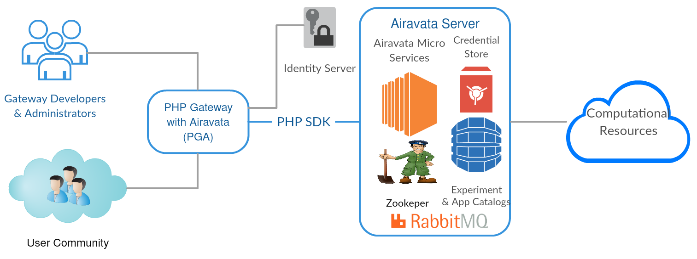
Recap of Big Picture
You will be using PGA for Hands-on exercises to understand the capabilities of Airavata.

Slide 3
PGA Overview
The PHP Reference Gateway (PGA) is built to demonstrate Airavata middleware features.
You are encouraged to plagiarize it freely to suit your need.
PGA uses Airavata’s PHP SDK and is built over Laravel framework.
Talk to us is you would like to use other language SDK’c (Java, PHP, Pytho, C++ ) or program directly against the API.
2

Slide 4
Tutorial Links
PGA https://testdrive.airavata.org/
Collaborative Notes - http://s.apache.org/xsede15-notes
Tutorial Agenda – http://s.apache.org/xsede15

Slide 5
Hands-On Summary
Use PGA as a gateway end user to:
  Create an Account.
  Create, Configure and Launch an Experiment (Job).
  Monitor, view, download Experiment Outputs.
  Clone & Cancel Experiment.
Use PGA as a gateway administrator to:
  View Experiment Statistics and drill-down.
  View Compute Resource and Application descriptions.
  View gateway compute resource preferences.
3

Slide 6
Module 2: PGA as end user
Create your own user account.
Follow the demo or navigate your self.
Step by step instructions are documented and linked from PGA.
  https://cwiki.apache.org/confluence/display/AIRAVATA/PGA+End+User+Tutorial
Speak up your questions, comments, criticism or capture them in notes doc - http://s.apache.org/xsede15-notes
4

Slide 7
Defualt User Roles
PGA has 3 user roles;
  End User
  Gateway Administrator
  Gateway Administrator with read-only privileges.
Newly created user accounts have end user role.
Speak up and ask to be promoted to be a read-only gateway admin. These are controlled by Role Based Access Control (RBAC).
5

Slide 8
As a end user try:
Create and Launch Experiments.
Monitor Experiments.
Create Projects (Experiment grouping).
Clone, Cancel and Edit Experiment.
Report Issues & Provide Feedback.
6

Slide 9
As a Gateway Read-Only-Admin try:
View available Compute Resources.
View Application descriptions
View Gateway Compute preferences
View Experiment (job) Statistics.
View Users and their Roles.
View Experiment Statistics
Analyze execution details
7

Slide 10
Module 3: Gateway Operators
Create your own gateway
With gateway admin privileges:
  Create, Manage Compute Resources.
  Create, Manage Applications.
  Manage Users and User Roles.
  Monitor gateway activities and experiment statistics.
  Register new applications.
8

Slide 11
Registering an Application
3 step process:
  Create Application Module.
  Create Application Interface.
  Create Application Deployment.
Create an experiment with newly created application and launch.
Monitor the experiment & view output.
9

Slide 12
Questions:
Please Interrupt and Speak up
10

