Slide 1
Apache Airavata Architecture Overview
Shameera Rathnayaka
Graduate Assistant
Science Gateways Group
Indiana University
07/27/2015

Slide 2
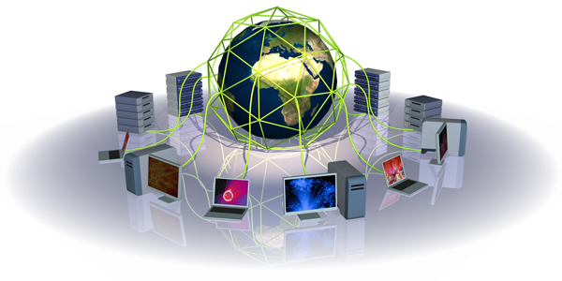




What is Apache Airavata?
An open source software framework for executing and managing computational jobs and workflows.
Supports local cluster, supercomputers, national grids, academic and commercial clouds.

Slide 3

Architectural Goals
Loosely Coupled Components.
Scalability.
Fault Tolerance.
Experiment Recovery.
Reliable Job Monitoring.
Fault Handling.
Security.
Workflow Enactment.

Slide 4

Terminology
Task – Single unit of execution.
Job – Special task which submit a Job to a computer resource.
Process – Collection of tasks. One process per Application
Experiment – User submit an experiment to Apache Airavata.
Workflow – More than one application per experiment.

Slide 5
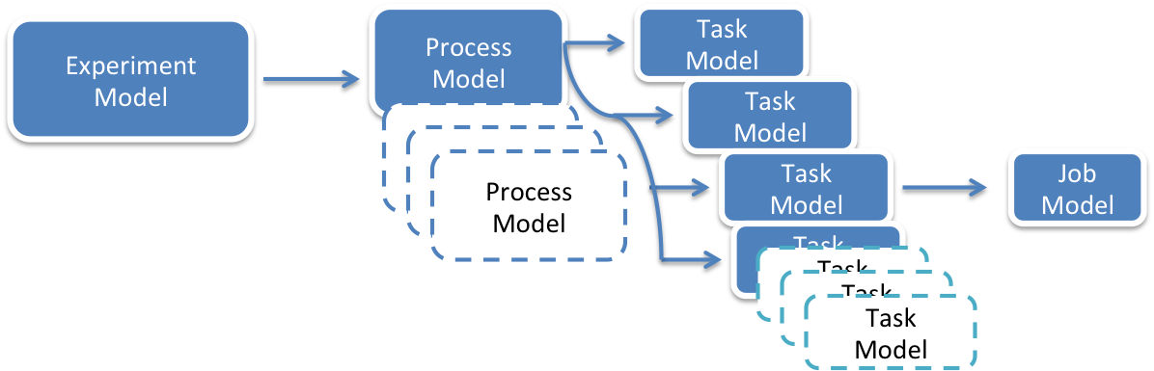
Relationship of Data Models

Slide 6
Loosely Coupled Components
Separation of Concerns - Each component has specific work to do.
AMQP based messaging provide inter component communications provides gateways a transparent white box view of Airavata inner happenings.
Easy to evolve with new technologies..
  Eg: WS Messaging replaced with widely used RabbitMQ broker.
Notes:
Airavata is a research based project, so we do research on several directions.
API Server – Hide all component from User
Orchestrator – Take Decision and Selection
GFac – Execute set of Tasks
Registry - Data Catalog
Workflow Interpreter – Workflow Enactment

Slide 7
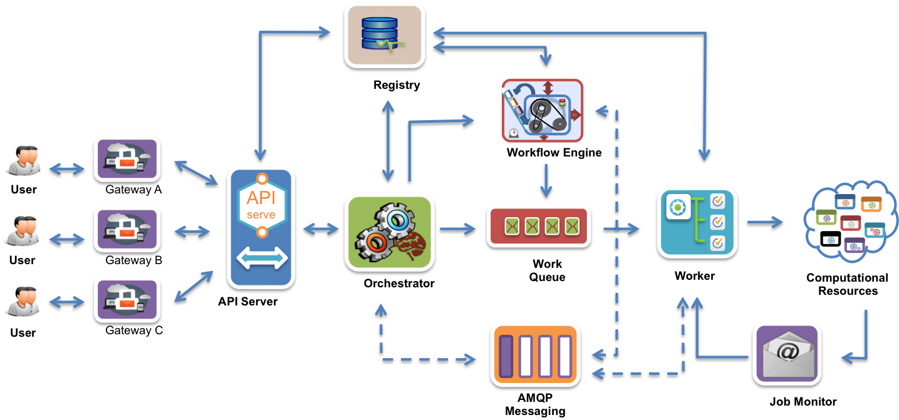
Airavata Component Architecture

Slide 8
Component Based Architecture(CBA) Pattern.
Reusable, Replaceable, Easy of development.
Airavata Components
  API Server – Hide all component from User.
  Orchestrator – Take Decisions and Selection.
  Worker – Execute set of Tasks.
  Registry - Data Catalog.
  Workflow Engine – Workflow Enactment.

Slide 9
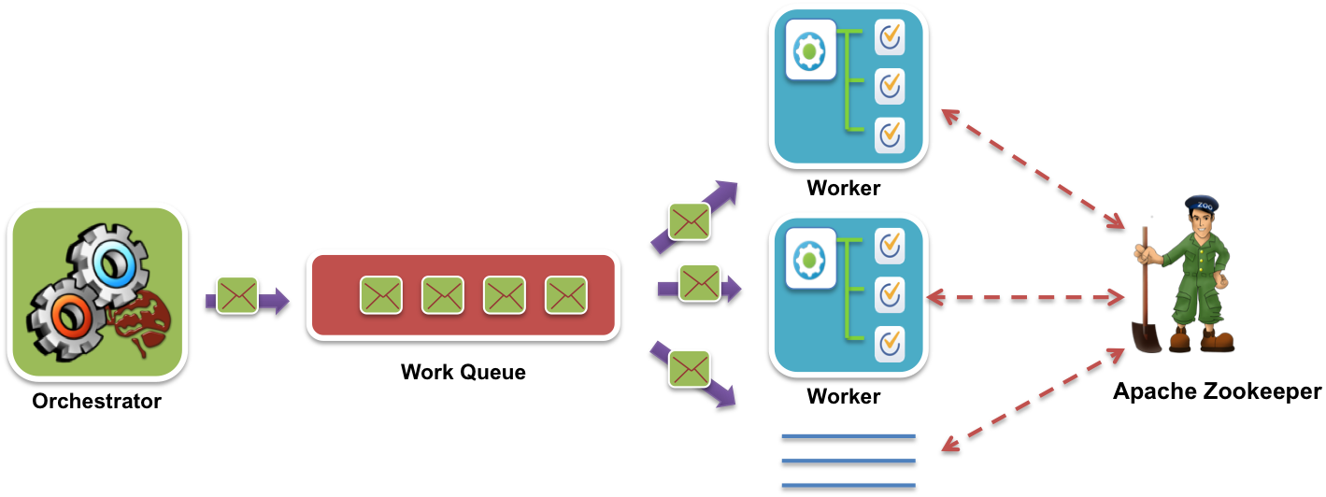
Scalability
Airavata worker capacity can be increased and decreased on demand to maintain performance and load spikes.
Workers scale horizontally.
Distribute jobs between workers using the internal work queue.
Notes:
Most of the real world scientific applications consume significant processing time to resolve a problem, even in supercomputers.
Applications may run for minutes, hours, even days with dataset.
Apache Airavata worker components can be scaled horizontally.
New worker instances can be added infinitely (Theoretically).
Job resubmit in case of server crash.
Able to serve large number of requests.

Slide 10
Fault Tolerance
To support long running jobs, it is important for the middleware to sustain network glitches and restarts the upgrades of the middleware services with maximum fault tolerance.
Airavata worker component which interacts with computational resource is fully fault tolerant.
Schedule or unscheduled component down time possible.
Airavata Components unlikely to be downed but VMs.
  Ultrascan deployment instances up and running smoothly.

Slide 11
Experiment Recovery
Experiment recovery in Airavata internal.
Work queue based process submission.
Status update in checkpoints.
Avoid duplicate job submission to computational resource.

Slide 12
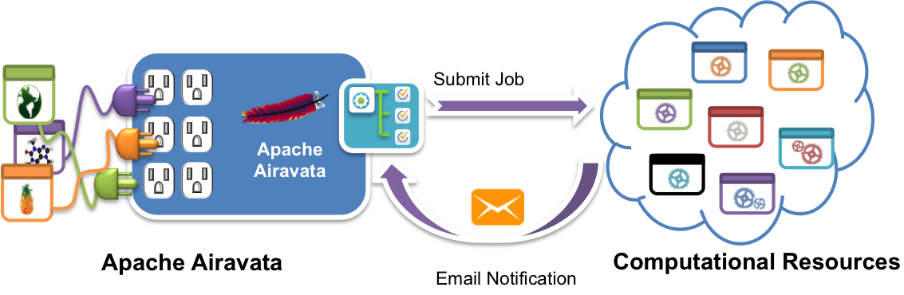
Reliable Job Monitoring
Polling job status by scheduler monitor commands doesn’t work always.
  Some schedulers remove completed jobs aggressively
Too many SSH connections to compute resource.
What are the alternatives? UDP, Demon & Email
Schedulers send email job notifications.
Notes:
Can fixe polling status by increasing keep_completed attribute on the job execution queue.
the most important operations in batch processing: job submission, job monitoring, and job control

Slide 13
Fault Handling
Retry job submission in SSH connection issues.
Identify input and output data staging failures.
Verify job status on computational resources after successful job submission.
Failure jobs identified by email notification and retrieve standard output and standard error.
Show useful error message to user on exceptions.

Slide 14




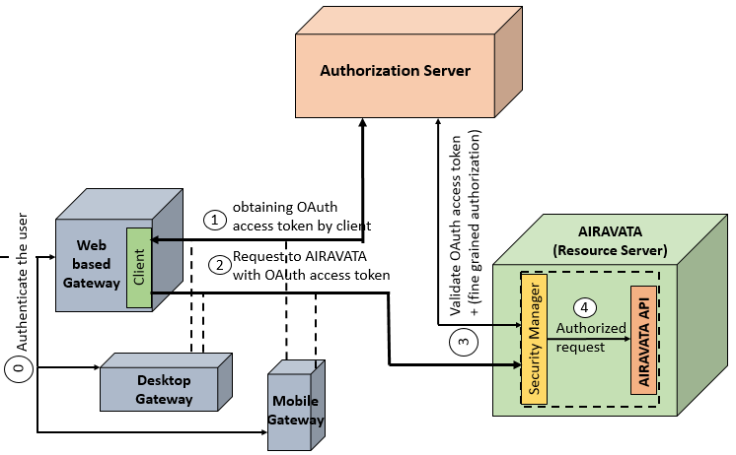
Security
Implemented in review and guidance by CTSC - Center for Trustworthy Scientific Cyberinfrastructure
Airavata API security with WSO2 IS.
Credential store manages all machine credentials.
  SSH keys
  SSH username & passwords.
Airavata provide user permission based on security role.
  Super administrator
  Administrator
  User
Apache
Airavata
Common API for Clients

Slide 15

Workflow Enactment
An experiment with more than one application is considered as a workflow in Airavata.
Airavata workflow interpreter manages dependency among applications and execute them.
Parallel execution of applications if possible.
Currently under development with new architectural changes.
Compose Workflows
Launch Workflows

Slide 16
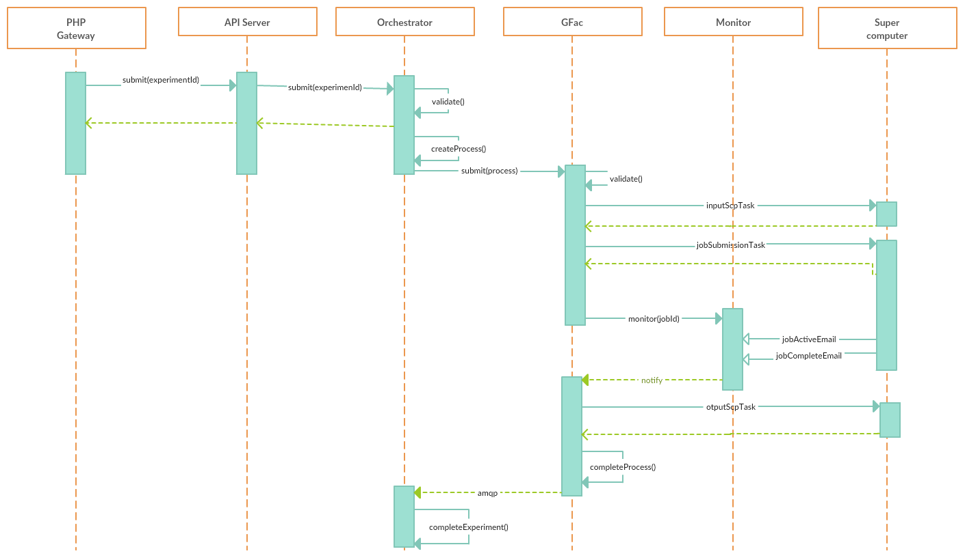
e.g: Experiment Launch

Slide 17

Questions ?
  syodage@indiana.edu

