Slide 1

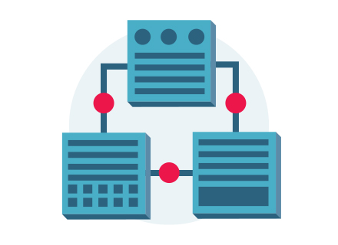


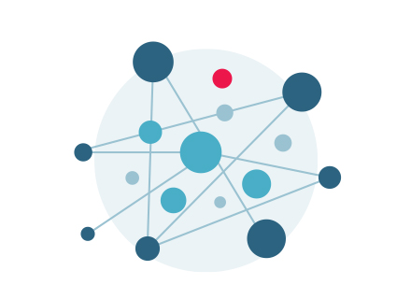


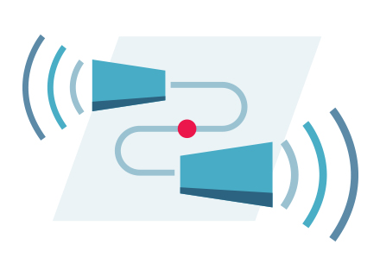
Airavata overview
Big Picture: How all the Tutorial Modules fit together

Slide 2
Airavata Overview
Airavata is a general purpose distributed system software framework build on micro-service and component based architecture principles.
Airavata provides capabilities to compose, manage, execute and monitor large scale applications and workflows on distributed computing resources.
Airavata supports executions on local clusters, national grids, academic and commercial clouds.
Airavata is inherently multi-tenanted.

Slide 3
Airavata PMC & Committers
Aleksander Slominski, IBM
Amila Jayasekara, IU
Ate Douma, One Hippo
Chathura Herath, Knight Capital
Chathuri Wimalasena, IU
Chris A. Mattmann, NASA JPL
Danushka Menikkumbura, Purdue
David Reagan, IU
Eran Chinthaka, Comprehend
Eroma Abeysinghe, IU
Heshan Suriyaarachchi, Concur
Lahiru Gunathilake, HighFive
Marlon Pierce, IU
Milinda Pathirage, IU
Nipurn Doshi, IU
Patanachai Tangchaisin, Ipsy
Raminder Singh, IU
Sachith Withana, WSO2
Saminda Wijeratne, Georgia Tech
Shahbaz Memon, JSC
Shahani Weerawarana, Auxenta
Shameera Rathnayaka, IU
Srinath Perera, WSO2
Supun Nakandala, UoM
Suresh Marru (Chair), IU
Thilina Gunarathne, KPMG
Viknes Balasubramanee, PernixData

Slide 4
Airavata as a Science Gateway Middleware
Airavata is dominantly used to build science gateways.
Airavata supports secured communications to HPC resources and empowers gateway operators to administer and monitor long running executions.
A reference PHP based gateway is provided to illustrate the Airavata capabilities and can be used to customize science-centric gateways

Slide 5
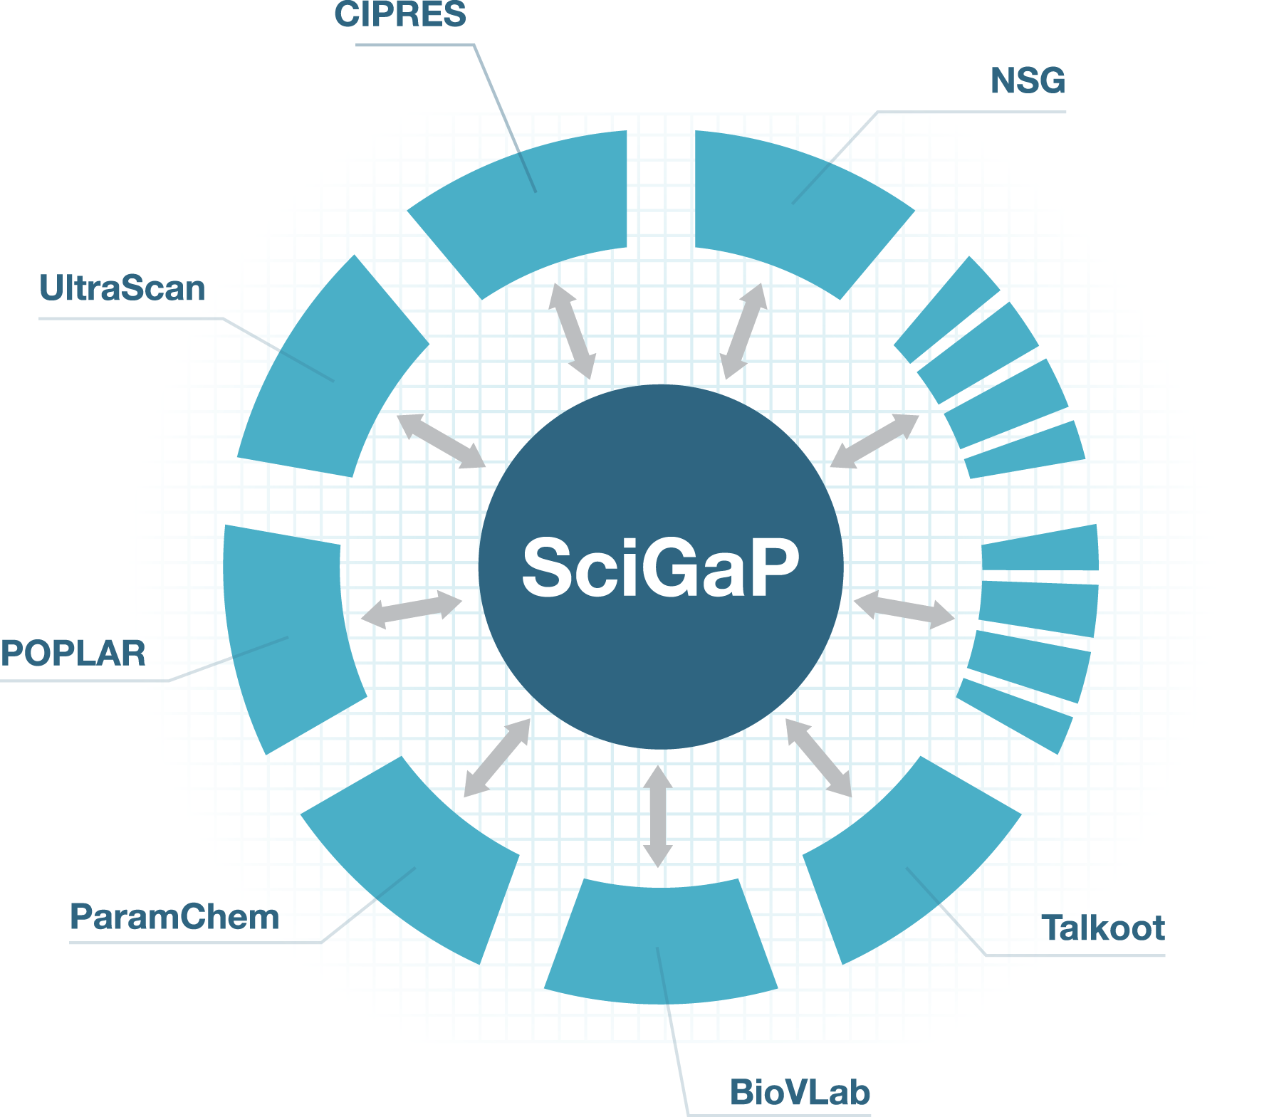

SciGaP Key Mission
Scale number of gateways without having to scale FTE’s needed to support them

Slide 6



SciGaP: Diverse and Complementing TEAM
PI: Marlon Pierce Co-I: Suresh Marru Sudhakar Pamidigantam Eroma Abayasinghe Chathuri Wimalasena Shameera Ratnayake Supun Nakandala | PI: Mark Miller Co-I: Amit Majumdar Terri Schwartz Kenneth Yoshimoto Subhashini Sivagnanam Paul Hoover | PI: Borries Demeler Gary E. Gorbet
GridChem Science Gateway | CIPRES Science Gateway | Ultrascan Science Gateway
IU Cyberinfrastructure Gateway | Neuroscience Gateway

Slide 7
Improve sustainability by converging on a single set of hosted infrastructure services
CIPRES
Neuro Science
Ultrascan
Param
Chem
DES SimWG
GAAMP
BioVLAB
Science Gateways
Science Gateway Platform as a Service (SciGaP)
Graphical Interfaces
Application Programmer Interface
Admin Dashboards
User Identity Management
Job & Workflow Management
Data & Provenance Management
Information, Monitoring & Auditing
Scalable
Load Balanced
Configurable
Fault Tolerant
Maintainable
Secure
Performance
XSEDE
OSG
Future Grid
Data Nets
Campus Clusters
Academic & Commercial Clouds
International Grids

Slide 8
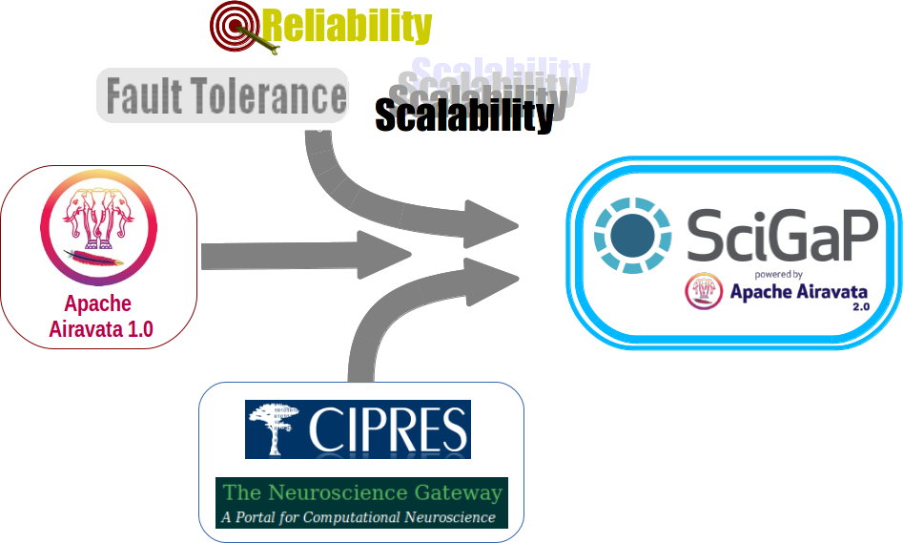

Slide 9
SciGaP Summary
Science Gateway Platform as a Service (SciGaP) provides application programmer interfaces (APIs) to hosted generic infrastructure services that can be used by domain science communities to create Science Gateways.
SciGaP hosted service platform is powered by Apache Airavata.
SciGaP helps gateway developers to concentrate their efforts on building their scientific communities and not worry about operations.

Slide 10
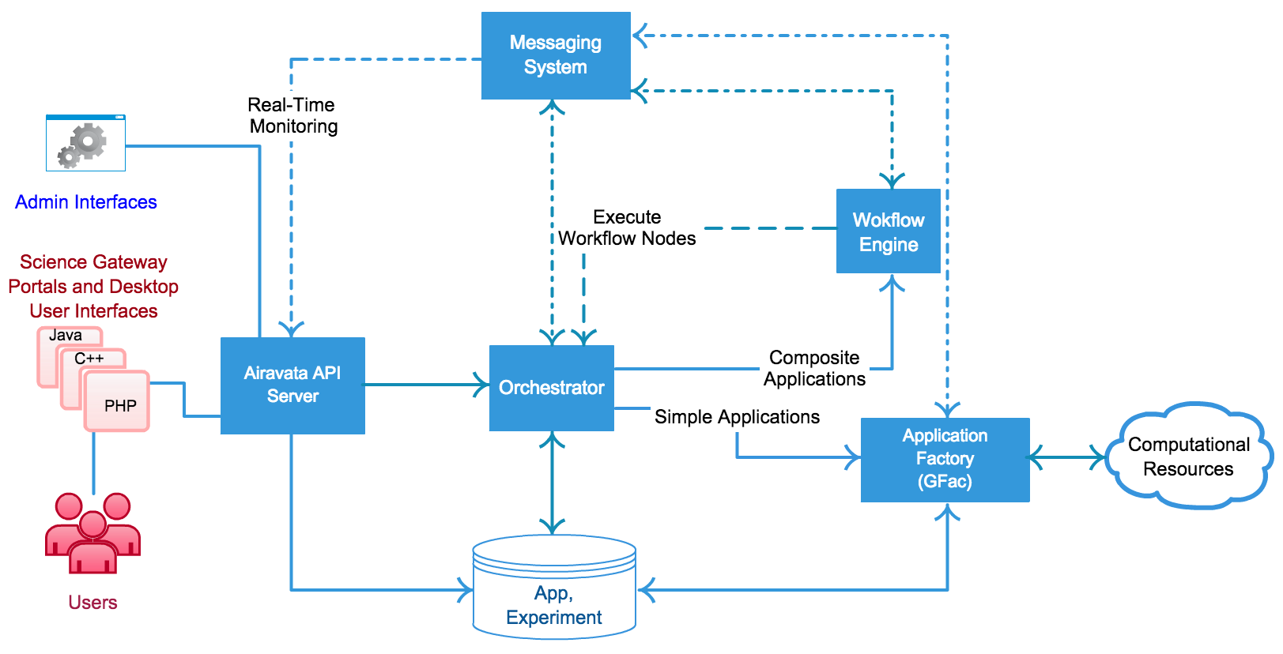
Airavata: Keep it simple, yet flexible

Slide 11
API’s & CPI’s
External clients interact with Airavata API (based on Apache Thrift).
Internally, components interact with each other through Component Programming Interfaces (thrift based CPIs).

Slide 12
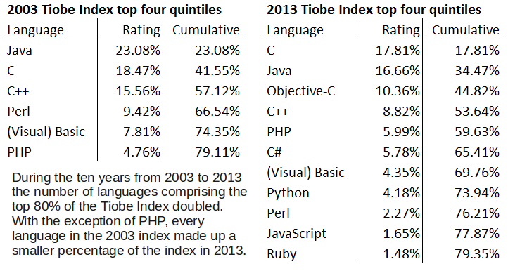
Gateways User Interfaces are Polyglot
Modern distributed applications are rarely composed of modules written in a single language.
Weaving together innovations made in a range of languages is a core competency of successful enterprises.
Cross language communications are a necessity, not a luxury.
* source: The Programmer’s Guide to Apache Thrift.

Slide 13
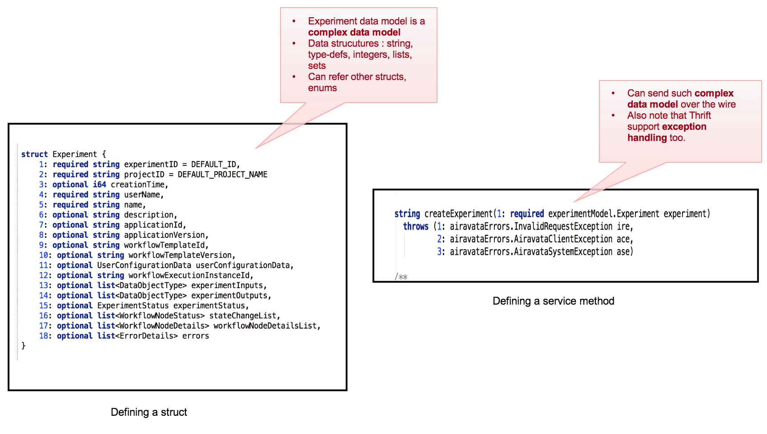
Apache Airavata API’s built over Apache Thrift
Clean way to define IDLs with richer data structures

Slide 14
Experiences with Thrift based API’s
Driving needs:
  Complex use cases evolve over time which challenges the need to preserve a cleaner design.
  Support native clients in various languages.
Thrift Advantages:
  API/CPI Servers can be built with robust implementations to switch based on QoS (TSimpleServer, TThreadPoolServer TNonblockingServer, THsHaServer).
  No need to marshall / unmarshall data – objects are transmitted as compact binary and generated models are used internally as well.
  Auto-generation of Client-SDK’s makes it easy to do modifications to the models.
  Convenient way to achieve backward compatibility.

Slide 15








Science Gateways:
Enabling & Democratizing Scientific Research
Advanced Science Tools
Computational Resources
Scientific Instruments
Algorithms and Models
Archived Data and Metadata
Knowledge and Expertise

Slide 16
Science Gateway Communities
Community | Gateway Capabilities
Multisite Collaborations and Virtual Organizations | Funded or unfunded, including self-organized communities, who need to collaborate and use a common pool of resources: SEAGrid, CIPRES, NSG, LEAD, ENZO……
Shared Instrument Facilities | Simplify access to instruments, support research derived from common data products: UltraScan, LIGO, DES, LSST…
Small Research Groups | “Long tail” of science, need to preserve the work that is done.
Campus Wide Resources | Simply use of complex Cyberinfrastructure. IU CyberGateway, Many other campus gateways and portals
Universities and Academic Departments | Provide simplified access to computing resources for students, faculty, and staff. Gateways supporting MOOCs

Slide 17
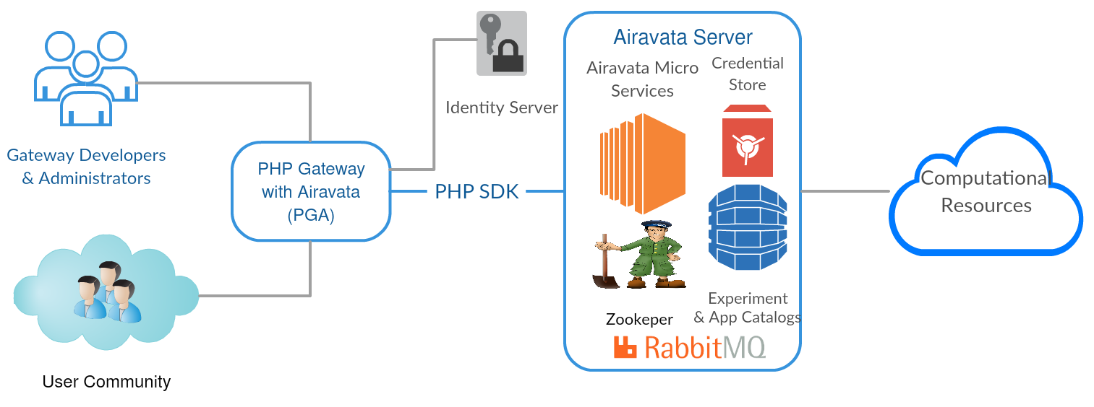
Gateway Anatomy mapped to Airavata
Gateway Middleware
Gateway User Interface

Slide 18
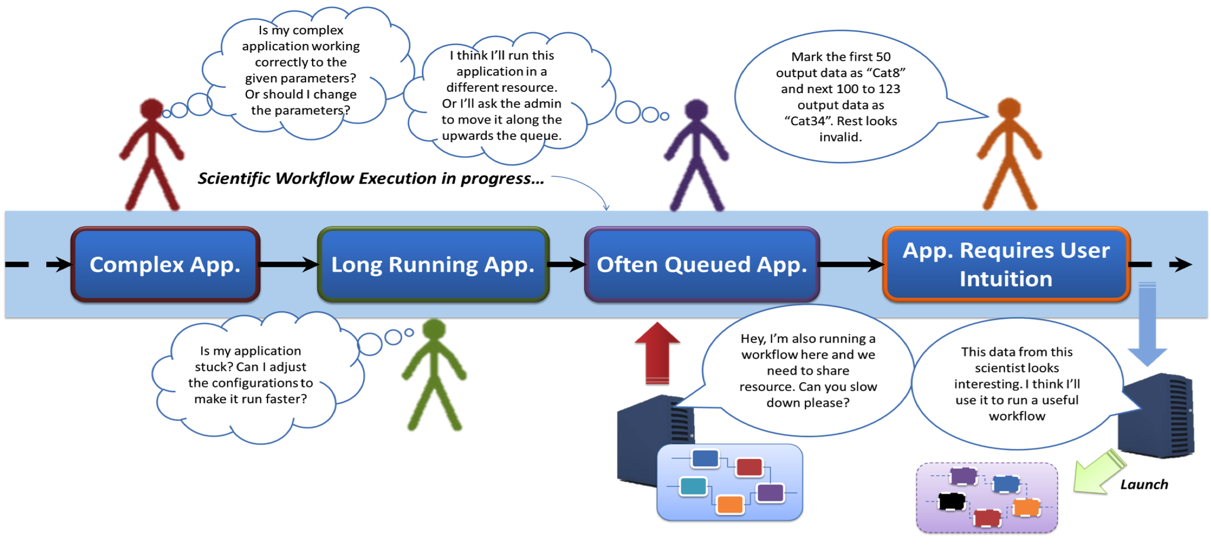
Apache Airavata: Supporting exploratory Science
How do we enable ￼￼“step by step evaluations”, “iterative/customized executions” and “periodic validations”

Slide 19
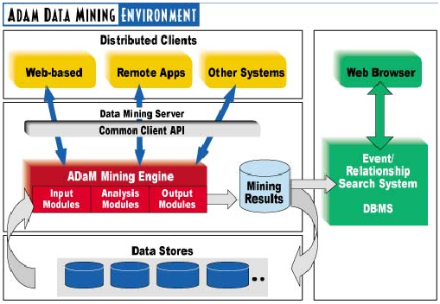

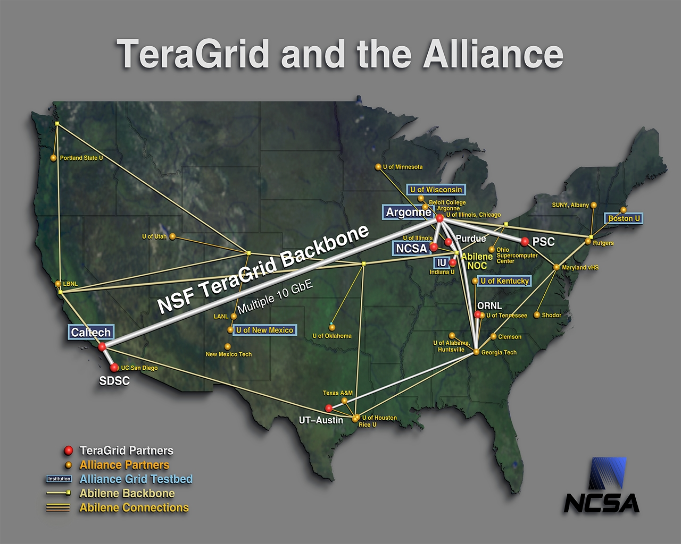
Initial Driver: Adapting Weather Prediction to Observational Sources Using Dynamic Adaptivity
Storms Forming
Forecast Model
Streaming
Observations
Data Mining
On-Demand
Grid Computing

Slide 20
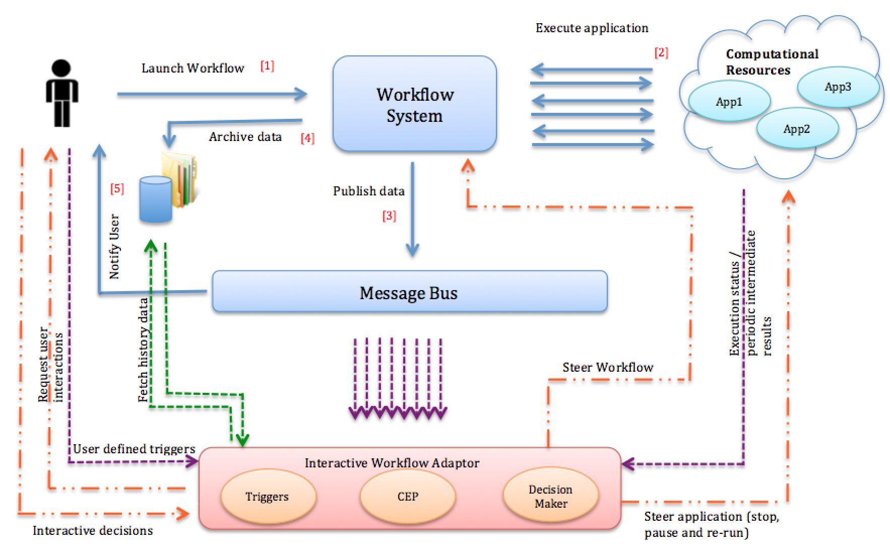
More Open Problems to Collaborate

Slide 21


Architecture Feedback: architecture@airavata.apache.org
Not so fast, My friend

Slide 22

What we learn from fellow Apache Projects:
Working collaboratively.
Constructive criticism is a blessing.
Commit early and commit often.
Test driven development
  https://cwiki.apache.org/confluence/display/AIRAVATA/Tests+in+Airavata
Don’t be afraid to make a change, after all version control systems (git, svn) can be trusted.

Slide 23
Community helps find New Stakeholders
Current stakeholders have been slow to adopt cloud computing.
Scientific “big data” could change this.
And we want Airavata to move beyond academic computing.
Where does Airavata fit in the stack?

Slide 24

Community Hangout
Mailing lists:
architecture@airavata.apache.org
dev@airavata.apache.org
users@airavata.apache.org
Direct Contact:
Marlon Pierce (marpierc@iu.edu)
Suresh Marru (smarru@iu.edu)

