Slide 1
Airavata Usecases from SEAGrid Applications and Workflows
Sudhakar Pamidighantam
pamidigs@iu.edu
4 Oct 2015

Slide 2
Some SEAGrid Supported Workflows
Multiple jobs – Highthrough-put
Application specific Post-processing on monitor prompt
Lammps-DS Workflows
Paramchem Workflows
Nek5000 Workflows
QuantmEspresso Workflows

Slide 3


Script Based high-throughput Job Creation

Slide 4
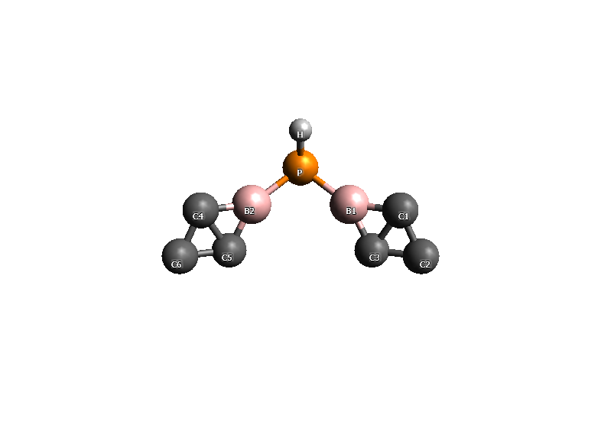

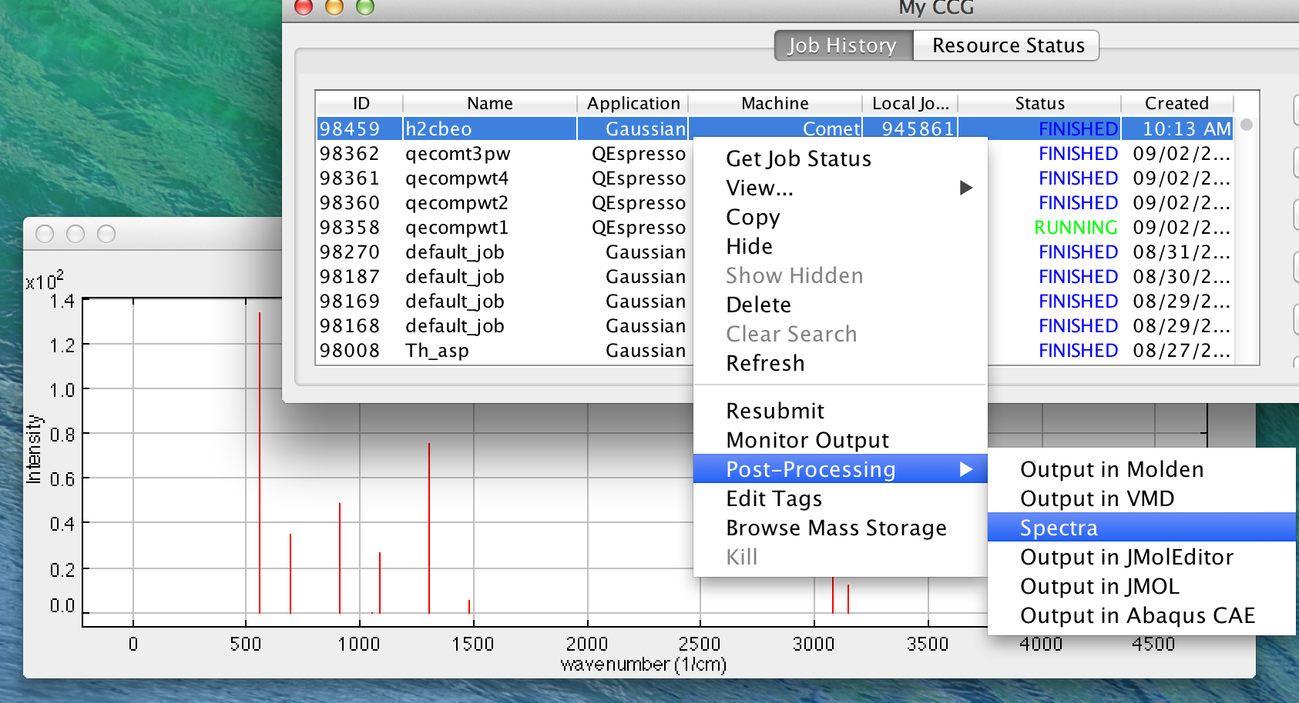
Monitoring QM Optimization/Frequency run

Slide 5
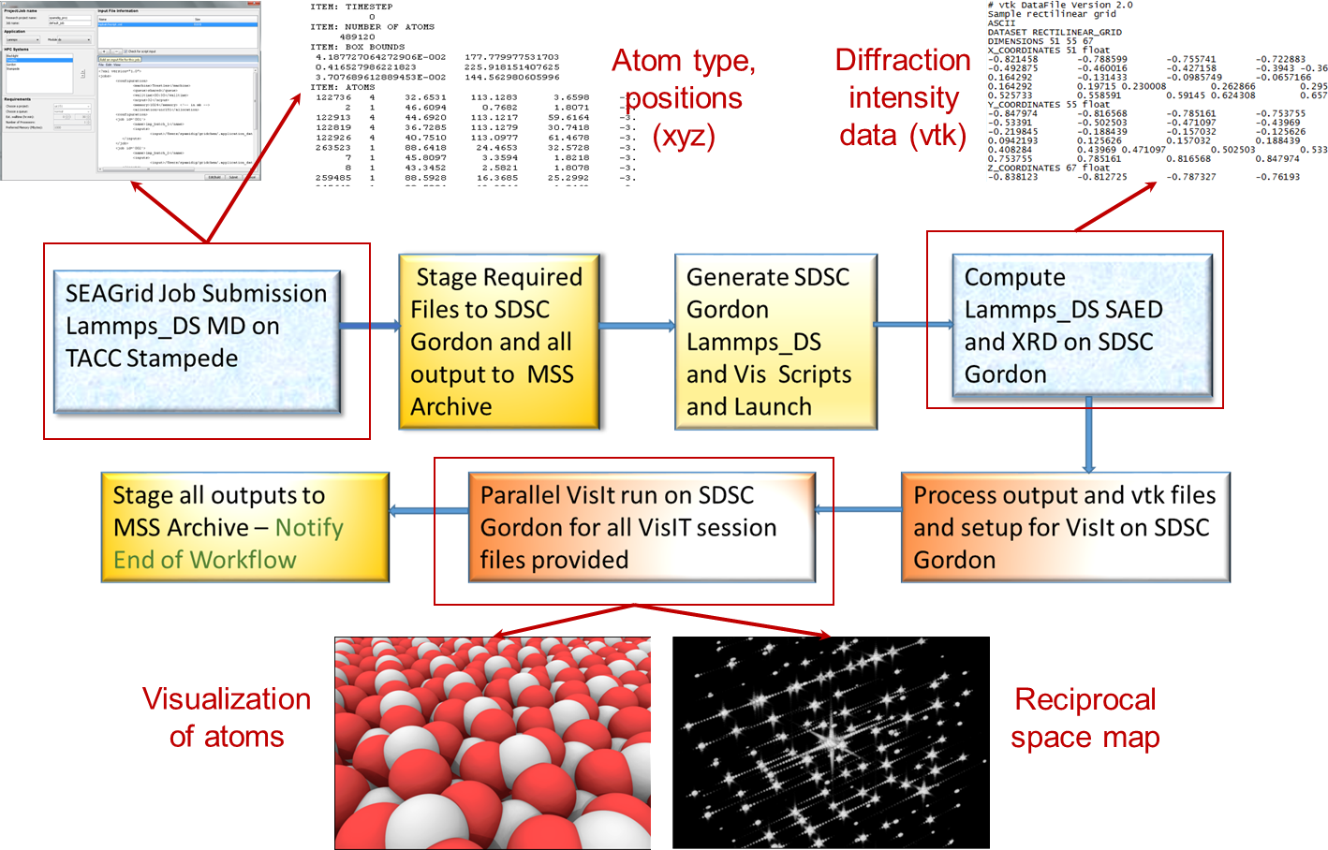
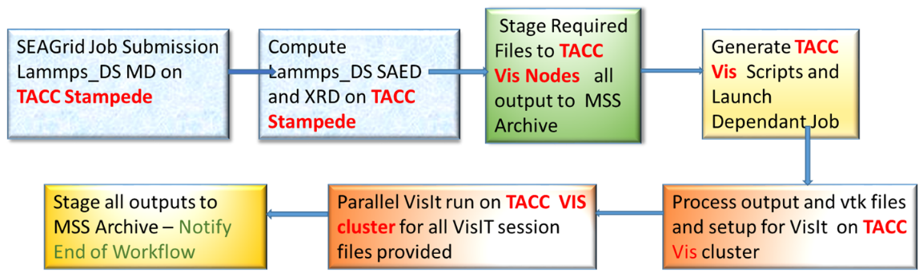
Workflow and Visualization
For large memory calculations a workflow is required to use the appropriate XSEDE resource
  TACC Stampede: Atomistic simulation of alumina
  SDSC Gordon: Calculation of diffraction intensities + Visualization
Workflow implemented through SEAGrid Science gateway
  Supports a private “DS” LAMMPS build
  Supports single jobID handle for multiresource job submission
  Supports the development of a XML script for high throughput job submission
  Compatible with parallel VisIt executions so that diffraction pattern generation is automated
Workflow to run on TACC resources only

Slide 6
Lammps-DS Workflow Steps
Lammps MD
Check for successful creation of dump files
Diffraction Compute
Vis input setup
Execute Visit (local) (if all nodes can be used)
Execute Visit-Diffraction Compute –on Gordon from stampede
Execute Visit – as a separate job on Vis queue on stampede

Slide 7
Variables for programs in the workflow
# Step 1 - Variables for running LAMMPS MD
PWD=`pwd`
export MPI1=`echo "$Nodes*16" | bc `
# Step 2 - Variables for running LAMMPS diffraction
export Diffraction_Base=DiffFromDumpLoop.in
export Find_Suffix1=dump
export Input=tmp_Input
export OpenMP=16
export MPI2=$Nodes
export MIC=240
# Step 3 - Variables for running VisIt
export MPI3=`echo "$Nodes*16" | bc `
export Find_Suffix2=vtk
# MVM: changed this
# MVM: render.py is a link to the most recent version
export Vis_Script="/home1/00421/ccguser/apps/ds_lammps/bin/render.py"
# MVM: changed this
# MVM: these are here because of CCG's file upload limits
export Vis_Session="/home1/00421/ccguser/apps/ds_lammps/data/*session"
# Step 1- LAMMPS MD simulation
# Step 2- Create unique LAMMPS jobs that run diffraction on each *.dump file
# Step 3- Multiple VisIt sessions creating images from *vtk files

Slide 8
Lammps MD Step
# Step 1 LAMMPS MD
echo "ibrun ~/apps/ds_lammps/bin/lmp_stampede < $Diskinputfile > ${job}.out" >> $qsubin
# if no dump files were created by lmp_stampede,
# then skip trying to submit a vis job
# on Gordon (or Stampede)
/bin/cat >> $qsubin << EOF
Ndumps=\`find . -type f -name \*dump | wc -l\`
if [ \$Ndumps -eq "0" ]
then
echo "No dump files were generated, skipping vis job." ;
else
echo "dump files generated, creating vis job."
fi
### New loopdiffraction.sh with MIC outputs

Slide 9
Lammps Diffraction Step
# Step 2 LAMMPS Diffraction Copute
Ndumps=\`ls -l *$Find_Suffix1 |wc -l\`
if [ \$Ndumps -eq "0" ]; then ; echo " No dump files found in $PWD ”; exit; fi
n=0
for i in *.$Find_Suffix1
do
D=\`echo \${i}\`; P=\`echo \${i%%.$Find_Suffix1}\`
tmp=\`echo \${i%%.$Find_Suffix1} | sed 's#^.*/##' | rev\`
N=\`echo "\${tmp%%_*}" | rev\`; sed 's/XXXXX/'\$N'/g' $Diffraction_Base > $Input.\$n
sed -i 's/DUMPFILE/'\$D'/g' $Input.\$n; sed -i 's/PREFIX/'\$P'/g' $Input.\$n
n=\$((\$n+1))
done
# Setting up environment variables
export SLURM_NNODES=$MPI2; export SLURM_TACC_NODES=$MPI2; export SLURM_NTASKS=$MPI2; export SLURM_TASKS_PER_NODE='1(x$MPI2)'
export SLURM_NPROCS=$MPI2; export SLURM_JOB_CPUS_PER_NODE='16(x$MPI2)’; export SLURM_JOB_NUM_NODES=$MPI2
export SLURM_TACC_CORES=$MPI2; export SLURM_TACC_NNODES_SET=1; export OMP_NUM_THREADS=$OpenMP
export MIC_OMP_NUM_THREADS=$MIC; export LAMMPS=/home1/00421/ccguser/apps/ds_lammps/bin/lmp_stampede
# Run LAMMPS Jobs
for i in \$(seq 0 \$n)
do
#ibrun tacc_affinity \$LAMMPS < $PWD/$Input.\$i > $PWD/$Input.\$i.out
ibrun tacc_affinity \$LAMMPS < $Input.\$i > $Input.\$i.out
done

Slide 10
Step 3 Visit setup
# Step 3 (On vis queue)
# Run multiple VisIt sessions for each *.vtk
#module load visit/2.7
# We will use visit from ccguser
export visit=/work/00421/ccguser/VisIt/visit2.7.2/src/bin/visit
Nvtk=\`ls -l *$Find_Suffix2 |wc -l\`
if [ \$Nvtk -eq "0" ]; then
echo " No vtk files found in $PWD "
exit
fi
Nmin=\`echo \$((\$Nvtk<$MPI3?\$Nvtk:$MPI3))\`
for i in \$(seq 1 \$Nmin )
do
mkdir tmp.\$i
cp $Vis_Script $Vis_Session tmp.\$i/
done
n=1
for i in *.vtk
do
cp \${i} tmp.\$n/
n=\$((\$n+1))
if [ \$n -gt \$Nmin ]; then
n=1
fi
done

Slide 11
Visit execution and file management
for i in \$(seq 1 \$Nmin )
do
#cd $PWD/tmp.\$i
cd tmp.\$i
ibrun -o \$i -n 1 \$visit -cli -nowin -quiet -s $Vis_Script &
cd ..
done
#cd $PWD/
jobs -p > JOB
for i in \$(seq 1 \$Nmin )
do
fg \`sed "\$i!d" JOB \`
done
wait
#mv -f $PWD/tmp.*/*png $PWD/
mv -f tmp.*/*png .
#rm -rf $PWD/tmp.* $PWD/JOB $PWD/$Input.*
#rm -rf $PWD/tmp.* $PWD/JOB $PWD/$Input.*
rename .0.vtk. . *png
rename .session.0000. . *png
#### End of new loopDiffraction
EOF
# Create the Vis specific files here
qsubin_vis="$TEMPDIR1/qsubin$$_vis"
test -f "$qsubin_vis" && /bin/rm $qsubin_vis
touch $qsubin_vis
chmod 700 $qsubin_vis
qsubin_uberftp_vis1=qsubin$$_uberftp_vis1
qsubin_uberftp_vis1="$TEMPDIR1/$qsubin_uberftp_vis1"
test -f "$qsubin_uberftp_vis1" && /bin/rm $qsubin_uberftp_vis1
touch $qsubin_uberftp_vis1
chmod 700 $qsubin_uberftp_vis1

Slide 12
Dependent Vis batch job
#echo "MVM: vis batch is being created based on $jobid" >> $qsubin
# MVM - create the qsubin_vis script
# MVM this is the Stampede vis job
VIS_BATCH="#!/bin/bash
#SBATCH -J ${job} #SBATCH -p vis #SBATCH -o ${job}.o%j #SBATCH -N 1 #SBATCH -n 1 #SBATCH -t 00:05:00 #SBATCH --mail-user=$email_addresses #SBATCH --mail-type=ALL #SBATCH -A TG-CHE080068N"
eval "echo \"$VIS_BATCH\" " >> $qsubin_vis
echo "set -x" >> $qsubin_vis
echo "echo \"copying render.py to pwd\" " >> $qsubin_vis
echo "jobdir=\"$job.$clustername.$jobid.$date_YYMMDD\" " >> $qsubin_vis
echo "export OutDir=/home1/00421/$USER/scratch/$GridchemUserid/$ResearchProject/\$jobdir" >> $qsubin_vis
echo "# SCRATCH_BATCH=\"/home/00421/$USER/$OutDir\" " >> $qsubin_vis
echo "#cd \$SCRATCH_BATCH" >> $qsubin_vis
echo "cd \$OutDir" >> $qsubin_vis
echo "cp /home1/00421/ccguser/apps/ds_lammps/bin/render.py ." >> $qsubin_vis
echo "echo \"loading visit module\" " >> $qsubin_vis
echo "module load visit" >> $qsubin_vis
echo "echo \"timing visit run\" " >> $qsubin_vis
echo "time visit -cli -nowin -quiet -s render.py >> ${job}.out 2>&1" >> $qsubin_vis
echo "cp * \$OutDir " >> $qsubin_vis
echo ". $qsubin_uberftp_vis1" >> $qsubin_vis
echo "exit" >> $qsubin_vis
# MVM - submit the qsubin_vis script
# eval "$qsub --dependency=afterok:$jobid $qsubin_vis"

Slide 13
Gordon Offloading for Vis Compute
# MVM: 20140318 Commenting this section out as we're returning to
# doing both compute and vis on stampede.
# qsubin_uberftp_gordon_vis=qsubin$$_uberftp_gordon_vis
# qsubin_uberftp_gordon_vis="$TEMPDIR1/$qsubin_uberftp_gordon_vis"
# test -f "$qsubin_uberftp_gordon_vis" && /bin/rm $qsubin_uberftp_gordon_vis
# touch $qsubin_uberftp_gordon_vis
# chmod 700 $qsubin_uberftp_gordon_vis
# ssh_gordon_sh=ssh$$_gordon_sh
# ssh_gordon_sh="$TEMPDIR1/$ssh_gordon_sh"
# test -f "$ssh_gordon_sh" && /bin/rm $ssh_gordon_sh
# touch $ssh_gordon_sh
# chmod 700 $ssh_gordon_sh
#TODO - create gordon cleanup script here.
# START of script that ssh on login1.stampede will use to copy files to Gordon
# echo "#!/bin/bash" >> $ssh_gordon_sh
# echo "set +x" >> $ssh_gordon_sh
# echo "module load GLOBUS-5.0" >> $ssh_gordon_sh
# # mvm: note to self, this confuses me, $X509_USER_PROXY exists, but I still have to
# # export it?
# echo "echo X509_USER_PROXY: $X509_USER_PROXY" >> $ssh_gordon_sh
# echo "export X509_USER_PROXY=$X509_USER_PROXY" >> $ssh_gordon_sh
# echo "grid-proxy-info" >> $ssh_gordon_sh
# echo "gsissh gordon.sdsc.edu mkdir $GridchemUserid/$ResearchProject/\$jobdir" >> $ssh_gordon_sh
#
#
# echo "cd \$OutDir" >> $ssh_gordon_sh
# echo "for f in *" >> $ssh_gordon_sh
# echo "do" >> $ssh_gordon_sh
# echo " gsiscp \$f gordon.sdsc.edu:$GridchemUserid/$ResearchProject/\$jobdir" >> $ssh_gordon_sh
# echo "done" >> $ssh_gordon_sh
#
# # LoopDiffraction_normal.sh creates the PBS job script, SubmitScript, only; it still has to be submitted.
# echo "gsissh gordon.sdsc.edu <<EOF
# cp apps/ds_lammps_hybrid/bin/LoopDiffraction_normal.sh $GridchemUserid/$ResearchProject/\$jobdir
# cd $GridchemUserid/$ResearchProject/\$jobdir
##
# sed -i \"s%^EOF%gsiscp ./images.tar.gz $mss_machine:mss/$topdir_name/$GridchemUserid/$ResearchProject/\$jobdir\nEOF%\" ./LoopDiffraction_normal.sh
# sed -i \"s%^EOF%gsiscp ./*.xrd $mss_machine:mss/$topdir_name/$GridchemUserid/$ResearchProject/\$jobdir\nEOF%\" ./LoopDiffraction_normal.sh
# sed -i \"s%^EOF%gsiscp ./*.vtk $mss_machine:mss/$topdir_name/$GridchemUserid/$ResearchProject/\$jobdir\nEOF%\" ./LoopDiffraction_normal.sh
#
# ./LoopDiffraction_normal.sh

Slide 14
Gordon job submission
# qsub SubmitScript
#EOF" >> $ssh_gordon_sh
# #echo "gsiscp $qsubin_uberftp_gordon_vis gordon.sdsc.edu:$GridchemUserid/$ResearchProject" >> $ssh_gordon_sh
# # END of scrpt
# This starts the process of connecting to Gordon
# Define $jobdir with current information in the script before running
# /bin/cat >> $qsubin << EOF
# export jobdir=\$jobdir
# export OutDir=\$OutDir
# sed -i "s/export/export jobdir=\$jobdir \nexport/" $ssh_gordon_sh
# sed -i "s%export%export OutDir=\$OutDir \nexport%" $ssh_gordon_sh
# ssh login1.stampede.tacc.utexas.edu $ssh_gordon_sh > ssh_gordon.out 2>&1
#fi #end of Ndump conditional
#EOF
fi # closes check for gordon clustername
fi # closes check for $PROGRAM_TO_RUN

Slide 15
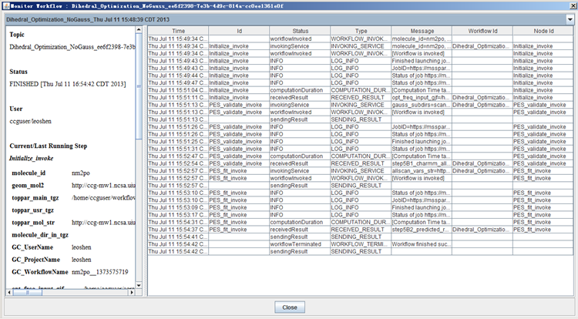
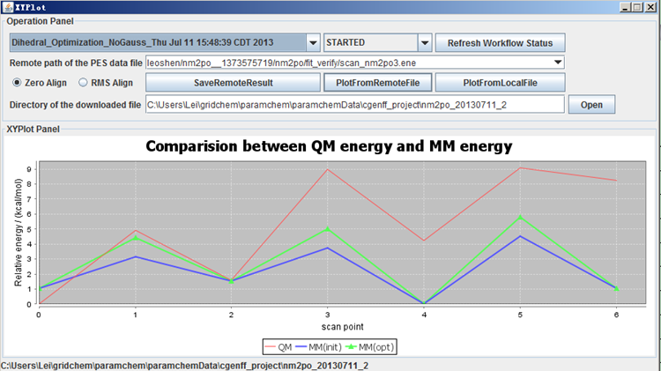
Workflow Monitor and Validation of the dihedral parameters
"lsfitpar" program for robust fitting of bonded parameters: http://doi.org/10.1002/jcc.23897

Slide 16
Nek5000 Based Vortex Shedding Workflow
Arne Pearlstein UIUC
http://gw165.iu.xsede.org/vortexshedding/
Workflow Contains multiple steps
Multiple File staging
Extraction of base name and creating additional inputs
Prepare mapfile
- prepare genmap input
4. Run genmap
5. Compile nek5000 with user subroutines and parameters
6. Run nek5000 for production
7. Prepare Visit inputs and Environment
8. Run Visit for individual images
9. Run ffmpeg for making a movie

Slide 17
Running Nek5000 workflow Steps 1-4
Basename=${Diskinputfile%.*} #Get basename (remove extension)
echo "export Basename=${Diskinputfile%.*}" >> $qsubin
echo "cp -p $Diskinputdir/$Basename.* ." >> $qsubin
echo "cp -p $Diskinputdir/*.usr ." >> $qsubin
echo "cp -p $Diskinputdir/SIZE ." >> $qsubin
echo "echo $Basename > ./SESSION.NAME" >> $qsubin
echo "echo \`pwd\`'/' >> ./SESSION.NAME" >> $qsubin
#Prepare mapfile
#prepare genmap input
echo "$Basename" > genmap.in
echo "0.2" >> genmap.in
#Run genmap
/home/gridchem/bin/genmap < genmap.in

Slide 18
Running nek5000 workflow Steps 5-9
# compile nek5000
cp -r /home/gridchem/apps/nek5000/nek5/trunk/nek/makenek .
chmod 755 makenek
./makenek $Basename
#Run nek
mpirun -np 24 ./nek5000 $Basename > session.log
sleep 2
ln $Basename.log logfile
ln $Basename.log $Basename.out
/home/gridchem/apps/nek5000/nek5/trunk/tools/scripts/visnek
# MVM - 20150707 VisIt for Nek5000
module unload mvapich2_ib
module unload intel
Module load gnu openmpi_ib li
export NODE_MEMORY=`free -k | grep ^Mem: | awk '{ print $2; }'`
NODE_MEMORY_LIMIT=\`echo 0.95*\$NODE_MEMORY / 1 | bc\`
ulimit -v \$NODE_MEMORY_LIMIT -m \$NODE_MEMORY_LIMIT
# launch visit to run our script render.py as batch process
/opt/visit/bin/visit -nowin -cli -s /home/gridchem/render.py
#Set ffmpeg environments and run to create the movie
export LD_LIBRARY_PATH=/home/gridchem/apps/ffmpeg/2.7.2/lib:\$LD_LIBRARY_PATH
export LD_LIBRARY_PATH=/home/gridchem/apps/x264/20150727/lib:\$LD_LIBRARY_PATH
/home/gridchem/apps/ffmpeg/2.7.2/bin/ffmpeg -r 30 -f image2 -s 1280x720 -i "$Basename"_%04d.png -vcodec libx264 -qp 0 $Basename.mp4

Slide 20
QuantumEspresso Workflows
Multiple modules in QuantumEspresso
Extract prefix (basename) from input
If job is a continuation of previous run get the previous JobID
Run pw scf run (pw.x)
Run non scf single point run
Run Bands
Run 3d plot of wavefunctions for Xcrysden

Slide 21
QuantumEspresso environments
module load qe
export SCRATCH=\$SCRATCH_BATCH
export PSEUDO_DIR=/home/gridchem/apps/QEspresso/upf_files
export TMP_DIR=\$SCRATCH
export PW_EXE=\$QEHOME/bin/pw.x
export PP_EXE=\$QEHOME/bin/pp.x
export BANDS_EXE=\$QEHOME/bin/bands.x
export PL_BAND_EXE=\$QEHOME/bin/plotband.x
export QE_PREFIX=`grep -i prefix $Diskinputfile | awk -F= '{print $2}'| sed "s/'//g;s/ //g;s/^M//g"`

Slide 22
Slurm node setup
#Generate a hostfile from the slurm node list
export SLURM_NODEFILE=\`generate_pbs_nodefile\`
#Find the unique hosts and copy data to the local scratch
#Check copytoscratch.sh file and change source location if needed
cat \$SLURM_NODEFILE > nodes.list
uniq nodes.list > nodes.unq.list
export NNODES=\`cat nodes.unq.list |wc -l\`
cp ~/bin/copytoscratch.sh .
#Change to the scratch directory
#mpirun_rsh -export -hostfile ./nodes.unq.list -np \$NNODES ./copytoscratch.sh
#cd /scratch/$USER/$SLURM_JOBID/ESPRESSO

Slide 23
Non SCF and Dependent Bands execution
if [ $PROGRAM_TO_RUN = "nscfwb" -o $PROGRAM_TO_RUN = "bandsqe" ]; then
export PJobID=`grep -i localjobid $Diskinputfile | awk -F= '{print $2}' | sed "s/^M//"` >> $qsubin
/bin/cat >> $qsubin << HERE2
#export PJobID=`grep -i localjobid $Diskinputfile | awk -F= '{print $2}' | sed "s/^M//"`
cd /oasis/scratch/comet/gridchem/temp_project/$PJobID
cp \$SCRATCH/$Diskinputfile .
export OMP_NUM_THREADS=1
HERE2
fi
if [ $PROGRAM_TO_RUN != "bandsqe" ]; then
mpirun_rsh -hostfile \$SLURM_NODEFILE -np $cpus \$PW_EXE < $Diskinputfile >| \$Diskoutputfile_with_dir >> $qsubin
fi
/bin/cat >> $qsubin << HERE3
if [ -d \$QE_PREFIX.save ]; then
#cd out
# post-processing for band structure
cat > \$QE_PREFIX.bands.in << EOF
&bands
prefix = '\$QE_PREFIX'
outdir = './'
filband = '\$QE_PREFIX.bands.dat'
/
EOF
which \$BANDS_EXE
mpirun_rsh -hostfile \$SLURM_NODEFILE -np $cpus \$BANDS_EXE < \$QE_PREFIX.bands.in >| \$QE_PREFIX.bands.out
#cd ..
else
echo "Error in pw scf run. Bands not executed."
fi
HERE3

