Slide 1
Data Lake and HAWQ Integration
LU WENBIN

Slide 2
Agenda
Data Lake
Analytic Insights Module From Dell EMC
HAWQ Integration

Slide 3
Data Lake

Slide 4
A Typical Data Scientist
My friend, a data scientist who works for a leading bank in US, told me his working content
Data Gathering: From internal RDBMS, Hadoop, Document Store and external government or third-party data source.
Data Cleansing: Normally to integrate data and reduce dimension. Put cleaned data into division Unix File Server, normally in SAS format.
Data Analysis: Uses SAS normally. Trend analysis, Prediction, Time serious analysis, clustering analysis, etc. Analysis result and reports still stores back into division owned Unix file server. BI/IT team is involved for data sharing.

Slide 5
Problems
Data is not integrated: Creates a lot of Data Silos in the enterprise
Data is not easy to share: To share data, one data scientist need to inform BI team to put the data into data warehouse and used by another team for analysis, a lot of manual work
Data is not indexed and cataloged
No single catalog for users to search and find data
Data Lineage is not preserved
No well-designed data governance and auditing

Slide 6
Data Lake
Pentaho CTO James Dixon has generally been credited with coining the term “data lake”.
A data lake is like a body of water in its natural state. Data flows from the streams (the source systems) to the lake. Users have access to the lake to examine, take samples or dive in.

Slide 7
Difference from Data Warehouse
Data Lake retains all data: Compared to the selected and special designed and transformed data in the data warehouse
All Data Format: “Schema on Read of Data Lake” vs “Schema on Write of Data Warehouse”
User friendly to all: Compared to the report oriented Data Warehouse users, Data Lake has a much wide audience, especially to Data Scientist
Adapts fast to changes
Still the rigid data format and cost way to design and build of Data Warehouse.
On the other hand, Data Lake stores the raw data

Slide 8
Business Ready Data Lake
Data Ingestion
From a wide range of internal and external data sources
Load the data as-is
Data Indexing and Catalog
Data lineage and Governance
Easy to analysis
Data Sharing
Action for surface and management users

Slide 9
Analytic Insights Module
Gather Analyze Act

Slide 10
Analytic Insights Module
Analytic Insights Module is engineered by DELL EMC to combine self-service data analytics, with cloud-native application development into a single cloud platform. It enables organizations to rapidly transform data into actionable insights with high business value
Gather: Gather the right data with deep awareness through powerful indexing and ingestion capabilities with data centric security and lineage.
Analyze: Analyze data through a self-service experience with a choice of expansive ecosystem tools and cataloged data sets for reuse.
Act: Act to operationalize insights into data-driven applications, new business process and enhanced customers engagements.

Slide 11
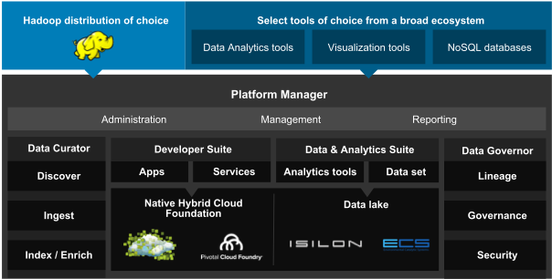
Solution Architecture

Slide 12
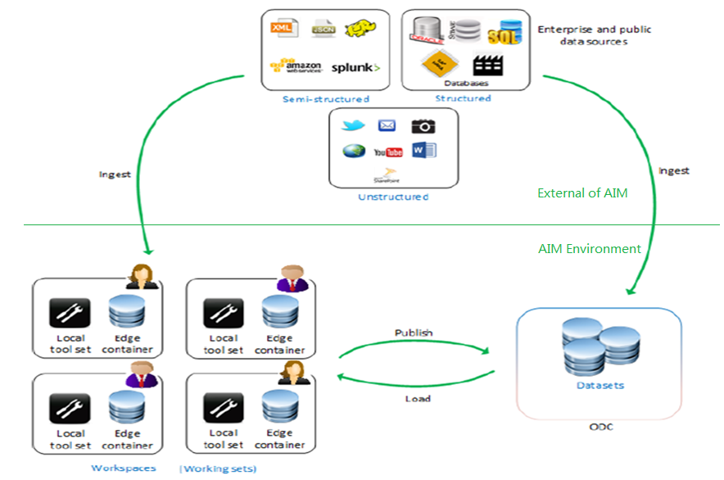
Data Flow

Slide 13
Functions
Data Curator
Attivio DSD for source data discovery
Zaloni Bedrock for data ingestion pipeline
Consolidated data lineage tracking
Data Scientist
Self-service analysis environment
Open Architecture for adopting any data analysis and visualization tools
Easy and efficient data sharing
Global data view and index for quick search

Slide 14
Functions Cont.
Data Governor
BlueTalon for global security policy configuration, enforcement and auditing
All data access is enforced by BlueTalon Policy Enforcement Point for different data containers, i.e. HDFS, Hive, HAWQ, etc
IT/Admin
Built on Hyper-Converged Infrastructure EMC VxRail
PCF as PAAS
Open architecture to deploy Big Data Suite: CDH, HDP, Mongo, etc.
Fine-grained quota setting
System Monitoring
Integrated Logs Analysis

Slide 15
Functions Cont.
App Developer
PCF for Native Cloud Apps development
Extremely easy to develop data driven application
All data container has PCF User Provided Service exposed

Slide 16
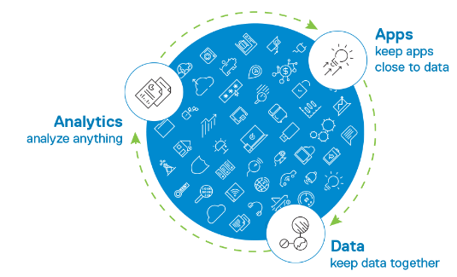
Demo Video
https://www.emc.com/en-us/solutions/big-data/analytic-insights.htm

Slide 17
HAWQ Integration
Provided as one of SQL on Hadoop tool in AIM
Some of our customers widely use HAWQ
Automatic provision
Data Ingestion into HAWQ table
HAWQ table sharing between Data Scientists
Data Access Security of HAWQ

Slide 18
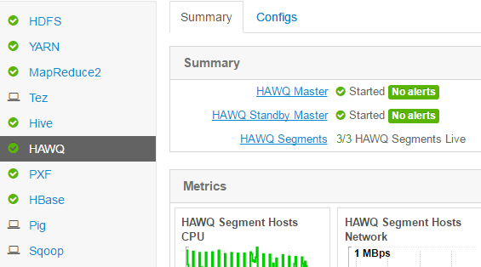
Automatic Provision
HDP 2.5 with HDB 2.1.0 and PXF
Automatically deployed with HDP
Integrated with Dell EMC Isilon Storage

Slide 19
Data Ingestion into HAWQ
Data can be ingested into HAWQ in three ways:
Dirt Way: Data Scientist manually created the HAWQ table and use whatever ways to ingest data into HAWQ table.
Paved Way: Data Scientist can use pre-created Ingestion Pipeline to bring data into their own workspace HAWQ
The pipeline starts from data discovery.
Direct into ODC: Data Admin can use pre-created Ingestion Workflow to ingest external files directly into Operational Data Container (ODC) as published HAWQ table

Slide 20
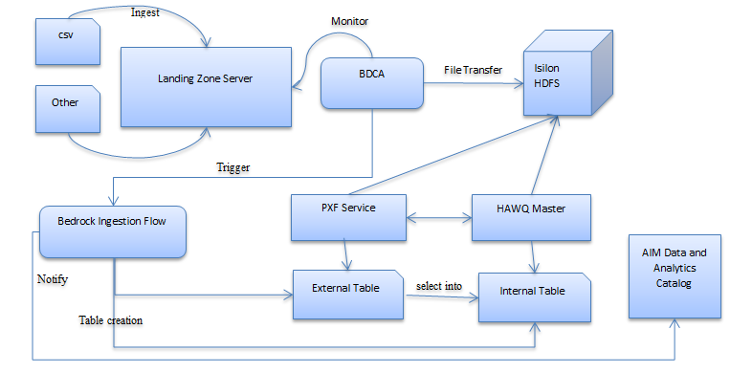
ODC HAWQ Ingestion Architecture

Slide 21
ODC HAWQ Ingestion Detail
We use Zaloni Bedrock as the Ingestion Engine, which has a component called BDCA to monitoring the incoming files and transfer into HDFS
Zaloni Bedrock as ingestion workflow manager
Zaloni guarantees the data quality during ingestion
Based on the incoming file, an external Table and an internal HAWQ table will be created
External Table uses PXF to connect to the HDFS location
After File Ingestion is completed, External table will be “selected into” internal table. External table will be dropped.
Notify Data And Analytics Catalog (DAC) component

Slide 22
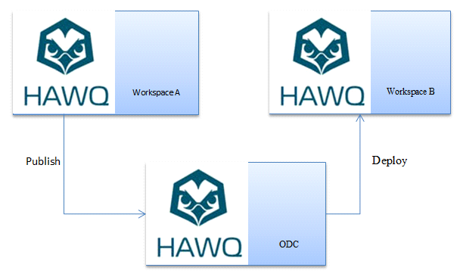
Data Scientist Share HAWQ Table

Slide 23
Data Scientist Share HAWQ Table
The problem is how to migrate between HAWQ clusters
General Steps:
Get Table Underlying HDFS Location from Catalog Table
Transfer Source HAWQ HDFS files into target HAWQ HDFS using EMC Isilon API
Use hawq extract to extract the source table metadata
Modify the yaml file HDFS location and DFS location
Use hawq register to register into target HAWQ
Issue an “analyze” to refresh target table statistics

Slide 24
For Non-Partitioned Table
pg_database:
1) dat2tablespace (table space id)
2) oid (database id)
pg_class and pg_namespace:
relfilenode (table id)
pg_filespace_entry and pg_filespace:
fselocation (HDFS HAWQ Directory)
Based on the above information, we can identify the HDFS location of the table as:
fselocation/dat2tablespace/(database)oid/relfilenode/

Slide 25
For One-Level Partitioned Table
Only one-level partitioned table is supported now
In addition to non-partitioned table, pg_partitions is used to get partitionschemaname and partitiontablename
Iterates from each partitions above:
Get partitioned table relfilenode (table id) from pg_class and pg_namespace
Then, all partitioned table’s HDFS location are:
fselocation/dat2tablespace/(database)oid/[List]relfilenode/

Slide 26
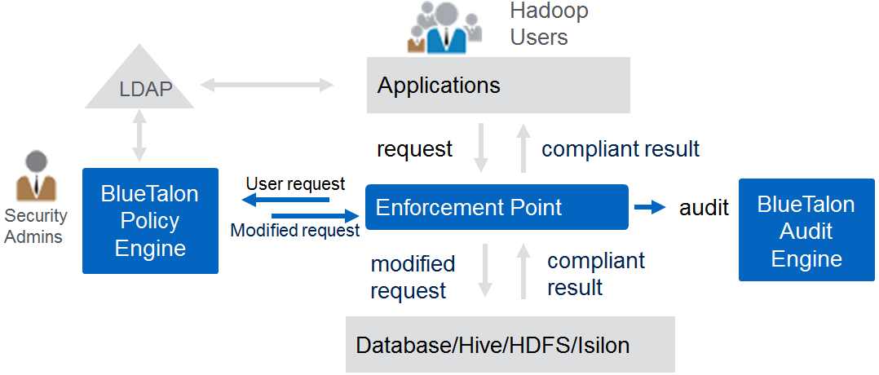
Data Access Protection for HAWQ
We used a partner product BlueTalon as the global policy and enforcement engine.
It protects all our data containers like: Isilon HDFS, Hive, HAWQ, etc.

Slide 27
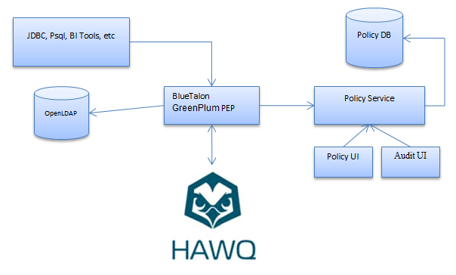
Data Access Protection for HAWQ

Slide 28
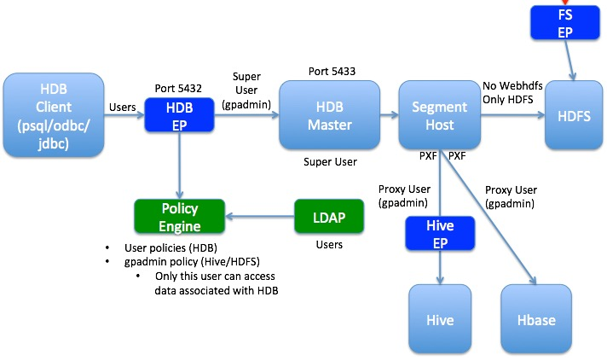
Data Access Protection for HAWQ

Slide 29
Data Access Protection for HAWQ Cont.
GreenPlum Policy Enforcement Point is automatically deployed and configured
GreenPlum Data Domain is added for the specified HAWQ
User Domain is integrated with LDAP group
BlueTalon service account is created on HAWQ
BlueTalon service account is added into hba.conf
BlueTalon has integrated policy setting, enforcement and auditing control and display

Slide 30
Thank you!

Slide 31
Q&A

