Slide 1
HAWQ TRANSACTION INTRODUCTION
Ming Li （李 明）
Email: mli@pivotal.io
mli@apache.org
Co-branded Logo here

Slide 2
Agenda
PostgreSQL transaction Introduction
HAWQ Transaction Design
Recovery consideration
Hints in production environment
About Us

Slide 3
PostgreSQL TRANSACTION INTRODUCTION

Slide 4
MVCC (Multiple Version Concurrency Control)
Multiple Version representation:
          Version indication
          Relationship between tuple and transaction
The relationship between old version and new version
Data struct & functions

Slide 5
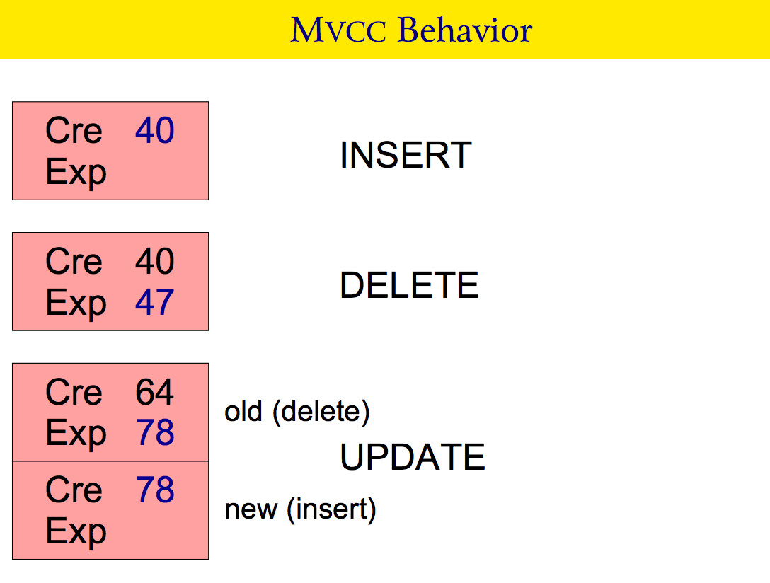

Slide 6
Snapshot – filter to see the specific version
MVCC snapshots control which tuples are visible for specific statement in a transaction

Slide 7
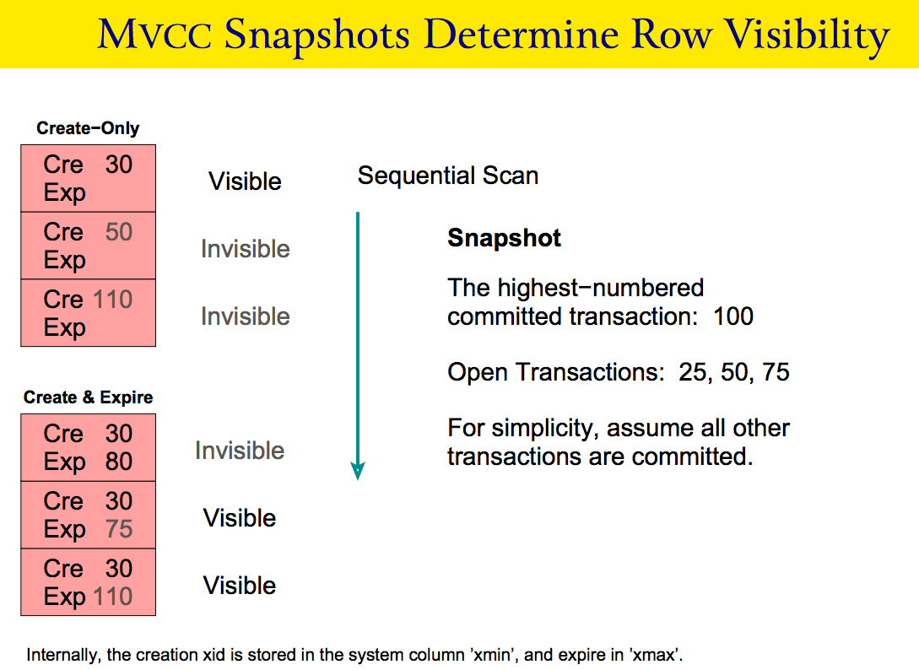

Slide 8
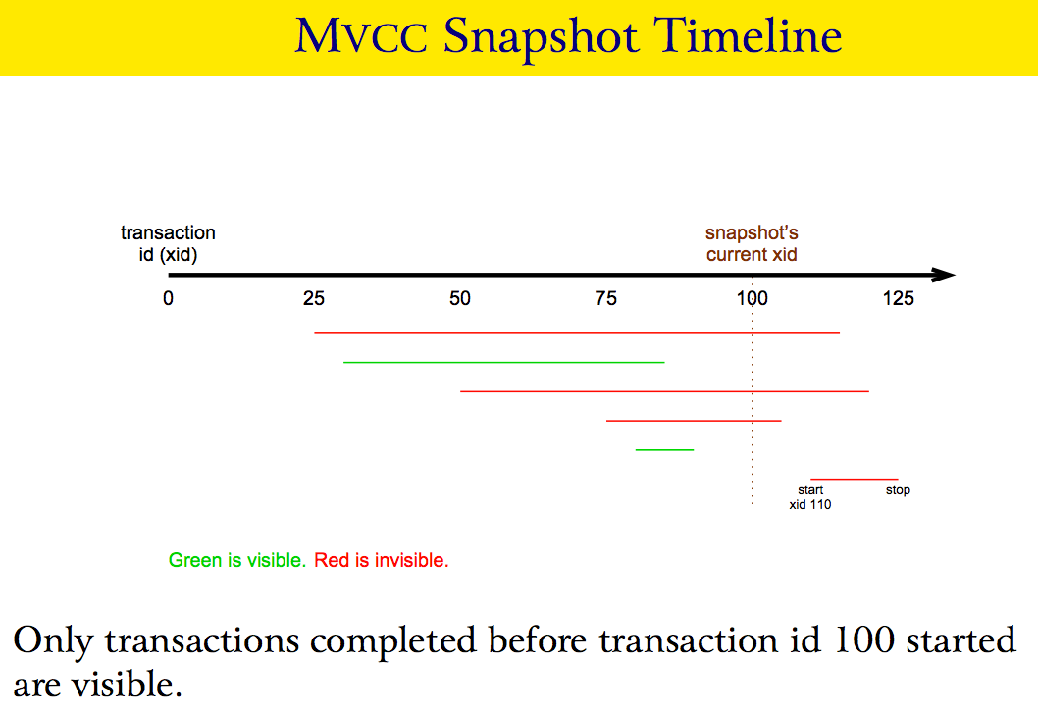

Slide 9
Data structure: HeapTupleHeaderData

Slide 10
Notes:
The related code in function: HeapTupleSatisfiesVisibility()

Slide 11
Isolation Level Processing
Snapshot is fetched:
  At the start of each SQL statement in READ COMMITTED transaction isolation mode
  At transaction start in SERIALIZABLE transaction isolation mode.
Different processing when concurrently update/delete one tuple:

Slide 13
HAWQ TRANSACTION DESIGN

Slide 14
HAWQ Characteristics
  SQL On HDFS
  HDFS don’t support UPDATE in place
  HAWQ Supported: Append Only (CREATE / INSERT/ TRUNCATE / SELECT/ NO UPDATE/ NO DELETE)
  HAWQ now only support one active master for catalog management
  Dispatch catalog info to segment if needed
  2PC: no need

Slide 15
HAWQ Transaction Basic
    Combine MVCC with Append Only
    Most scenario: INSERT in batch in one transaction.
    Concurrency control at seg file level instead of tuple level
    Valid File Length maintained in MVCC catalog.
    Support different hdfs, if invalid data (because of transaction rollback) appended at segfile:
    Supporting truncate: we should truncate before next time appending data.
    Not support truncate: This segfile cannot be appended any more. Use next segfile instead.

Slide 16
Demo
    Thinking that put all metadata into one sys table will cause performance downgrading when hawq data escalation.
    For AO tables, valid file length in systable: pg_aoseg.pg_aoseg_$TID
    For PARQUET tables, valid file length in systable: pg_aoseg.pg_paqseg_$TID
    Concurrency control by updating tuples in these systables.
Notes:
DBNAME="postgres"
psql -c $DBNAME “
drop table IF EXISTS t1;
create table t1 (c1 int) WITH (appendonly=true);
insert into t1 select generate_series(1,100000);
drop table IF EXISTS t2;
create table t2 (c1 int) WITH (appendonly=true, orientation=parquet);
insert into t2 select generate_series(1,100000);
SET TRANSACTION ISOLATION LEVEL SERIALIZABLE;
set gp_select_invisible=true;
“
# For AO tables:
psql -tc “select 'SELECT xmin, xmax,* FROM pg_aoseg.pg_aoseg_'|| relfilenode|| ';' from pg_class where relname='t1';" $DBNAME | psql -a $DBNAME
# For PARQUET tables:
psql -tc “select 'SELECT xmin, xmax,* FROM pg_aoseg.pg_paqseg_'|| relfilenode|| ';' from pg_class where relname=’t2';" $DBNAME | psql -a $DBNAME

Slide 17
INSERT Optimization
  INSERT parallel processing:
    -- Lane model: one executor process handling one segfile
    -- Each vseg processing one groups of seg files
          Speedup transaction ending:
  -- Dispatch the segfile creating/deleting tasking to segments for parallel processing
              Speedup Table dropping and selecting:
                -- Change hdfs relation segfile path: now for one relation, all segfile put at one directory, instead of put all relations’ segfiles in one directory.
    Painpoint at large number of partitions
    ToDo
  Only allocate one segfile for one physical segment node, instead of each segfile for one vseg.
  Multiple supplier one consumer mode write

Slide 18
RECOVERY CONSIDERATION

Slide 19
PostgreSQL Recovery
Take an e.g. Transaction T1 inserts lot of data
System crashes before T1 can commit
System comes back up again, needs recovery
REDO (Do the same actions again), UNDO (Revert the effect of an action)
Postgres supports only REDO. No UNDO is supported.
In fact, does Postgres need UNDO ?
  Not Really! WHY ?? (MVCC is the answer)
What is the advantage and what is the downside ?
  Adv – Fast recovery (only REDO)
  Downside – Unnecessary space wastage

Slide 20
Persistent Table Introduction: Derived from GPDB
Intent – Clean the INCOMPLETE work
Persistent Tables (PT) are ‘Database Object Life Managers’
Database objects are either relations, databases, table spaces or filespaces
Manage life of the same object both on the master & standby side
PT are heap tables but do NOT follow MVCC rules. They do NOT follow transaction snapshotting rules. Newly added tuple becomes visible instantly.
Mapping: One ‘Persistent Table’ ⬄ Per database object type
gp_persistent_filespace_node gp_persistent_tablespace_node gp_persistent_database_node gp_persistent_relation_node gp_persistent_relfile_node

Slide 21
Persistent Table: Why Non-MVCC?
Motivation - PT should act as a on-disk Hash Table that manages information about an object life
Changes made to the Database (e.g. Relation File Creation) by an incomplete transaction should be still visible, so that they can be revoked
If PT were MVCC compliant, for e.g. a transaction that created a table, inserted some data and never committed due to system crash would lead to never cleaning the created table
This consume disk space (resources)

Slide 22
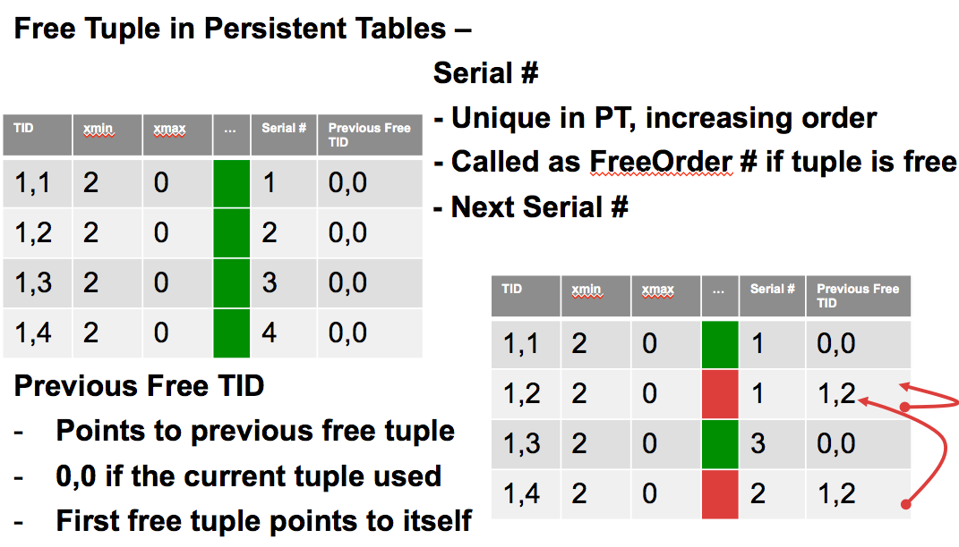
Persistent Table: Struct & Storage

Slide 23
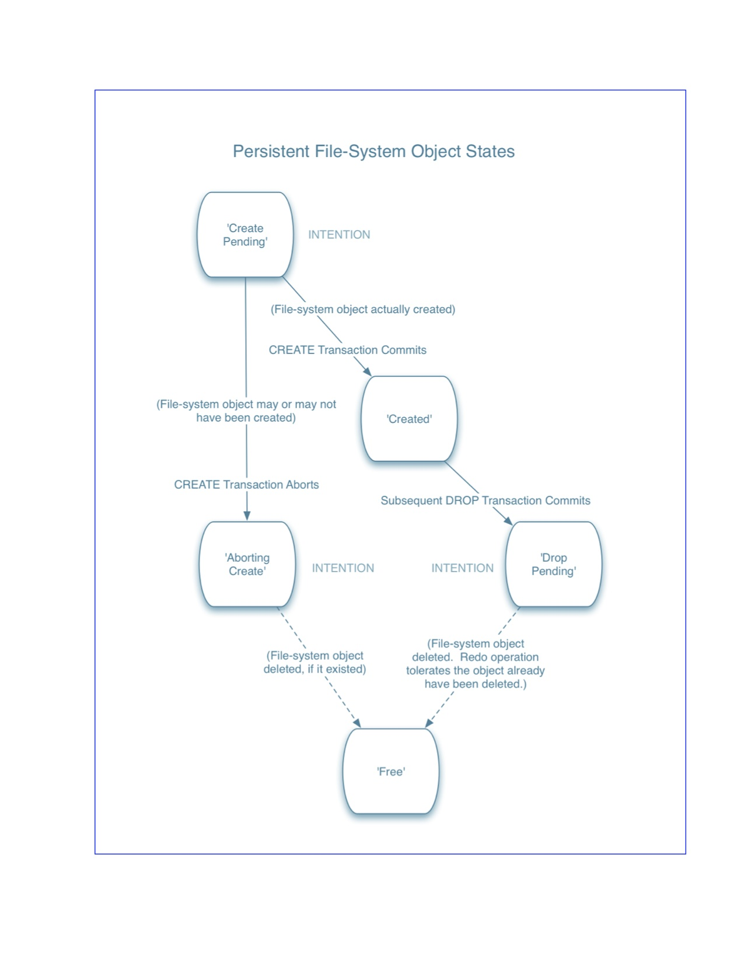
Persistent Table: Status Transfer Diagram

Slide 24
HAWQ Recovery Stages:
Pass 1
  Recover ONLY Persistent Tables & Check their integrity
  Integrity checks include FreeTID linked list correctness, FreeOrder sequence correctness etc
Pass 2
  Using the same redo xlog records as in Pass 1, create infrastructure to find which Database objects need to cleaned and which need to remain etc
  E.g. Free a create pending state tuple and drop corresponding object
Pass 3
  Again, using the same redo xlog records recover only non-PT tables
Pass 4
  Some more integrity checks like gp_globalsequence correctness etc

Slide 25
HAWQ Recovery Speedup
Skip segfile creating/deleting if the transaction is rollback finally.
ToDo:
  Persistent Table for relation file creation/deletion tracing is too heavy.
  Can we just revert relation file creation/deletion operation for rollback transaction directly?

Slide 26
HINTS IN PRODUCTION ENVIRONMENT

Slide 27
Recovery Performance Factor
Partition number too big lead to too many seg file (besides partition definition)
  Hash distributed table: affected by the bucket number (the default value is set by guc default_hash_table_bucket_number) .
  Randomly Distributed and External Tables: affected by virtual segment number ( the guc hawq_rm_nvseg_perquery_perseg_limit manages the number of vsegs per host; the guc hawq_rm_nvseg_perquery_limit set the cluster wide number of vsegs per query)
Manually Trigger Checkpoint if any transaction related to too many segfiles committed.
VACUUM FULL catalog if too many out-of-date tuples exists

Slide 28
Futhur Issues

Slide 29
Catalog Bloating (Too many out-of-dated tuples)
Example: gp_fastsequence up to 2G in customer’s env, The related index up to 9G ( 3.4G even after reindex it), it will slow down 15 minutes for some query ( eg. Analyze).
Why not VACUUM FULL? There are more than 100 queries, 10 Applications running at the same time, which always access gp_fastsequence, so the vacuum operation cannot get lock and proceed.
HAWQ 2.0 removed gp_fastsequence because it is only used in the index of user data table.
To Do:
  What: Other catalogs ( need more investigation )
  How:
  Change MVCC to Update-in-place (like Persistent Tables)
  Split into many small catalog (like pg_aoseg.pg_aoseg_$TID)

Slide 30
ToDo: UPDATE Supporting
Update emulation in HAWQ
  LSMT ( Log Structured Merge Tree) vs. Multiple Version
  Valid File length
  Relationship between NEW and OLD version tuple ( pointer ? Bitmap?)
  Bloom filter usage for skipping single version tuple
  Sorted ItemPointer for delta tuples
  Binary search for each delta block (Random Read)
  Merge sorting for all delta blocks (Full Scan Read)

Slide 31
About Us

Slide 32
ABOUT ME

Slide 33
About Pivotal

Slide 34
Q & A

