Slide 1


Introduction to Apache HAWQ Elastic Query Engine
Hubert Zhang
Pivotal Inc.
hzhang@pivotal.io

Slide 2
Outline
Motivation of Elastic Engine
Core Components of Elastic Engine
Best Practice
Demo

Slide 3
Motivation
Concurrency
query on subset of segments
Scalability
dynamic cluster expanding & shrinking
FTS
Sharing cluster with other engines

Slide 4
HAWQ Architecture
Yarn
NameNode
NameNode
libYARN
Masters
Resource Broker
Optimizer
Parser/
Analyzer
Core Components
Elastic Engine
Resource Manager
Resource
Negotiator
HDFS Catalog Cache
client
Fault Tolerance Service
Dispatcher
Catalog
Service
Virtual
Segment
Virtual
Segment
Virtual
Segment
Virtual
Segment
Virtual
Segment
Virtual
Segment
Physical Segment
Physical Segment
Physical Segment
Interconnect
Interconnect
DataNode
DataNode
DataNode
NodeManager
NodeManager
NodeManager
External System

Slide 5
Component: Resource Negotiator
range table list
slice number
HDFS Metadata Cache
Resource Negotiator
Resource Manager
Virtual segments with assigned splits

Slide 6
Physical Segment to Virtual Segment
Physical segments are the fixed granularity of parallelism in HAWQ 1.X
how many physica segments determine how many processes will be used for one slice of one query.
HAWQ 1.X deploy 6 to 8 (depending on the node type) physical segments on each node.
Virtual segments are the containers of resource(CPU, memory)
one physical segment can use many virtual segments to run one query
HAWQ 2.X only need to deploy one physical segment one each node

Slide 7
Storage change
Single directory for each table
HDFS directory: /filespace/tablespace-id/database-oid/table-oid/files
decouple of storage and computing
Block level storage
a scan node can process multi blocks instead of the whole file.(hash distributed table is an exception)

Slide 8
Component: Resource Negotiator
Get hdfs locations of input table
Calculate virtual segment number(resource)
Acquire resource from Resource Manager
Assign splits to virtual segments

Slide 9
Component: Resource Negotiator
Calculate the number of virtual segments:
random table only: data size/#file
hash table only: #bucket
random&hash table: data size/#bucket
result relation: random/hash
external table: command/gpfdist/pxf
copy: from/to; hash/random
analyze: random/hash

Slide 10
Component: Resource Negotiator
Assign splits to virtual segments:
ratio of local read
continuity of file read
data balance among virtual segments
hash table is assigned at file level.
random table is assigned at random level.
greedy algorithm

Slide 11
Greedy Algorithm
STAGE I: Assign the continue blocks to local virtual segments
non-continue block queue
VSEG
STAGE II: Assign non continue blocks to local virtual segments with prefer to insert host
VSEG
network block queue
STAGE III: Assign blocks in network block queue with penalty
random table assign algorithm

Slide 12
Component: Resource Negotiator
B11
B12
B13
B14
B12
B13
B21
B23
B11
B14
B21
B22
B22
B23
B32
B41
B24
B31
B33
B41
B24
B31
B32
B33
Data node
virtual segments

Slide 13
Component: Resource Negotiator
B11
B12
B13
B14
B12
B13
B21
B23
B11
B14
B21
B22
B22
B23
B32
B41
B24
B31
B33
B41
B24
B31
B32
B33
Data node
B11
B12
B13
B23
B24
B21
B22
B31
B14
B32
virtual segments

Slide 14
Component: Resource Negotiator
B11
B12
B13
B14
B12
B13
B21
B23
B11
B14
B21
B22
B22
B23
B32
B41
B24
B31
B33
B41
B24
B31
B32
B33
Data node
B11
B12
B13
B23
B24
B33
B21
B22
B31
B14
B41
B32
virtual segments

Slide 15
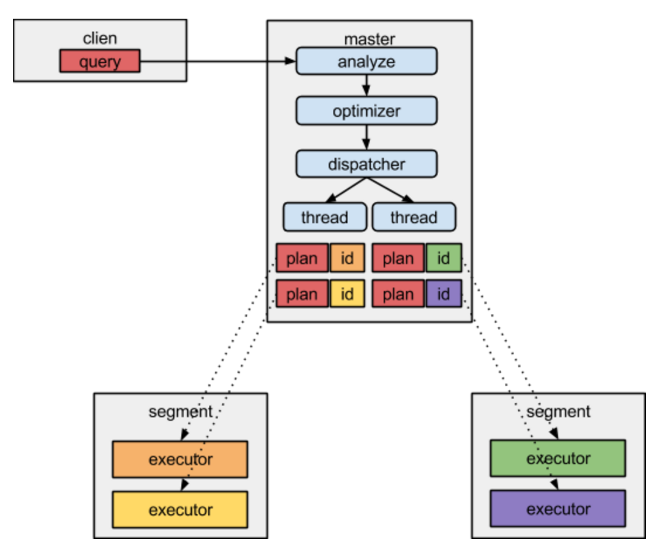
Components: Dispatcher

Slide 16
Components: Dispatcher
dispatch init
prepare dispatch data
MAIN
THREAD
compute thread number
create worker manager
executor pool
dispatch run
bind executors
serialization
start working thread
join working thread
dispatch wait
send failed node to RM

Slide 17
Components: Dispatcher
WORKER
THREAD
dispatch data to QE
QE
QE
segment
poll result from QE
QE
QE
segment
cancel QE if error happens

Slide 18
Best Practice
Hash distributed V.S. Random distributed
Pros: hash table may reduce a motion stage: e.g. select id,count(price) from sales group by id;
Cons: degree of parallelism of hash table is fixed: the bucket number.
Cons: distributed columns of hash table is also fixed.

Slide 19
Best Practice
Performance related GUC:
net_disk_ratio: penalty for remote read.
min_datasize_to_combine_segment: small blocks will be combined into one virtual segment.
hawq_rm_nvseg_perquery_perseg_limit: increase it to improve query performance but decrease concurrency.
default_hash_table_bucket_number: better not to set a different buckter number when create a hash distributed table.

Slide 20
Best Practice
Cluster expanding and shrinking
rebalance hdfs
update HDFS metacache
execute select gp_metadata_cache_clear()
modify GUC default_hash_table_bucket_number
redistributed the hash table.

Slide 21
Demo
Cluster expanding and shrinking
Adjust virtual segment number to control query speed.

Slide 22

Hiring
We are hiring GPDB/HAWQ software engineer, please send C.V. to
pivotalrnd_china_jobs@pivotal.io

Slide 23


