Slide 1
QUIC
Bryan Call
ATS Spring Summit 2016

Slide 2
How do you make the web faster?
$BROWSER
HTTP/1.1
TLS 1.2
User-perceived latency
TCP
IP
Physical Network
google.com
Notes:
Copied from Redefining Internet Transport Janna Iyengar

Slide 3
How do you make the web faster?
$BROWSER
HTTP/1.1
TLS 1.2
User-perceived latency
TCP
IP
Physical Network
Build a carrier-grade network
Google CDN
google.com
google.com
Notes:
Copied from Redefining Internet Transport Janna Iyengar

Slide 4
How do you make the web faster?
$BROWSER
Chrome
Launch your own browser
Update HTTP
HTTP/1.1
HTTP/2
TLS 1.2
User-perceived latency
TCP
IP
Physical Network
Build a carrier-grade network
Google CDN
google.com
google.com
Notes:
Copied from Redefining Internet Transport Janna Iyengar

Slide 5
How do you make the web faster?
$BROWSER
Chrome
Launch your own browser
Update HTTP
HTTP/1.1
HTTP/2
TLS 1.2
User-perceived latency
TCP
???
IP
Physical Network
Build a carrier-grade network
Google CDN
google.com
google.com
Notes:
Copied from Redefining Internet Transport Janna Iyengar

Slide 6
QUIC Features
0-RTT connection handshake
0-RTT encryption handshake
Connections survive IP address change
Enhanced packet loss recovery
Always encrypted
Mostly fixes head of line blocking
FEC (Forward Error Correction) data recovery

Slide 7
HTTP/2 Features in QUIC
Multiplexed streams
Sharing connection across domains
HPACK header compression
Stream prioritization
Flow Control
Server­initiated streams

Slide 8
QUIC
Congestion control, encryption, and some HTTP/2 move to QUIC
Notes:
Runs in user-space

Slide 9
Streams
One stream per request
Stream are broken up into frames
Stream 1 crypto handshake
Stream 3 is for headers – to serialize headers (HPACK)

Slide 10
Multiplexed Streams
HTTP/1.1
  4-8 outstanding requests on 4-8 connections
  Resource intensive on the server
HTTP/2 and QUIC
  One connection, many concurrent requests
  Normally limited to 100

Slide 11
Connection Sharing
Multiple domains over one TCP connection
  Domain must be in certificate and resolve to same IP

Slide 12
Prioritization
Ability for clients to set a priority of a stream
Dependency tree for streams
Higher weights get more resources
Resources proportional to the weighting

Slide 13
Flow Control
Client and server
Connection and streams
Credit based
  Default 64KB – clients and server normally set this higher
  Requires updates by WINDOW_UPDATE frame

Slide 14
Server-Initiated Streams
Should send push before referencing resource - race condition
Response must be cacheable
Depending on the use case can be faster or slower
  Browser already has the resource cached
  Client canceling the stream using RST_STREAM frame

Slide 15
Establishing a QUIC Connection
HTTP response header
  Alternate-Protocol: 443:quic
Client establishes QUIC connection in the background
Client’s can cache if server supports QUIC

Slide 16
QUIC - Connections
Handshake
  0-RTT for reestablished connections
  1-RTT for new connections
  Accounts for 50% latency improvements
  Will use TLS 1.3 handshake
UDP encrypted and authenticated packets
  TCP like header are encrypted
  Prevents active attacks and middlebox changes unlike TCP
Moved congestion control into application layer
Connections are keep-alive for 30 seconds (default) due to NATs

Slide 17
QUIC - Connections
Unencrypted connection ID (64-bit)
  Connections survive IP address change
  Used for routing connections
ICW remembered by the client for reestablished connections

Slide 18
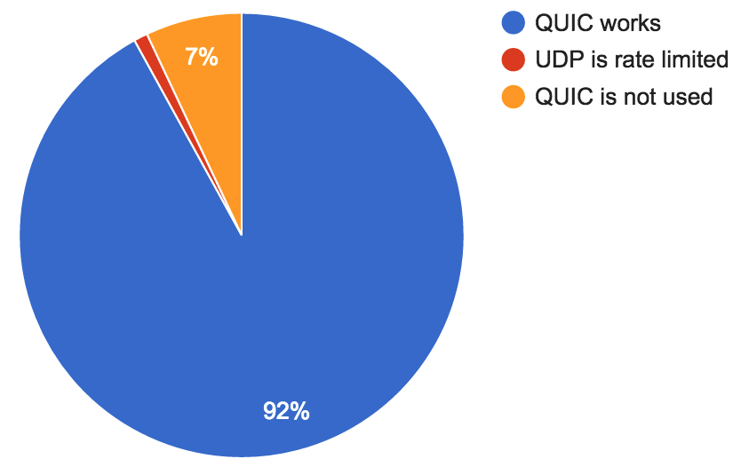
QUIC Success Rate
QUIC connection success rate
  92% works
  7% doesn’t work
  1% is rate limited
Google disables QUIC to specific ASNs
Notes:
Chart copied from Redefining Internet Transport Janna Iyengar

Slide 19
QUIC Performance
5% latency reduction on average
30% reduction in rebuffers (video pauses) on YouTube
1 second faster at the 99th percentile for Google web search
Helps more for higher latency networks

Slide 20
QUIC Features in TCP and TLS
Feature | Server Support | Client Support
TCP
Increasing TCP's Initial Window | RHEL 6.2 | N/A
Computing TCP's Retransmission Timer | RHEL 6.3 | N/A
CUBIC Inflated Window Bug | RHEL 6.7 | N/A
TCP Fast Open | ATS done, RHEL 7.2 | IOS, OSX, Android needs to be enabled
TCP Loss Probe | RHEL 7 | N/A
Early Retransmit for TCP | RHEL 7 | N/A
TCP Packet Pacing | RHEL 7.2 | N/A
RACK: a time-based fast loss detection algorithm for TCP | Linux 4.4 | N/A
ICW 32 | Dependent on TCP enhancements | N/A
TLS
TLS 1.3 | RFC not done

Slide 21
QUIC Status
Draft 2 in IETF
  https://tools.ietf.org/html/draft-tsvwg-quic-protocol-02
Waiting on TLS 1.3

Slide 22
QUIC Potential Issues
UDP rate limiting and blocking
More CPU usage on client and server
DOS attacks

Slide 23
QUIC Support
Client
  Chrome enable by default
  Wireshark support
Library
  libquic / goquic
  proto-quic
    First release 4/1
    Supported by Google

Slide 25
QUIC in ATS
Started using libquic
Switched to proto-quic
  More dependencies
Build time enabled

Slide 26
Currently in ATS

Slide 27
QUIC in ATS

Slide 28
Discussion
Routing connections with IP change
Long term implementation in ATS

