Slide 1
Traffic Server Debugging using ASAN / TSAN
Brian Geffon

Slide 2
What exactly is ASAN
ASAN : Address Sanitizer
  ASAN is a Memory Error Detector for C/C++
  Created by Google
https://code.google.com/p/address-sanitizer/

Slide 3
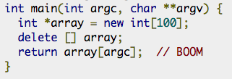
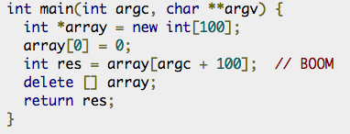
What can I use ASAN to find?
Use after free (dangling pointer reference)
Heap Buffer Overflow

Slide 4
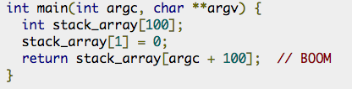

What can I use ASAN to find?
Stack buffer overflow
Global buffer overflow

Slide 5
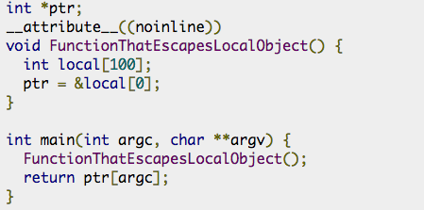
What can I use ASAN to find?
Use after return

Slide 6
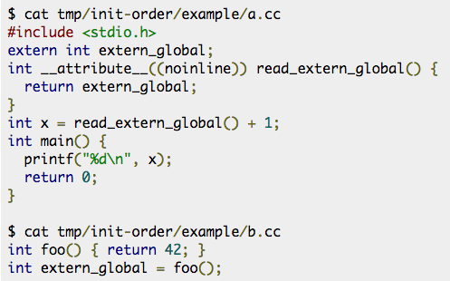
What can I use ASAN to find?
Initialization Order Bugs
(aka. Static Initialization Order Fiasco)

Slide 7
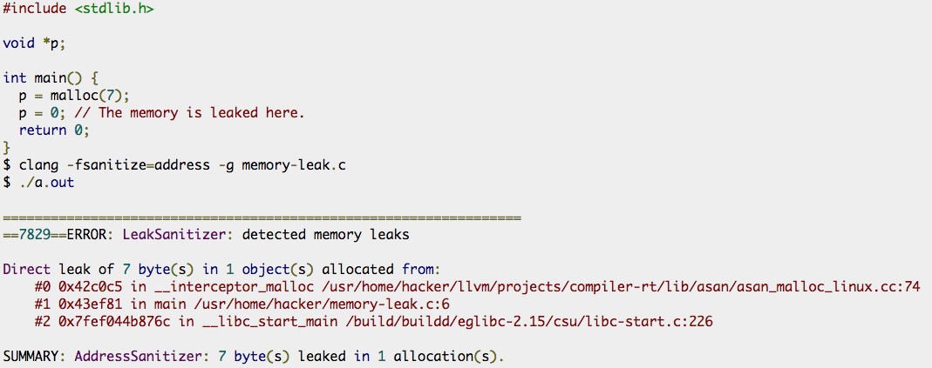
What can I use ASAN to find?
Memory Leaks!

Slide 8
How does it work?
The tool consists of a compiler instrumentation module and a runtime library that replaces malloc / free / new / delete / etc.
The memory around the malloc-ed regions (red zones) is poisoned. The free-ed memory is placed in quarantine and also poisoned.

Slide 9

How does it work?
Before
After
Not too different from Valgrind or other tools, ASAN is great because it’s FAST.
https://code.google.com/p/address-sanitizer/wiki/AddressSanitizerAlgorithm

Slide 10
Don’t tools like this slow things down?
YES, Yes they do!
Valgrind typically introduces a slowdown of 10 to 20x.
ASAN introduces a slowdown of roughly 2x

Slide 11
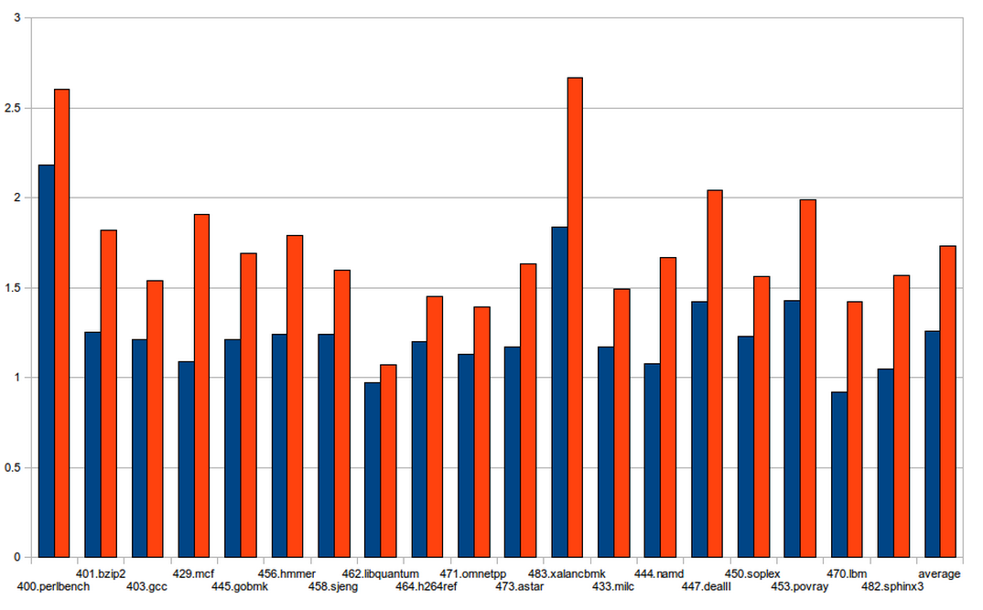
Performance of ASAN
https://code.google.com/p/address-sanitizer/wiki/PerformanceNumbers

Slide 12
Getting / Using ASAN
ASAN is included in LLVM versions > 3.1
ASAN is included with GCC versions > 4.8
Unfortunately, you cannot just LD_PRELOAD the library like TCMALLOC or JEMALLOC.
You’ll have to recompile.

Slide 13
Using ASAN
You need to compile and link with the
-fsanitize=address switch.
To get the best possible stack traces make sure to also include -fno-omit-frame-pointer
ASAN will require around 20TB of Virtual Memory (YES, 20TB). So you’ll likely need to enable memory overcommit if you have hard limits:
sudo sysctl –w vm.overcommit_memory=1

Slide 14
But what about freelists?
Given that Traffic Server uses freelist the memory is never out of scope…so once we suspect a memory bug we’ll need to disable freelist + enable ASAN.
./configure –disable-freelist \
CXXFLAGS=“-fsanitize=address –fno-omit-frame-pointer …”

Slide 15
Memory Corruption masked by Freelists
These bugs are very difficult to find
  Because it’s a race condition. It requires the object to be returned to the freelist early and another thread to pick it up and starting using it in such a way that causes one of the two threads to crash.
These are almost always dangling encapsulated pointers.

Slide 16
When to suspect memory problems w/ Freelists
Typically it will look like a random crash, it won’t be entirely clear why memory has become corrupted
Frequently you’ll spot an inconsistency between a code path and a variable value.

Slide 17
Variable / Codepath Mismatch
A common example might be:
  if (close_connection) {
  a->boom(); // something weird happens here
  }
  (gdb) p close_connection
  close_connection = false // WTF?
It appears the object has been recycled and is being used by two different threads, it’s clearly been reinitalized.

Slide 18
Let’s see the power of ASAN
This example is based on a REAL bug.
I’ll demo what we actually saw in a production environment (using a fake server).
What we’ll see from the crash is something that is very very hard to explain…

Slide 19
Debug Builds
Please consider running your internal integration / unit tests w/ ASAN. This extra coverage might uncover memory corruption bugs.
Most plugins rely on malloc / new / etc, so you’ll actually be able to catch plugin bugs too.

Slide 20
Debug Production Builds
Because ASAN doesn’t hurt performance too much please consider deploying a debug production build to help unmask these type of bugs. Every has a slightly different use case.
We found 2 bugs between 5.0 and 5.2 that were of these type.
docs.trafficserver.apache.org has an ASAN build: but it simply doesn’t get enough load to uncover most of these race conditions.

Slide 21
Using ASAN w/ GDB
(gdb) break __asan_report_error
  Otherwise you’ll exit gdb before you have a chance to inspect the frame

