Slide 1
Experience with jemalloc
Kit Chan (kichan@oath.com)

Slide 2
Problem – Difficult to debug memory leak in ATS Plugins
Plugin coded in C or C++ - easy to produce memory leak bugs
Hard to debug in large scale production system
  Leak can take days or weeks to be noticeable
  Can’t roll back
    Don’t know which one. Multiple changes can be suspects
    Critical feature cannot be rolled back

Slide 3
Options
Valgrind
  Typically slows down by 10 to 20x
AddressSanitizer (ASAN)
  Need to recompile.
  Can slow down by 2x
Notes:
In the past valgrind is a very popular tool to debug memory leak. However it typically will slow down the process by 10 to 20X.
In ATS there is effort to use ASAN to find memory leak problems. And there is a presentation in ATS Summit in 2015 to go into details on how to use Address Santizier. One problem with ASAN is that we need to recompile the binary.
Still it is reported by with ASAN we can still experience a 2X slow down in performance. So it may still not be suitable for live debugging for critical system.
Finally, we can always set up monitoring for the Ats process memory usage. Then we can trace back the changes that cause the memory to grow over a period of times. However, as stated above, there is still a lot of guess works needed to pinpoint the actual root cause. So we need something more. And Jemalloc comes to the rescue.

Slide 4
Jemalloc for Memory Profiling
Compile and install jemalloc
Create a file (/usr/local/bin/start_ats.sh) with the following contents
#!/bin/sh
MALLOC_CONF="prof:true,prof_prefix:/tmp/jeprof.out,lg_prof_interval:34,lg_prof_sample:20"
LD_PRELOAD=”/usr/local/lib/libjemalloc.so.2"
export MALLOC_CONF
export LD_PRELOAD
/home/y/bin64/traffic_server "$@”
  Interval between sampling – 2^20 = 1MB
  Interval between file dump – 2^32 = 4GB
  Prefix of file dump - /tmp/jeprof.out
  Profiling is on.
Update “proxy.config.proxy_binary” to the file above in records.config
Other options available – please see jemalloc’s doc
Notes:
Please note that there are a few other options available for memory profiling and you can check it out in the jemalloc documents.

Slide 5
Viewing the Results
Sample Usage
jeprof --show_bytes --gif /usr/local/bin/traffic_server /tmp/jeprof.out.32201.3730.i3730.heap > /tmp/32201.3730.gif
Generate a gif file containing the call graph of the program
Other formats and options supported
Here is an example

Slide 6
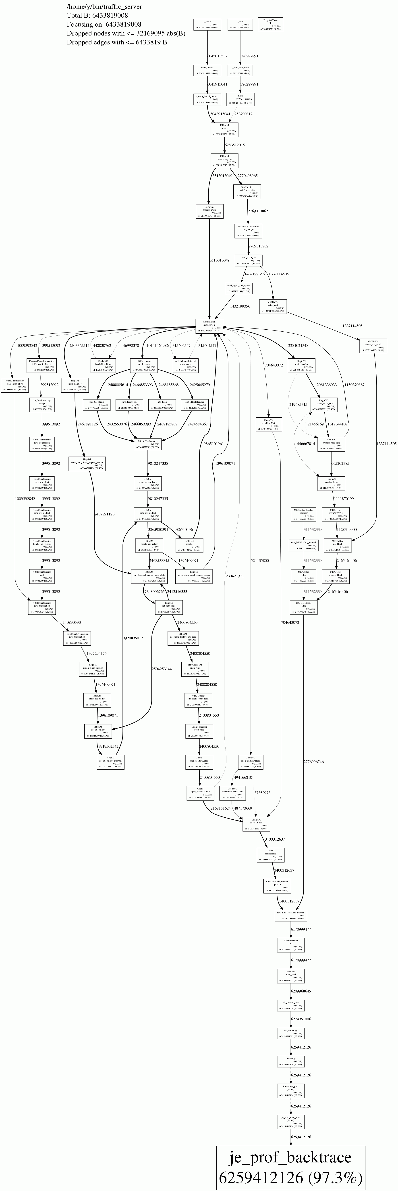

Slide 7
Case Study #1
ATS in front of multiple API Origins
Leak happened for several months.
Took about 2 weeks to be noticeable

Slide 8
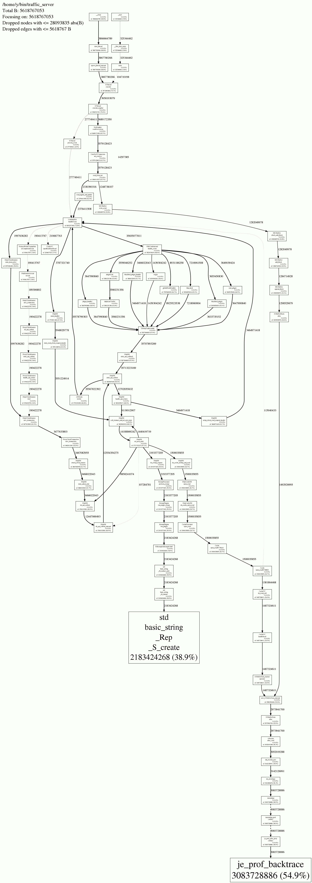
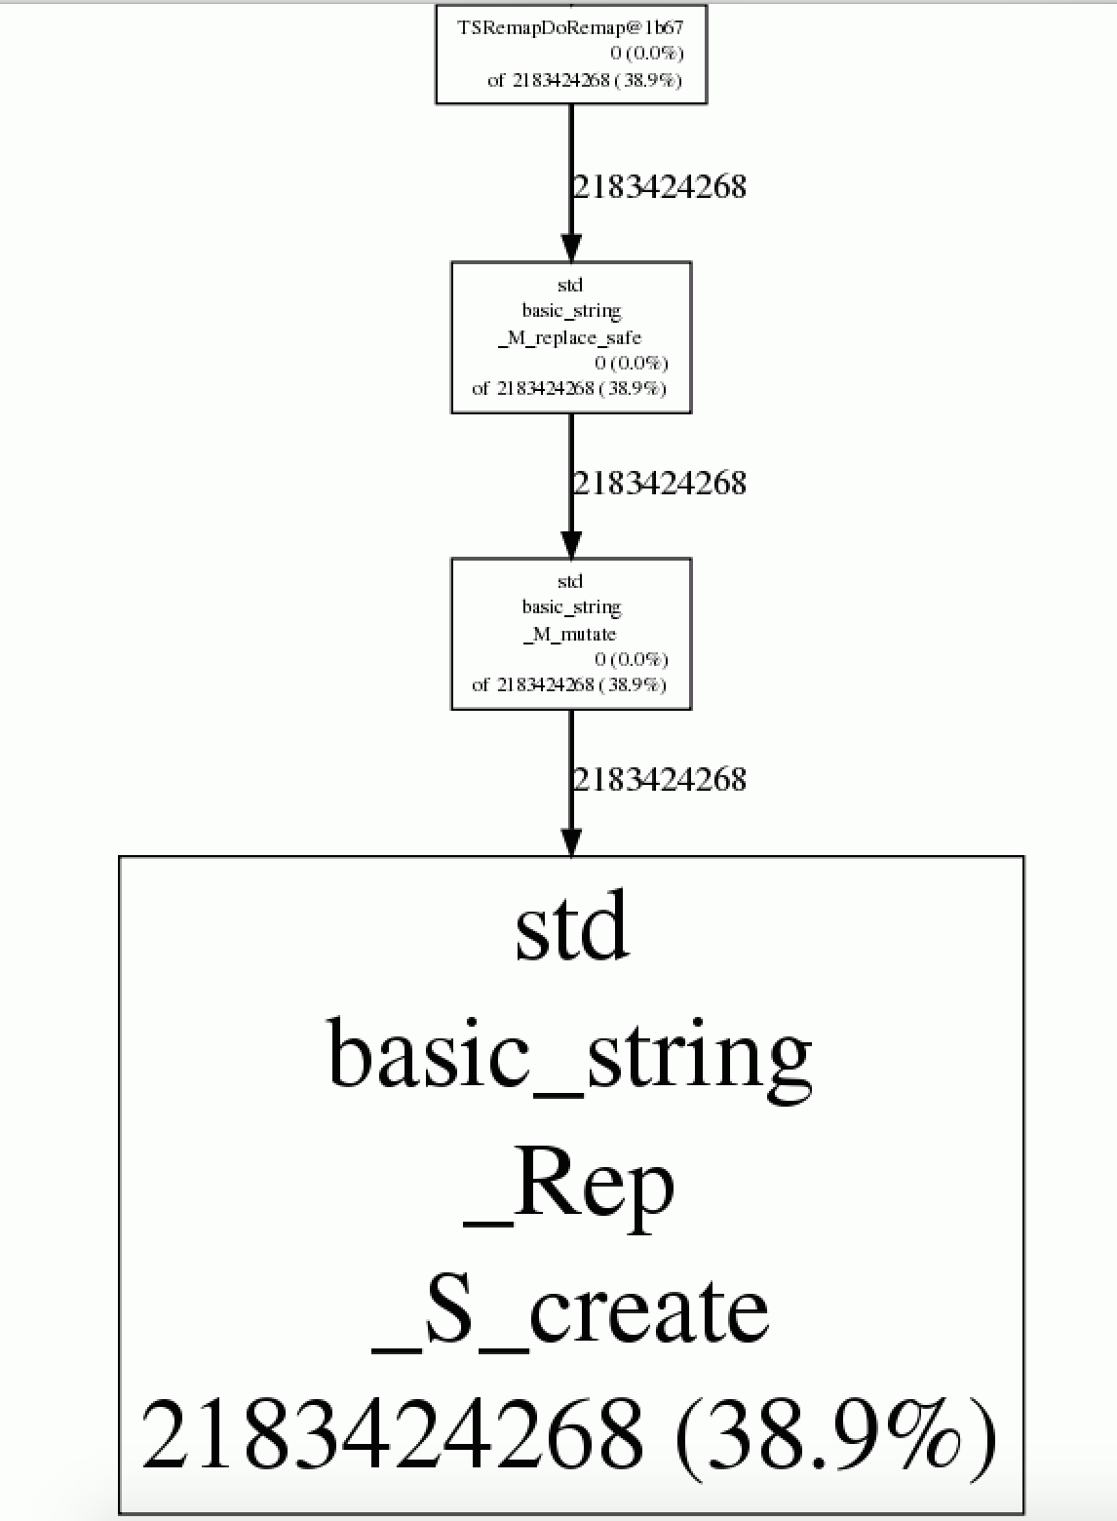

Slide 9
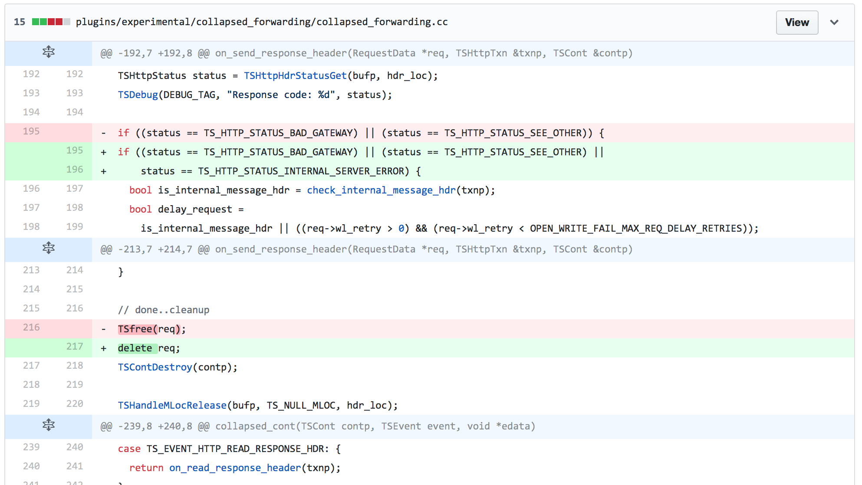
Case Study #1

Slide 10
Case Study #2
ATS in front of multiple origins, serving HTML and JS/CSS/Images assets
Leak happened and took 12 hours to OOM
Multiple critical fixes out at the same time

Slide 11
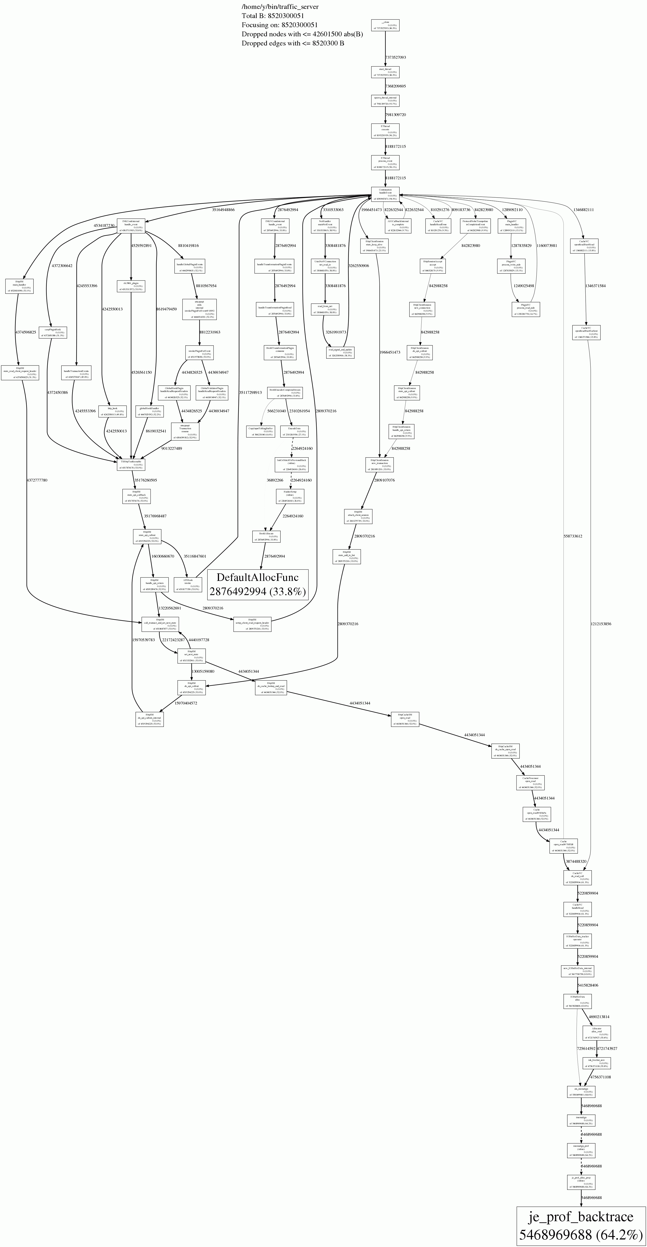
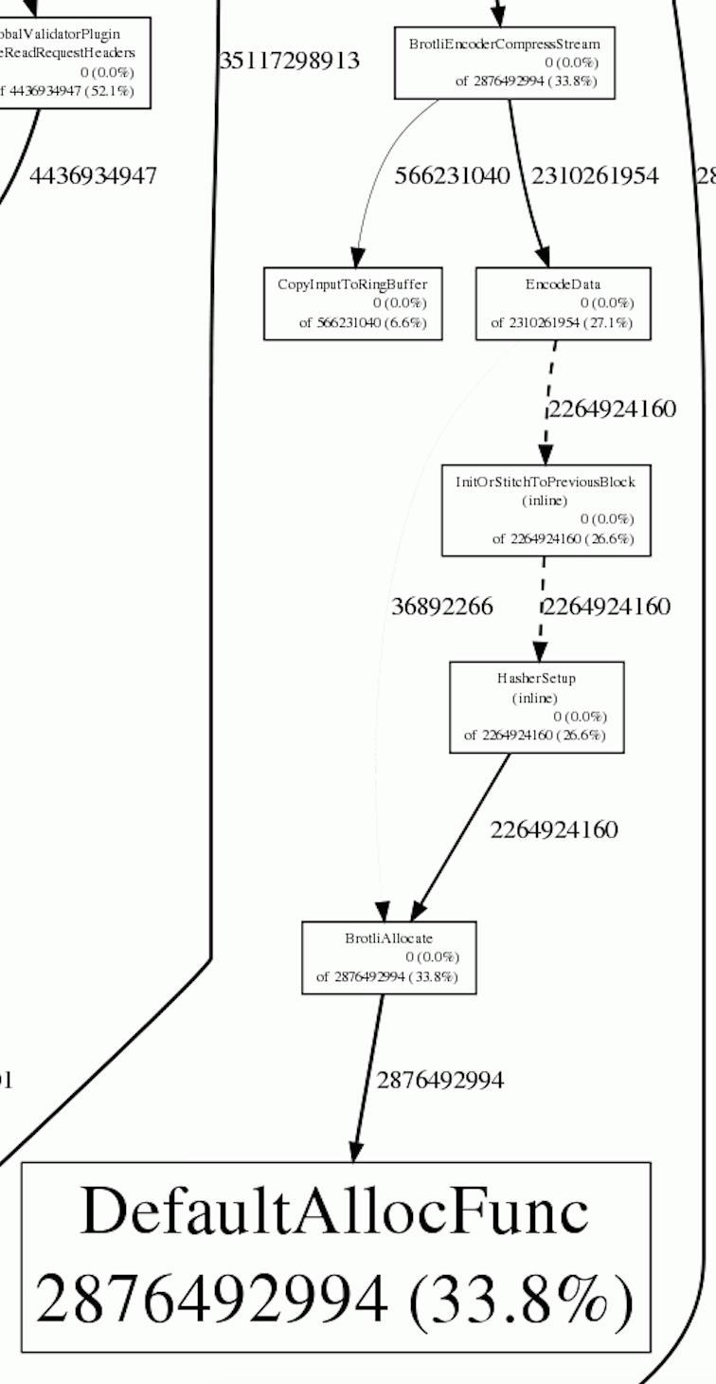

Slide 12
Case Study #2
Our own Brotli plugin did not release the encoder instance correctly

Slide 13
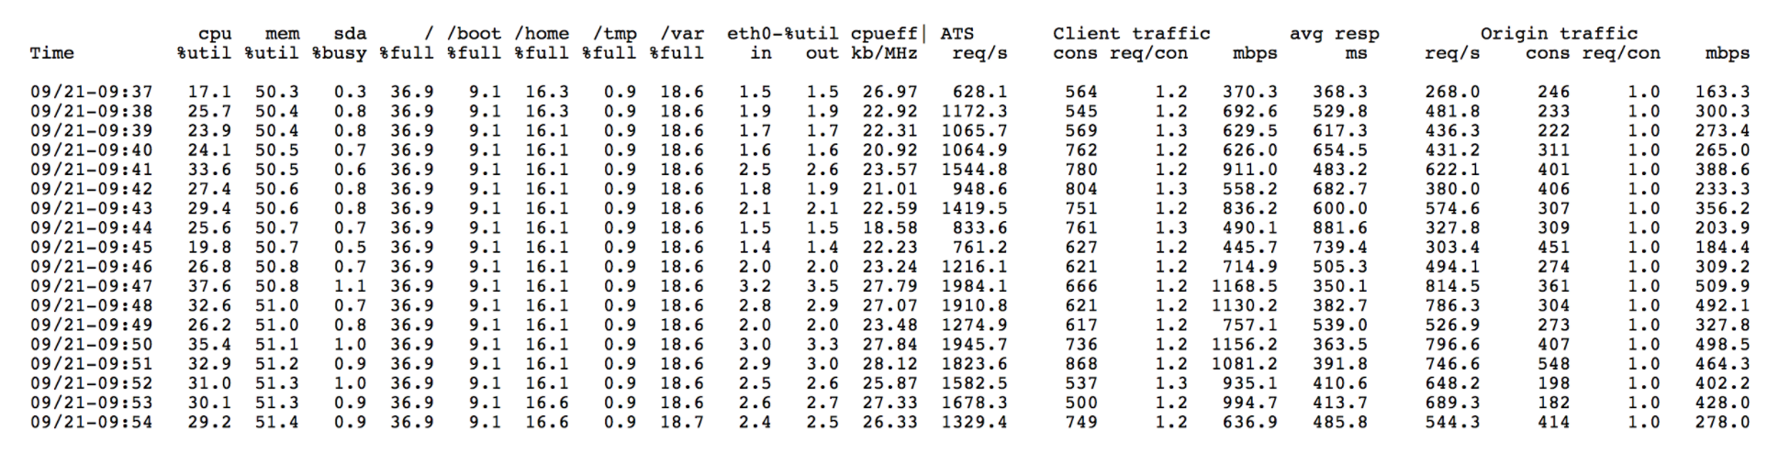
Problem – ATS not scaling up on more Cores/Better CPU

Slide 14
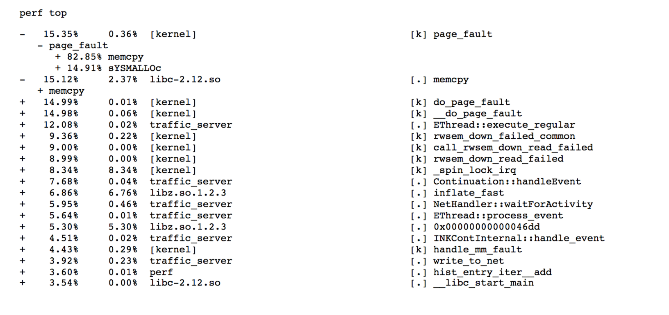
Memory operations are the issues

Slide 15
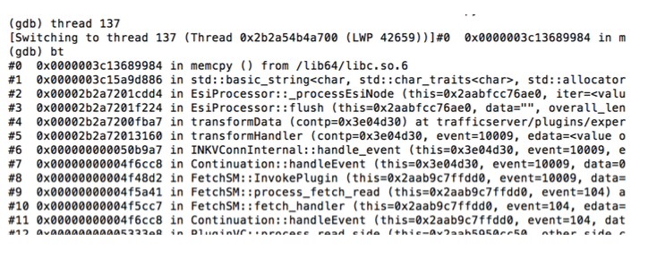
Plugins (ESI) are the problem

Slide 16
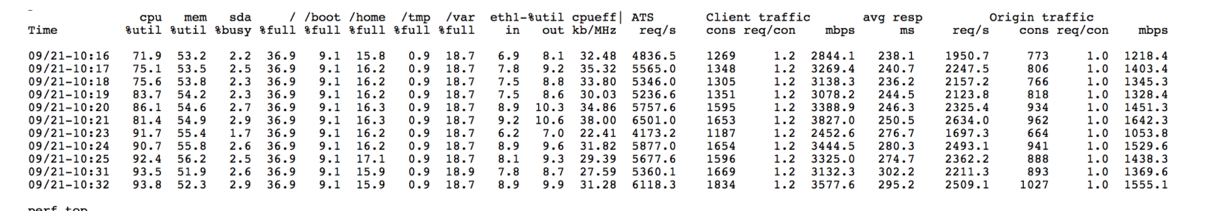
Jemalloc is the solution
CPU utilization can now stress to 90%+

Slide 17
Future
  Running it on production
  ATS 7.x allows us to turn off freelist
  Tuning Options. E.g
    lg_dirty_mult
    lg_chunk

Slide 18
Conclusion
Jemalloc/Jeprof – good complementary tool for debugging memory leak
Improve scalability
Tunable

