Slide 1

Using Apache Airavata and SciGaP Services to Build Science Gateways
Marlon Pierce
marpierc@iu.edu
Indiana University
PEARC17, July 10th 2017

Slide 2
Tutorial Goals: We Will Cover...
Apache Airavata capabilities
Creating a new hosted gateway
Using the API to create custom gateways
Next steps, getting support

Slide 3
Introduction (Discussion)
Gateway User (Exercise)
Gateway Administrator (Exercise)
Build your own Gateway (Exercise)
Customize your Gateway (Demo & Exercise)
Advance Capabilities (Demo & Presentation)
Participant Next Steps (Discussion)

Slide 4
Introduce yourselves

Slide 5
What Does Apache Airavata Do?
Airavata runs computational experiments
This means
  Encoding how to run a wide range of scientific applications on a wide range of resources
  Staging inputs and outputs to target resources
  Monitoring long running applications
And most importantly...
  Managing all the data and metadata generated by these experiments

Slide 6
Let’s Look at Some Example Science Gateways
And the people behind them

Slide 7
dREG: discriminative Regulatory Element detection from GRO-seq
Prof. Charles Danko and Dr. Zhong Wang, Cornell
dREG: Identification of the genomic regions that regulate transcription
  Genetic basis of many diseases
Code is actively developed
You may not have local resources for running it.
  Traditional MPI and GPU versions
https://github.com/Danko-Lab/dREG

Slide 8
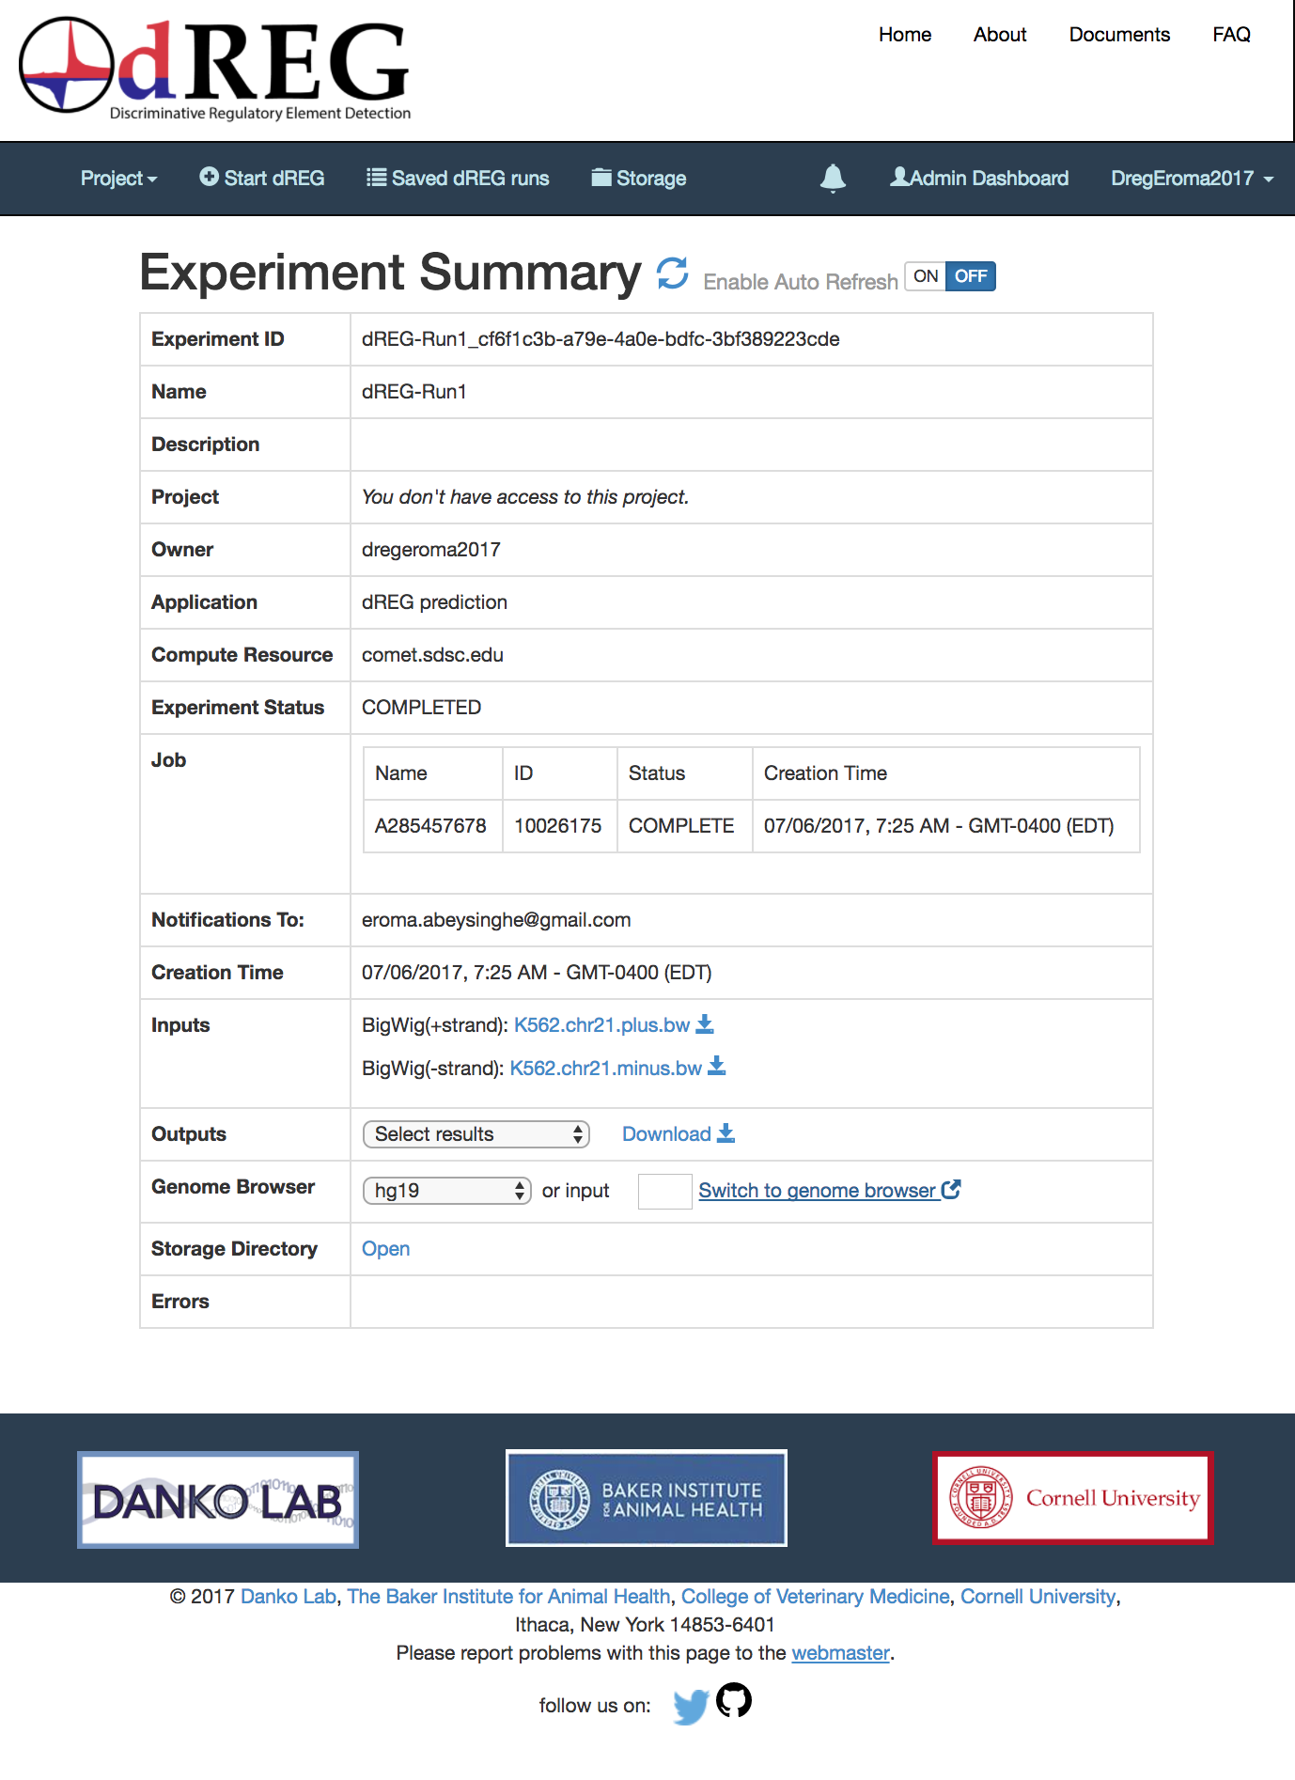
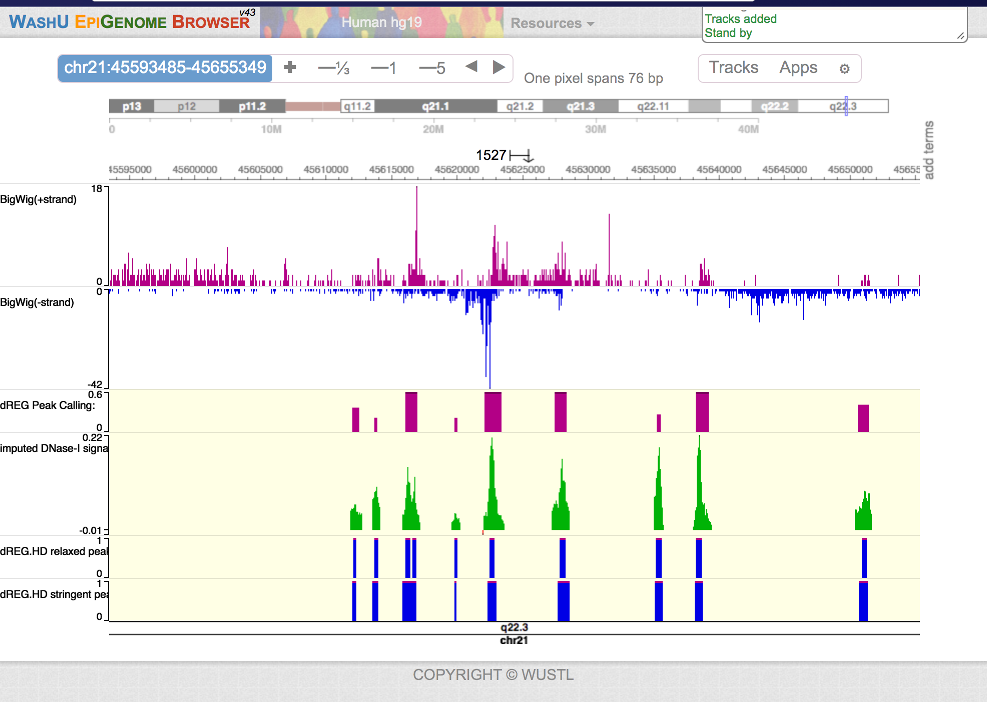
dREG: Software as a Service
Instead of requiring users to download and install the code, deliver it through a gateway.
And integrate third party Web tools

Slide 9
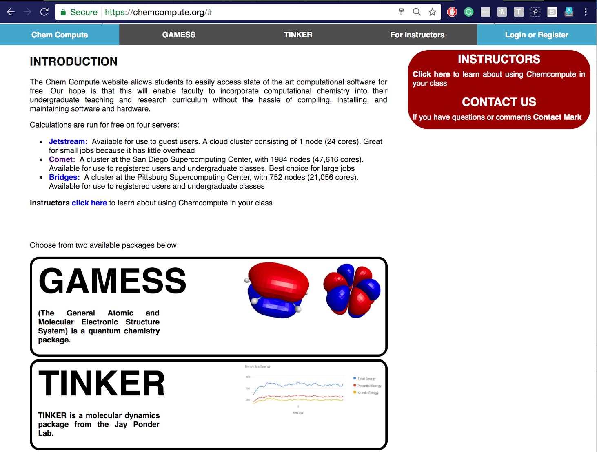
ChemCompute.org: Educational Gateway
Prof. Mark Perri, PI
Help students use computational chemistry tools
Develop custom user interfaces tailored to students
Bring more resources to the gateway.
Outsource general services to Airavata and SciGaP

Slide 10
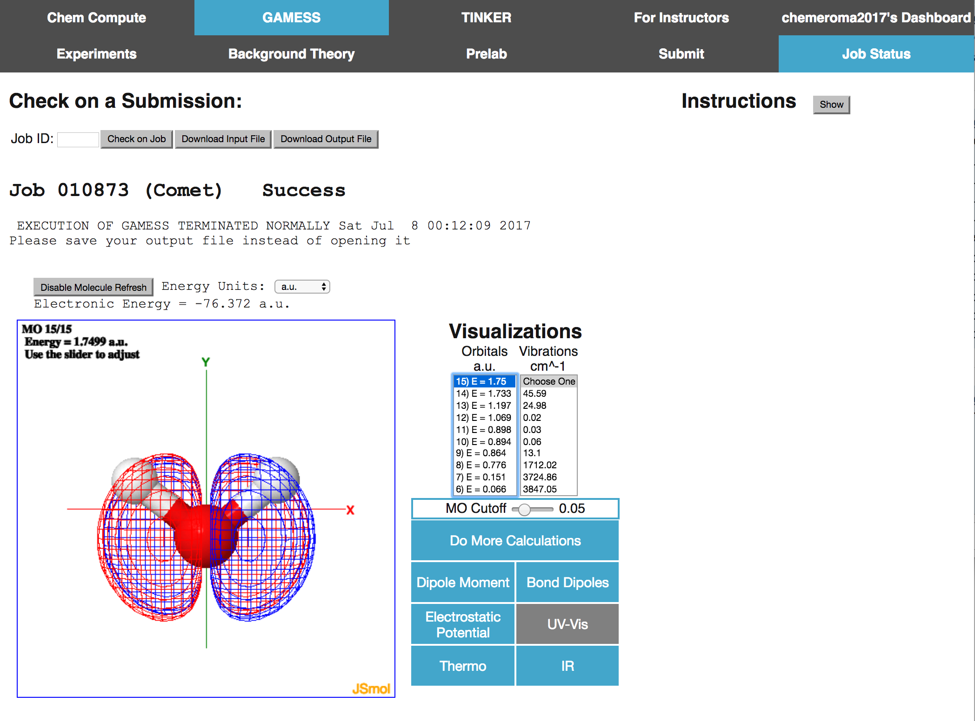
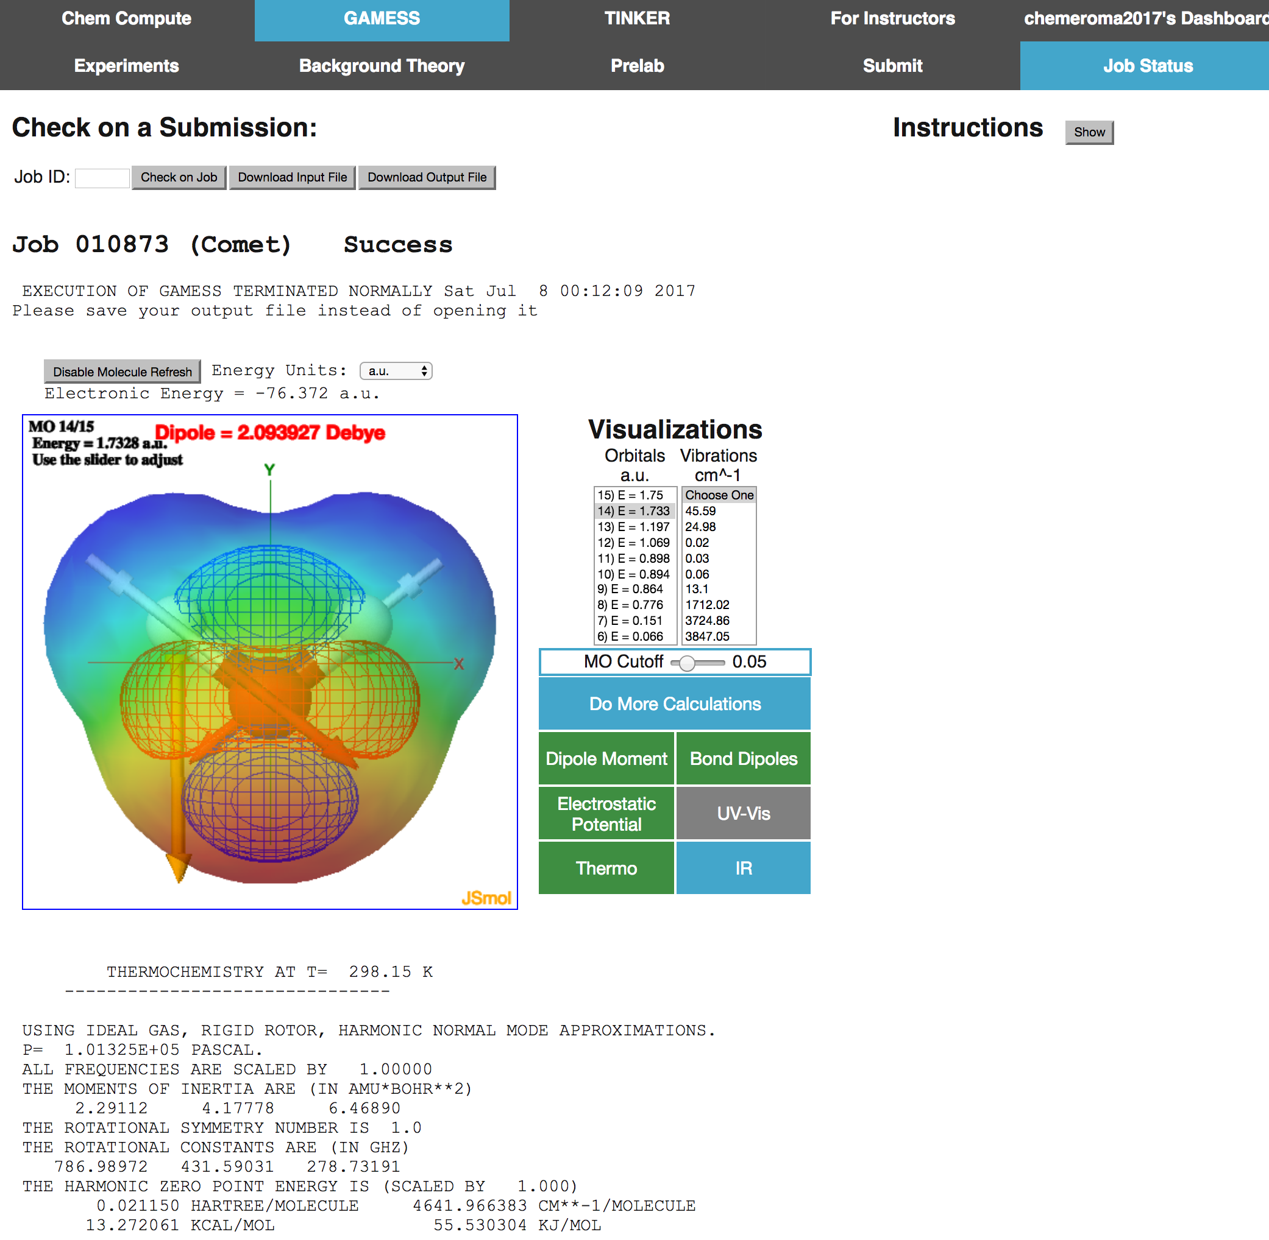

Slide 11

University of South Dakota Campus Gateway
Provide simplified access to campus computing resources
Use campus identities all the way through (no community accounts)
Simplify bridging between campus resources and XSEDE.

Slide 12
Did any of these resonate with you?
Do you want to build any of these gateways? Or do you work with someone who does?

Slide 13
Some Gateway Types
Software as a Service Gateways
Broaden access to your application suite
Simplify customer support
Domain Gateways
Provide access to many tools across a scientific domain
Integrate many different computing resources
Campus Gateways
Simplify access to campus resources
Security integration is important
Include instrument gateways
Wide range of applications and users
Support both education and research
Apache Airavata provides a platform for these types of gateways

Slide 14
Terminology
Apache Airavata: open source software for building science gateways.
SciGaP: A hosted version of Apache Airavata and supporting services.
We

Slide 15
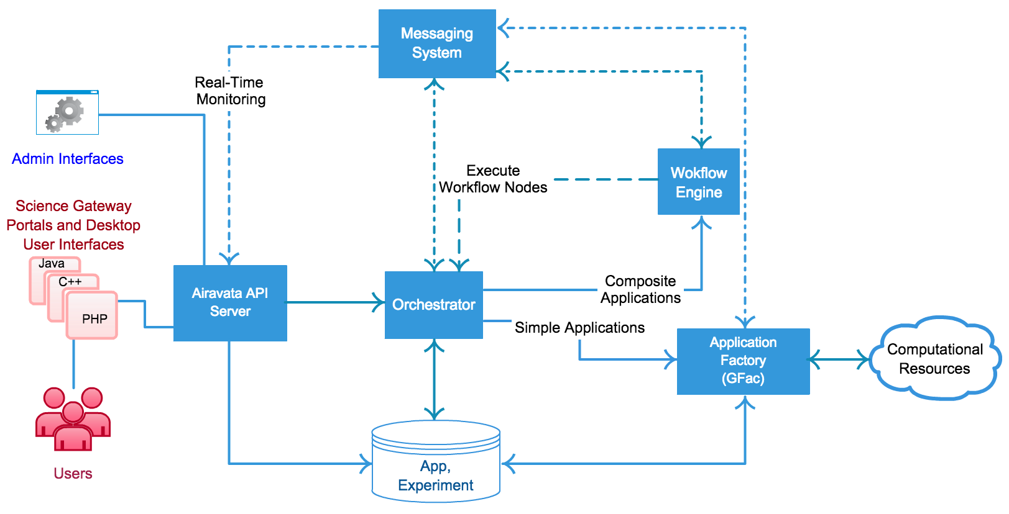
Apache Airavata: High Level Architecture

Slide 16
This Tutorial Focuses on the API
How to configure a gateway.
How to integrate with campus and XSEDE resources.
How to customize the default gateway
How to use the API

Slide 17
Tutorial Outline
User view: Running experiments using the PGA
Administrator view: managing users and resources
Administrator view: deploying new applications
Gateway Provider view: applying for a new hosted gateway
Developer view: Overview of the API
Next Steps
Wrap Up

Slide 18
Let’s Make Some Experiments

Slide 20
Introduction (Discussion)
Gateway User (Exercise)
Gateway Administrator (Exercise)
Build your own Gateway (Exercise)
Customize your Gateway (Demo & Exercise)
Advance Capabilities (Demo & Presentation)
Participant Next Steps (Discussion)

Slide 21
Can Apache Airavata ...
Make the groceries? Save the world? Run my R scripts? Optimally schedule my application on 17 different resources?

Slide 22
New Capability | Description
LDAP integration with campus resources | Simplify campus-based user onboarding; end-to-end multifactor authentication
Higher level python libraries for Jupyter and Django-based gateways | Remake the PGA into a more flexible framework; application-specific input and output parsers
Integration with Apache Helix | Use Helix as a microservice management framework for resilience, load balancing, and elasticity.
Multi-task job submissions | Executing high-throughput parallel applications efficiently with Apache Mesos.
Globus Transfer | Move large files
Client-Drive Developments in the Apache Airavata Laboratory

Slide 23
Wrap Up

Slide 24
XSEDE New User Tutorial: Using Science Gateways
Science Gateway | Gateway Type | Session Type
CIPRES | Domain gateway for phylogenetics | Hands On
Neuroscience Gateway | Domain gateway for neuroscience | Demo
UltraScan Science Gateway | SaaS/Instrument science gateway for analytical ultracentrifugation | Demo
SEAGrid | Domain gateway for computational chemistry, material science, and engineering. | Hands on
Lightning round: dREG, ChemCompute, and USD Gateway | SaaS gateway, domain gateway, and campus gateway | Demos

Slide 25
Presentation | Time | Notes
Apache Airavata Sharing Service: A Tool for Enabling User Collaboration in Science Gateways: Supun Nakandala | 9:00 am Thursday | More details on the sharing services
Distributed Task Execution: Gourav Shenoy | 5:30 pm Tuesday (poster) | Details on next generation of Airavata middleware.
Apache Airavata Database Versioning: Getting the Airavata Registry under Version Control: Sneha Tilak | 5:30 pm Tuesday (poster) | Part of our continuing integration and delivery
The PHASTA Science Gateway: Cameron Smith and Eroma Abeysinghe | 5:30 pm Tuesday (poster) | A SaaS gateway for the PHASTA finite element code
Technical presentations on Apache Airavata

Slide 26
Next Steps
Get help building a gateway!
  Extended Developer Support from the Science Gateways Community Institute
  XSEDE Extended Collaborative Support Services
Get involved in the science gateway community
  https://sciencegateways.org

