Slide 1
Customizing & Adding New Applications
From Gateway Deployment to ‘Ready-for-Users’
Eroma Abeysinghe
eabeysin@iu.edu
Indiana University
07/10/2017
PEARC17, July 10th 2017

Slide 2
Where We Are
Introduction (Discussion)
Participant Next Steps (Discussion)
Gateway User (Exercise)
Advance Capabilities (Demo & Presentation)
Gateway Administrator (Exercise)
Customize your Gateway (Demo & Exercise)
Build your own Gateway (Exercise)

Slide 3

After Gateway Deployment & Configuration
Pre-requisite: The Gateway will needs to be deployed & configured (currently manual process and not covered in the tutorial).
Customize the look and feel of the gateway.
Add and test application software.

Slide 4
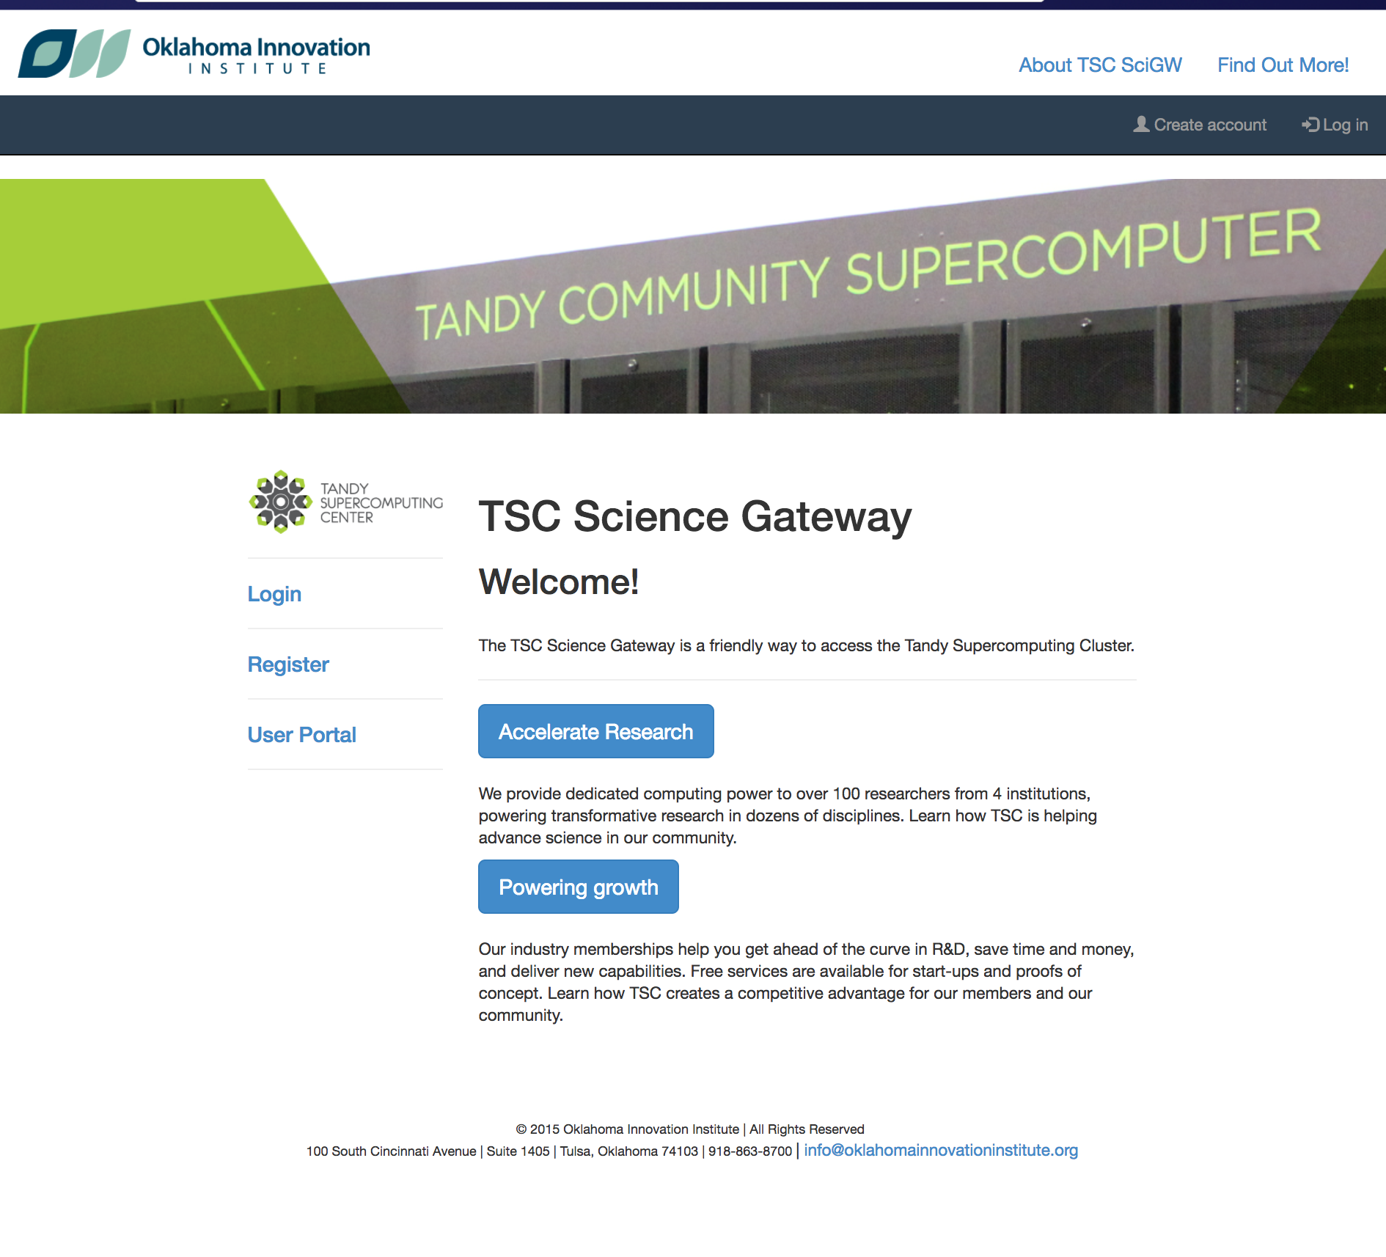
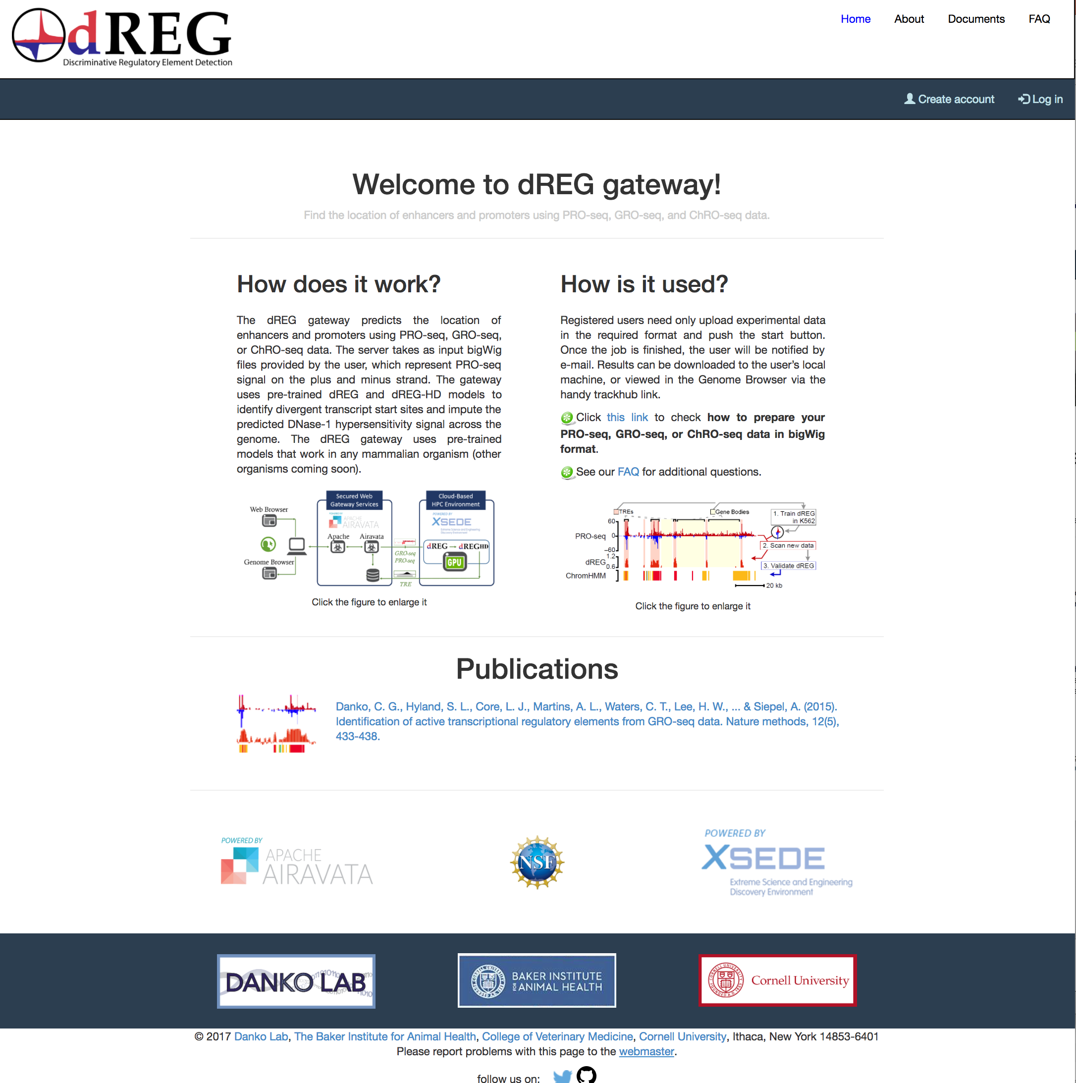
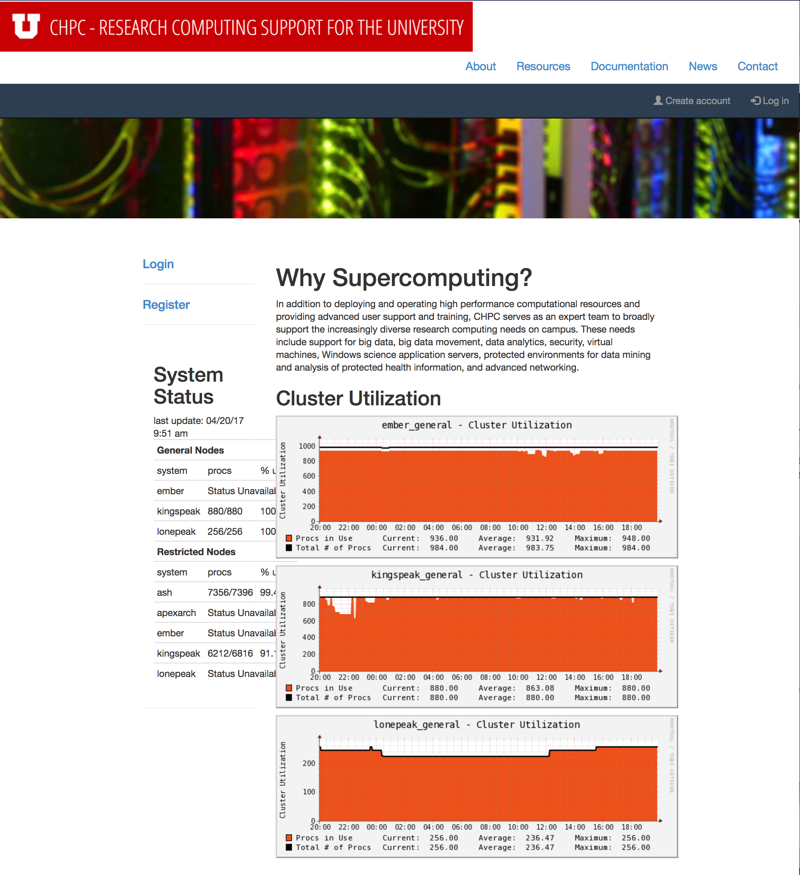
Gateway Customization
Change of look and feel, theme.
Change default workflows of experiment creation.
Plugin in post processing tools.
Make the gateway your own – add user guides, Contact details, Citing mechanisms, etc…

Slide 5
Adding Applications
Goal: Abstract the complexity of command line job submission steps providing user friendly web access.
Assumption: Gateway admin has prior knowledge of running the application within a batch script.
Steps to add application to the gateway:
  Register the application in the gateway.
  Define inputs and outputs (and corresponding arguments).
  Application deployment details in the cluster.
Demo: Let’s add a new Application …

Slide 6
Thank you

