Slide 1
A Gateway Parade
Examples of some recent gateways

Slide 2
dREG: discriminative Regulatory Element detection from GRO-seq
Prof. Charles Danko and Dr. Zhong Wang, Cornell
dREG: Identification of the genomic regions that regulate transcription
  Genetic basis of many diseases
Code is actively developed
You may not have local resources for running it.
  Traditional MPI and GPU versions

Slide 3
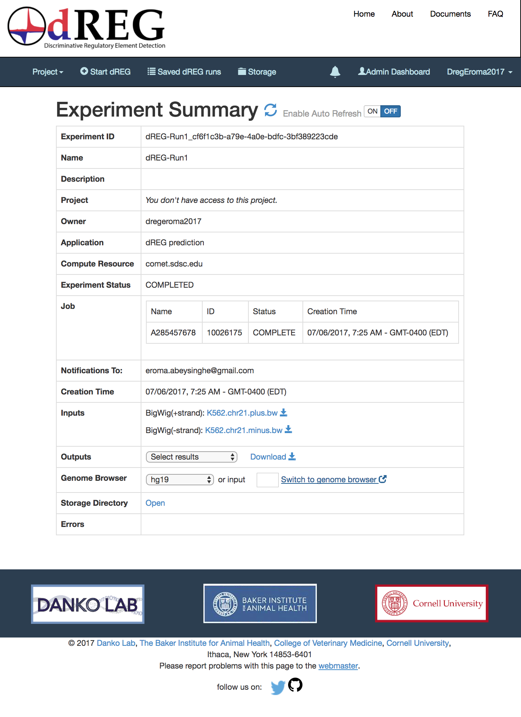
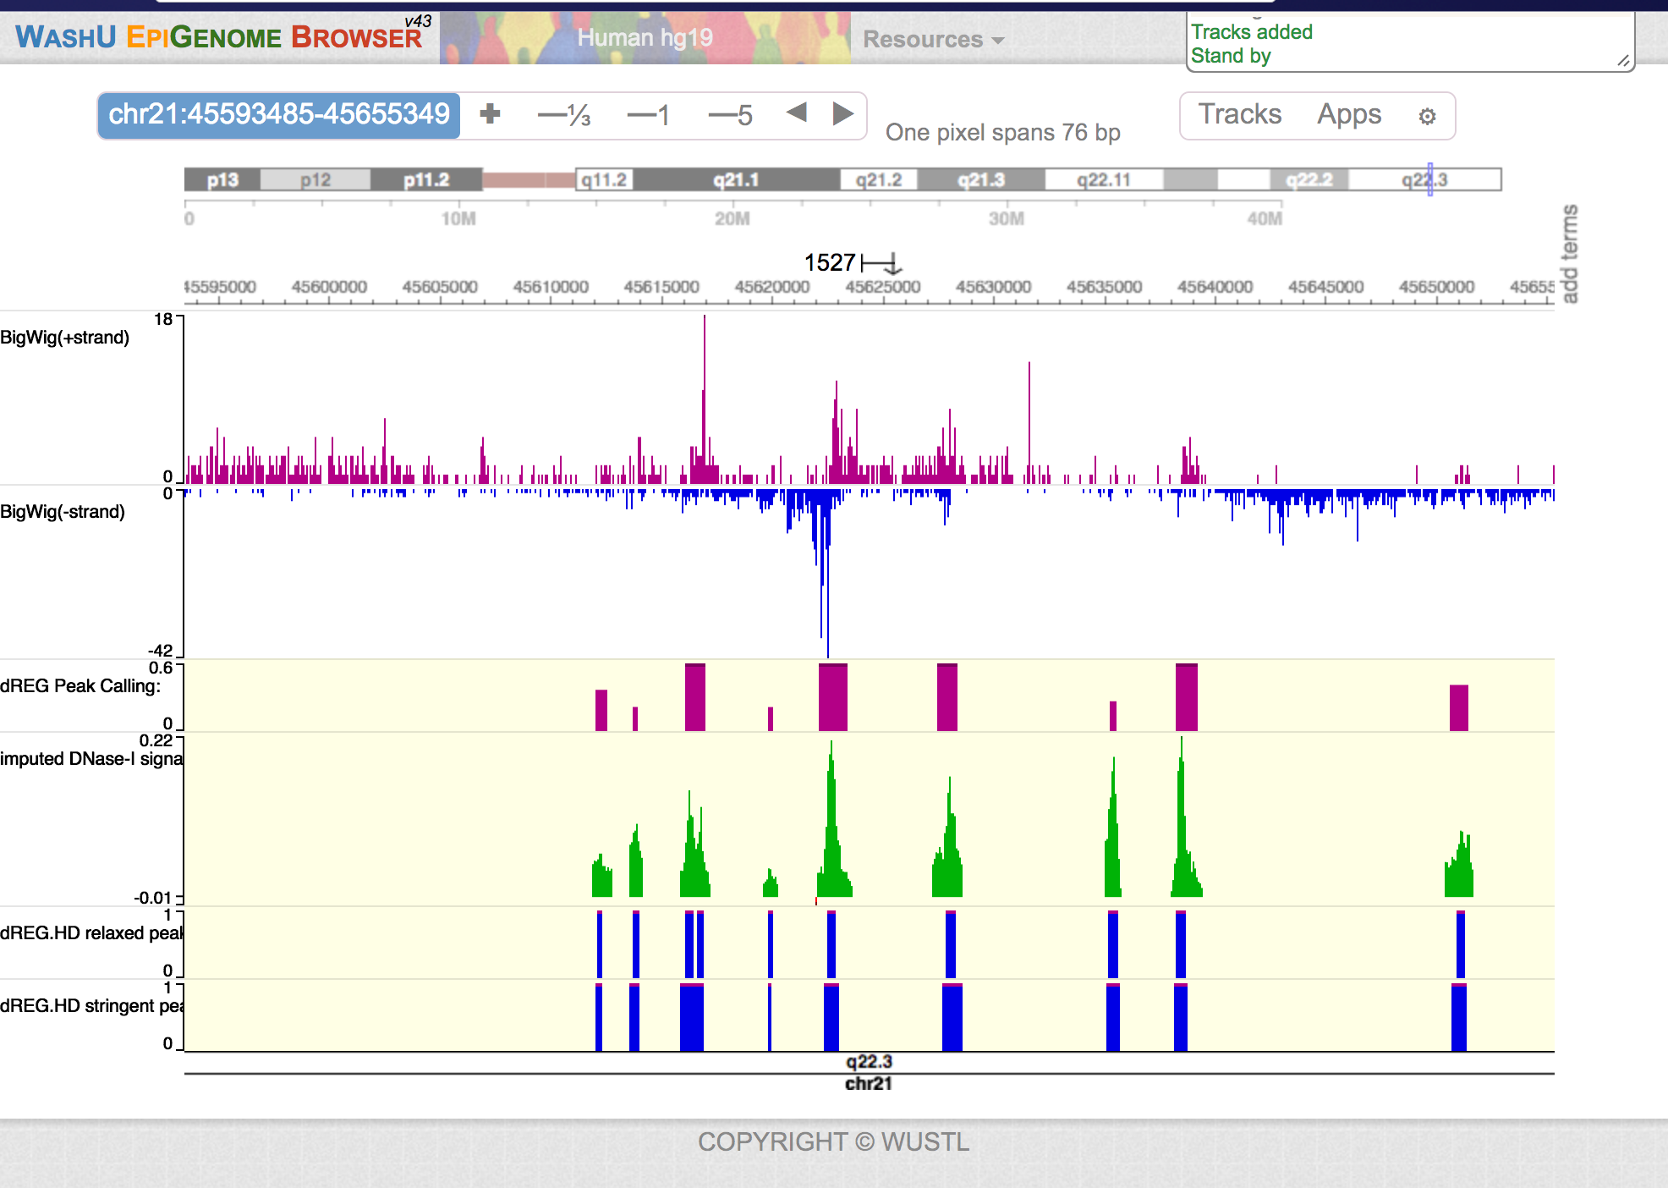
dREG: Software as a Service
Instead of requiring users to download and install the code, deliver it through a gateway.
And integrate third party Web tools

Slide 4
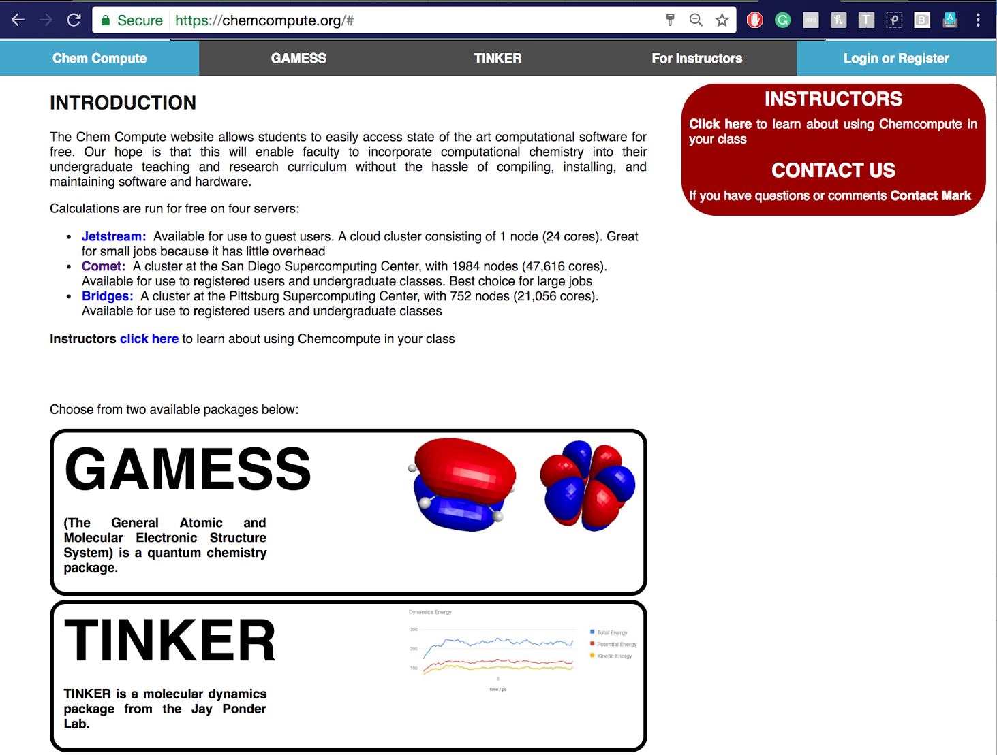
ChemCompute.org: Educational Gateway
Prof. Mark Perri, PI
Goal: Help students use computational chemistry tools
Provide custom user interfaces tailored to students
Use XSEDE and Apache Airavata to provide backend power.

Slide 5

University of South Dakota Campus Gateway
Doug Jennewein, PI
Provide simplified access to campus computing resources
Use campus identities all the way through (no community accounts)
Simplify bridging between campus resources and XSEDE.

Slide 6
Next Steps
Explore other science gateways
  https://www.xsede.org/gateways-listing
Get help building a gateway!
  Extended Developer Support from the Science Gateways Community Institute
  XSEDE Extended Collaborative Support Services
Get involved in the science gateway community
  https://sciencegateways.org

