Slide 1
The CIPRES Science Gateway: Enabling High-Impact Science for Phylogenetics Researchers with Limited Resources
Mark A. Miller
San Diego Supercomputer Center

Slide 2


Phylogenetics is the study of the diversification of life on the planet Earth, both past and present, and the relationships among living things through time
?

Slide 3
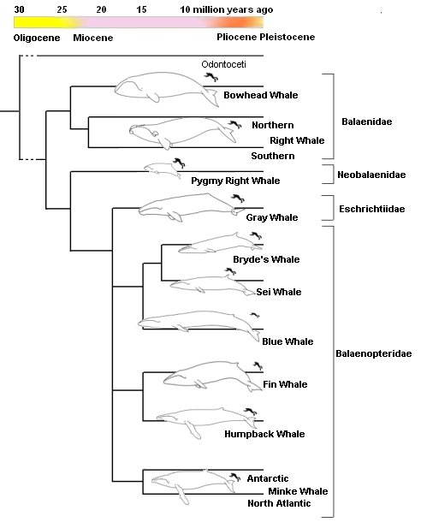
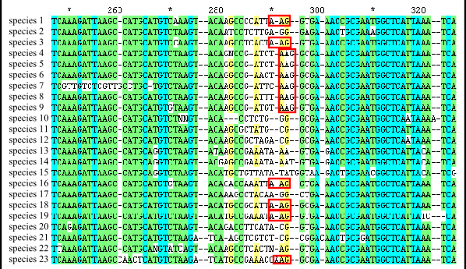
Evolutionary relationships can be inferred from DNA sequence comparisons:
1. Align sequences to determine evolutionary equivalence:
2. Infer evolutionary relationships based on some set of assumptions:

Slide 4
Exploring Tree Space is NP Hard!.
Number of Species | Number of Rooted Trees
3 | 3
4 | 15
5 | 105
10 | 3.44 x10⁷
20 | 8.20 x10²¹
30 | 4.95 x10³⁸

Slide 5
Exploring Tree Space is NP Hard!.
Number of Species | Number of Rooted Trees
3 | 3
4 | 15
5 | 105
10 | 3.44 x10⁷
20 | 8.20 x10²¹
30 | 4.95 x10³⁸
Age of the universe: 4.339 ~ 0.035 ×10¹⁷ seconds.

Slide 6
Inferring Evolutionary relationships from DNA sequence comparisons is powerful:
DNA sequences are determined by fully automated procedures.
Sequence data can be gathered from many species at scales from gene to whole genome.
The high speed and low cost of NexGen Sequencing means new levels of sensitivity and resolution can be obtained.
The speed of sequencing is still increasing, while the cost of sequencing is decreasing.

Slide 7
Inferring Evolutionary relationships from DNA sequence comparisons is powerful, BUT:
Current analyses often involve 1000’s of species and 1000’s of characters, creating very large matrices.
Sequence alignment and Tree inference are NP hard; even with heuristics, computational power often limits the analyses (already).
The length of tree search analysis scales exponentially with number of taxa and with number of characters with codes in current use.
There are at least 10⁷ species, each with 3000 - 30,000 genes, so the need
for computational power and new approaches will continue to grow.

Slide 8
Inferring Evolutionary relationships from DNA sequence comparisons is powerful, BUT:
Current analyses often involve 1000’s of species and 1000’s of characters, creating very large matrices.
Sequence alignment and Tree inference are NP hard; even with heuristics, computational power often limits the analyses (already).
The length of tree search analysis scales exponentially with number of taxa and with number of characters with codes in current use.
There are at least 10⁷ species, each with 3000 - 30,000 genes, so the need
for computational power and new approaches will continue to grow.

Slide 9
Inferring Evolutionary relationships from DNA sequence comparisons is powerful, BUT:
Current analyses often involve 1000’s of species and 1000’s of characters, creating very large matrices.
Sequence alignment and Tree inference are NP hard; even with heuristics, computational power often limits the analyses (already).
The length of tree search analysis scales exponentially with number of taxa and with number of characters with codes in current use.
There are at least 10⁷ species, each with 3000 - 30,000 genes, so the need
for computational power and new approaches will continue to grow.

Slide 10
Inferring Evolutionary relationships from DNA sequence comparisons is powerful, BUT:
Current analyses often involve 1000’s of species and 1000’s of characters, creating very large matrices.
Sequence alignment and Tree inference are NP hard; even with heuristics, computational power often limits the analyses (already).
The length of tree search analysis scales exponentially with number of taxa and with number of characters with codes in current use.
There are at least 10⁷ species, each with 3000 - 30,000 genes, so the need
for computational power and new approaches will continue to grow.

Slide 11
Inferring Evolutionary relationships from DNA sequence comparisons is powerful, BUT:
Current analyses often involve 1000’s of species and 1000’s of characters, creating very large matrices.
Sequence alignment and Tree inference are NP hard; even with heuristics, computational power often limits the analyses (already).
The length of tree search analysis scales exponentially with number of taxa and with number of characters with codes in current use.
There are at least 10⁷ species, each with 3000 - 30,000 genes, so the need
for computational power and new approaches will continue to grow.

Slide 12
In this new, DNA sequence-rich world, laptops and desktops are no
longer adequate for phylogenetic analysis….
How do we keep lesser-resourced groups engaged in relevant research?

Slide 13
The solution: make parallel versions of community codes available on scalable, sustainable resources via the Science Gateway Program
TeraGrid/XSEDE
Parallel codes
Workbench
Framework
TSCC
Serial codes

Slide 14
Workflow for the CIPRES Science Gateway:
CIPRES Portal
Assemble Sequences
Upload to
Portal
Run Alignment
Store
Run Tree
Inference
Post-Tree
Analysis
Download

Slide 15
Step 1. Democratizing access
The CIPRES Science Gateway was designed to allow users to analyze large sequence data sets using community codes on significant computational resources.
The CSG provides
Login-protected personal user space for storing results indefinitely.
Access to most/all native command line options for several codes.
Support for adding new tools and upgrading to new versions as needed.

Slide 16
Step 1. Democratizing access
The CIPRES Science Gateway was designed to allow users to analyze large sequence data sets using community codes on significant computational resources.
The CSG provides
Login-protected personal user space for storing results indefinitely.
Access to most/all native command line options for several codes.
Support for adding new tools and upgrading to new versions as needed.

Slide 17
Step 1. Democratizing access
The CIPRES Science Gateway was designed to allow users to analyze large sequence data sets using community codes on significant computational resources.
The CSG provides
Login-protected personal user space for storing results indefinitely.
Access to most/all native command line options for several codes.
Support for adding new tools and upgrading to new versions as needed.

Slide 18
Step 1. Democratizing access
The CIPRES Science Gateway was designed to allow users to analyze large sequence data sets using community codes on significant computational resources.
The CSG provides
Login-protected personal user space for storing results indefinitely.
Access to most/all native command line options for several codes.
Support for adding new tools and upgrading to new versions as needed.

Slide 19
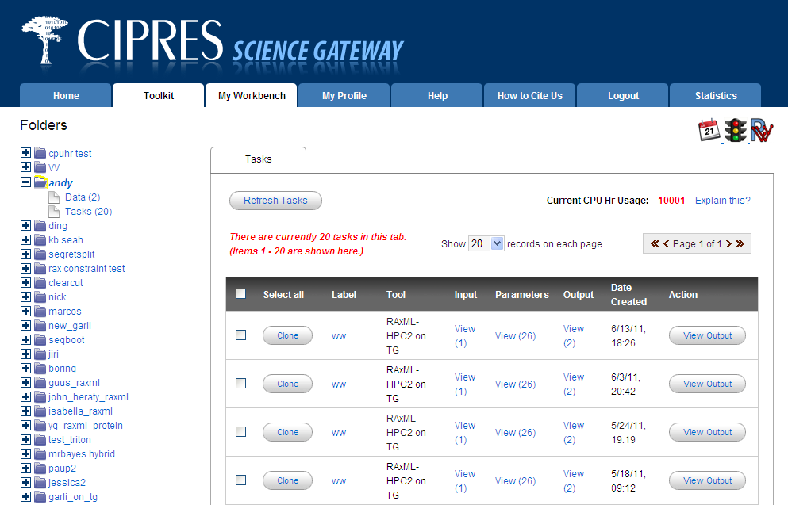
Provide a simple interface…..

Slide 20
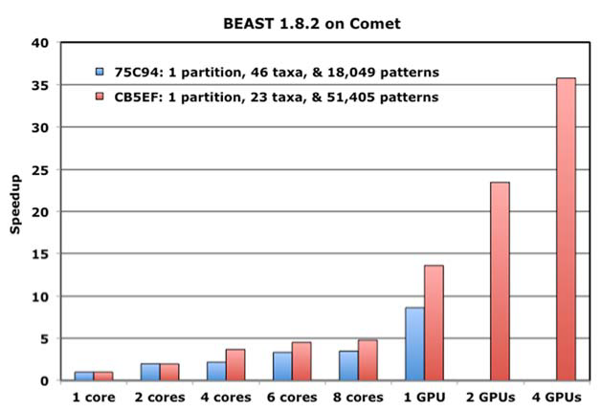

Slide 21
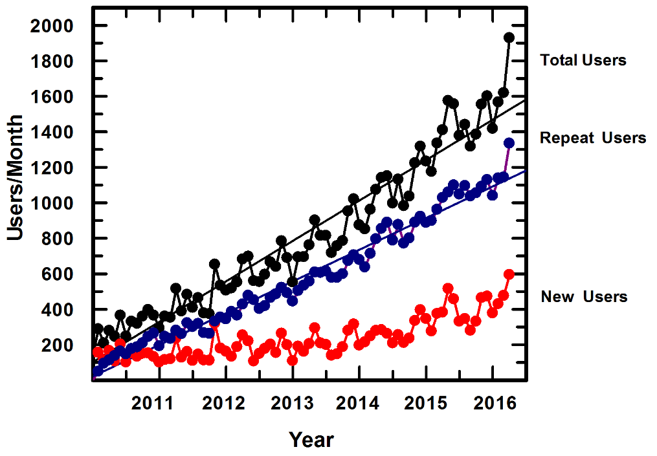
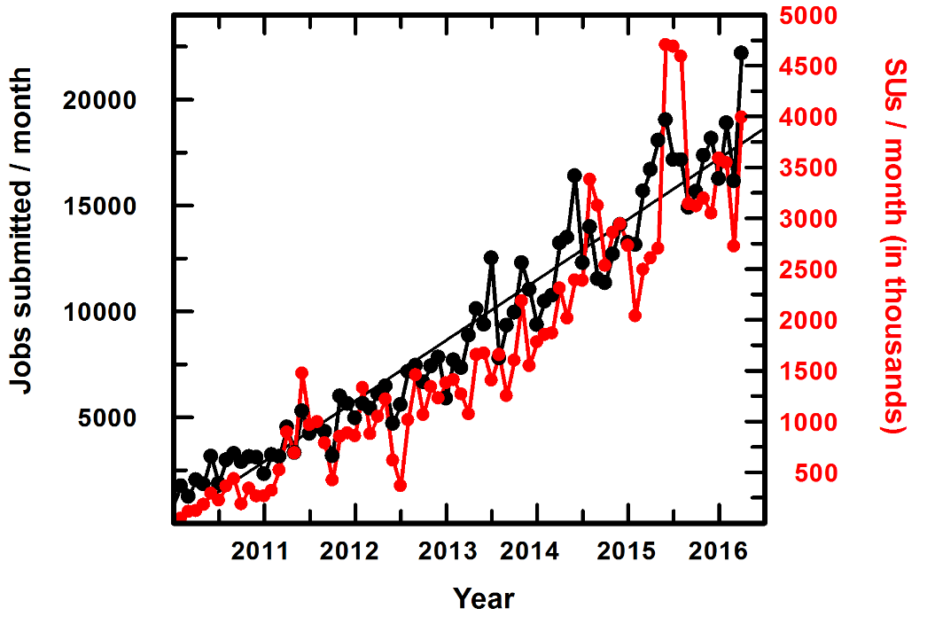
Usage Statistics for CIPRES as of 3/31/2016

Slide 22
Who Uses CIPRES?
In the past 14 months, we received submissions from 1938 users in the US,
52 US states/territories (GU, PR, DC).
29/31 EPSCOR states/territories (all save DE and VI).
252 US Institutions of Higher education: 184 PhD-granting, 68 non-PhD.
Including 4 historically black colleges, 24 Hispanic-serving, and 2 Alaska/Hawaii native-serving institutions. 4 high schools.
24 NGOs/independent research institutes; 13 museums, 7 botanical gardens, and 2 zoos, and 4 commercial entities.
Woods Hole Oceanographic Institution, Cold Spring Harbor Laboratory, J. Craig Venter Institute, MD Anderson Cancer Center, American Association for the Advancement of Science, The California Academy of Sciences, The Smithsonian Institute, American Museum of Natural History, Louisiana State University Museum of Natural Science, Sam Noble Oklahoma Museum of Natural History, The Morton Arboretum, Missouri Botanical Garden, New York Botanical Garden, Rancho Santa Ana Botanic Garden, Second Genome - The Microbiome Company, and Assured Bio Labs.

Slide 23
Who Uses CIPRES?
Jobs were submitted also from 22 federal and state government agencies:
DHHS: Centers for Disease Control and Prevention; Food and Drug Administration, NCI, NHGRI, NLM, NIAID;
USDA: US Forest Service, National Center for Agricultural Utilization Research, National Animal Disease Center, Southern Regional Research Center, Systematic Microbiology and Mycology Laboratory;
Department of Defense: Walter Reed Army Institute of Research;
Department of the Interior: National Wildlife Health Center, US Geological Survey;
Department of Energy: Los Alamos, Lawrence Berkeley, and Lawrence Livermore Laboratories;
Department of Commerce, NOAA Fisheries;
NSF;
NASA Kennedy Space Center;
Florida’s Fish and Wildlife Research Institute;
California Department of Food & Agriculture.

Slide 24
Who Uses CIPRES?
CIPRES also received jobs from 4560 users at 968 institutions in 85 unique countries outside the US.
134 Federal Institutions (including the NIH equivalent in the Canada, the UK, Macedonia, and others; CSIRO in Australia; and the Chinese Academy of Sciences)
603 Universities (from all 85 countries, ranging from China and the UK to Togo and Seychelles)
161 Scientific Institutes (Including the Max Planck in Germany, and Institute Pasteur in Paris and Tunis)
34 Museums (including Museum of Zoological Research Alexander Koenig in Mexico, the Hungarian Natural History Museum, and Museo Argentino de Ciencias Naturales)
40 Botanical Gardens (including the Royal Botanical Gardens, the Korean National Arboretum, and the Fairylake Botanical Garden in Malaysia)
6 Zoos (including the Zoological Institute in Russia, and the Zoological Museum in Denmark)
6 Private entities (including the Vale Institute and the Beijing Genomics Institute).

Slide 25
Impact on Scientific Productivity:
In Q1 2016, 47% of all XSEDE users who ran one or more jobs ran them from the CSG (They used less then 2% of XSEDEs allocatable resources)
50% of users said they had no access to local resources, nor funds to purchase access on cloud computing resources
90% of users said progress would be slowed or halted without CIPRES
Used for curriculum delivery by at least 93 instructors.

Slide 26
Publications enabled by the CIPRES Science Gateway/
CIPRES Portal:
Year Publications
2016 228*
2015 623
2014 526
2013 348
2012 249
2011 153
2010 97
2009 61
:
* (as of March 31)

Slide 27
What Kind of Science Does CIPRES Support?

Slide 28
We know the bacteria we can culture, and can out them in the tree of life,
but what about all those bacteria we have not succeeded in culturing,
and those that we have not even tried culturing yet?
A new method was tried by Hug et al. (2016):
Sample DNA directly from many environments.
Study includes 1,011 organisms from lineages
for which genomes were not previously available.
Collect samples from:
a shallow aquifer system,
a deep subsurface research site in Japan,
a salt crust in the Atacama Desert,
grassland meadow soil in northern California,
a CO2-rich geyser system,
two dolphin mouths.

Slide 29
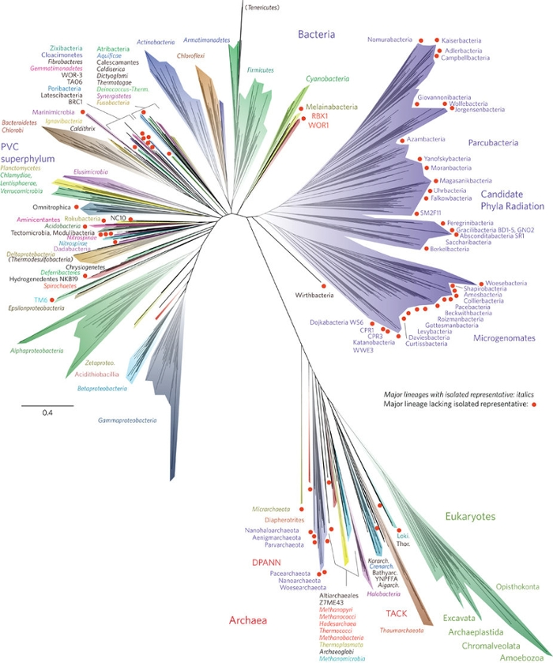
Sequence and assemble.
Focus study on ribosomal protein sequences.
Fit into the existing phylogenetic tree.
Red dots indicate major lineages sequenced in this study that have not yet been cultured.

Slide 30
Hug: “I spent over a month attempting to conduct these jobs on other servers with no success – the jobs always failed prior to finishing.

Slide 31
“I am pushing now to submit a MS by Friday, and I am making multiple runs by RAxML and Mr Bayes each day (small by your standards), but all of which are necessary to get the final picture polished and submission-ready.”

Slide 32
“For young researchers at the transition of postdoc to PI, CIPRES is an important resource because we usually lack [our] own funding/infrastructure for these kind of analyses. Thus, CIPRES has helped me a lot towards achieving scientific independence.”

Slide 33
“….the computations took 6 minutes on Gordon for my input file, while trying to run this on my PC it collapsed after 2 weeks! User friendly server both due to assistance and design which greatly facilitates research!”

Slide 34
“I’m in the jungles of Panama for fieldwork, can't tell you how helpful it is to have this online resource.”

Slide 35
“I am at a small regional university where I do not have access to the kind of computing power available at R1 universities. Therefore, my research program really benefits from this amazing resource.”

Slide 36
“The wall time for these data sets are 30 min (2000 Bootstrap reps) [on the CSG], but locally it would take 24 hours for each run. So, instead of 10 days to complete all the analyses with a few local computers, I have publication quality trees overnight.”

Slide 37
Impact on Education:
“It is an easy-to-use cluster to run BEAST analyses in a short time. This allows students to run analyses that actually converge in a single class.”

Slide 38
Goals for this tutorial:
Make an account and login.
Upload a data file to work on.
Run a canonical CIPRES workflow:
  Sequence alignment
  Tree Inference
  Links:
  http://www.phylo.org/portal2 CIPRES Gateway
  http://www.phylo.org/tools/tool_tests/mafft_input.txt Input for sequence alignment
  http://etetoolkit.org/treeview/ Second Party Tree Viewer

