Slide 1
Science Gateways for New XSEDE Users
PEARC17
New Orleans, LA
July 10th, 2017

Slide 2
https://s.apache.org/pearc17-gateway-tutorials
This is the only URL you’ll need

Slide 3
Purposes of the Tutorial
Show new XSEDE users how to quickly get access to scientific applications without
  Going through the allocation process.
  Deciding which machines to use
  Learning how to use batch schedulers, etc.
Show Campus Champions how gateways can increase their impact

Slide 4
Most XSEDE users are science gateway users

Slide 5
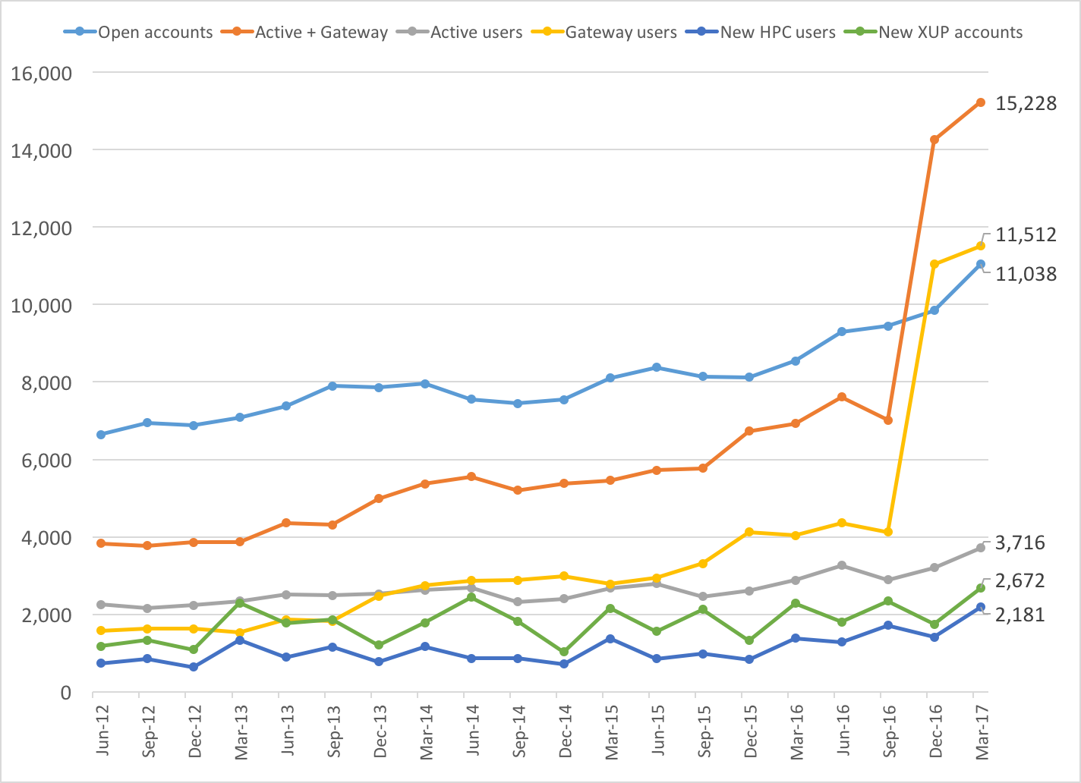
XSEDE quarterly user counts
Gateways
SSH Users

Slide 6
XSEDE Gateways Are in Production
You can use them today. No allocation required.

Slide 7
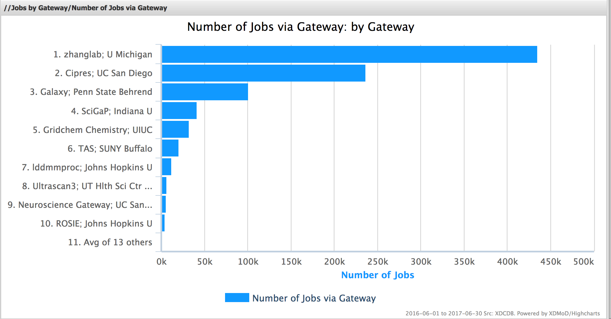
2017
https://xdmod.ccr.buffalo.edu/

Slide 8
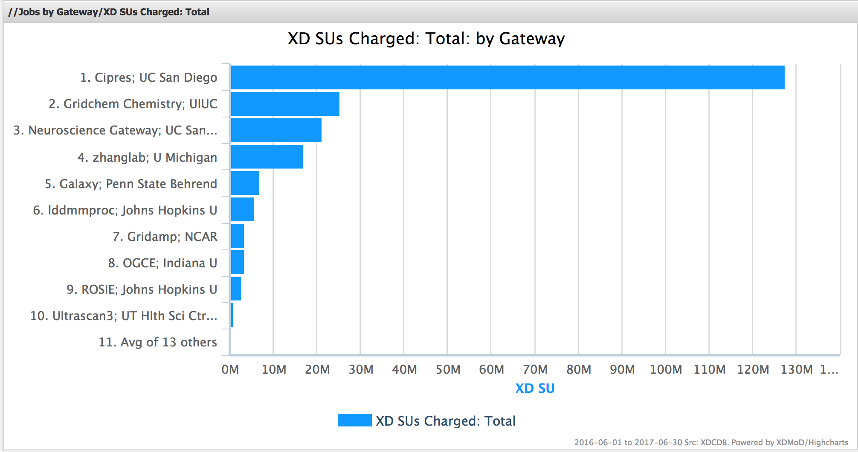
https://xdmod.ccr.buffalo.edu/

Slide 9
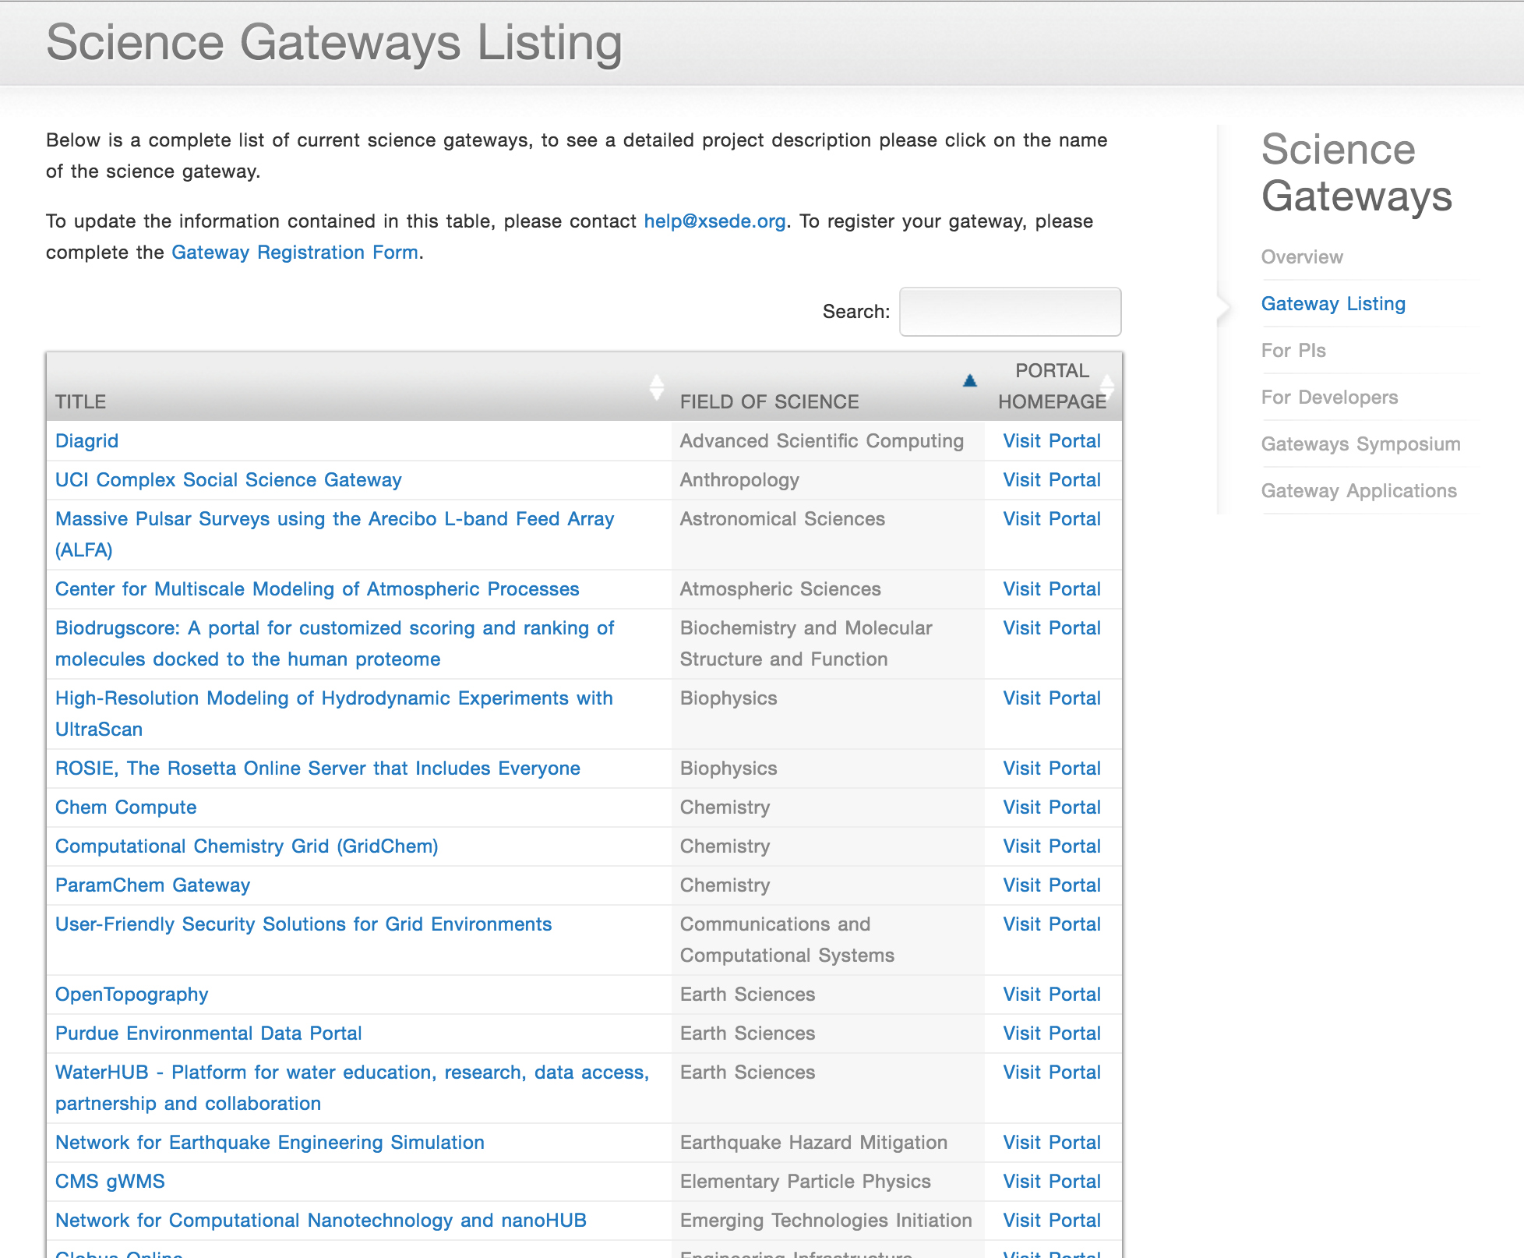
Find an XSEDE Science Gateway
https://www.xsede.org/gateways-listing

Slide 10
Build a Science Gateway
Request Extended Developer Support from the Science Gateways Community Institute
  https://sciencegateways.org/
For XSEDE integration, include an Extended Collaborative Support request with your allocation request.
I manage both support programs, so just contact me if in doubt.
We are also happy to talk while here
  marpierc@iu.edu
  https://sciencegateways.org/

