Slide 1
Science Gateways for New Users
XSEDE16 Tutorial

Slide 2
https://s.apache.org/xsede16-gateway-tutorials
This is the only URL you’ll need

Slide 3
Purposes of the Tutorial
Show new XSEDE users how to quickly get access to scientific applications without
  Going through the allocation process.
  Deciding which machines to use
  Learning how to use batch schedulers, etc.
Show Campus Champions how gateways can increase their impact

Slide 4
Most XSEDE users are science gateway users

Slide 5
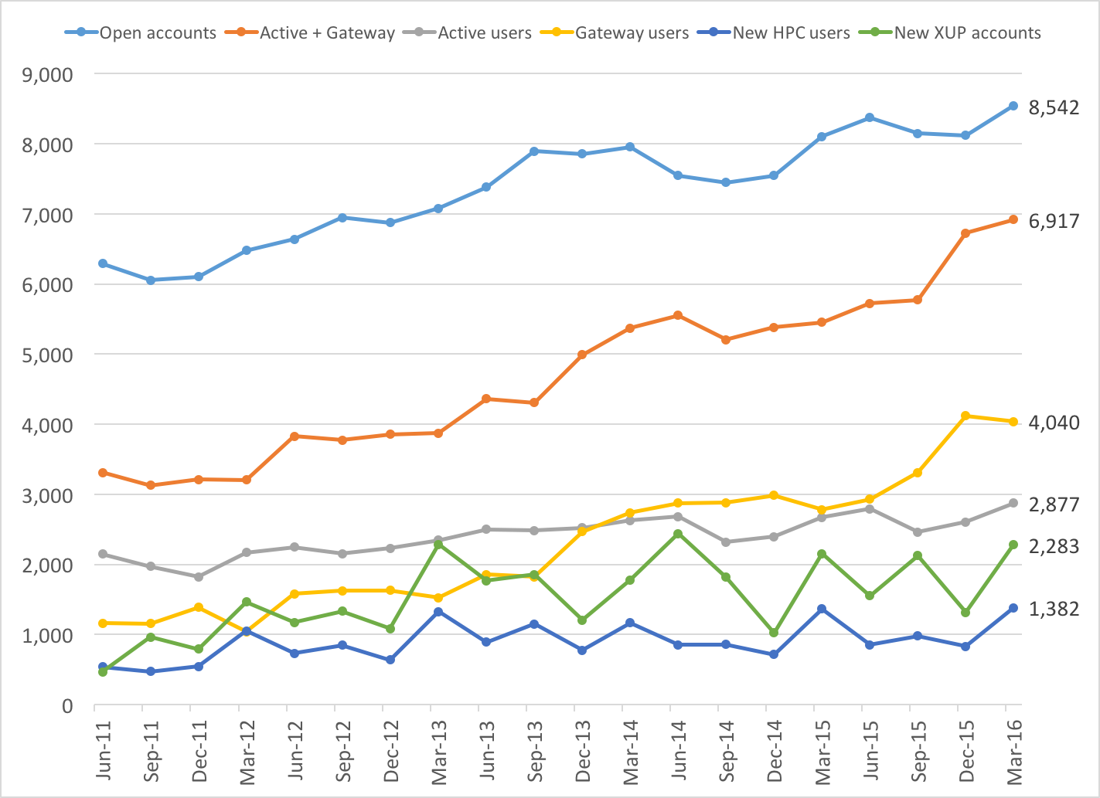
XSEDE quarterly user counts
Gateways
SSH Users

Slide 6
The Gateways in this Tutorial Are in Production

Slide 7
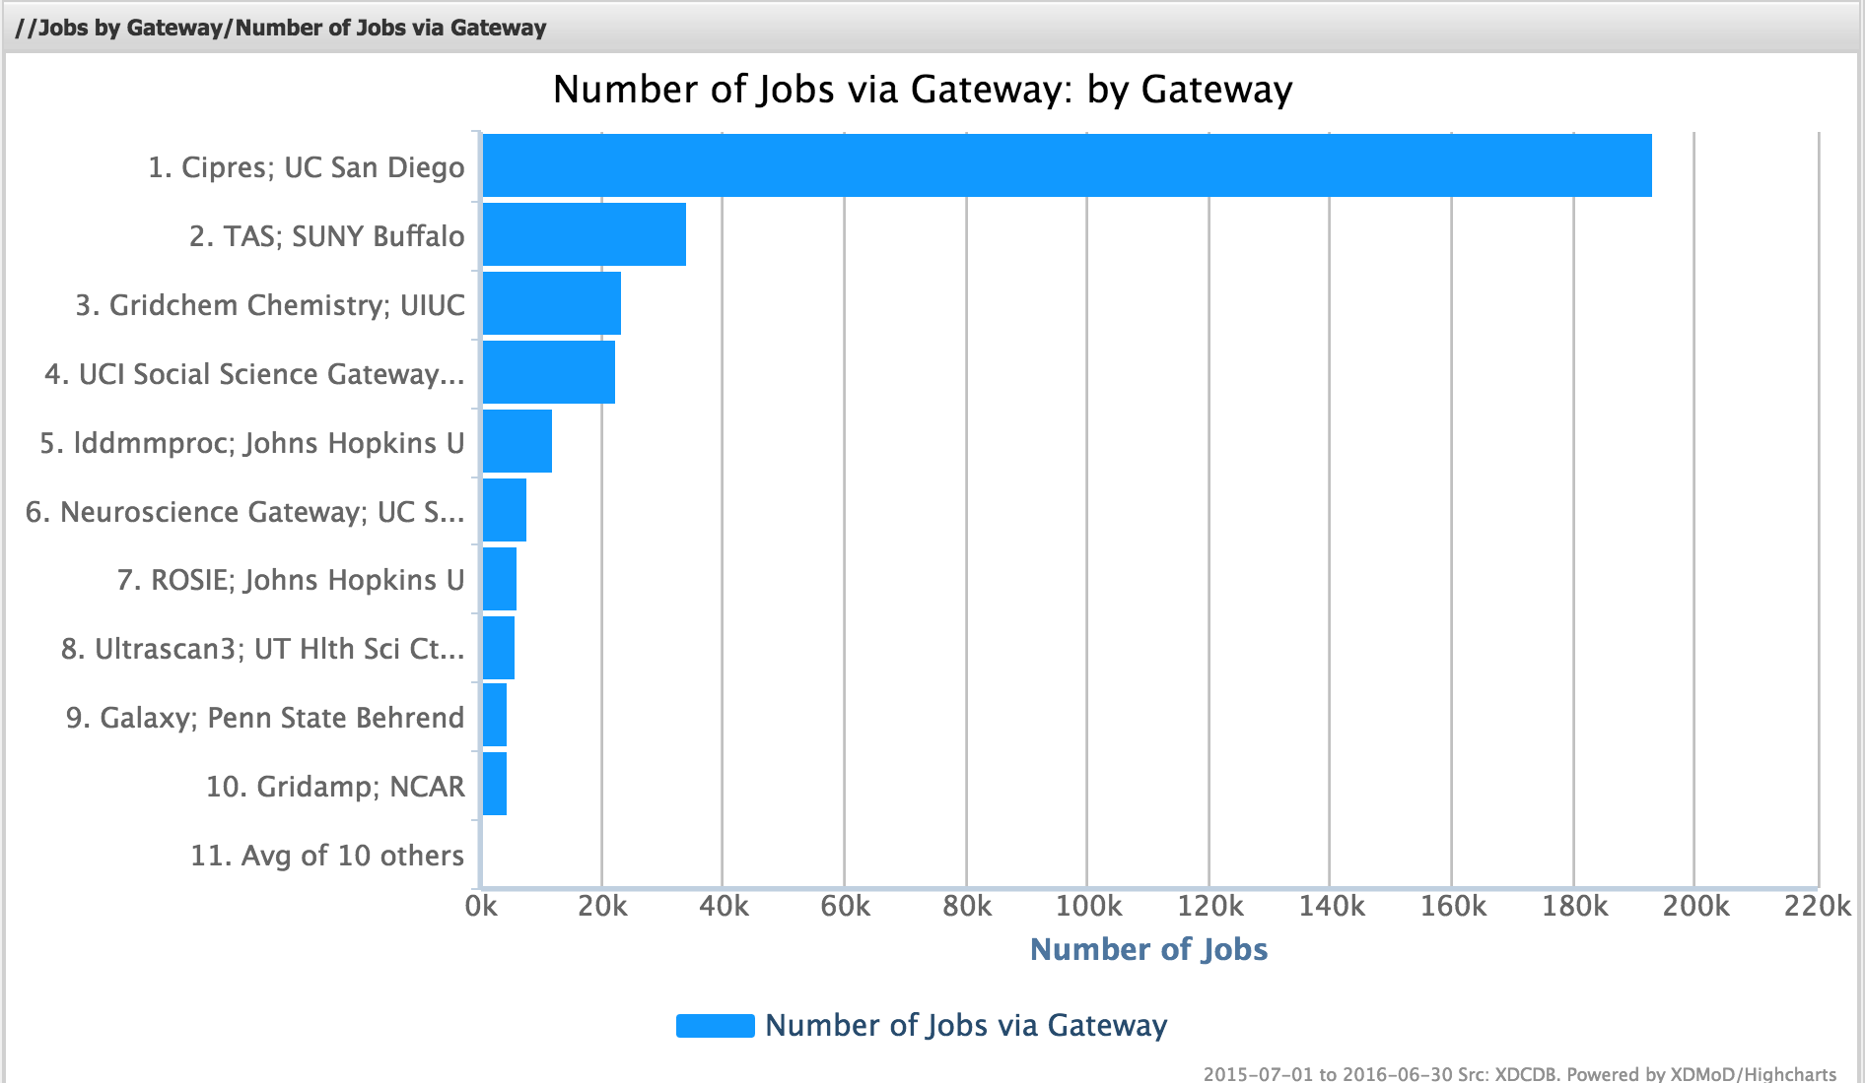
https://xdmod.ccr.buffalo.edu/

Slide 8
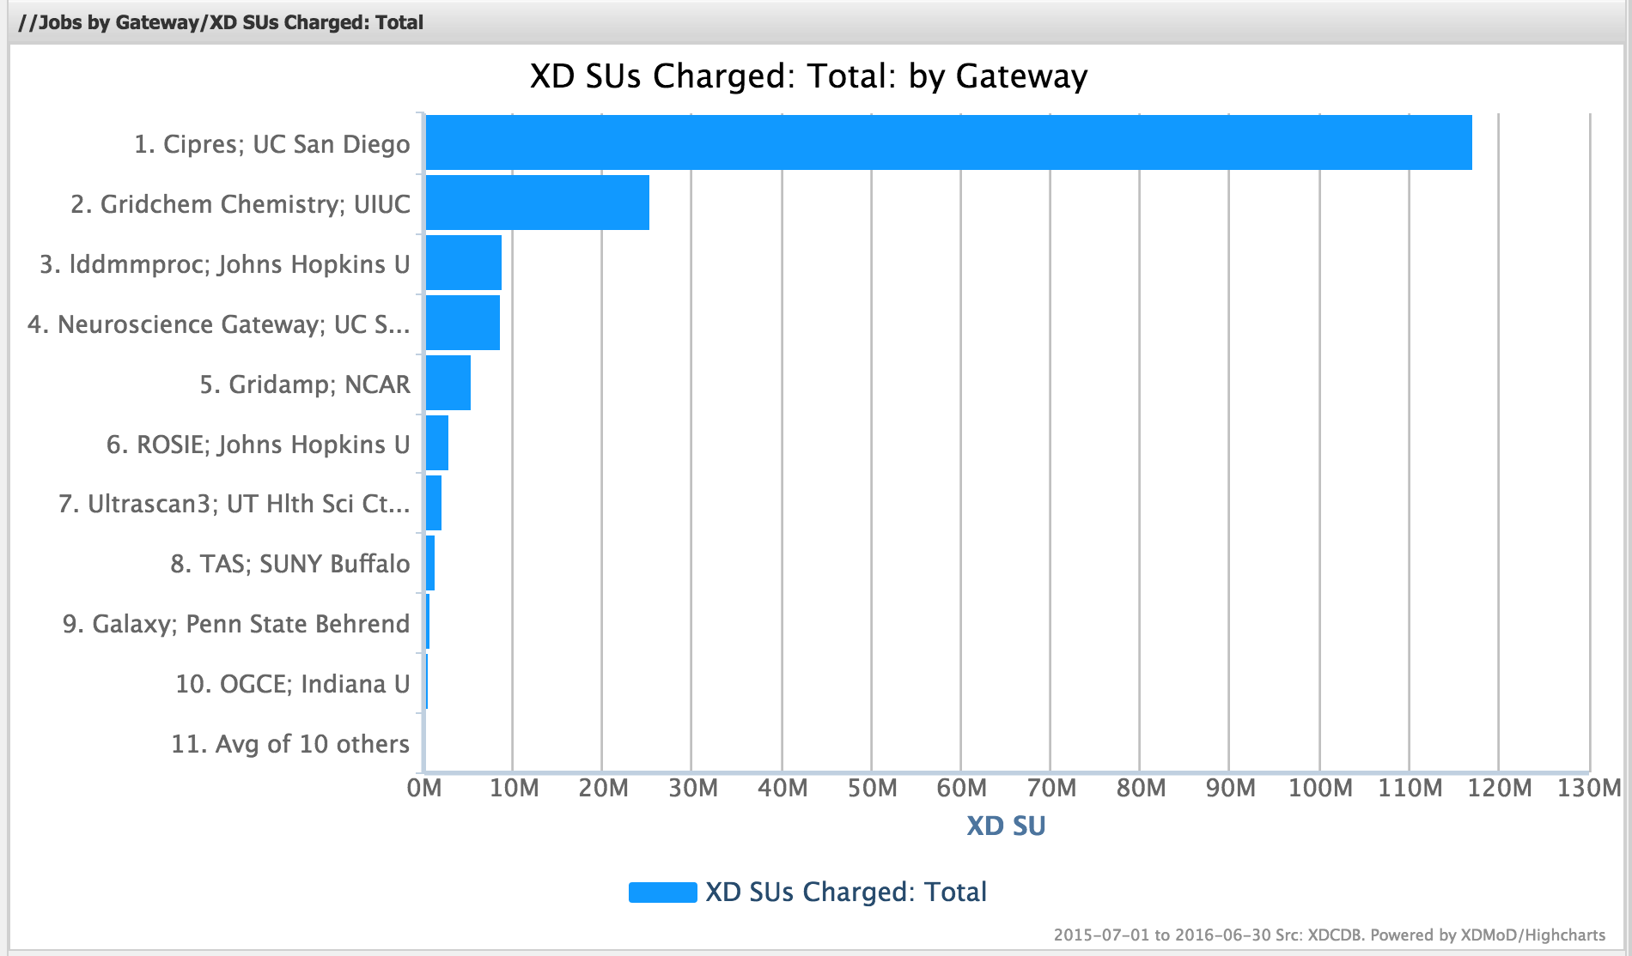
https://xdmod.ccr.buffalo.edu/

Slide 9
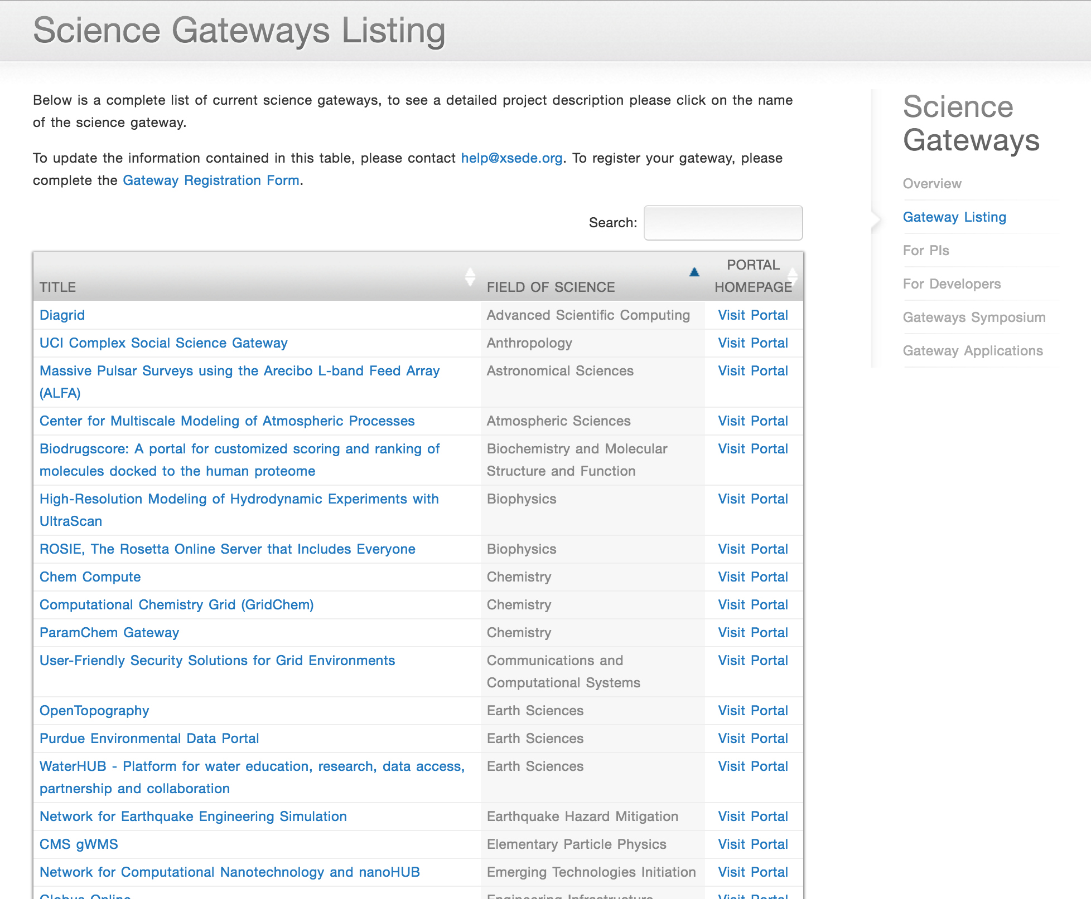
Find an XSEDE Science Gateway
https://www.xsede.org/gateways-listing

Slide 10
Build an XSEDE Science Gateway
Attend the SciGaP tutorial this afternoon.
Request XSEDE Extended Collaborative Support for your gateway
Attend the Science Gateways Community Institute BOF
  5:15 pm Tuesday

Slide 11
More Information
Contact me: marpierc@iu.edu
I’ll be at XSEDE16 all week and will be glad to talk

