Slide 1
Event Loop and
Continuation Thread Affinity
Fei Deng

Slide 2
Introduction
Event loop.
  Event loop changes.
  Event loop metrics.
  Accept thread initialization.
Continuation thread affinity.
  New APIs.
  Example Usage.

Slide 3
Event Loop Changes
Removed condition variable for “fast” signal tracking.
Split “execute_regular” function.
Changed thread initialization logic.
Don’t re-purpose main thread as event thread.

Slide 4
Event Loop Stalling
Event loop must have a stall point to wait for external activity.
Two stall points originally.
  Condition variable for external event queue.
  I/O.
Updated to have a single stall point, I/O.
  tail_cb mechanism replaces signal_hook.

Slide 5
Event Loop Metrics
proxy.process.eventloop.count: # of event loops executed.
proxy.process.eventloop.events: # of events.
proxy.process.eventloop.events.min: min # of events dispatched in a loop.
proxy.process.eventloop.events.max: max # of events dispatched in a loop.
proxy.process.eventloop.wait: # of I/O waits per period.
proxy.process.eventloop.time.min: Shortest time spent in loop.
proxy.process.eventloop.time.max: Longest time spent in loop.
Three time spans - 10s, 100s, 1000s

Slide 6
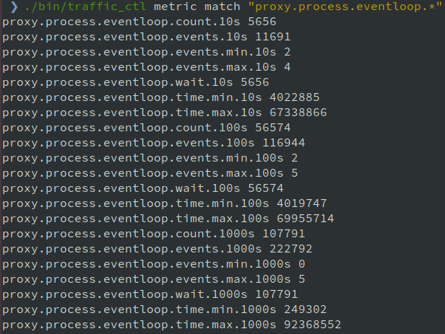
Event Loop Metrics Sample Output

Slide 7
Race Condition with Accept Threads
traffic_server: received signal 11 (Segmentation fault) traffic_server - STACK TRACE: traffic_server(_Z19crash_logger_invokeiP9siginfo_tPv+0xd4)[0x56401d70d8c0] /lib/x86_64-linux-gnu/libpthread.so.0(+0x13150)[0x7f409ad7d150] traffic_server(_ZN7EventIO5startEP14PollDescriptoriP12Continuationi+0x7d)[0x56401d904e37] traffic_server(_ZN7EventIO5startEP14PollDescriptorP9NetAccepti+0x43)[0x56401d977a13] traffic_server(_ZN9NetAccept22init_accept_per_threadEv+0x16d)[0x56401d975d67] traffic_server(_ZN16UnixNetProcessor15accept_internalEP12ContinuationiRKN12NetProcessor13AcceptOptionsE+0x74b)[0x56401d978cb1] traffic_server(_ZN12NetProcessor11main_acceptEP12ContinuationiRKNS_13AcceptOptionsE+0xe5)[0x56401d97854f] traffic_server(_Z21start_HttpProxyServerv+0x112)[0x56401d7dc853] traffic_server(main+0x137b)[0x56401d7390bf] /lib/x86_64-linux-gnu/libc.so.6(__libc_start_main+0xf1)[0x7f4099eb41c1] traffic_server(_start+0x2a)[0x56401d6f61ca]
Happens when proxy.config.accept_threads was set to 0.
Notes:
Thread group

Slide 8
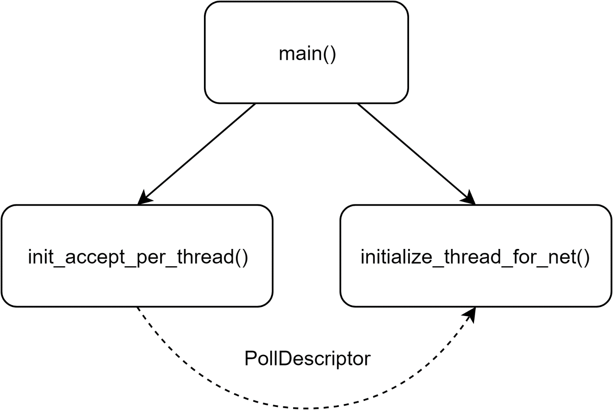
Race Condition with Accept Threads
Added _started counter in ThreadGroupDescriptor.
Use condition variable to check whether all ET_NET threads have finished initialization.

Slide 9
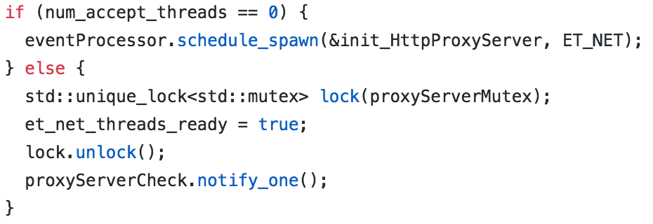
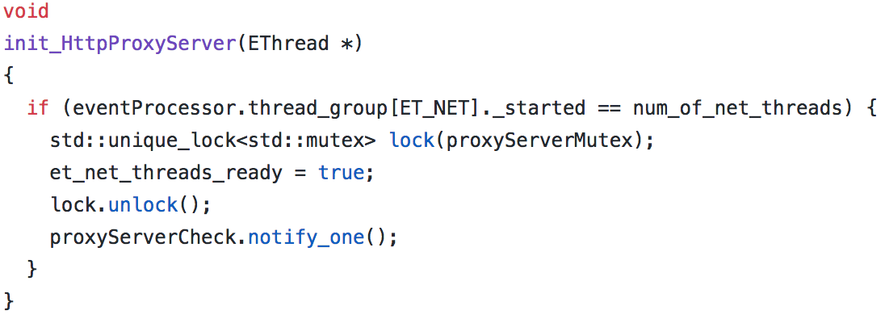
Race Condition with Accept Threads
Use schedule_spawn to setup checking mechanism.
Use condition variable to check whether ET_NET threads finished initialization.

Slide 10
New API Proposal
Thread Affinity
  TSReturnCode TSContThreadAffinitySet(TSCont contp, TSEventThread ethread)
  TSEventThread TSContThreadAffinityGet(TSCont contp)
  void TSContThreadAffinityClear(TSCont contp)
  TSEventThread TSEventThreadSelf(void)
Event Scheduling
  TSAction TSContScheduleOn(TSCont contp, TSHRTime timeout, TSEventThread ethread)
  TSAction TSContScheduleOnEvery(TSCont contp, TSHRTime every, TSEventThread ethread)
  Modified behavior for TSContSchedule and TSContScheduleEvery.
Notes:
When a continuation is scheduled on a specific thread that is not the current thread, it's because there is a locked object with the lock held on another thread, and the goal is to have the continuation run on that thread. This can help gather interacting objects on the same thread where they won't have lock contention (because if I try to get a mutex that's locked on *this* thread, it is successful).

Slide 11
Thread Affinity
TSReturnCode TSContThreadAffinitySet(TSCont contp, TSEventThread ethread)
  Set the thread affinity of continuation TSCont contp to TSEventThread ethread.
TSEventThread TSContThreadAffinityGet(TSCont contp)
  Get the thread affinity information of continuation TSCont contp.
void TSContThreadAffinityClear(TSCont contp)
  Clear the thread affinity of continuation TSCont contp.
TSEventThread TSEventThreadSelf(void)
  Get the current event thread.

Slide 12
Event Scheduling
TSAction TSContScheduleOn(TSCont contp, TSHRTime timeout, TSEventThread ethread)
  Schedules contp to run approximately timeout milliseconds in the future. The delay will be at least timeout but possibly more. Resolutions finer than roughly 5 milliseconds will not be effective. contp is required to have a mutex, which is provided to TSContCreate.
  The return value can be used to cancel the scheduled event via TSActionCancel. This is effective until the continuation contp is being dispatched. However, if it is scheduled on another thread other than the current one, it can be problematic to be correctly timed. The return value can be checked with TSActionDone to see if the continuation ran before the return, which is possible if timeout is 0.
  The continuation is scheduled on the thread as indicated by ethread.

Slide 13
Event Scheduling
TSAction TSContScheduleOnEvery(TSCont contp, TSHRTime every, TSEventThread ethread)
  Schedules contp to run approximately every every milliseconds. The interval will be at least every but possibly more. Resolutions finer than roughly 5 milliseconds will not be effective. contp is required to have a mutex, which is provided to TSContCreate.
  The return value can be used to cancel the scheduled event via TSActionCancel. This is effective until the continuation contp is being dispatched. However, if it is scheduled on another thread other than the current one, it can be problematic to be correctly timed. The return value can be checked with TSActionDone to see if the continuation ran before the return, which is possible if every is 0.
  The continuation is scheduled on the thread as indicated by ethread.

Slide 14
Event Scheduling
Modified behavior for
TSAction TSContSchedule(TSCont contp, TSHRTime timeout, TSThreadPool tp)
TSAction TSContScheduleEvery(TSCont contp, TSHRTime every, TSThreadPool tp)
  If thread affinity was not set for continuation contp, the behavior stays unchanged.
  If thread affinity was set for continuation contp, and the thread type is the same as tp, the continuation will be scheduled on the thread specified by thread affinity.

Slide 15
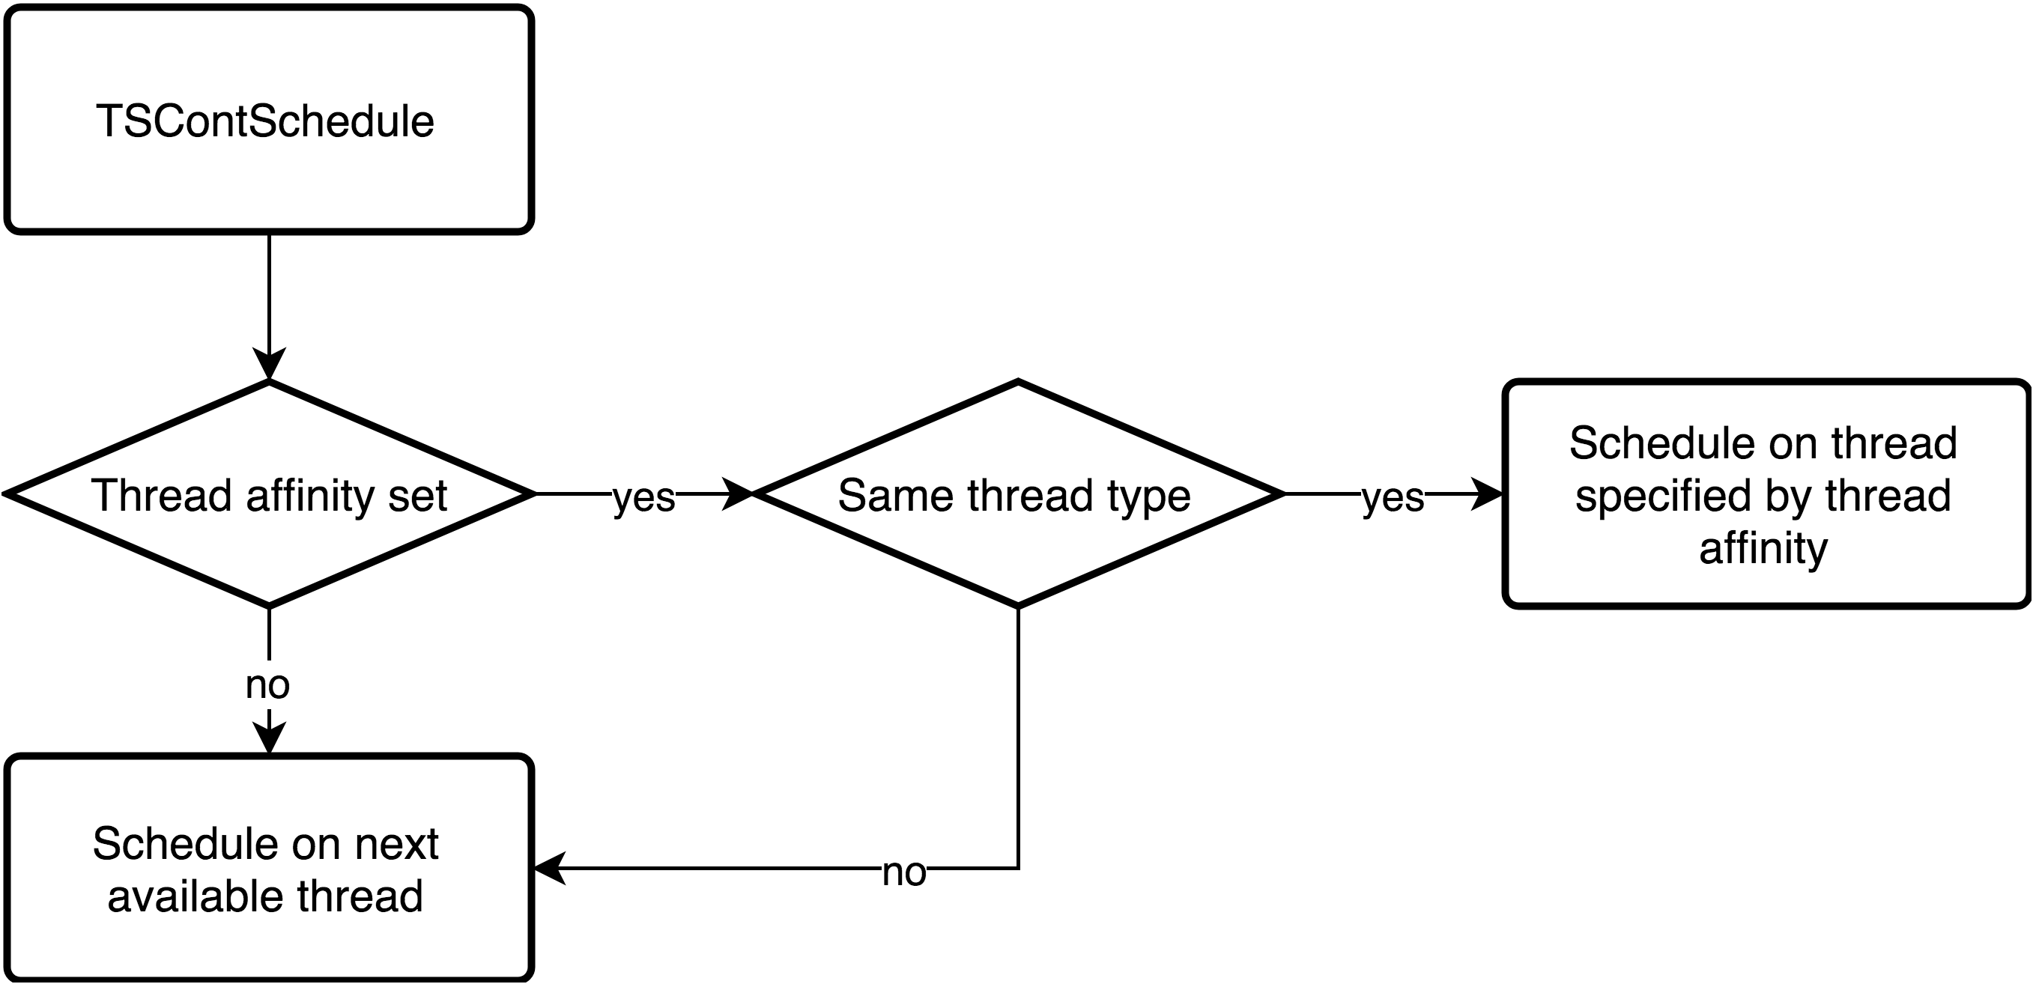
Event Scheduling

Slide 16
Example Usage
TSHRTime timeout = 5;
TSCont contp = TSContCreate(stubby_stub, nullptr);
      .
      .
      .
TSContSchedule(contp, timeout, TS_THREAD_POOL_DEFAULT);

Slide 17
Example Usage 1
TSHRTime timeout = 5;
TSCont contp = TSContCreate(stubby_stub, nullptr);
TSEventThread ethread = TSEventThreadSelf();
      .
      .
      .
TSContScheduleOn(contp, timeout, ethread);

Slide 18
Example Usage 2
TSHRTime timeout = 5;
TSCont contp = TSContCreate(stubby_stub, nullptr);
TSEventThread ethread = TSEventThreadSelf(void);
if (TSContThreadAffinityGet(contp) == nullptr) {
TSContThreadAffinitySet(contp, ethread);
}
      .
      .
      .
TSContSchedule(contp, timeout, TS_THREAD_POOL_DEFAULT);

Slide 19
Example Usage 3
TSHRTime timeout = 5;
TSCont contp = TSContCreate(stubby_stub, nullptr);
      .
      .
      .
TSContThreadAffinityClear(contp);
TSContSchedule(contp, timeout, TS_THREAD_POOL_DEFAULT);

Slide 20
Discussion
Do we want to have the thread affinity to be set to the current thread by default?
…

