Slide 1
NextHop Progress
Layer 7 Routing
ATS Summit Fall 2018
Aaron Canary - Oath
John Rushford - Comcast
Vijay Mamidi - Apple

Slide 2
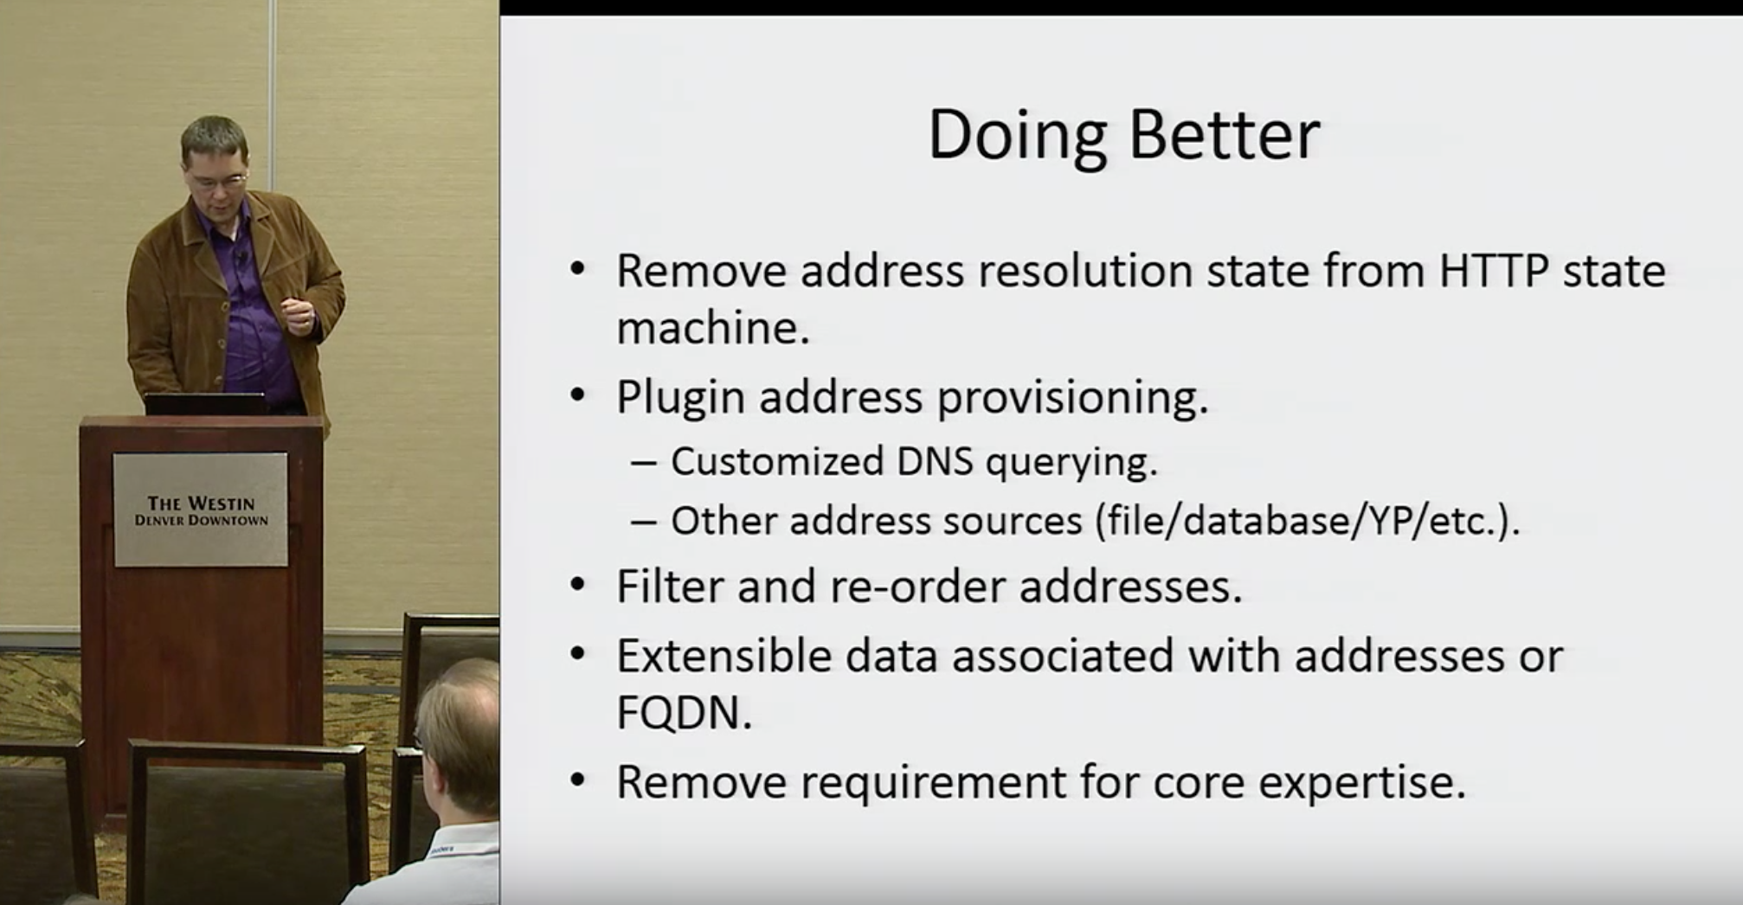
Design Legacy
Extensible Host Resolution
Alan Carroll
ApacheCon2014
Notes:
https://youtu.be/KL2hc-DB4LI?t=572

Slide 3

Why
Caching Proxy
Fast
Extensible
Proven CDN
(Stable, Scalable, Supported)

Slide 4
Why
Caching Proxy
Efficient:
Runtime
Deployment
Development

Slide 5
How
Layer7 Framework
Goal: Robustly provide
an Upstream Connection
Notes:
We are creating a framework for dev/Ops to define the upstream selection logic, and additional restrictions

Slide 6
What
jjrushford
vmamidi
ParentSelection
HostStatus
Config Routing Architecture
UpStream Generator
Modular Routing Logic
Shared Data Storage
DBTable
Extendible
AcidPtr
acanary
solidwallofcode
Notes:
John Rushford and Vijay have been taking a top down, business approach, to providing upstream selection logic.
While Alan and I have been writing a backend for which will allow then to modularize and simplify that logic.

Slide 7
Shared Data Storage
Currently host state is stored by system
HostDB
HttpConnectionCount
HostStatus
CARP/Host
ParentHost
HealthCheckPlugin
Each new system requires
new storage container
reimplement thread safety
indexing and hashing
performance optimization

Slide 8
Shared Data Storage
HostDB
HttpConnectionCount
HostStatus
CARP/Host
ParentHost
HealthCheckPlugin
Systems extend existing data
HostExtData
AddrExtData
store
Notes:
The big idea is that all these systems store the data in shared structure.

Slide 9
Shared Data Storage - Properties
High Performance
Many read operations
Few write operations
Prefer fast operations
Minimize blocking
Volatile
In memory only
Transient data

Slide 10
Shared Data Storage - Properties
Not A.C.I.D. Compliant DB
ACID DB | Fast, Simple
Atomic | Atomic
Consistent | Inconsistent - Snapshot
Isolated | Sequential Write
Durable | Volatile
Notes:
https://en.wikipedia.org/wiki/ACID_(computer_science)
Previously I have spoken about replicating ACID properties into the data storage, then I asked why are we not using an off-the-shelf DB.

Slide 11
Shared Data Storage - Expectations
Fast
Extensible
Proven
Reduce Allocations
Precache Efficiency
Reduce Mutexes
Supports common use
Scales for custom use
Code Reuse & Sharing
Thread Safe
Stable Data

Slide 12
Shared Data Storage
DBTable
Extendible
Design
Atomic Items
Contiguous Objects
Fields are RT-static
Concurrent
Use scoped blocking
Objects are stable
idx
Field
idx
 |  | Item
Object
Notes:
Contiguous Objects
Fields are declared in plugInit

Slide 13
Shared Data Storage
Type | Atomic Item
bool | BitRef
int | std::atomic<T>
char[], struct | SnapshotPtr

Slide 14
Shared Data Storage
BitRef - a reference to a bit → xxxxx0xx
BitRef(uint8* store, uint8 mask)
bool operator=(bool)
bool operator==(bool) const
explicit operator const bool() const
bool compare_exchange(bool)
bool test_and_set()
Notes:
In the C++ API I wanted to return a bool by reference, but also pack them into bytes. So i wrote a little class to do that.

Slide 15
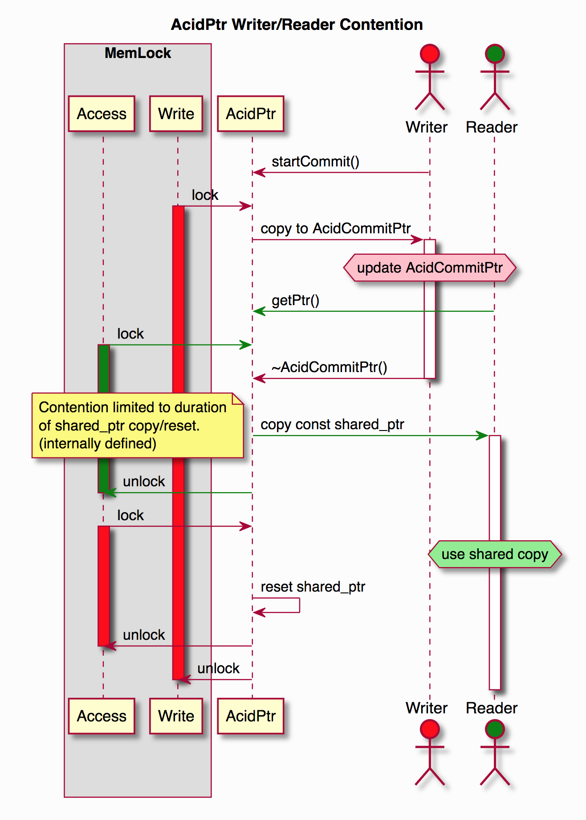
Shared Data Storage
SnapshotPtr<T>
shared_ptr<const T> getPtr()
void commit(T*)
startCommit()
CommitPtr<T>
: unique_ptr<T>
void abort()
Notes:
https://docs.trafficserver.apache.org/en/latest/developer-guide/internal-libraries/AcidPtr.en.html
Soon to be renamed to SnapshotPtr and CommitPtr.

Slide 16
Shared Data Storage
DBTable
Extendible
Design
Atomic Items
Contiguous Objects
Fields are RT-static
Concurrent
Use scoped blocking
Objects are stable
idx
Field
idx
 |  | Item
Object
Notes:
Contiguous Objects
Fields are declared in plugInit

Slide 17
Shared Data Storage
TxnArgs
Extendible
Allocation | Compile Time Static | Runtime Const
Tracking | Index Reservation | Memory Schema
Number of Args | Compile Time Const | Runtime Const
Typed Storage | No, 64 bits | Any size, Any Type, Packed booleans, Constructor/Destructor
Named | Yes | Yes
toYAML |  | Yes
Notes:
Both allocate space for runtime variables
Extendible is more flexible

Slide 18
Shared Data Storage
Shared Data Storage - Allocation
TxnArgs
Extendible
compile time size
CORE
OBJECT
CORE OBJECT
allocated size
arg0
Reserve
Register
arg0
arg1
arg2
Notes:
TxnArgs is a reservation mechanic.
Entendible is a over-allocation mechanic
Is how we have unlimited args, and size.

Slide 19
Shared Data Storage - Inheritance
TxnArgs
Extendible
compile time size
Derived
OBJECT
Derived
OBJECT
CORE
OBJECT
CORE OBJECT
allocated size
arg0
Reserve
arg1
Register
arg0
arg2

Slide 20
Shared Data Storage - Inheritance
TxnArgs
Extendible
compile time size
Derived
OBJECT
Derived
OBJECT
CORE
OBJECT
CORE OBJECT
allocated size
arg0
arg1
arg0
arg2
arg_d0
arg_d0
Notes:
Fields are allocated after the compiled structure.

Slide 21
Shared Data Storage - API
TxnArgs
Extendible C
ObjTxnArgIndexReserve(name,*idx)
ObjTxnArgIndexLookup(name,*idx)
void* ObjTxnArgGet(obj,idx)
ObjTxnArgSet(obj,idx,*arg)
ObjExtAdd(name,size,*idx)
ObjExtFind(name,*idx,*size)
void* ObjExtGet(obj,idx,*size)
ObjExtSet(obj,idx,*arg)
Notes:
Extendible API is similar to

Slide 22
Shared Data Storage - API
TxnArgs
Extendible C++
ExtFieldId<Obj,T> idx;
ExtAdd(name,*idx)
ExtFind(name,*idx)
T const& ExtGet(obj,idx)
T& ExtSet(obj,idx)
ObjTxnArgIndexReserve(name,*idx)
ObjTxnArgIndexLookup(name,*idx)
void* ObjTxnArgGet(obj,idx)
ObjTxnArgSet(obj,idx,*arg)
Notes:
Provides Type Safety between plugins at PluginLoaded.

Slide 23
Shared Data Storage
Extendible is a “runtime static” dictionary.
Plugin Init: define fields
Fields are Frozen
System computes memory alignment and size
Plugin Loaded: find defined fields
  Assert same types
Plugin Hooks: efficiently access allocations
PluginInit(Reload): find defined fields
  Assert same types
Notes:
Provides Type Safety between plugins at PluginLoaded.

Slide 24
Shared Data Storage
DBTable
Extendible
Design
Atomic Items
Contiguous Objects
Fields are RT-static
Concurrent
Use scoped blocking
Objects are stable
idx
Field
idx
 |  | Item
Object
Notes:
Contiguous Objects
Fields are declared in plugInit

Slide 25
Shared Data Storage
DBTable<K,V>(N)
vector<part>(N)
  Scope lock shared_mutex
  unordered_map<K,share_ptr<V>>
Notes:
DBTable is a partitioned hashmap
With locking to prevent breaking iterators.
Contains shared_ptr to ensure score persistence

Slide 26
Shared Data Storage
DBTable<K,V>(N)
share_ptr<V> obtain(K)
operator[], find, pop, clear
visit(function<bool(K const &, V &)>)
Notes:
the API is similar to hash tables.
Obtain will a find or alloc.
Visit is to apply a lambda for each element.

Slide 27
Shared Data Storage
DBTable
Extendible
Design
Atomic Items
Contiguous Object
Fields are RT-static
Concurrent
Use scoped blocking
Objects are stable
idx
Field
idx
 |  | Item
Object
Notes:
Contiguous Objects
Fields are declared in plugInit

Slide 28
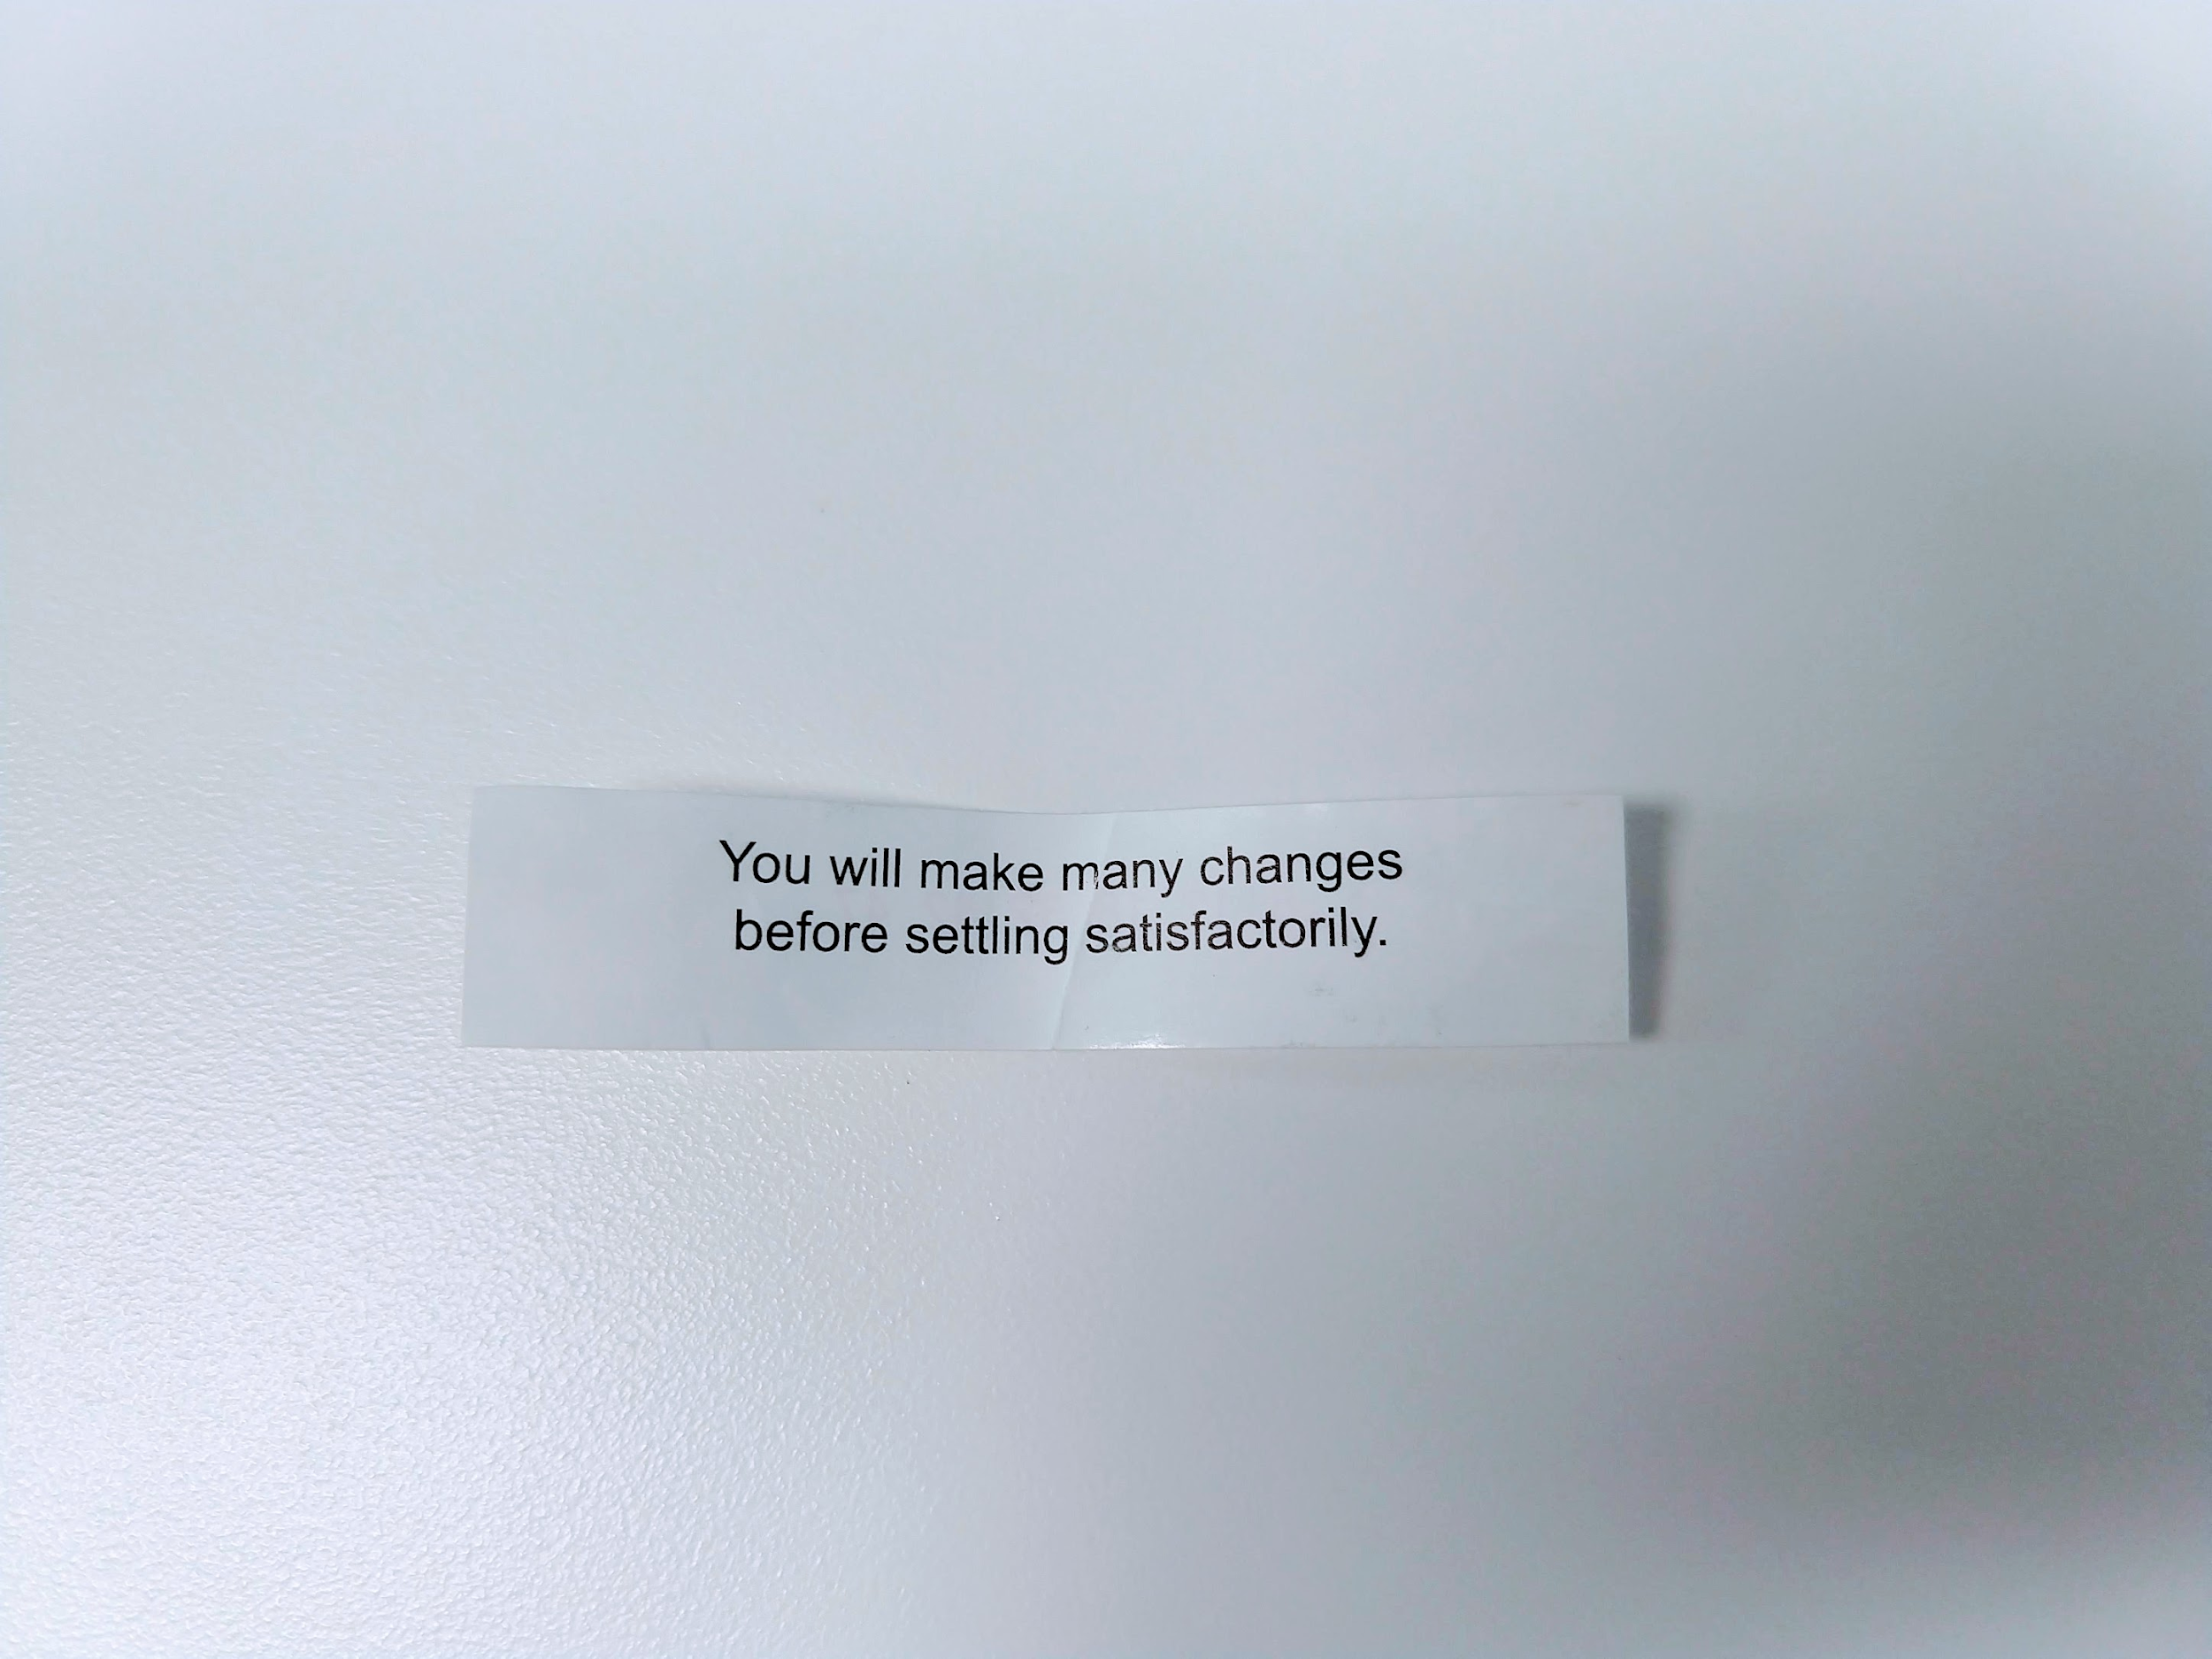
Shared Data Storage
Forgot Simplify Internals

Slide 29
How
jjrushford
vmamidi
ParentSelection
HostStatus
Config Routing Architecture
UpStream Generator
Modular Routing Logic
Shared Data Storage
DBTable
Extendible
AcidPtr
acanary
solidwallofcode
Notes:
Changing topic

Slide 30
Modular Routing Logic
Async Update Logic
Shared Data
Per Txn Logic
Producer
Consumer

Slide 31
Modular Routing Logic
Remap
Failover
Latch
ParentSelection
CARP
HostDB
SessionMgr
ConnectionCount
HttpSM
RR
ConsistHash
Health
DNScache
NoLoop
Reuse Ssn
Open Ssn
Send Request Upstream

Slide 32
UpStream Generator
Remap
Failover
Latch
GetSession
Strategy Config
RR
ConsistHash
Health
DNScache
NoLoop
Reuse Ssn
Open Ssn
Send Request Upstream

Slide 33
UpStream Generator
TxnSetTargetAddr
Remap
CDN Routing Logic
Failover
Latch
GetSession
Strategy Config
RR
ConsistHash
Connection Logic
Health
DNScache
NoLoop
Send Request Upstream
Reuse Ssn
Open Ssn

Slide 34
UpStream Generator
Remap
GetSession
Strategy Config
(Override)
404
Send Request Upstream
Notes:
When a different strategy is needed, it can be overridden by the remap rule or a remap plugin.
When we receive response codes, the strategy can also failover and retry with a different strategy.

Slide 35
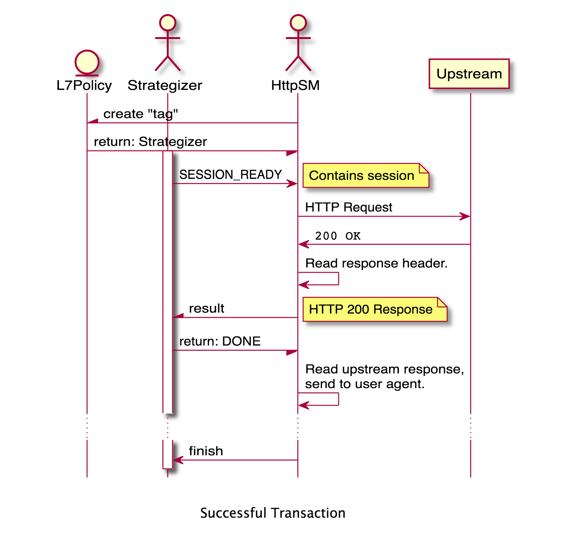
UpStream Generator
Notes:
https://solidwallofcode.github.io/notes/L7R-Denver.en.html

Slide 36
What
jjrushford
vmamidi
ParentSelection
HostStatus
Config Routing Architecture
UpStream Generator
Modular Routing Logic
Shared Data Storage
DBTable
Extendible
AcidPtr
acanary
solidwallofcode
Notes:
John Rushford and Vijay have been taking a top down, business approach, to providing upstream selection logic.
While Alan and I have been writing a backend for which will allow then to modularize and simplify that logic.

Slide 37
Host Status
Hosts are configured in remap.config and parent.config
Status of hosts are managed passively, marked unavailable, due to transaction timeouts or connection errors.
Hosts are managed by removing them from config files for maintenance or mitigation of connectivity issues.

Slide 38
Parent selection Host Status changes
(completed)
Added HostStatus class along with changes to Parent selection and traffic_ctl to mark parent proxies offline.
# traffic_ctl host down parent-proxy01.cdn.com
Marks the parent unavailable for use, next available parent is used.
# traffic_ctl host up parent-proxy01.cdn.com

Slide 39
Origin host status changes
Changes to HttpTransact.cc to mark origins offline using traffic_ctl
# traffic_ctl host down origin-01.cdn.com
Objects served stale from cache with “Warning: 111” Revalidation Failed due to inability to reach the origin server).
      proxy.config.http.cache.max_stale_age
HTTP 503 “Origin server congested” is sent to client if object is not in cache or is too stale.

Slide 40
Next steps
Health checking tools coming soon from Oath & Apple
Convert parent.config to yaml format
Combine parent.config functionality with remap.config.

Slide 41
Example parents.yaml
hosts:
p1: &p1
  host: p1-cache-cdn.com
protocol:
- http: 80
- https: 443
healthcheck:
url: tcp://192.168.1.80
p2: &p2
host: p2-cache-cdn.com
protocol:
- http: 80
- https: 443
healthcheck:
url: tcp://192.168.1.81
groups:
- g1: &g1
- *p1
- *p2

Slide 42
Example strategy.yaml
# strategy.yaml
#
#include parents.yaml
#
strategy:
policy: consistent_hash # (Enum of 'consistent_hash' or 'first_live' or 'rr_strict' or 'rr_ip' or 'latched')
hash_key: path+query
groups:
- *g1
- *g2
protocol: http
failover:
ring_mode: exhaust_rings
response_codes:
- 404
- 503
health_check:
- passive

