Slide 1
QUIC & NetHandler
A Sub-System to handle QUICNetVC

Slide 2
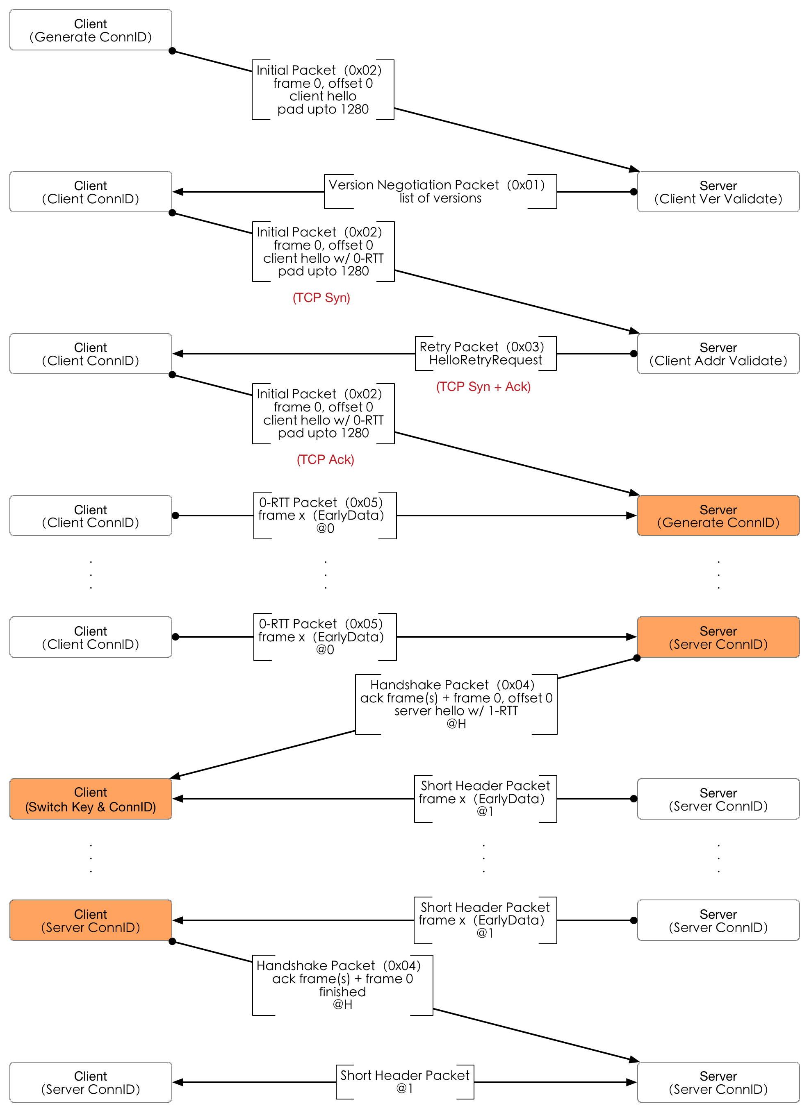
Handshake
Source address validation
  TCP 3-ways
  HelloRetryRequest cookie extension
Client Generated ConnID
  Should not be trusted
  Initial Packet
  0-RTT Packet

Slide 3
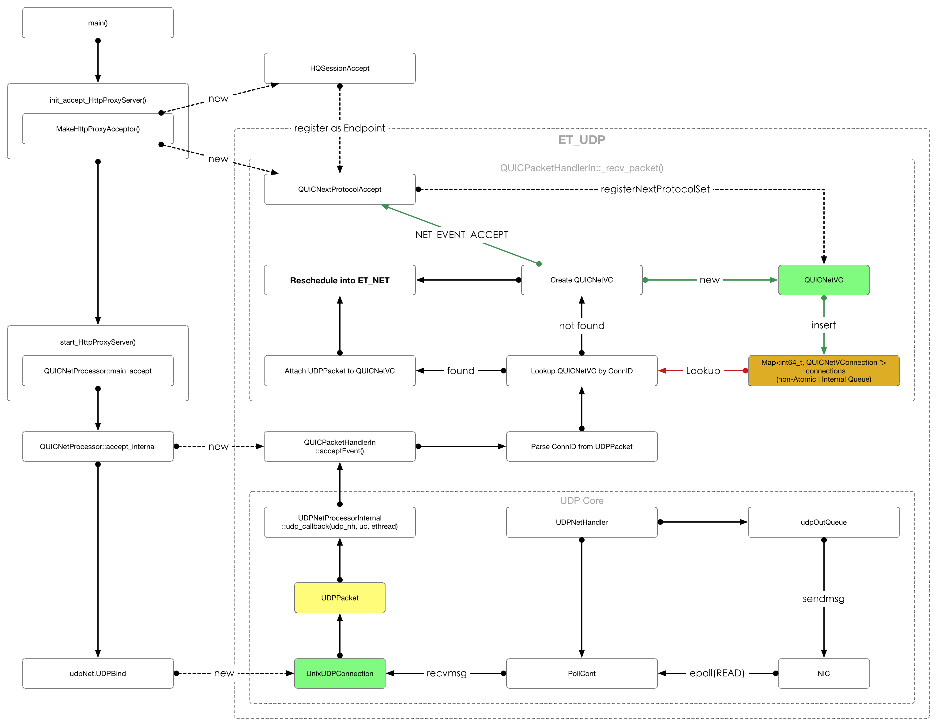
QUICPacketHandlerIn

Slide 4
QUICPacketHandlerIn
Trampoline for UDPPacket
  Map UDPPacket to QUIC Connection
  Transfer UDPPacket from ET_UDP to ET_NET
Called back within ET_UDP
  Light weight and High efficiency
  Do not block the ET_UDP
Client Generated ConnID
  Should not be trusted
  Initial Packet & 0-RTT Packet

Slide 5
QUICNetVC
NetVC is a tunnel
  Socket FD as a Endpoint
  AppSM as another Endpoint
NetHandler is a tunnelSM
  Transfer the data between the Endpoints.
QUICNetVC
  QUIC Connection is a Endpoint
  QUIC App is another Endpoint
Better performance
  If the Endpoints within the same EThread

Slide 6
Polling the QUIC Read Event
SSLNetVC inherits from UnixNetVC
  SSLNetVC and UnixNetVC are both managed by NetHandler.
  The PollCont::pollEvent is design to polling I/O event on them.
  The triggered NetVC is pushed into the ready_list.
QUICNetVC inherits from UnixNetVC
  In order to manage the QUICNetVC by NetHandler
    class QUICEventIO : public EventIO
    QUICPollCont::pollEvent is called back periodically to push the triggered QUICNetVC into the ready_list queue.

Slide 7
QUICPollCont
QUICPacketHandlerIn
  Locate an EThread by QUIC ConnID
    Map<int64_t, EThread *> _connections
Queues
  Locate a QUICNetVC by QUIC ConnID with in current EThread.
    Map<int64_t, QUICNetVConnection *> _connections
  Save LongHeader Packets
    Initial/Handshake/ZeroRTT Protect Queue
  Save ShartHeader Packets
    Short Protect Queue
UDPPacket is transferred from ET_UDP into these queues
  Do less within QUICPacketHandlerIn
Traverse these queues within QUICPollCont on each EThread
  Create a new QUICNetVC
  Or trigger the QUICNetVC

Slide 8
Interfaces for NetHandler
QUICNetVC::net_read_io
  Call to the QUICNetVC::handleEvent
QUICNetVC::write_to_net_io
  Do nothing
QUICNetVC::mainEvent
  For InactivityCop
Do not call eventProcessor.schedule_xxx()
  Call QUICNetVC::reenable() or reenable_re()

Slide 9
QUICNextProtocolAccept
Initial read on QUICNetVC
  To receive the handshake packet and 0-RTT packet
  Cause only triggered and enabled NetVC is processed by NetHandler

Slide 10
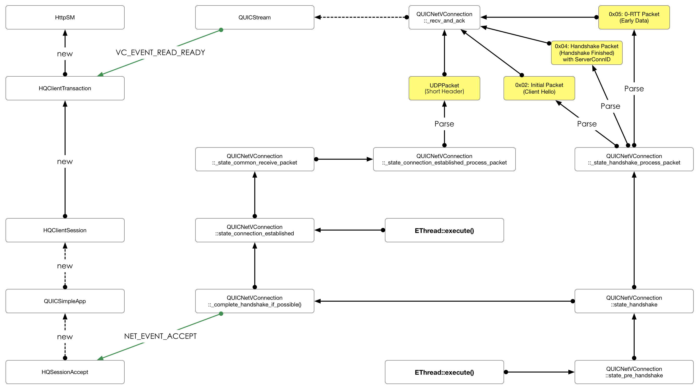
QUICNetVC – Handshake & Read

Slide 11
QUICNetVC – Handshake
HQSessionAccept
  Handshake Done if NET_EVENT_ACCEPT is received.
  It is similar to the Zero-Length Read within SSLNextProtocolAccept

Slide 12
MIOStream
The idea from MIOBuffer
  1 x Producer (writer) as the input
  5 x Consumer (IOBufferReader) as the output
MIOStream
  1 x Producer (Incoming UDPPacket from QUICPacketHandlerIn)
  N x Consumer (QUICStream)

